Slide 1
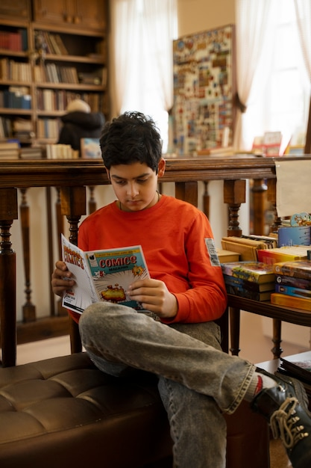
Reading Comprehension
Notes:
Notes for Teacher - < Information for further reference or explanation >
Suggestions: <Ideas/ Images/ Animations / Others – To make better representation of the content >
Source of Multimedia used in this slide -
1. Boy reading: https://www.freepik.com/free-photo/front-view-boy-reading-comics-library_41253589.htm#page=2&query=indian%20reading%20book&position=10&from_view=search&track=ais (Attribution: freepik)

Slide 2
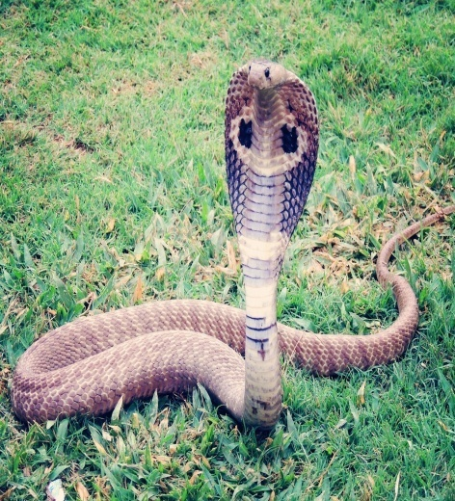
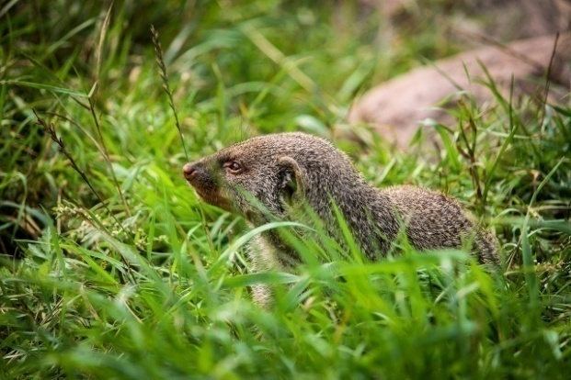
Introducing Reading Comprehension
Let no one deviate from the path of justice and truth for friendship or enmity.
Deviate- move away
or leave
Emerged- came out
At the same time, a mongoose emerged from the bushes and went straight for the cobra.
The little elf began to do Patrick’s homework. Except there was one glitch. The elf did not always know what to do.
Glitch- a fault
or problem
Notes:
Notes for Teacher -[Students may use the dictionary to confirm the meanings of those words. Continue to the next slide that gives information on how to comprehend a reading text. (Comprehension is being able to understand something. Reading comprehension means the ability to understand the meaning of a text)].
Suggestions: <Ideas/ Images/ Animations / Others – To make better representation of the content >
Source of Multimedia used in this slide -
Mongoose: https://pixabay.com/photos/mongoose-zoo-animal-wildlife-7942218/ (Attribution: SmillaSvaneFeijn)
Cobra: https://pixabay.com/photos/king-cobra-cobra-snake-reptile-405623/ (Attribution: Antriksh)
Glitch: https://www.freepik.com/free-vector/glitch-background_4039498.htm#page=2&query=glitch&position=4&from_view=search&track=sph (Attribution: freepik)
4. Justice scale: https://pixabay.com/photos/scale-justice-weight-health-2634795/ (Attribution: Qimono)

Slide 3
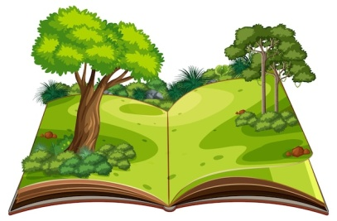
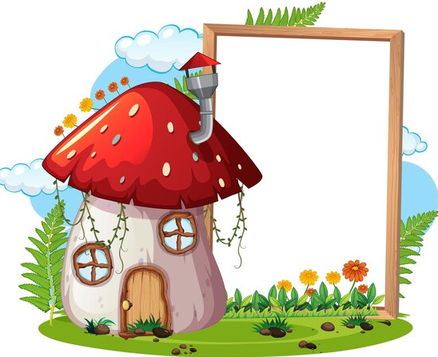
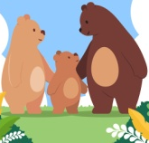
Reading to Comprehend
Look for the title name, images and headings
Stage 1
Pre-reading
Stage 2
Visualize the scene and underline difficult
words
While-reading
Stage 3
Post-reading
Identify meanings of words through the context
Title
The 3 Bears
Images
Notes:
Notes for Teacher - < Information for further reference or explanation >
Suggestions: <Ideas/ Images/ Animations / Others – To make better representation of the content >
Source of Multimedia used in this slide -
Picture: https://www.freepik.com/free-vector/empty-banner-with-fantasy-mushroom-house_18385515.htm#query=jack%20and%20the%20beanstalk&position=13&from_view=search&track=ais (Attribution: brgfx)
3 Bears: https://www.freepik.com/free-vector/flat-design-bear-family-illustration_29684704.htm#query=3%20bears&position=11&from_view=search&track=ais (Attribution: freepik)
Book: https://www.freepik.com/free-vector/pop-up-book-with-outdoor-nature-scene_25538769.htm#page=8&query=open%20book&position=5&from_view=search&track=ais (Attribution: brgfx)

Slide 4
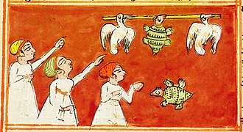
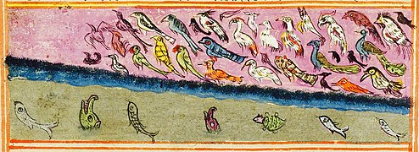
Reading to Comprehend
Paragraph 1
Paragraph 2
Panchatantra comes from TWO
words PANCHA (5) and TANTRA
(categories). It was written in
Sanskrit language by Vishnu
Sharma to teach and guide the
3 sons of King Amarashakti to
rule the country better.
Panchatantra is translated into
many languages. They are: Persian, Arabic, English, and many more. In India, it is known
as ‘Nitisastra’ meaning ‘the wise
conduct of life’.
PANCHATANTRA TALES
The stories teach practical intelligence along with morals
and values required in life. It is a genre of literature where animals can talk with human beings. The FIVE categories are based on certain norms and conventions. They are:
1.Gaining friends
2. Losing friends
3. Loss of gains
4. Acting without thinking
5. Crows and owls.
There are about 84 stories.
Find the meanings of the underlined words
Notes:
Notes for Teacher - < Information for further reference or explanation >
Suggestions: <Ideas/ Images/ Animations / Others – To make better representation of the content >
Source of Multimedia used in this slide -
Tortoise: https://commons.wikimedia.org/wiki/File:18th_century_Panchatantra_manuscript_page,_the_talkative_turtle_picture.jpg (Attribution: Philadelphia Museum of Arts, Artist/maker unknown, India (18th century)
Birds: https://commons.wikimedia.org/wiki/File:18th_century_Panchatantra_manuscript_page,_The_Birds_Try_to_Beat_Down_the_Ocean_picture.jpg (Attribution: Philadelphia Museum of Arts, Artist/maker unknown, India (18th century)

Slide 5
Let us Analyse
Pre-reading
Title-Panchatantra; Images-tortoise, birds, fish, turtle
While-reading
Underline difficult words (listed below)
Post-reading
Identify meaning of words from the context (given below)
Categories
To put in groups according to types
Translate(d)
To change any written work into other languages
Conduct
Behaviour or way of acting
Morals
What you believe to be right and wrong
Values
Principles or standards of behaviour; the true worth
Genre
A category; a group
Literature
Written works like prose, poetry and drama
Norms
A standard behaviour accepted by people and society
Convention
A traditional way of something
Notes:
Notes for Teacher - < Information for further reference or explanation >
Suggestions: <Ideas/ Images/ Animations / Others – To make better representation of the content >
Source of Multimedia used in this slide - <Please provide source URL where we find the image and the license agreement>

Slide 6
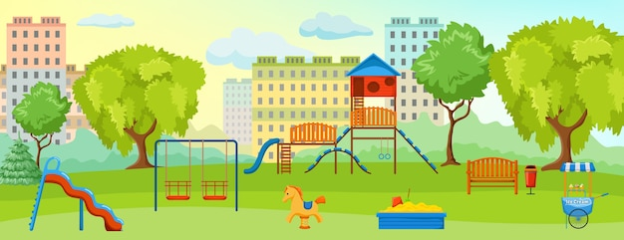
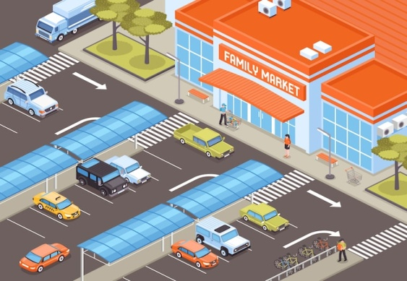
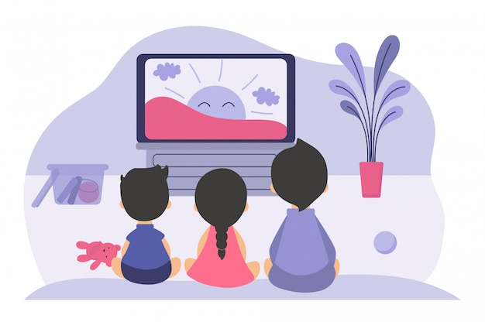
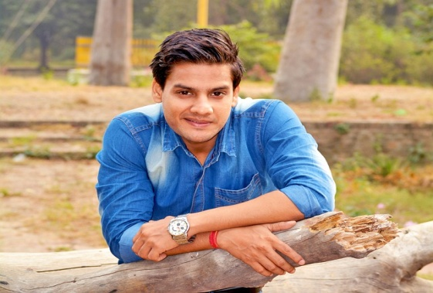
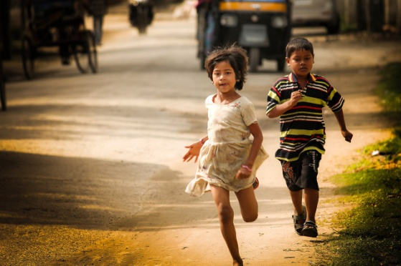
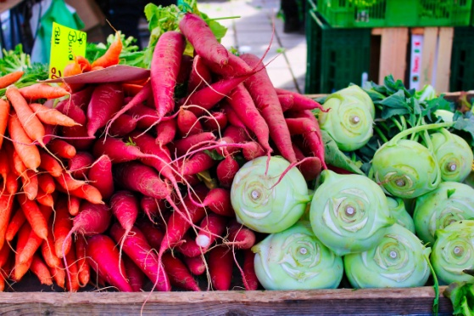
What does the word mean?
Words with 2 meanings
Park:
1. There is a beautiful park near my house.
2. You can park your car in front of the market.
Watch:
1. We watch television for 2 hours every evening.
2. Ram wears his watch to the office everyday.
Run:
1. Children can run very fast.
2. I run a vegetable shop.
Notes:
Notes for Teacher - < Information for further reference or explanation >
Suggestions: <Ideas/ Images/ Animations / Others – To make better representation of the content >
Source of Multimedia used in this slide -
Park: https://www.freepik.com/free-vector/playground-park-composition-with-empty-playground-with-swings-toys-green-spaces_10346774.htm#page=2&query=park%20home&position=34&from_view=search&track=ais (Attribution: macrovector)
Market: https://www.freepik.com/free-vector/personal-transport-parking-zone-near-market-building-isometric-illustration_6821688.htm#query=park%20car%20shops&position=40&from_view=search&track=ais (Attribution: macrovector)
Watch TV: https://www.freepik.com/free-vector/boys-girls-sitting-tv-screen_8270944.htm#query=Television%20watch%20children&position=2&from_view=search&track=ais#position=2&query=Television%20watch%20children (Attribution: pch.vector)
Boy: https://pixabay.com/photos/man-boy-park-trees-garden-woods-4281707/ (Attribution: Virat_Maurya)
Children: https://pixabay.com/photos/children-kids-running-young-girl-5559749/ (Attribution: moonbhuyan)
Vegetables: https://pixabay.com/photos/carrots-beets-vegetables-kohlrabi-6148040/ (Attribution: BiggiBe)

Slide 7
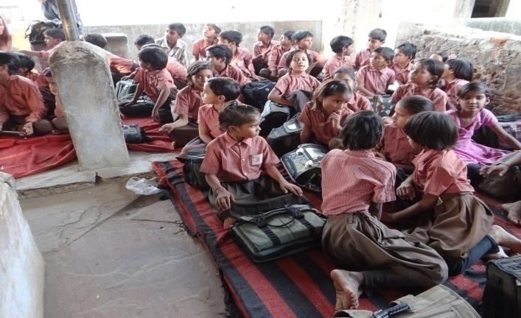
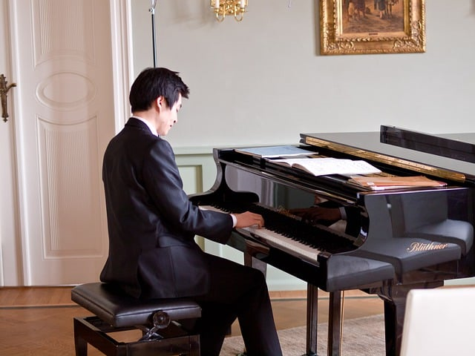
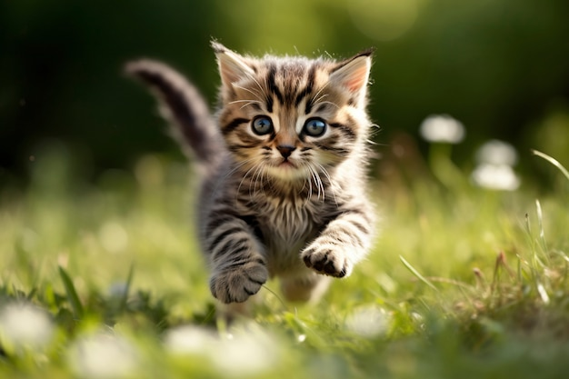
What does the sentence mean?
Sentences interpreted differently
One student listens in class.
Jack played the piano with a broken leg.
The cat chased the rat till it fell.
Notes:
Notes for Teacher –
One student listens in class. (Who listens in class? one student out of the many or some student?)
Jack played the piano with a broken leg (Whose leg was broken? Jack’s or the piano’s?
The cat chased the rat till it fell. (Who fell? the cat or the rat?)
Suggestions: <Ideas/ Images/ Animations / Others – To make better representation of the content >
Source of Multimedia used in this slide -
Students: https://pixabay.com/photos/children-students-school-india-702211/ (Attribution: Biedermann)
Cat: https://www.freepik.com/free-ai-image/view-adorable-kitten-running-outdoors_65157538.htm#page=3&query=cat%20running&position=14&from_view=search&track=ais (Attribution: freepik)
Rat: https://www.freepik.com/free-vector/cute-grey-mouse-different-poses-cartoon-illustration-set-little-house-mice-rat-character-with-long-tail-isolated-white-background-animal-rodent-concept_26876830.htm#query=rat&position=5&from_view=search&track=sph (Attribution: pch.vector)
Pianist: https://pixabay.com/photos/man-pianist-musician-piano-concert-7898836/ (Attribution: u_uvj4hyda56)

Slide 8
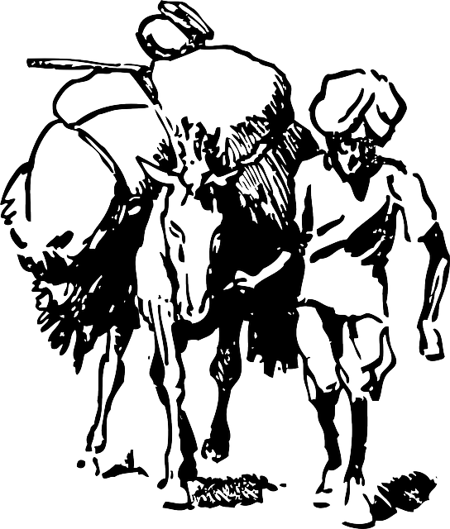
Testing Time
Dev was a merchant. He mainly sold salt, cotton and wheat in bulk to the neighbouring villages. It was a beautiful spring morning. Dev loaded his donkey with bags of salt to be sold in the next village. As they started crossing the river, his donkey slipped and fell in the river. He helped him to get up. They continued to walk when the donkey realised that the weight on his back had reduced. The following day, Dev loaded his donkey again with bags of salt. Like the previous day, the donkey fell in the river. Dev helped him to get up. ‘’Today too I cannot earn any money to feed my family’’, he thought to himself. Then it suddenly struck him that his donkey was falling in the river deliberately to reduce the weight on his back. The next day, he loaded the donkey with cotton. The donkey tried the same trick again. Dev helped him get up and as they began to walk, the donkey realised that the load on his back had become heavier. He realised that his
master had found the trick he was playing.
Dev and his Donkey
Notes:
Notes for Teacher - < Information for further reference or explanation >
Suggestions: <Ideas/ Images/ Animations / Others – To make better representation of the content >
Source of Multimedia used in this slide -
1. Donkey: https://pixabay.com/vectors/donkey-load-farmer-man-india-36532/ (Attribution: Clker-Free-Vector-images)

Slide 9
Testing Time
1
What happened to the donkey after he fell in the river?
2
Why did the donkey fall in the river the 2nd and 3rd time?
3
Who do you think is intelligent? Dev or his donkey? Why?
4
Can we fool everyone all the time? Why?
5
Write the antonyms for the words in red: started, reduced and heavier
6
Write the synonyms for the words in blue: bulk and loaded
Notes:
Notes for Teacher - < Information for further reference or explanation >
Suggestions: <Ideas/ Images/ Animations / Others – To make better representation of the content >
Source of Multimedia used in this slide - <Please provide source URL where we find the image and the license agreement>

Slide 10
Testing Time
Match the words in column 1 with the meanings in column 2
Column 1
Column 2
1
Neighbouring
a
The day before
1
Neighbouring
a
The day before
2
Deliberately
b
Near you
2
Deliberately
b
Near you
3
Previous day
c
The next day
3
Previous day
c
The next day
4
Following day
d
Doing something purposely
4
Following day
d
Doing something purposely
Notes:
Notes for Teacher - < Information for further reference or explanation >
Suggestions: <Ideas/ Images/ Animations / Others – To make better representation of the content >
Source of Multimedia used in this slide - <Please provide source URL where we find the image and the license agreement>

Slide 11
Attribution / Citation
Slide # | Thumbnail | Source link | Author
1 |  | 1. Boy reading: https://www.freepik.com/free-photo/front-view-boy-reading-comics- library_41253589.htm#page=2&query=indian%20reading%20book&position=10&from_view=search&track=ais | freepik
2 |  | Mongoose: https://pixabay.com/photos/mongoose-zoo-animal-wildlife-7942218/ Cobra: https://pixabay.com/photos/king-cobra-cobra-snake-reptile-405623/ Glitch: https://www.freepik.com/free-vector/glitch-background_4039498.htm#page=2&query=glitch&position=4&from_view=search&track=sph 4. Justice scale: https://pixabay.com/photos/scale-justice-weight-health-2634795/ | SmillaSvaneFeijn Antriksh Freepik Qimono
3 |  | Picture: https://www.freepik.com/free-vector/empty-banner-with-fantasy-mushroom-house_18385515.htm#query=jack%20and%20the%20beanstalk&position=13&from_view=search&track=ais 3 Bears: https://www.freepik.com/free-vector/flat-design-bear-family-illustration_29684704.htm#query=3%20bears&position=11&from_view=search&track=ais Book: https://www.freepik.com/free-vector/pop-up-book-with-outdoor-nature-scene_25538769.htm#page=8&query=open%20book&position=5&from_view=search&track=ais | Brgfx Freepik brgfx
4 |  | Tortoise: https://commons.wikimedia.org/wiki/File:18th_century_Panchatantra_manuscript_page,_the_talkative_turtle_picture.jpg Birds: https://commons.wikimedia.org/wiki/File:18th_century_Panchatantra_manuscript_page,_The_Birds_Try_to_Beat_Down_the_Ocean_picture.jpg | Philadelphia Museum of Arts, Artist/maker unknown, India (18th century Philadelphia Museum of Arts, Artist/maker unknown, India (18th century
6 |  | Park: https://www.freepik.com/free-vector/playground-park-composition-with-empty-playground-with-swings-toys-green-spaces_10346774.htm#page=2&query=park%20home&position=34&from_view=search&track=ais Market: https://www.freepik.com/free-vector/personal-transport-parking-zone-near-market-building-isometric-illustration_6821688.htm#query=park%20car%20shops&position=40&from_view=search&track=ais Watch TV: https://www.freepik.com/free-vector/boys-girls-sitting-tv-screen_8270944.htm#query=Television%20watch%20children&position=2&from_view=search&track=ais#position=2&query=Television%20watch%20children Boy: https://pixabay.com/photos/man-boy-park-trees-garden-woods-4281707/ Children: https://pixabay.com/photos/children-kids-running-young-girl-5559749/ Vegetables: https://pixabay.com/photos/carrots-beets-vegetables-kohlrabi-6148040/ | Macrovector Macrovector Pch.vector Virat Maurya Moonbhuv BiggiBe

Slide 12
Attribution / Citation
Slide # | Thumbnail | Source link | Author
7 |  | Students: https://pixabay.com/photos/children-students-school-india-702211/ Cat: https://www.freepik.com/free-ai-image/view-adorable-kitten-running-outdoors_65157538.htm#page=3&query=cat%20running&position=14&from_view=search&track=ais Rat: https://www.freepik.com/free-vector/cute-grey-mouse-different-poses-cartoon-illustration-set-little-house-mice-rat-character-with-long-tail-isolated-white-background-animal-rodent-concept_26876830.htm#query=rat&position=5&from_view=search&track=sph Pianist: https://pixabay.com/photos/man-pianist-musician-piano-concert-7898836/ | Bedemann Freepik Pch.vector u_uvj4hyda56
8 |  | 1 . Donkey: https://pixabay.com/vectors/donkey-load-farmer-man-india-36532/ | Clker-Free-Vector-Images

