Slide 1
Advertisement Writing

Slide 2
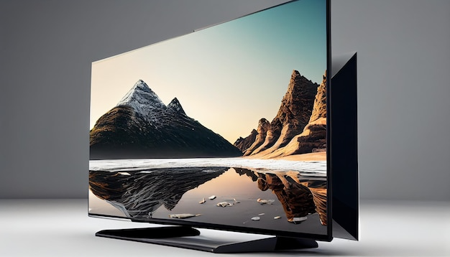
Why Advertisements?
If you want to buy a new Television set, how will you choose from the many brands available in the market?
SmartPlaza
BIG TV days
ABM
Buy the one which looks good.
Go through advertisements to know about each brand.
Go through advertisements to know about each brand.
Bring home the big TV with big offers
Buy the one which your friend has.
Get Soundbar worth up to ₹99990
Get Galaxy A51/A31 worth up to ₹22999
Up to 20% cashback
Notes:
Notes for Teacher - Begin the class with a casual talk about how difficult it is to buy anything when there are so many products available in the market. Then throw a simple question and allow them to come up with multiple answers before giving them the choices Suggestions: NA
Source of Multimedia used in this slide - https://www.freepik.com/free-photo/mountain-landscape-with-computer-monitor-sunset-generative-ai_41060534.htm#

Slide 3
Why Advertisement?
4. Where to buy
1. The special features of the product
What do advertisements tell us?
3. Discounts available
2. The price ranges
Notes:
Notes for Teacher - Go through advertisements is the right answer. Now move on to the second slide to show the image of a TV advertisement. Using the image encourage students to talk about the various TV advertisements: the image, tagline, the mascot Suggestions: NA
Source of Multimedia used in this slide - NA

Slide 4
Why Advertisements?
The eye catchers of an advertisement are
an attractive picture
a catchy tagline
a mascot (a symbolic figure) - optional
Notes:
Notes for Teacher - Go through advertisements is the right answer. Now move on to the second slide to show the image of a TV advertisement. Using the image encourage students to talk about the various TV advertisements: the image, tagline, the mascot Suggestions: NA
Source of Multimedia used in this slide - https://www.freepik.com/free-vector/bright-voucher-diwali_943224.htm#

Slide 5
Why Advertisements?
Advertisements are everywhere. What are some of the advertisements that you have been attracted to? Why?
Notes:
Notes for Teacher - Draw the students’ attention to the fact that advertisements are an active part of our lives and we see them everywhere.Engage the students in a healthy discussion about some of the popular advertisements.
Suggestions: NA
Source of Multimedia used in this slide - https://img.freepik.com/free-vector/blue-sales-background-monsoon_23-2147651392.jpg https://img.freepik.com/free-vector/hand-drawn-background-back-school-season_23-2150581354.jpg

Slide 6
The Making of Advertisements
An effective advertisement should have
Image: an eye catching image of the product is the first point of attraction for the customer.
There should be no more than 50 words in the advertisement.
1
6
Contact Information: gives the organisation or the shop’s name and address where the product could be bought from.
Title: also known as the Tagline is a very important aspect of any advertisement. It should be brief and catchy.
2
5
3
Body: describes the product. It should be brief, informative and convincing.
Call to action: is a short sentence that encourages the reader to do something: buy the product, visit the website or call a number.
4
Notes:
Notes for Teacher - Now list out the salient features or the format of an advertisement. Using these factors develop a toothpaste advertisement
Suggestions: NA
Source of Multimedia used in this slide - NA

Slide 7
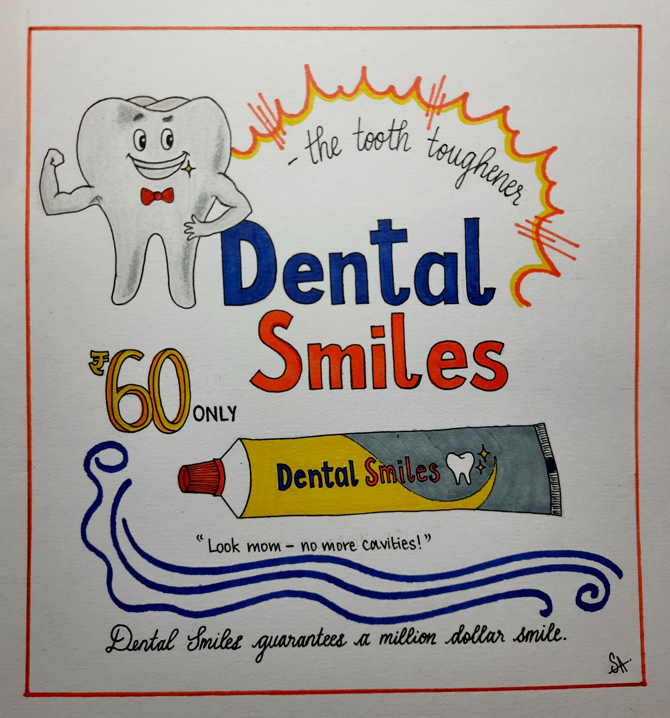
The Making of Advertisements
Image
Title
Body
Call To Action
Tag Line
Notes:
Notes for Teacher - Now list out the salient features or the format of an advertisement. Using these factors develop a toothpaste advertisemen
Suggestions: NA
Source of Multimedia used in this slide - https://contentmanagement.srisathyasaividyavahini.org/mediabank.php?inp=gm_img_01922

Slide 8
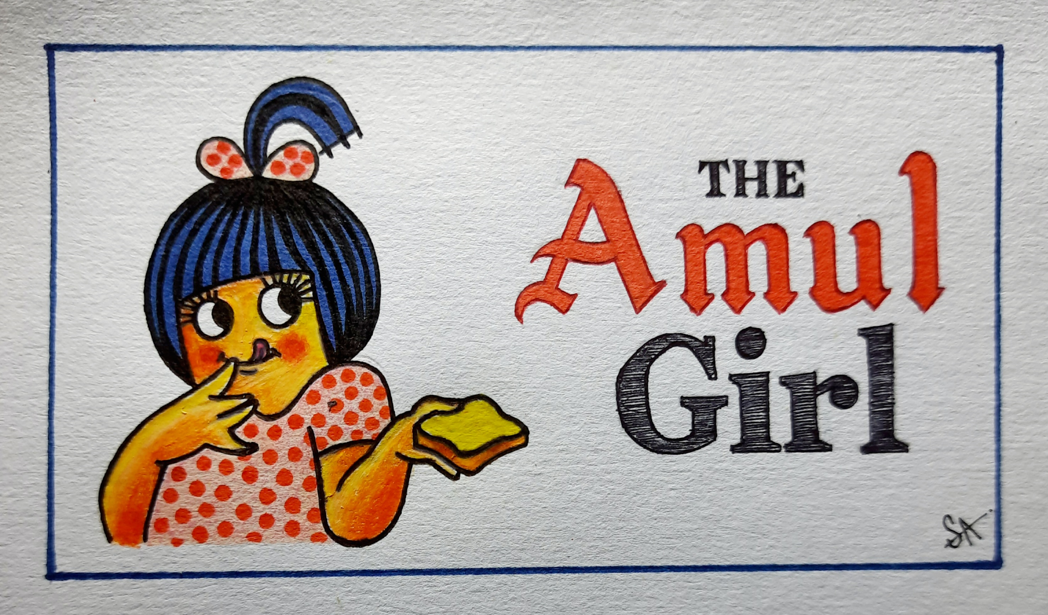
The Amul Girl
The Amul girl is one of the most popular advertisement mascots of India used by dairy company Amul. The Amul girl, a chubby-cheeked, mischievous cartoon wearing a polka dotted frock, holding a slice of bread with butter on top was created in 1966 by artist Fernandes and Sylvester D'Cunha.
Notes:
Notes for Teacher - Draw the students’ attention to the use of mascots (a symbolic figure, supposed to bring good luck, linked to a particular organization or event). Then tell them the story of the ‘Amul girl’ .Encourage students to recall their favorite of the Amul advertisements
Suggestions: NA
Source of Multimedia used in this slide - https://contentmanagement.srisathyasaividyavahini.org/mediabank.php?inp=gm_img_01921

Slide 9
The Amul Girl
Over the years the Amul girl has become a household favorite. The advertisement is very popular because of the unique tagline that is made about every special event around the world, be it the launch of Chandrayaan, FIFA world cup or a new year wish. The Amul girl’s expression that matches the tagline is something everyone appreciates.
Notes:
Notes for Teacher - Draw the students’ attention to the use of mascots (a symbolic figure, supposed to bring good luck, linked to a particular organization or event). Then tell them the story of the ‘Amul girl’ .Encourage students to recall their favorite of the Amul advertisements
Suggestions: NA
Source of Multimedia used in this slide - https://contentmanagement.srisathyasaividyavahini.org/mediabank.php?inp=gm_img_01921

Slide 10
Attribution / Citation
Slide # | Thumbnail | Source link | Author
2 |  | https://www.freepik.com/free-photo/mountain-landscape-with-computer-monitor-sunset-generative-ai_41060534.htm#
4 |  | https://www.freepik.com/free-vector/bright-voucher-diwali_943224.htm#
5 |  | https://www.freepik.com/free-vector/blue-sales-background-monsoon_1227957.htm# https://img.freepik.com/free-vector/hand-drawn-background-back-school-season_23-2150581354.jpg
7 |  | https://contentmanagement.srisathyasaividyavahini.org/mediabank.php?inp=gm_img_01922
8 |  | https://contentmanagement.srisathyasaividyavahini.org/mediabank.php?inp=gm_img_01921

