Slide 1
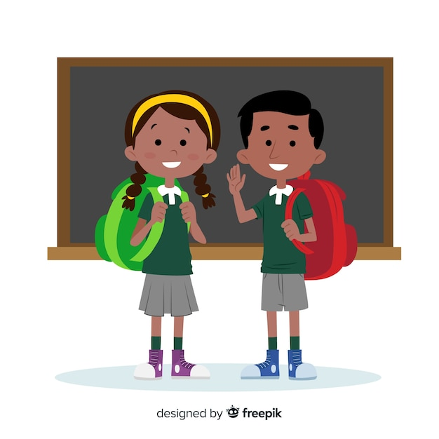
TENSES COME TO CLASS
Notes:
Notes for Teacher – Begin with an emphasis on the use of tenses for meaningful communication.
Draw the students’ attention to the fact that every spoken/written sentence has reference to time.
Hence, tenses are an integral part of effective English communication skills.
This ppt has been provided to aid this understanding. The nine tense forms learnt so far (and commonly used) have been highlighted to recapitulate.
Allow the students to read and observe the use of tenses.
The classroom background used connects the concept to reality.
Relatable topics from different subjects bring in an interdisciplinary approach.
Suggestions: <Ideas/ Images/ Animations / Others – To make better representation of the content >
Source of Multimedia used in this slide - https://www.freepik.com/free-vector/cartoon-children-back-school-background_4823867.htm

Slide 2
TENSE
Tenses bring in the time element to our communications, both written and oral, which is a vital part of effective communication.
Notes:
Notes for Teacher - < Information for further reference or explanation >
Suggestions: <Ideas/ Images/ Animations / Others – To make better representation of the content >
Source of Multimedia used in this slide - <Please provide source URL where we find the image and the license agreement>

Slide 3
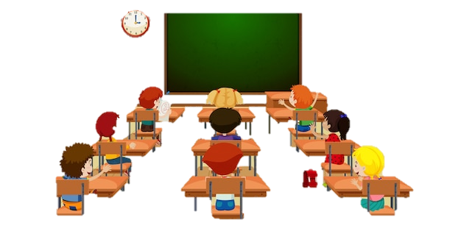
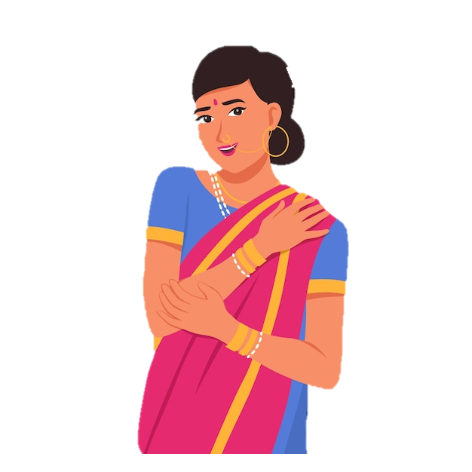
TENSE
Our planet, the Earth goes around the Sun which is called Revolution.
I have told you about the nine planets in our galaxy called the ‘Milky Way’.
Ma’am, my sister has seen all of this in the planetarium. I am reading about it in a book about planets.
We experience different seasons due to this. The Earth rotates on its own axis and this rotation causes days and nights.
The Earth is moving around the sun and on its axis continuously
Notes:
Notes for Teacher - < Information for further reference or explanation >
Suggestions: <Ideas/ Images/ Animations / Others – To make better representation of the content >
Source of Multimedia used in this slide - https://www.freepik.com/free-vector/hand-drawn-ethnic-beauty-illustration_38477117.htm
https://www.freepik.com/free-vector/student-classroom-template_4428227.htm

Slide 4
IDENTIFICATION OF TENSES
I am reading, Earth is moving- Present Continuous Tense
Earth goes, we experience, earth rotates, rotation causes - Simple Present Tense
I have told, my sister has seen - Present Perfect Tense
Notes:
Notes for Teacher - < Information for further reference or explanation >
Suggestions: <Ideas/ Images/ Animations / Others – To make better representation of the content >
Source of Multimedia used in this slide -

Slide 5
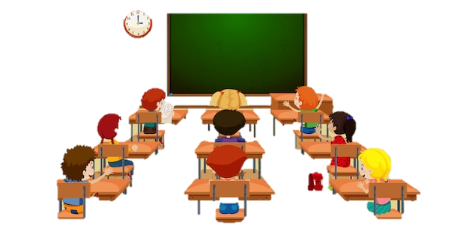
TENSE
She fought fearlessly against the British. Jhansi Rani refused to surrender.
She had carried her son on her back to the battle field. I saw this while we were watching a movie about her
Yesterday I was explaining about India's freedom struggle. Rani Lakshmi Bai was the Queen of Jhansi.
This helped her when she became the Queen.
As a little girl, she had shown great interest in archery and horse riding.
Notes:
Notes for Teacher - < Information for further reference or explanation >
Suggestions: <Ideas/ Images/ Animations / Others – To make better representation of the content >
Source of Multimedia used in this slide - https://www.freepik.com/free-vector/hand-drawn-ethnic-beauty-illustration_38477117.htm
https://www.freepik.com/free-vector/student-classroom-template_4428227.htm

Slide 6
IDENTIFICATION OF TENSES
She fought, Jhansi Rani refused, this helped, she became, I saw- Simple Past tense
She had shown, she had carried -Past perfect tense
I was explaining, we were watching - Past Continuous Tense
Notes:
Notes for Teacher - < Information for further reference or explanation >
Suggestions: <Ideas/ Images/ Animations / Others – To make better representation of the content >
Source of Multimedia used in this slide -

Slide 7
LEAVE APPLICATION
2nd July 2023
From,
Priya,
Class 5- B
To,
Mrs. Gupta,
Class Teacher,
Class 5- B
SUB:APPLICATION FOR LEAVE
Dear Ma’am,
As I will be travelling to attend my cousin’s wedding, I will be absent from school for 2 days on the 5th and 6th of July. I request you to grant me leave for the above mentioned days.
I will have completed and submitted the assignment before I leave. I will return before the terminal exams begin.
Thank You
Yours sincerely
Priya
Notes:
Notes for Teacher - < Information for further reference or explanation >
Suggestions: <Ideas/ Images/ Animations / Others – To make better representation of the content >
Source of Multimedia used in this slide -

Slide 8
IDENTIFICATION OF TENSES
I will be absent, I will return: Simple Future Tense
I will be travelling: Future Continuous Tense
I will have completed and submitted: Future Perfect Tense.
Tenses are very important to make our communication meaningful.
Notes:
Notes for Teacher - < Information for further reference or explanation >
Suggestions: <Ideas/ Images/ Animations / Others – To make better representation of the content >
Source of Multimedia used in this slide -

Slide 9
Attribution / Citation
Slide # | Thumbnail | Source link | Author
1 |  | https://www.freepik.com/free-vector/cartoon-children-back-school-background_4823867.htm | FREEPIK
3,5 |  | https://www.freepik.com/free-vector/hand-drawn-ethnic-beauty-illustration_38477117.htm https://www.freepik.com/free-vector/student-classroom-template_4428227.htm | BRGFX
Notes:
Notes for Teacher - < Information for further reference or explanation >
Suggestions: <Ideas/ Images/ Animations / Others – To make better representation of the content >
Source of Multimedia used in this slide - <Please provide source URL where we find the image and the license agreement>

