Slide 1
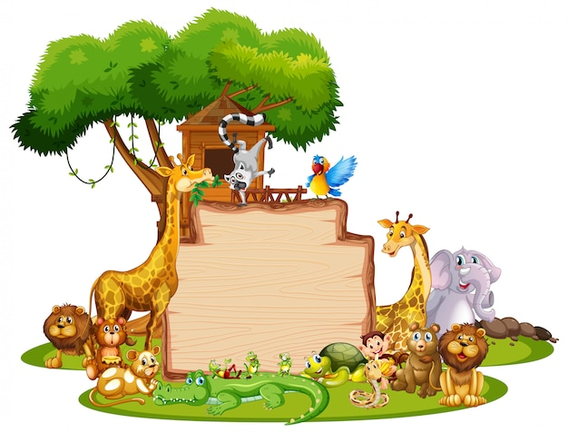
Story
Writing
Notes:
Notes for Teacher - < Information for further reference or explanation > Suggestions: <Ideas/ Images/ Animations / Others – To make better representation of the content >
Source of Multimedia used in this slide -
1. Zoo: https://www.freepik.com/free-vector/border-template-with-cute-animals_5769817.htm#query=ZOO&position=35&from_view=search&track=sph (Attribution: brgfx)

Slide 2
Introducing Story Writing
Aladdin and the Magic lamp
The Thirsty Crow
Monkey and the Crocodile
Notes:
Notes for Teacher -
Can you name the stories?
Do you know the names of the authors who wrote those stories?
Do you think the authors wrote the stories with a plan or strategy?
How do you think the authors came up with those stories?
Why do you think the authors wrote those stories?
Thirsty crow: Aesop’s fables-Greek origin
Aladdin and the magic lamp: Arabian Nights-Middle Eastern origin
Monkey and the crocodile: Panchatantra Stories-Indian origin Suggestions: <Ideas/ Images/ Animations / Others – To make better representation of the content
Source of Multimedia used in this slide -
Thirsty Crow: https://youtu.be/ZQ27PS14_sI (Attribution: Free Hug Point)
Aladdin: https://youtu.be/64NCM2mP_ms (Attribution: Storytime for Kids)
Monkey and crocodile: https://youtu.be/L1Khwb1Ucbg (Attribution: padma)

Slide 3
Story Writing - Process
A story is a narration of real or imaginary events involving people, animals, birds, insects etc
Every story follows the process given below:
Conclusion
story ends with a
memorable moral or
a closing sentence that
impacts the reader
Introduction
a catchy introductory
sentence
an introduction to the
characters
a setting for the story
1
5
2
4
3
Resolution
problem is solved and the story
comes to a satisfying and
interesting end
Plot
build the story with a series of
events
events connect with one another
- takes the story forward
Climax
turning point of the story
main character faces a
problem
Notes:
Notes for Teacher - < Information for further reference or explanation > Suggestions: <Ideas/ Images/ Animations / Others – To make better representation of the content >
Source of Multimedia used in this slide - <Please provide source URL where we find the image and the license agreement>

Slide 4
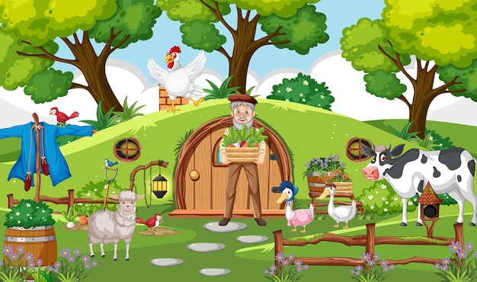
Let us write a story...
Notes:
Notes for Teacher - < Information for further reference or explanation >
Suggestions: <Ideas/ Images/ Animations / Others – To make better representation of the content >
Source of Multimedia used in this slide -
Farm: https://www.freepik.com/free-vector/farmer-rural-countryside-house_31235965.htm#page=5&query=farmer%20and%20his%20farm&position=21&from_view=search&track=ais (Attribution: brgfx)
Tiger: https://www.freepik.com/free-photo/amazing-bengal-tiger-nature_18520710.htm#query=Tiger&position=9&from_view=search&track=sph (Attribution: vladimircech)

Slide 5
Story Writing - Introduction
Catchy sentence
Introducing characters
Setting the story
One clear spring morning, the Sun had risen, ‘The Best Farm’ came to life. The smart ducks, innocent sheep and the intelligent cow, woke up to the chirping of the birds. They greeted one another and off they went to drink water and have some food
One clear spring morning, ‘The Best Farm’ came to life. The smart ducks, innocent sheep, happy hens and the intelligent cows, woke up to the chirping of birds. They greeted one another and off they went to drink water and have some food.
Notes:
Notes for Teacher - < Information for further reference or explanation >
Suggestions: <Ideas/ Images/ Animations / Others – To make better representation of the content >
Source of Multimedia used in this slide -
Farm: https://www.freepik.com/free-vector/farmer-rural-countryside-house_31235965.htm#page=5&query=farmer%20and%20his%20farm&position=21&from_view=search&track=ais (Attribution: brgfx)
Tiger: https://www.freepik.com/free-photo/amazing-bengal-tiger-nature_18520710.htm#query=Tiger&position=9&from_view=search&track=sph (Attribution: vladimircech)

Slide 6
Story Writing - Plot
Build the story with events
Events connect with one
another-take the story
forward
The farmer had his breakfast and went to water the plants. The cows were lazy so they stayed at the farm. The ducks quacked and went to bathe in the nearby pond. The tiny birds were busy
searching for grains. It was getting warmer so the sheep went back to their pen.
One clear spring morning, the Sun had risen, ‘The Best Farm’ came to life. The smart ducks, innocent sheep and the intelligent cow, woke up to the chirping of the birds. They greeted one another and off they went to drink water and have some food
Notes:
Notes for Teacher - < Information for further reference or explanation >
Suggestions: <Ideas/ Images/ Animations / Others – To make better representation of the content >
Source of Multimedia used in this slide -
Farm: https://www.freepik.com/free-vector/farmer-rural-countryside-house_31235965.htm#page=5&query=farmer%20and%20his%20farm&position=21&from_view=search&track=ais (Attribution: brgfx)
Tiger: https://www.freepik.com/free-photo/amazing-bengal-tiger-nature_18520710.htm#query=Tiger&position=9&from_view=search&track=sph (Attribution: vladimircech)

Slide 7
Story Writing - Climax
Turning point of the story
Main character faces a
problem
One clear spring morning, the Sun had risen, ‘The Best Farm’ came to life. The smart ducks, innocent sheep and the intelligent cow, woke up to the chirping of the birds. They greeted one another and off they went to drink water and have some food
The cows were feeling very uncomfortable. They could sense danger nearby. Slowly they got up and noticed 3 tigers walking quietly towards their farm. They knew that the sheep, hens and the ducks would be in danger.
Notes:
Notes for Teacher - < Information for further reference or explanation >
Suggestions: <Ideas/ Images/ Animations / Others – To make better representation of the content >
Source of Multimedia used in this slide -
Farm: https://www.freepik.com/free-vector/farmer-rural-countryside-house_31235965.htm#page=5&query=farmer%20and%20his%20farm&position=21&from_view=search&track=ais (Attribution: brgfx)
Tiger: https://www.freepik.com/free-photo/amazing-bengal-tiger-nature_18520710.htm#query=Tiger&position=9&from_view=search&track=sph (Attribution: vladimircech)

Slide 8
Story Writing - Resolution
Problem is solved and the
story comes to a satisfying
and interesting end
One clear spring morning, the Sun had risen, ‘The Best Farm’ came to life. The smart ducks, innocent sheep and the intelligent cow, woke up to the chirping of the birds. They greeted one another and off they went to drink water and have some food
The farmer was still watering the plants and plucking some fruits and vegetables for his midday meal. He noticed the cows walking towards him. He knew danger was ahead. He saw 3 tigers walking towards the farm. The moment the tigers saw the farmer, they walked away knowing that they would not have any food that day.
Notes:
Notes for Teacher - < Information for further reference or explanation >
Suggestions: <Ideas/ Images/ Animations / Others – To make better representation of the content >
Source of Multimedia used in this slide -
Farm: https://www.freepik.com/free-vector/farmer-rural-countryside-house_31235965.htm#page=5&query=farmer%20and%20his%20farm&position=21&from_view=search&track=ais (Attribution: brgfx)
Tiger: https://www.freepik.com/free-photo/amazing-bengal-tiger-nature_18520710.htm#query=Tiger&position=9&from_view=search&track=sph (Attribution: vladimircech)

Slide 9
Story Writing - Conclusion
story ends with a memorable
moral or
a closing sentence that
impacts the reader
The farmer patted the caring cows for saving everybody’s life. When everyone works hand in hand, we’ll be safe and happy. Unity is Strength.
Notes:
Notes for Teacher - < Information for further reference or explanation >
Suggestions: <Ideas/ Images/ Animations / Others – To make better representation of the content >
Source of Multimedia used in this slide -
Farm: https://www.freepik.com/free-vector/farmer-rural-countryside-house_31235965.htm#page=5&query=farmer%20and%20his%20farm&position=21&from_view=search&track=ais (Attribution: brgfx)
Tiger: https://www.freepik.com/free-photo/amazing-bengal-tiger-nature_18520710.htm#query=Tiger&position=9&from_view=search&track=sph (Attribution: vladimircech)

Slide 10
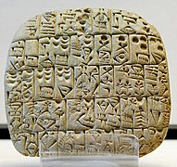
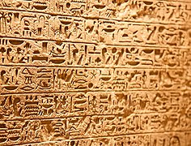
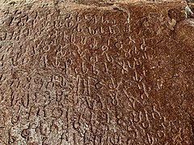
History of Story Writing
Writing began as drawing and changed into script
First form of writing – Cuneiform script Mesopotamia 3200 B.C.
Among the earliest – The Egyptian hieroglyphs
Appearance of writing in India is Ashoka’s edicts-3rd century B.C.
First written story - poem about king Gilgamesh - ruled modern
day Iraq in 2700 B.C.
The first collection of short stories appeared between 1810-1830 in many countries
Notes:
Notes for Teacher - < Information for further reference or explanation >
Suggestions: <Ideas/ Images/ Animations / Others – To make better representation of the content >
Source of Multimedia used in this slide -
Cuneiform: https://commons.wikimedia.org/wiki/File:Sales_contract_Shuruppak_Louvre_AO3766.jpg (Attribution: Unknown artist)
Hieroglyphs: https://commons.wikimedia.org/wiki/File:Hieroglifos_em_parede.jpg (Attribution: Fedor Selivanov)
Edict: https://commons.wikimedia.org/wiki/File:3rd-century_BCE_Jonnagiri_Erragudi_Yerragudi_Asoka_rock_edict_inscription,_Andhra_Pradesh_India_-_05.jpg Hieroglyphs: https://commons.wikimedia.org/wiki/File:Hieroglifos_em_parede.jpg (Attribution: Ms Sarah Welch)

Slide 11
Testing Time - Part 1
Match the columns
A
Conclusion
1
A
Conclusion
1
The problem is solved and the story comes
to a satisfying and interesting end
The problem is solved and the story comes
to a satisfying and interesting end
B
Plot
2
B
Plot
2
A catchy beginning sentence, introducing
characters and setting the story
A catchy beginning sentence, introducing
characters and setting the story
C
Climax
3
C
Climax
3
The story has to end with a memorable moral
or a closing sentence that impacts the reader
The story has to end with a memorable moral
or a closing sentence that impacts the reader
D
Introduction
4
D
Introduction
4
The turning point of the story. Here the main
character faces a problem
The turning point of the story. Here the main
character faces a problem
E
Resolution
E
Resolution
5
5
Build up the story with a series of events that
connect with one another and take it forward
Build up the story with a series of events that
connect with one another and take it forward
Notes:
Notes for Teacher - < Information for further reference or explanation >
Suggestions: <Ideas/ Images/ Animations / Others – To make better representation of the content >
Source of Multimedia used in this slide - <Please provide source URL where we find the image and the license agreement>

Slide 12
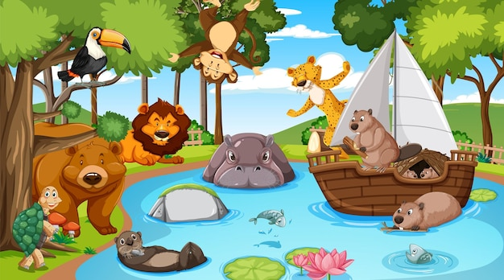
Testing Time - Part 2
See the image and write a story using the process taught earlier
Notes:
Notes for Teacher - < Information for further reference or explanation >
Suggestions: <Ideas/ Images/ Animations / Others – To make better representation of the content >
Source of Multimedia used in this slide -
1. Animals: https://www.freepik.com/free-vector/wild-animals-cartoon-characters-forest-scene_27175542.htm#page=16&query=big%20zoo&position=47&from_view=search&track=ais
2. Zoo keeper: https://www.freepik.com/free-vector/boy-safari-outfit-doing-different-activities_6874065.htm#query=zoo%20keeper&position=46&from_view=search&track=ais
3. Frog: https://www.freepik.com/free-vector/happy-frong-sitting-lotus-leaf_6952752.htm#query=frogs&position=39&from_view=search&track=sph

Slide 13
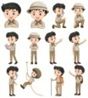
Attribution / Citation
Slide # | Thumbnail | Source link | Author
1 |  | Zoo: https://www.freepik.com/free-vector/border-template-with-cute-animals_5769817.htm#query=ZOO&position=35&from_view=search&track=sph | brgfx
2 |  | Thirsty Crow: https://youtu.be/ZQ27PS14_sI Aladdin: https://youtu.be/64NCM2mP_ms Monkey and crocodile: https://youtu.be/L1Khwb1Ucbg | Free Hug Point Storytime for Kids padma
4,5,6,7,8,9 |  | Farm: https://www.freepik.com/free-vector/farmer-rural-countryside-house_31235965.htm#page=5&query=farmer%20and%20his%20farm&position=21&from_view=search&track=ais Tiger: https://www.freepik.com/free-photo/amazing-bengal-tiger-nature_18520710.htm#query=Tiger&position=9&from_view=search&track=sph | brgfx vladimircech
10 |  | Cuneiform: https://commons.wikimedia.org/wiki/File:Sales_contract_Shuruppak_Louvre_AO3766.jpg Hieroglyphs: https://commons.wikimedia.org/wiki/File:Hieroglifos_em_parede.jpg 3. Edict: https://commons.wikimedia.org/wiki/File:3rd-century_BCE_Jonnagiri_Erragudi_Yerragudi_Asoka_rock_edict_inscription,_Andhra_Pradesh_India_-_05.jpg Hieroglyphs: https://commons.wikimedia.org/wiki/File:Hieroglifos_em_parede.jpg | Unknown artist Fedor Selivanov Ms Sarah Welch
12 |  | 1. Animals: https://www.freepik.com/free-vector/wild-animals-cartoon-characters-forest-scene_27175542.htm#page=16&query=big%20zoo&position=47&from_view=search&track=ais 2. Zoo keeper: https://www.freepik.com/free-vector/boy-safari-outfit-doing-different-activities_6874065.htm#query=zoo%20keeper&position=46&from_view=search&track=ais 3. Frog: https://www.freepik.com/free-vector/happy-frong-sitting-lotus-leaf_6952752.htm#query=frogs&position=39&from_view=search&track=sph | brgfx brgfx brgfx
Notes:
Notes for Teacher - < Information for further reference or explanation > Suggestions: <Ideas/ Images/ Animations / Others – To make better representation of the content >
Source of Multimedia used in this slide - <Please provide source URL where we find the image and the license agreement>

