Slide 1
Newly Formed States And Union Territories
Notes:
Notes for Teacher - < Information for further reference or explanation >
Suggestions: <Ideas/ Images/ Animations / Others – To make better representation of the content >
Source of Multimedia Objects (Image/audio/ Video/Animation) used in this slide -
1. <Short Description> - <SOURCE URL>

Slide 2
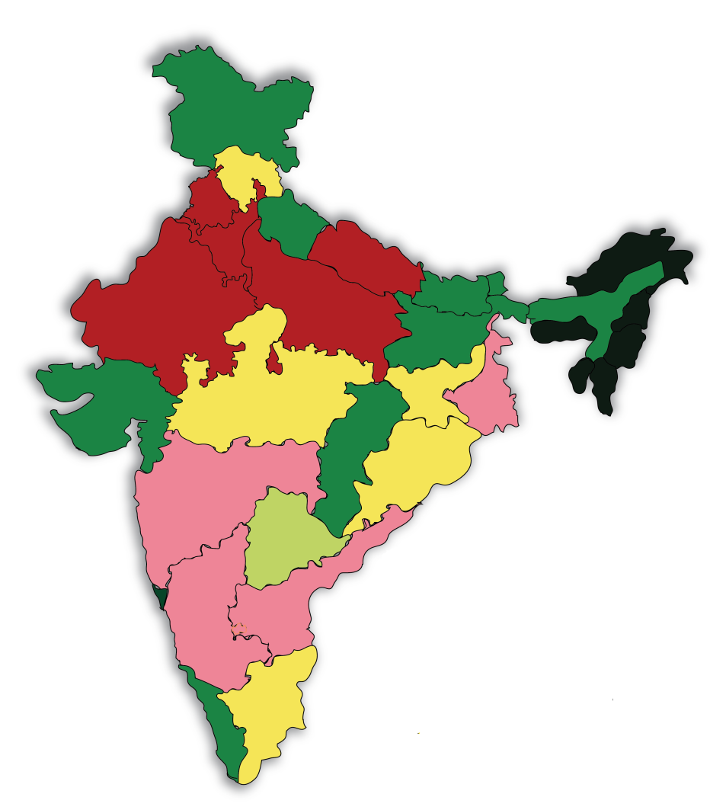
Indian States and Union territories
Indian states and Union Territories were formed for conveniently governing the country.
The states of India were
formed on the basis of
predominant language
spoken.
Notes:
Notes for Teacher - < Information for further reference or explanation >
Suggestions: <Ideas/ Images/ Animations / Others – To make better representation of the content >
Source of Multimedia Objects (Image/audio/ Video/Animation) used in this slide -
<Short Description> - <SOURCE URL>
MAP OF INDIA – SSSVV GALLERY

Slide 3
Newly formed States and Union Territories
STATES
UNION TERRITORIES
CHHATTISGARH
JAMMU & KASHMIR
JHARKHAND
LADAKH
UTTARAKHAND
DADRA & NAGAR HAVELI AND DAMAN & DIU
TELANGANA
Notes:
Notes for Teacher - < Information for further reference or explanation >left- states, Right- UT
Suggestions: <Ideas/ Images/ Animations / Others – To make better representation of the content >
Source of Multimedia Objects (Image/audio/ Video/Animation) used in this slide -
<Short Description> - <SOURCE URL>
TEACHER --https://pixabay.com/illustrations/businessman-cartoons-training-607831/
BOARD -- https://pixabay.com/vectors/pencil-draw-write-school-education-1302150/

Slide 4
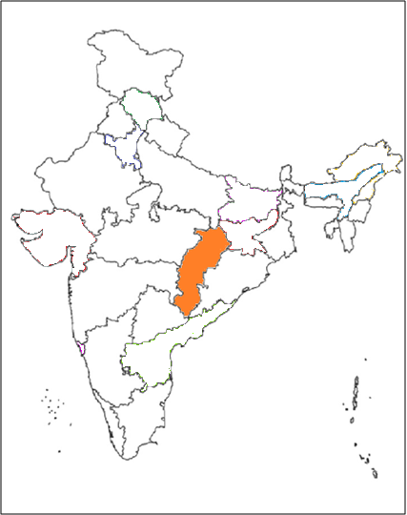
State - Chhattisgarh
New States of India:
Chhattisgarh
Formation:
1. Previously Part
of Madhya Pradesh
2. Formed in 2000
Language spoken:
Hindi
Handicrafts:
Kosha Silk, Dokra
Special features
Fastest developing state
Cleanest state of India
Resource rich state
Notes:
Notes for Teacher - < Information for further reference or explanation >
Suggestions: <Ideas/ Images/ Animations / Others – To make better representation of the content >
Source of Multimedia Objects (Image/audio/ Video/Animation) used in this slide -
<Short Description> - <SOURCE URL>
MAP OF INDIA --OC_piyalidas1485@gmail.com

Slide 5
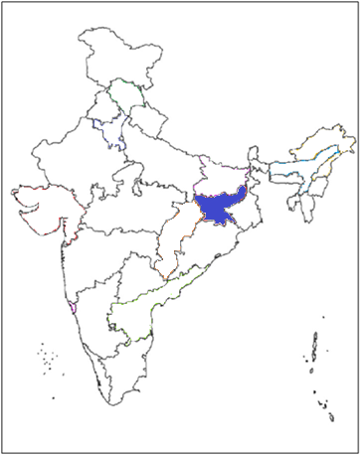
State - Jharkhand
New States of India:
Jharkhand
Formation:
1. Previously Part of Bihar
2. Formed in 2000
Language spoken:
Bhojpuri / Hindi
Handicrafts:
Sahrai Paintings
Special features:
40 % of Mineral resource concentrated in this state.
Leading state in economic development
Notes:
Notes for Teacher - < Information for further reference or explanation >
Suggestions: <Ideas/ Images/ Animations / Others – To make better representation of the content >
Source of Multimedia Objects (Image/audio/ Video/Animation) used in this slide -
<Short Description> - <SOURCE URL>
MAP OF INDIA --OC_piyalidas1485@gmail.com

Slide 6
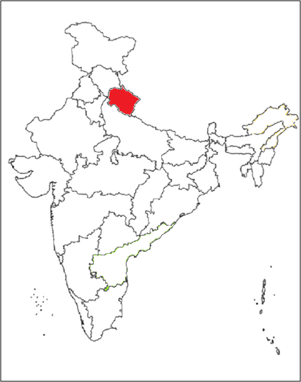
State- Uttarakhand
New States of India:
Uttarakhand
Formation:
1. Previously Part of Uttar Pradesh
2. Formed in 2000
Language spoken:
Garhwali / Hindi
Handicrafts:
Wood Carving, Pahadi Painting,
Woollen Shawls, Basketry.
Special features:
Epic Mahabharata was scripted in this state.
Chipko Movement on environment was started in this state.
Notes:
Notes for Teacher - < Information for further reference or explanation >
Suggestions: <Ideas/ Images/ Animations / Others – To make better representation of the content >
Source of Multimedia Objects (Image/audio/ Video/Animation) used in this slide -
<Short Description> - <SOURCE URL>
MAP OF INDIA --OC_piyalidas1485@gmail.com

Slide 7
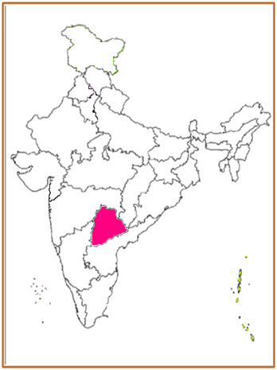
State- Telangana
New states of India:
Telangana
Formation:
Formed in 2014
Language spoken:
Telugu
Handicrafts:
Bidri Art, Silver Filigri, Dokra Casting.
Special feature :
One of the top IT exporting states in India
Notes:
Notes for Teacher - < Information for further reference or explanation >
Suggestions: <Ideas/ Images/ Animations / Others – To make better representation of the content >
Source of Multimedia Objects (Image/audio/ Video/Animation) used in this slide -
<Short Description> - <SOURCE URL>
MAP OF INDIA --OC_piyalidas1485@gmail.com

Slide 8
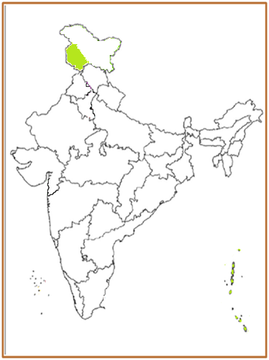
Union Territory- Jammu and Kashmir
New Union Territories of India:
Jammu & Kashmir
Formation:
Formed in 2019
Language spoken:
Kashmiri / Urdu / Hindi
Handicrafts:
Kashmiri shawls, carpets, calico - painting, Basohli painting
Special feature:
Tourism serves as a major livelihood
Notes:
Notes for Teacher - < Information for further reference or explanation >
Suggestions: <Ideas/ Images/ Animations / Others – To make better representation of the content >
Source of Multimedia Objects (Image/audio/ Video/Animation) used in this slide -
<Short Description> - <SOURCE URL>
MAP OF INDIA --OC_piyalidas1485@gmail.com

Slide 9
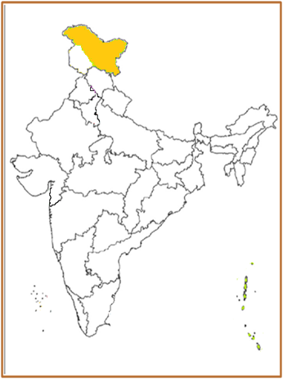
Union Territory- Ladakh
New Union Territories of India:
Ladakh
Formation:
Formed in 2019
Language spoken:
Ladakhi / Hindi / English
Handicrafts:
Weaving
Notes:
Notes for Teacher - < Information for further reference or explanation >
Suggestions: <Ideas/ Images/ Animations / Others – To make better representation of the content >
Source of Multimedia Objects (Image/audio/ Video/Animation) used in this slide -
<Short Description> - <SOURCE URL>
MAP OF INDIA --OC_piyalidas1485@gmail.com

Slide 10
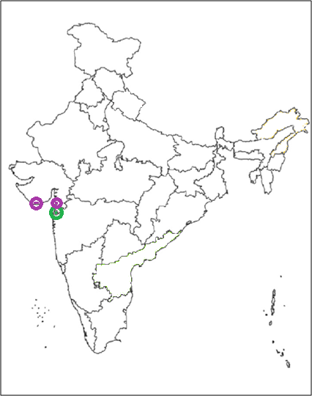
Union Territory - Dadra & Nagar Haveli and Daman & Diu
New Union Territories of India:
Dadra & Nagar Haveli and Daman & Diu
Formation:
1. The two union territories were merged together.
2. Formed in 2020.
Language spoken:
Gujarati / Hindi
Special features:
Tribal group make up more than 60% of the population.
Industrial hub has attracted people from all over India.
Notes:
Notes for Teacher - < Information for further reference or explanation >
Suggestions: <Ideas/ Images/ Animations / Others – To make better representation of the content >
Source of Multimedia Objects (Image/audio/ Video/Animation) used in this slide -
<Short Description> - <SOURCE URL>
MAP OF INDIA --OC_piyalidas1485@gmail.com

Slide 11
MM Index
Slide# | Thumbnail | Source and Attribution
4,5,6,7,8,19,10 |  | OC_piyalidas1485@gmail.com
2 |  | SSSVV GALLERY
3 |  | TEACHER --https://pixabay.com/illustrations/businessman-cartoons-training-607831/
3 |  | Board-- https://pixabay.com/vectors/pencil-draw-write-school-education-1302150/

