Slide 1
Locational Setting of India and Her Neighbours
Notes:
Notes for Teacher - < Information for further reference or explanation >
Suggestions: <Ideas/ Images/ Animations / Others – To make better representation of the content >
Source of Multimedia Objects (Image/audio/ Video/Animation) used in this slide -
1. <Short Description> - <SOURCE URL>

Slide 2
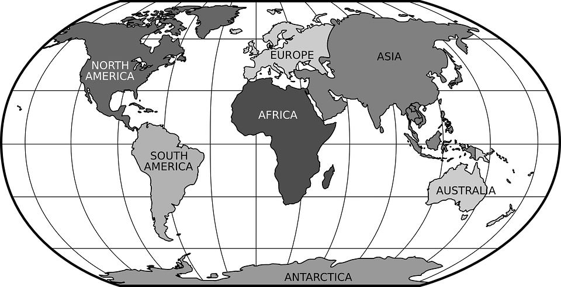
Strategic Location Of India
Equator
0
India is located in the Northern Hemisphere. It lies entirely to the north of the Equator.
Notes:
Notes for Teacher - < Information for further reference or explanation >
Suggestions: <Ideas/ Images/ Animations / Others – To make better representation of the content > Source of Multimedia Objects (Image/audio/ Video/Animation) used in this slide -
<Short Description> - <SOURCE URL>
WORLD MAP -- https://pixabay.com/vectors/world-map-robinson-projection-globe-42641/

Slide 3
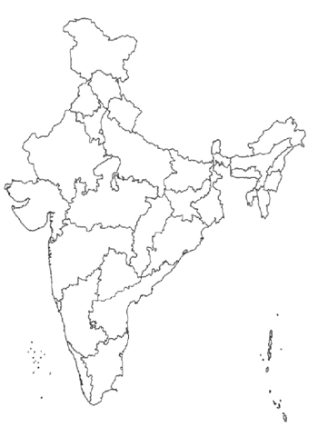
Does Tropic Of Cancer passes through India???
Notes:
Notes for Teacher - < Information for further reference or explanation >
Suggestions: <Ideas/ Images/ Animations / Others – To make better representation of the content >
Source of Multimedia Objects (Image/audio/ Video/Animation) used in this slide -
<Short Description> - <SOURCE URL>
Map of India – OC_piyalidas1485@gmail.com

Slide 4
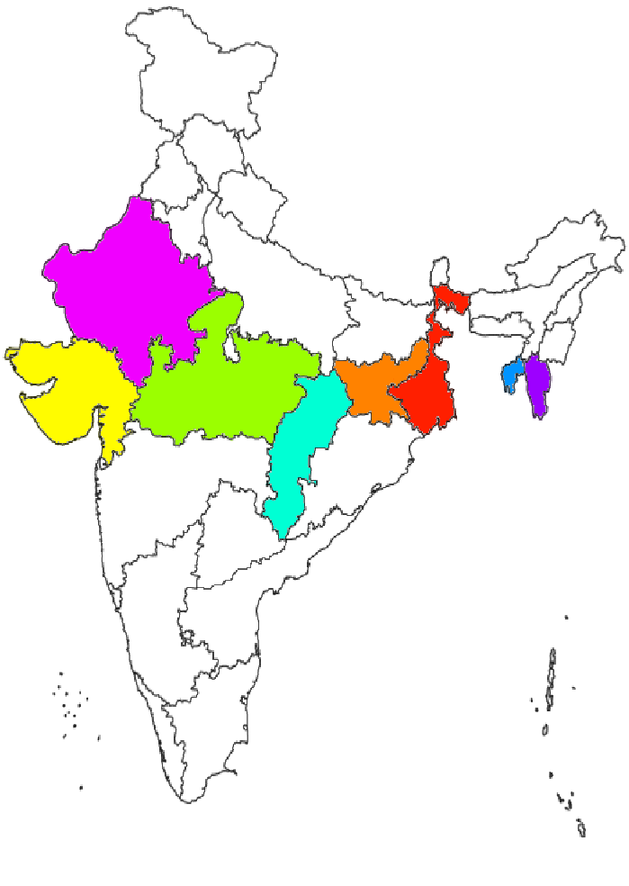
Does Tropic Of Cancer passes through India???
The Tropic of Cancer (23⁰ 30’ North) cuts it roughly into two halves.
Notes:
Notes for Teacher - < Information for further reference or explanation >
Suggestions: <Ideas/ Images/ Animations / Others – To make better representation of the content >
Source of Multimedia Objects (Image/audio/ Video/Animation) used in this slide -
<Short Description> - <SOURCE URL>
Map of India – OC_piyalidas1485@gmail.com

Slide 5
Geographical position of India
The latitudinal extent : 8⁰ 4’ N
to 37⁰ 6’ N latitude
37⁰ 6’ North latitude
The longitudinal extent : 68⁰ 7’
E to 97⁰ 35’ E longitude
2900 kms
The distance between eastern
most and western most part :
2900 kms
68⁰ 7’ East longitude
97⁰ 35’ East longitude
The distance between
northernmost and
southernmost part : 3200 kms
3200 kms
8⁰ 4’ North latitude
Notes:
Notes for Teacher - < Information for further reference or explanation >
Suggestions: <Ideas/ Images/ Animations / Others – To make better representation of the content >
Source of Multimedia Objects (Image/audio/ Video/Animation) used in this slide -
1. <Short Description> - <SOURCE URL>
Map OF INDIA – OC_piyalidas1485@gmail.com

Slide 6
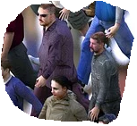
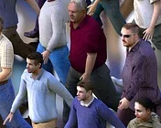
Idea about Area and Population of India
Total population :
120 crores
Notes:
Notes for Teacher - < Information for further reference or explanation >
Suggestions: <Ideas/ Images/ Animations / Others – To make better representation of the content >
Source of Multimedia Objects (Image/audio/ Video/Animation) used in this slide -
<Short Description> - <SOURCE URL>
MAP OF INDIA 1- OC_piyalidas1485@gmail.com
MEN & WOMEN -- https://pixabay.com/illustrations/crowd-men-women-casserole-2152653/

Slide 7
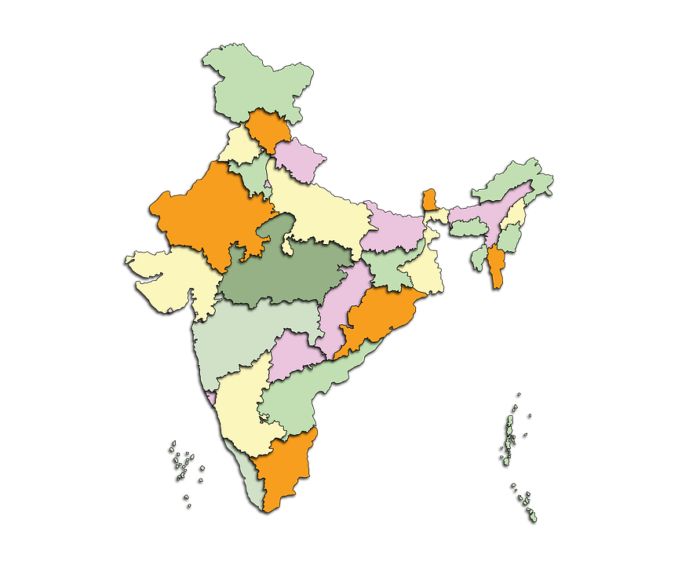
Idea about Area and Population of India
Total area of India:
3.28 million
square km.
Notes:
Notes for Teacher - < Information for further reference or explanation >
Suggestions: <Ideas/ Images/ Animations / Others – To make better representation of the content >
Source of Multimedia Objects (Image/audio/ Video/Animation) used in this slide -
<Short Description> - <SOURCE URL>
MAP OD INDIA 2 - https://pixabay.com/illustrations/map-india-country-geography-5505725/

Slide 8
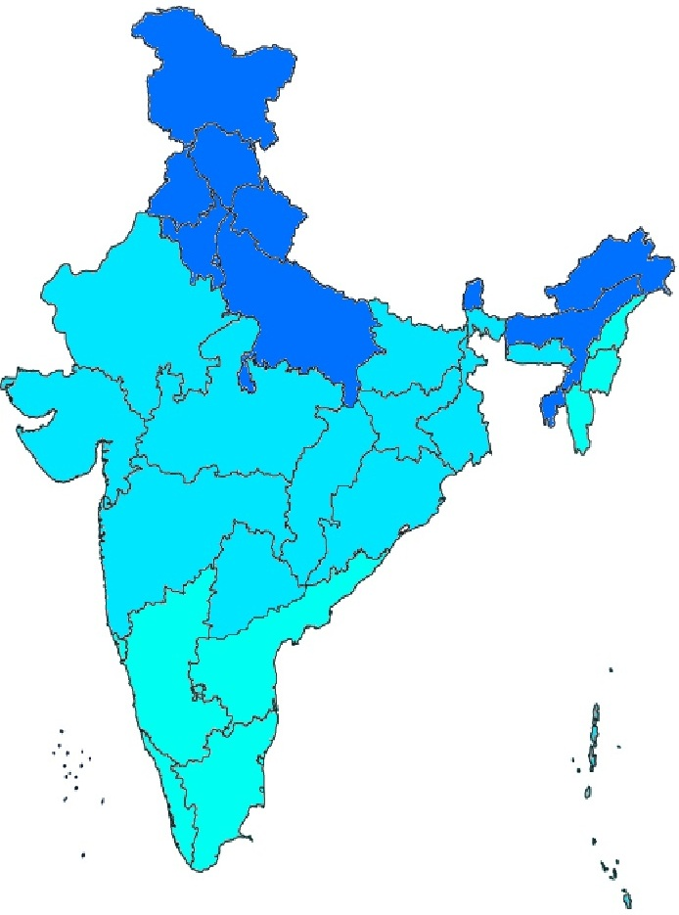
Diversity in India
Diversity in India is
witnessed in
1.Climate Type
Notes:
Notes for Teacher - < Information for further reference or explanation >
Suggestions: <Ideas/ Images/ Animations / Others – To make better representation of the content >
Source of Multimedia Objects (Image/audio/ Video/Animation) used in this slide -
1. <Short Description> - <SOURCE URL>
2.MAP OF INDIA - OC_piyalidas1485@gmail.com

Slide 9
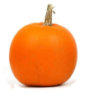
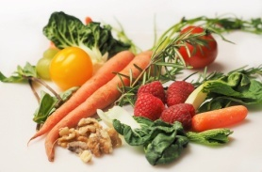
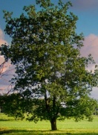
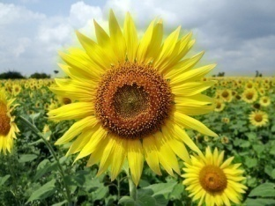
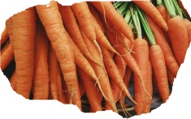
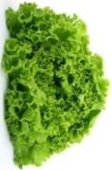
Diversity in India
Diversity in India is
witnessed in
1.Climate Type
2.Vegetation
Notes:
Notes for Teacher - < Information for further reference or explanation >
Suggestions: <Ideas/ Images/ Animations / Others – To make better representation of the content >
Source of Multimedia Objects (Image/audio/ Video/Animation) used in this slide -
1. <Short Description> - <SOURCE URL>
2.MAP OF INDIA - OC_piyalidas1485@gmail.com
3. CARROT --https://pixabay.com/photos/carrots-vegetable-food-fresh-1082251/
4.SUNFLOWER --https://pixabay.com/photos/flower-sunflower-karnataka-india-204161/
5. PUMPKIN -https://pixabay.com/photos/pumpkin-kabocha-squash-autumn-3806393/
6.SCENERY --https://pixabay.com/photos/bach-creek-stream-brook-meadow-5598321/
7.VEGETABLES - https://pixabay.com/photos/vegetables-carrot-food-healthy-1085063/
8.LETTUCE - https://pixabay.com/photos/lettuce-food-fresh-green-healthy-1239155/
9. ORANGE --https://pixabay.com/photos/autumn-decoration-fall-food-fresh-2905/
10.SCENERY2 - https://pixabay.com/photos/pond-banks-vegetation-tree-3790066/

Slide 10
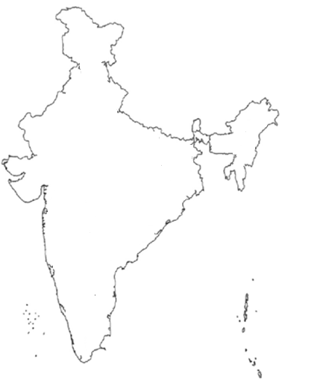
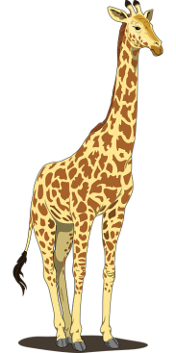
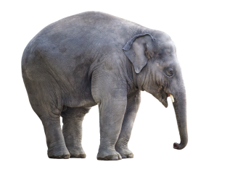
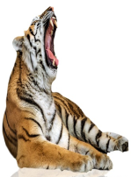
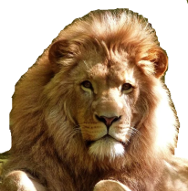
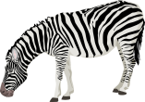
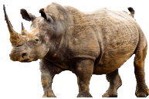
Diversity in India
Diversity in India is
witnessed in
1.Climate Type
2.Vegetation
3.Wildlife
Notes:
Notes for Teacher - < Information for further reference or explanation >
Suggestions: <Ideas/ Images/ Animations / Others – To make better representation of the content >
Source of Multimedia Objects (Image/audio/ Video/Animation) used in this slide -
1. <Short Description> - <SOURCE URL>
2.MAP OF INDIA - OC_piyalidas1485@gmail.com
3. TIGER --https://pixabay.com/photos/tiger-tiger-of-bengal-animal-feline-3028943/
4. ELEPHANT -https://pixabay.com/illustrations/elephant-white-background-isolated-2362696/
5.BLACK BIRD -https://pixabay.com/photos/blackbird-isolated-white-background-2781554/
6.LION -https://pixabay.com/photos/lion-feline-big-cat-1840092/
7.ZEBRA - https://pixabay.com/vectors/zebra-animal-mammal-black-white-41054/
8.FOX - https://pixabay.com/photos/red-fox-wildlife-snow-winter-2230734/
9.GIRAFFE -https://pixabay.com/vectors/giraffe-tall-spots-long-neck-tail-48393/
10.RHINO - https://pixabay.com/photos/animal-wild-animal-rhino-africa-2765319/
11.BIRD - https://pixabay.com/photos/alcedo-atthis-common-kingfisher-bird-881594/
12.SNAKE - https://pixabay.com/photos/snake-terrarium-bastards-animals-1519996/

Slide 11
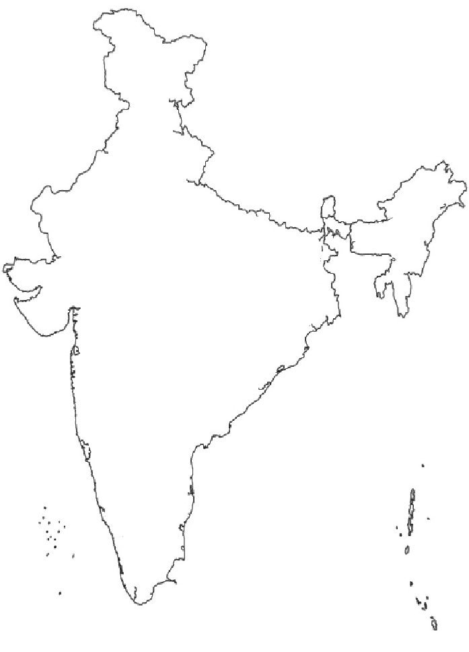
Diversity in India
Unity is seen in traditions which bind the nation as one.
Diversity in India is
witnessed in
Urdu
Kashmiri
Bodo
Punjabi
Santali
1.Climate Type
Bodo
Sanskrit
Sindhi
Urdu
Bodo
Meitei
Hindi
Hindi
Assamese
2.Vegetation
Odia
Nepali
Dogri
Nepali
Urdu
Hindi
Konkani
Santali
Bengali
Odia
Meitei
Bengali
Gujarati
Bodo
Gujarati
Sanskrit
3.Wildlife
Tamil
Odia
Marathi
Odia
Gujarati
Hindi
4.Language
Spoken
Maithili
Tamil
Sanskrit
Malayalam
Hindi
Telugu
Kannada
Nepali
Tamil
Sindhi
5.Culture Followed
Dogri
Urdu
Gujarati
Sindhi
Notes:
Notes for Teacher - < Information for further reference or explanation >
Suggestions: <Ideas/ Images/ Animations / Others – To make better representation of the content >
Source of Multimedia Objects (Image/audio/ Video/Animation) used in this slide -
1. <Short Description> - <SOURCE URL>
2.MAP OF INDIA - OC_piyalidas1485@gmail.com

Slide 12
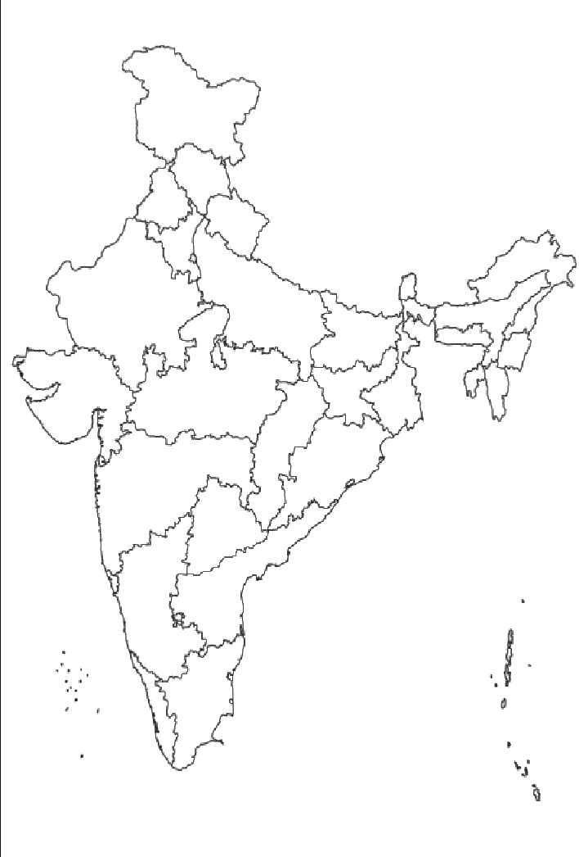
Indian Standard Time
The longitudinal extent of 29⁰ degree difference - time difference of 2 hrs between the easternmost and westernmost part of India.
82⁰ 30’ E
A standard meridian Chosen - uniform time followed throughout India
82⁰ 30’ E - Indian standard meridian.
Local time at this longitude is the Indian Standard Time.
Notes:
Notes for Teacher - < Information for further reference or explanation >
Suggestions: <Ideas/ Images/ Animations / Others – To make better representation of the content >
Source of Multimedia Objects (Image/audio/ Video/Animation) used in this slide -
1. <Short Description> - <SOURCE URL>
Map OF INDIA – OC_piyalidas1485@gmail.com

Slide 13
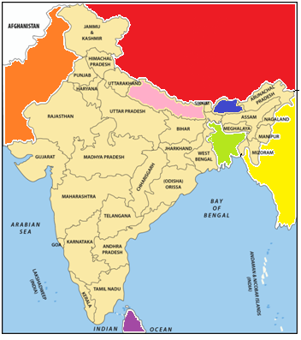
India’s Neighbour
The countries which are neighbours of India are:
1.Pakistan
2.China
3.Tibet
4.Myanmar
5.Bangladesh
6.Nepal
7.Bhutan
8.Srilanka
Notes:
Notes for Teacher - < Information for further reference or explanation >
Suggestions: <Ideas/ Images/ Animations / Others – To make better representation of the content >
Source of Multimedia Objects (Image/audio/ Video/Animation) used in this slide -
1. <Short Description> - <SOURCE URL>
Map OF INDIA – SSSVV Gallery

Slide 14
MM Index
Slide# | Thumbnail | Source and Attribution
2 |  | https://pixabay.com/vectors/world-map-robinson-projection-globe-42641/
3 |  | OC_piyalidas1485@gmail.com
7 |  | https://pixabay.com/illustrations/map-india-country-geography-5505725/
9 |  | https://pixabay.com/photos/carrots-vegetable-food-fresh-1082251/
6 |  | https://pixabay.com/illustrations/crowd-men-women-casserole-2152653/
9 |  | https://pixabay.com/photos/flower-sunflower-karnataka-india-204161/
9 |  | https://pixabay.com/photos/bach-creek-stream-brook-meadow-5598321/
9 |  | https://pixabay.com/photos/pond-banks-vegetation-tree-3790066/
9 |  | https://pixabay.com/photos/pumpkin-kabocha-squash-autumn-3806393/
9 |  | https://pixabay.com/photos/vegetables-carrot-food-healthy-1085063/

Slide 15
MM Index
Slide# | Thumbnail | Source and Attribution
9 |  | https://pixabay.com/photos/lettuce-food-fresh-green-healthy-1239155/
9 |  | https://pixabay.com/photos/autumn-decoration-fall-food-fresh-2905/
10 |  | https://pixabay.com/illustrations/elephant-white-background-isolated-2362696/
10 |  | https://pixabay.com/photos/blackbird-isolated-white-background-2781554/
10 |  | https://pixabay.com/photos/lion-feline-big-cat-1840092/
10 |  | https://pixabay.com/photos/tiger-tiger-of-bengal-animal-feline-3028943/
10 |  | https://pixabay.com/photos/red-fox-wildlife-snow-winter-2230734/
10 |  | https://pixabay.com/vectors/zebra-animal-mammal-black-white-41054/
10 |  | https://pixabay.com/vectors/giraffe-tall-spots-long-neck-tail-48393/

Slide 16
MM Index
Slide# | Thumbnail | Source and Attribution
10 |  | https://pixabay.com/photos/animal-wild-animal-rhino-africa-2765319/
10 |  | https://pixabay.com/photos/alcedo-atthis-common-kingfisher-bird-881594/
10 |  | https://pixabay.com/photos/snake-terrarium-bastards-animals-1519996/
13 |  | SSSVV - GALLERY

