Slide 1
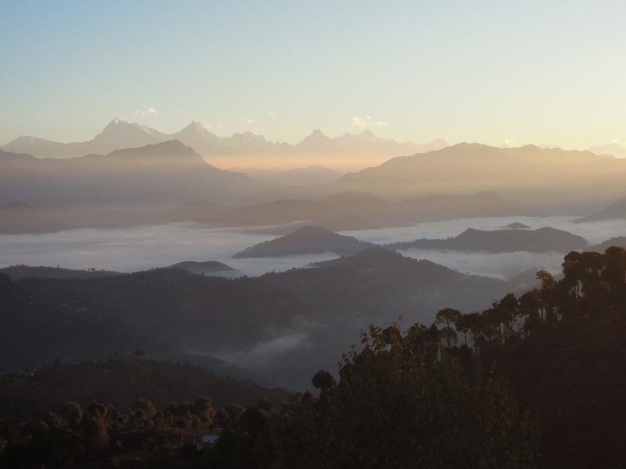
Mountains Ranges of India
Notes:
Notes for Teacher – N/A
Suggestions: N/A
Details of Multimedia Objects (Image/audio/ Video/Animation) used in this slide –
Himalayas: https://pixabay.com/photos/nepal-himalaya-himalayas-sky-5044095/

Slide 2
Himalayan Range
Very High Peak Examples
Mount Everest
Greater Himalayas
or
Himadri
Middle / Lesser Himalayas
Or Himachal
Greater Himalayas
or
Shiwalik
Kanchenjunga
3 Parallel Ranges
Notes:
Notes for Teacher – N/A
Suggestions: N/A
Details of Multimedia Objects (Image/audio/ Video/Animation) used in this slide – N/A

Slide 3
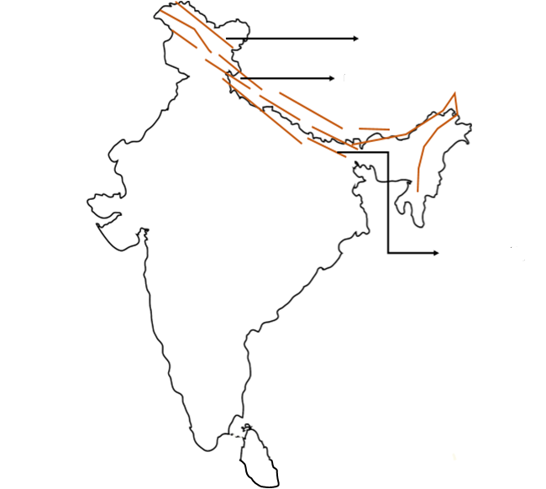
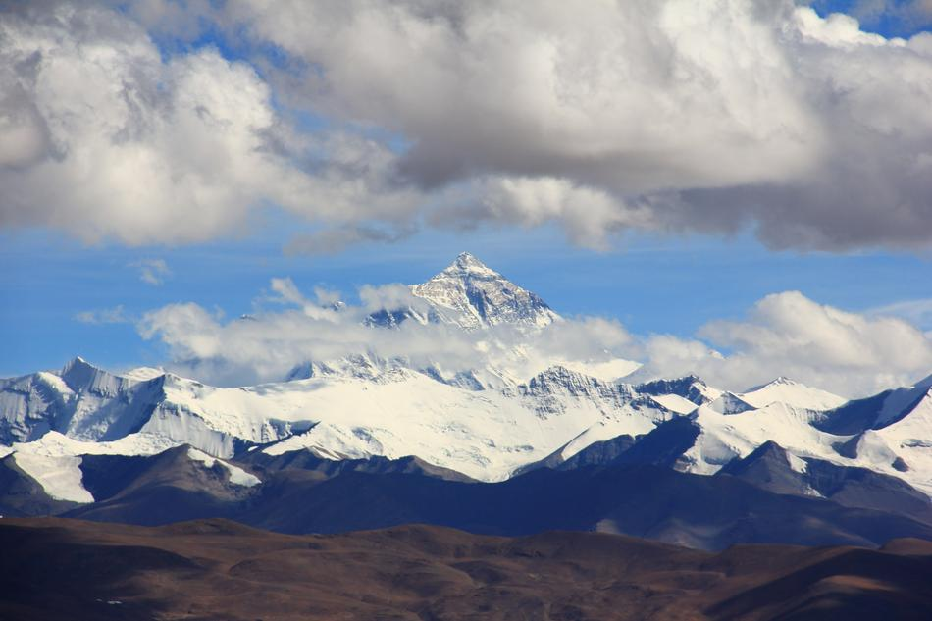
Himalayan Range
HIMACHAL
HIMADRI
Click the Picture
SHIWALIK
Notes:
Notes for Teacher – N/A
Suggestions: N/A
Details of Multimedia Objects (Image/audio/ Video/Animation) used in this slide –
Map: SSSVV Gallery
Himalayas: https://pixy.org/5954796/

Slide 4
Important aspects of Himalayan Mountain range in India
Some hills stations located in the Shiwalik range :
Mussouri, Nanital, Shimla, Darjeeling
Sources to some mighty rivers –Ganga, Brahmaputra, Indus and their tributaries.
Himalayan Glaciers :
Himalayan range protect us from :
Severe cold winds and provides rich ecosystem.
Notes:
Notes for Teacher – N/A
Suggestions: N/A
Details of Multimedia Objects (Image/audio/ Video/Animation) used in this slide – N/A

Slide 5
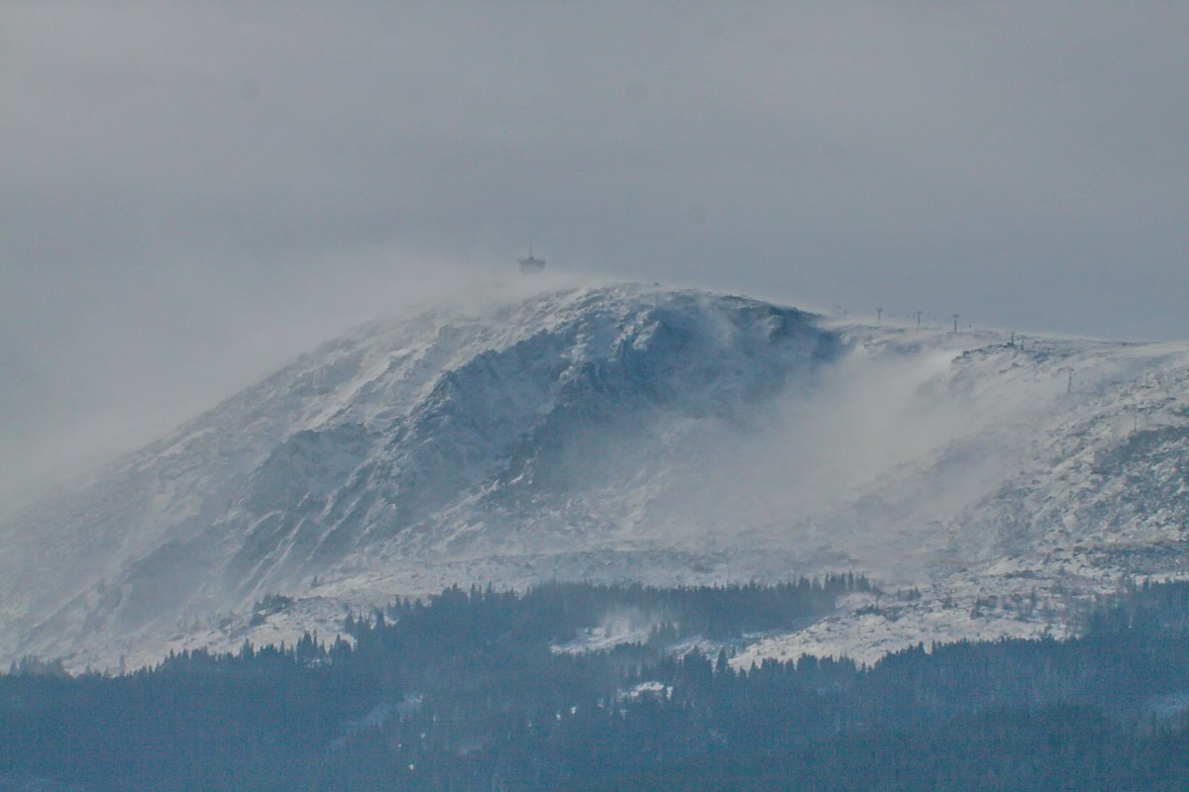
MM Index
Slide # | Images | Source or Attribution
1 |  | https://pixabay.com/photos/nepal-himalaya-himalayas-sky-5044095/
3 |  | https://pixy.org/5954796/

