Slide 1
States
and
Union Territories of India
Notes:
Notes for Teacher – N/A
Suggestions: N/A
Details of Multimedia Objects (Image/audio/ Video/Animation) used in this slide – N/A

Slide 2
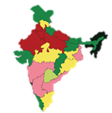
Administrative Division in India
India
STATE
Districts
UNION TERRITORIES
Sub-Divisions &
Blocks
Districts
Notes:
Notes for Teacher – N/A
Suggestions: N/A
Details of Multimedia Objects (Image/audio/ Video/Animation) used in this slide –

Slide 3
Administrative Division in India
India has been divided into administrative divisions for sake of smooth governance.
India has been divided into 28 states
States are further divided into districts and subdivisions
9 union territories
Notes:
Notes for Teacher – N/A
Suggestions: N/A
Details of Multimedia Objects (Image/audio/ Video/Animation) used in this slide – N/A

Slide 4
Union Territories of India
Delhi
(NCR)
Jammu & Kashmir
Daman
&
Diu
Union Territories
Puducherry
Ladakh
Andaman
&
Nicobar
Islands
Lakshadweep
Dadra
and
Nagar Haveli
Chandigarh
Notes:
Notes for Teacher – N/A
Suggestions: N/A
Details of Multimedia Objects (Image/audio/ Video/Animation) used in this slide – N/A

Slide 5
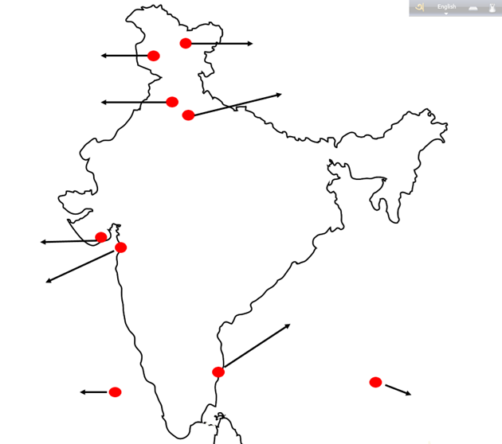
Union Territories of India
Ladakh
Jammu & Kashmir
Chandigarh
DELHI (NCR)
Dadra & Nagar Haveli
Dam & Diu
Puducherry
Lakshadweep
Andaman & Nicobar Island
Notes:
Notes for Teacher – N/A
Suggestions: N/A
Details of Multimedia Objects (Image/audio/ Video/Animation) used in this slide – SSSVV Gallery

Slide 6
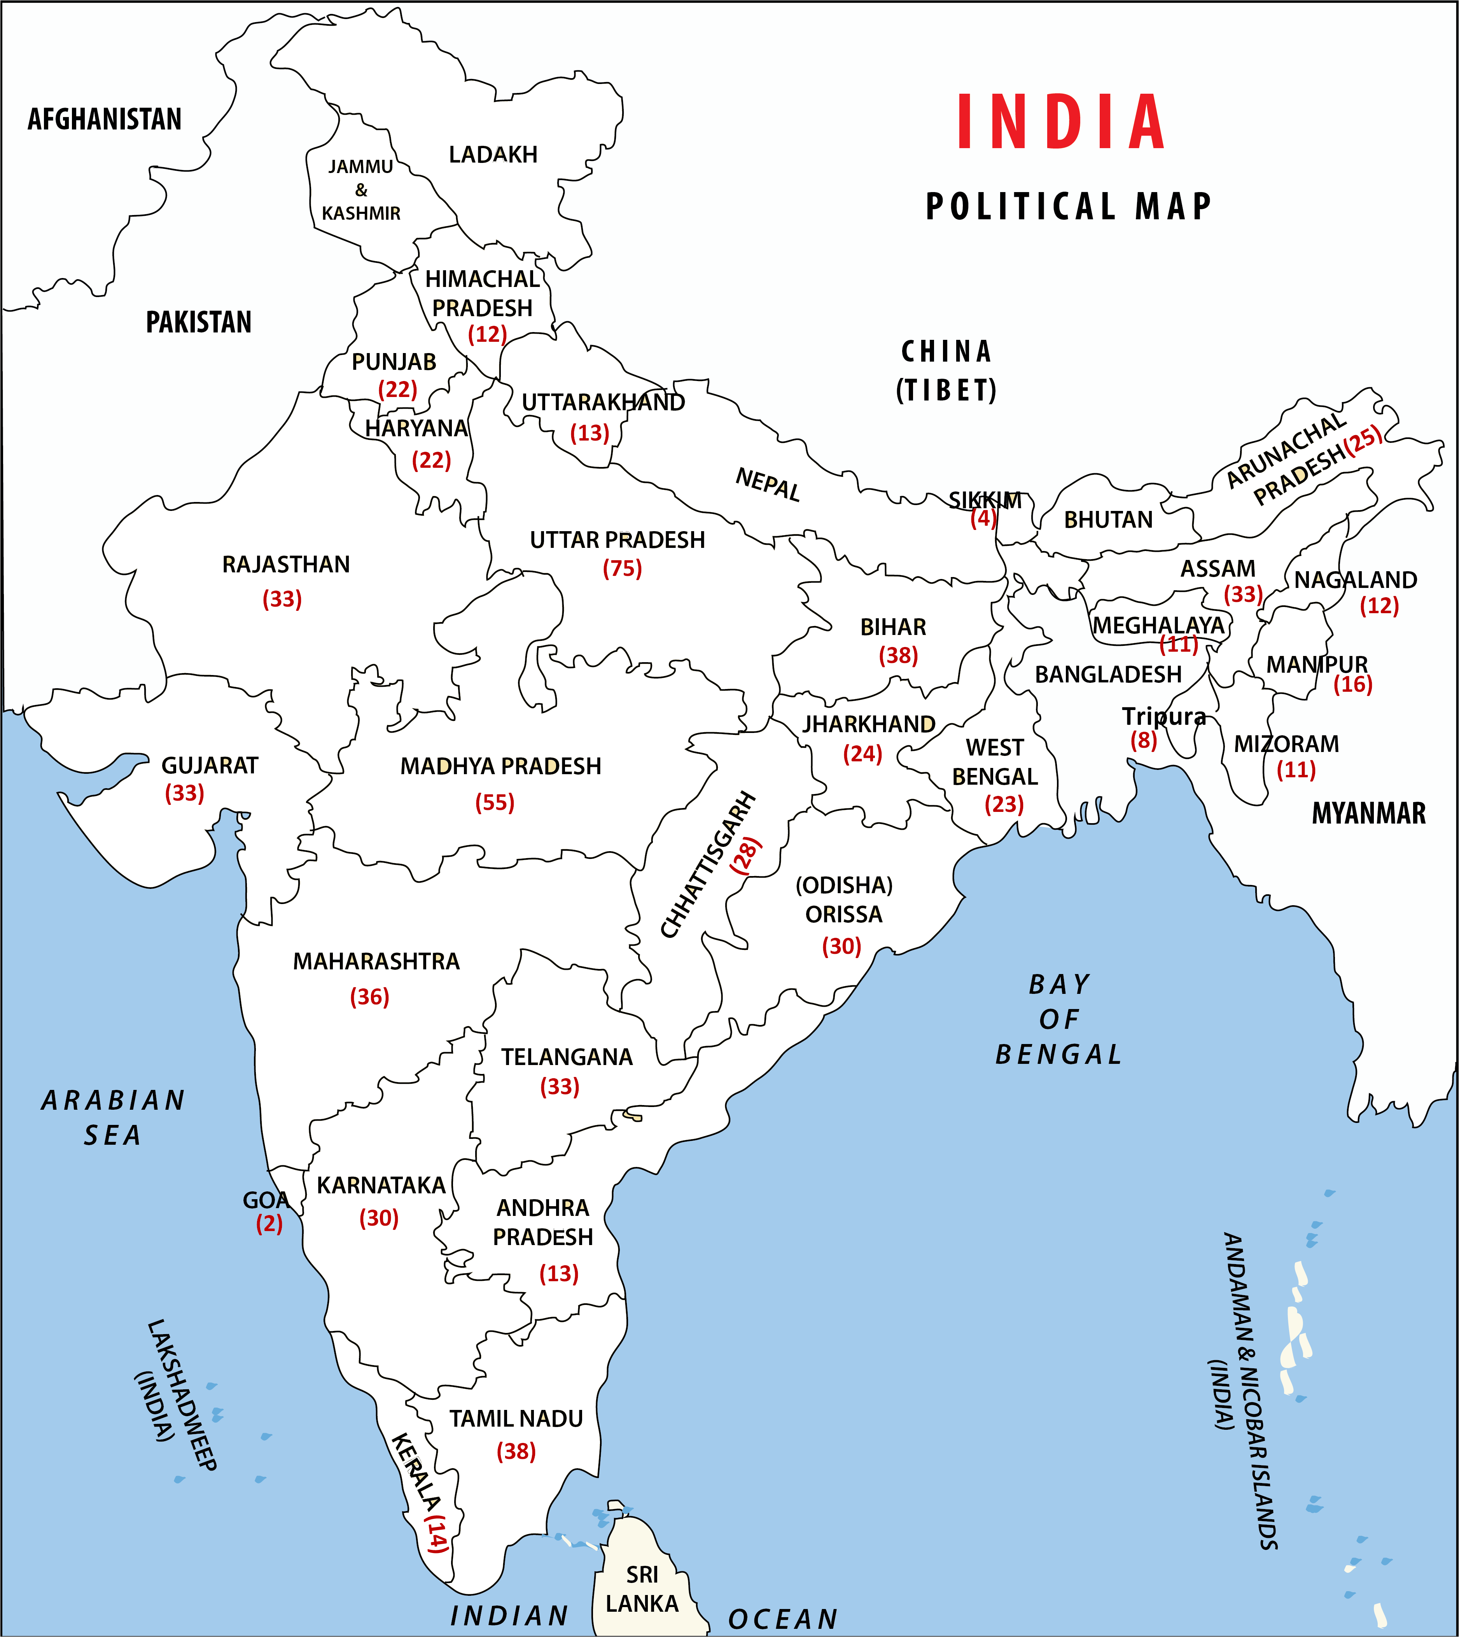
States and number of Districts India
Notes:
Notes for Teacher – N/A
Suggestions: N/A
Details of Multimedia Objects (Image/audio/ Video/Animation) used in this slide – SSSVV Gallery

Slide 7
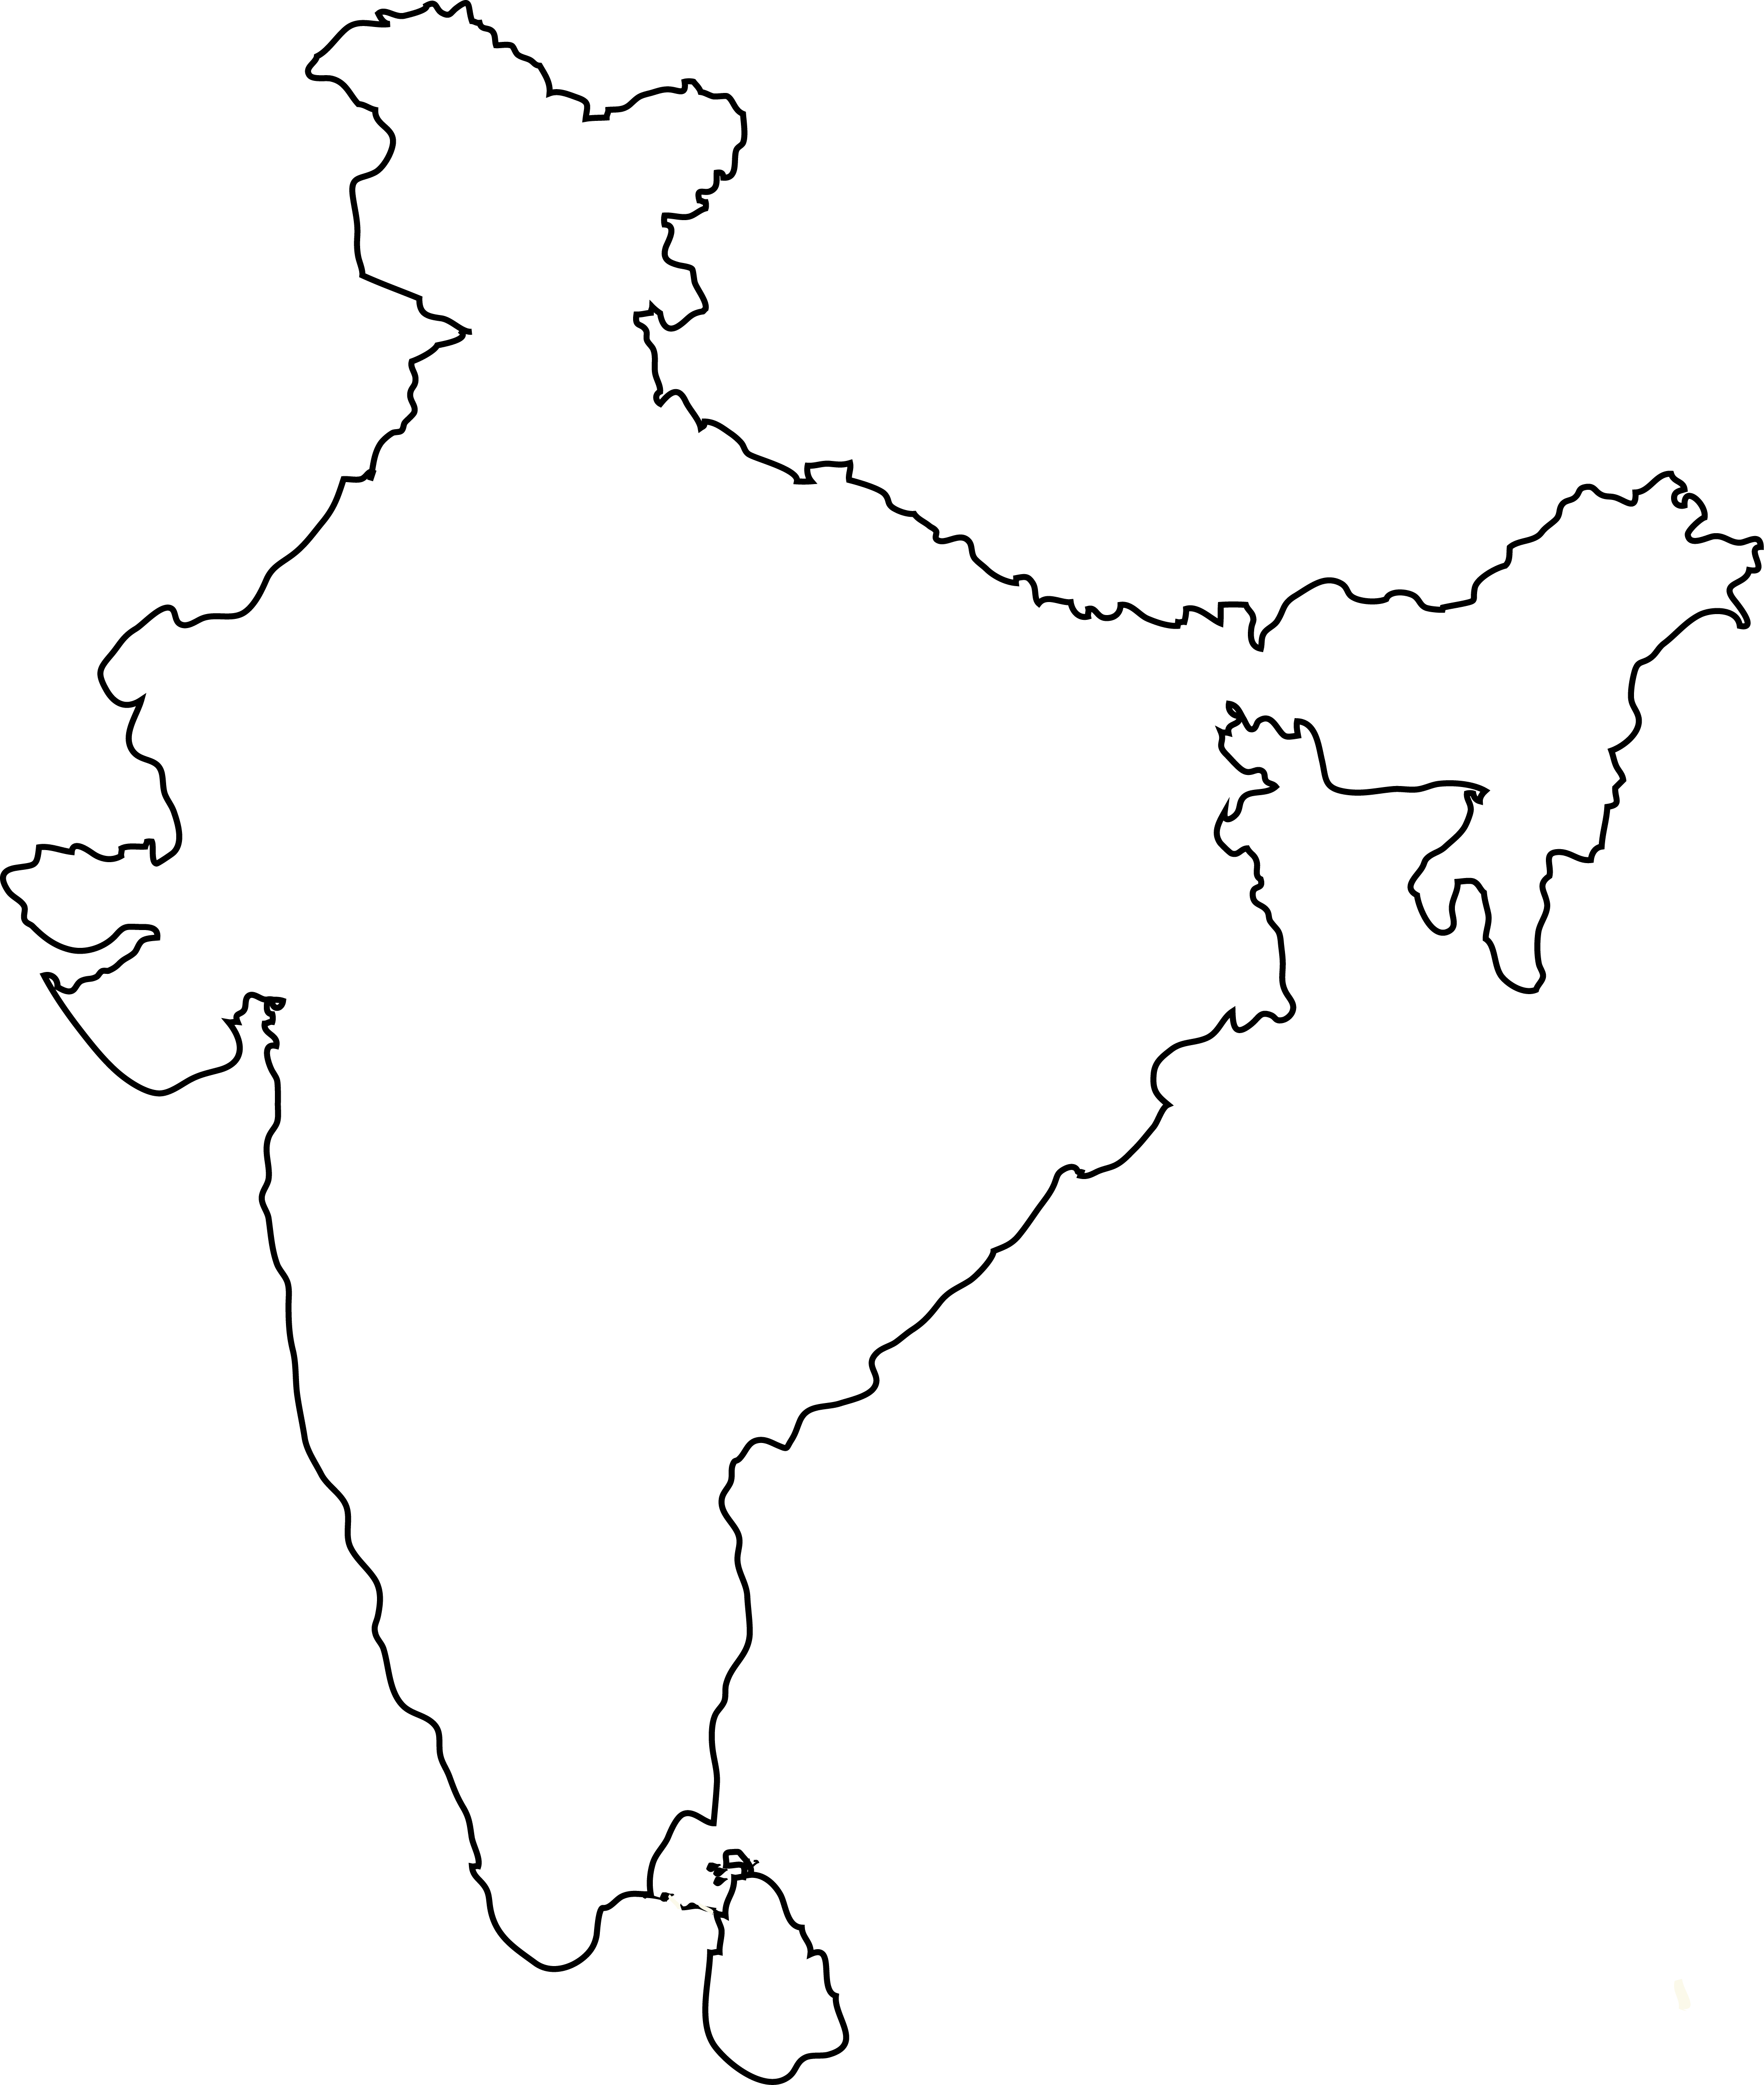
MM Index
Slide # | Images | Source or Attribution
2 |  | SSSVV Gallery – Keyword (India Map)
5 |  | SSSVV Gallery – Keyword (India Map)
6 |  | SSSVV Gallery – Keyword (India Map)

