Slide 1
Let us revise –
India's Physiographic Divisions!
Notes:
Notes for Teacher –N/A
Suggestions: N/A
Source of Multimedia Objects (Image/audio/ Video/Animation) used in this slide –
Test: https://pixabay.com/illustrations/test-clock-deadline-time-period-361512/

Slide 2
Observe & Answer
Q1. Look at the picture below and identify the
physical feature. In which part of Indian
physiography do you find it?
The picture shows a mountain.
This physical feature is found in the northernmost physiographic division of India.
Answer
Notes:
Notes for Teacher – Click on “ Answer” for the correct answer
Suggestions:
Source of Multimedia Objects (Image/audio/ Video/Animation) used in this slide -
Mountain: https://pixabay.com/photos/mount-everest-himalayas-nuptse-276995/

Slide 3
Identify the statements
Q2. State whether the following are True or False
Peninsula is a piece of land surrounded by water on all sides.
Desert occupies the union territory of Jammu and Kashmir.
False
Peninsula is a piece of land surrounded by water on 3 sides
False
Desert occupies the state of Rajasthan
Click for Answer
Notes:
Notes for Teacher –Click on “ Click for Answer” for the right answer
Suggestions: N/A
Source of Multimedia Objects (Image/audio/ Video/Animation) used in this slide - N/A

Slide 4
Identify the statements
Q2. State whether the following are True or False
3. A tributary discharges all its water into a main river.
Vindhya is an important range of the Siwalik.
Eastern coastal plains are much broader than western coastal plains.
True
False
Vindhya is an important range of the Peninsular Plateau
True
Click for Answer
Notes:
Notes for Teacher –Click on “ Click for Answer” for the right answer
Suggestions: N/A
Source of Multimedia Objects (Image/audio/ Video/Animation) used in this slide - N/A

Slide 5
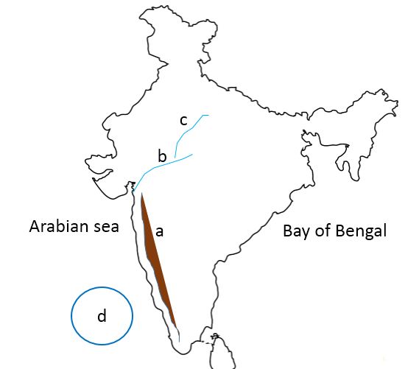
Map work
Q3. In an outline map of India show the following:
a) Western Ghats
b) Narmada
c) Chambal
d) Lakshadweep
Islands
e) Arabian Sea
and Bay of
Bengal
Chambal
Narmada
e
Western Ghats
e
Lakshadweep Islands
Click here to reveal the Answer
Notes:
Notes for Teacher –Please click on “ Click here to reveal the answer”
Suggestions: N/A
Source of Multimedia Objects (Image/audio/ Video/Animation) used in this slide -
Map: SSSVV Gallery

Slide 6
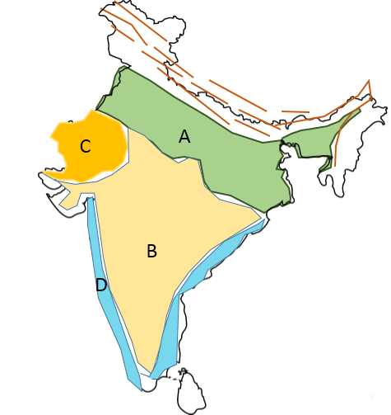
Map work
Q4. In the map of India below, identify the
specified physiographic divisions
Indian Desert
Northern Plains
Peninsular plateau
Western Coastal Plain
Click here to reveal the Answer
Notes:
Notes for Teacher – Please click on “ Click here to reveal the answer”
Suggestions: N/A
Source of Multimedia Objects (Image/audio/ Video/Animation) used in this slide -
Map: SSSVV Gallery

Slide 7
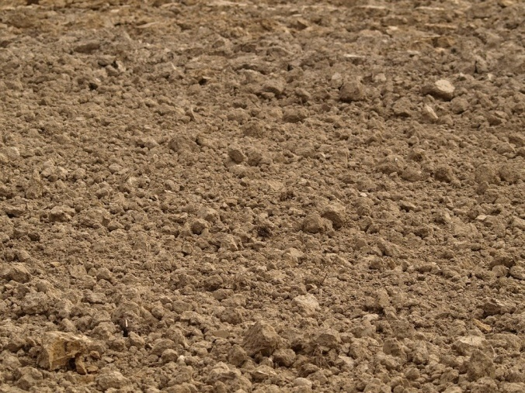
Answer in one or two sentences
The northern plains of India.
Alluvial soils are extremely fertile and are useful for cultivation of crops.
Q5. In which Physiographic division of India do
we find alluvial deposits? How is it helpful?
Answer
Notes:
Notes for Teacher –Click on “ Answer” for the correct answer
Suggestions: N/A
Source of Multimedia Objects (Image/audio/ Video/Animation) used in this slide -
Alluvial Soil: https://pixabay.com/photos/earth-soil-arable-field-312794/

Slide 8
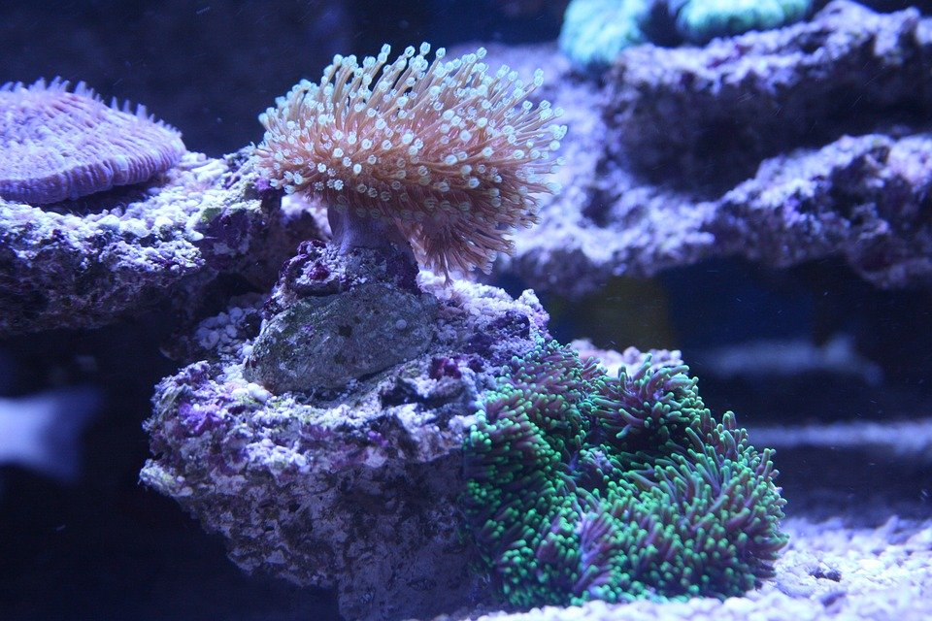
Answer in one or two sentences
Q6. How has Lakshadweep turned into a coral island?
Marine living organisms turns to coral (Skeletons) which accumulates in a heap and turns into islands.
Answer
Notes:
Notes for Teacher –Click on “ Answer” for the correct answer
Suggestions: N/A
Source of Multimedia Objects (Image/audio/ Video/Animation) used in this slide -
Coral: https://pixabay.com/photos/coral-leather-coral-polyps-2775067/

Slide 9
Answer Briefly
Answer in one or two sentences
Q7. Why is the peninsular plateau region hard and
rocky in nature? How is this nature of the
physiographic related to its formation?
The formation of the peninsular plateau is directly related to the flow of lava which solidified to form the peninsular plateau.
The volcanic rocks which formed from solidification made the plateau hard and rocky.
Answer

Slide 10
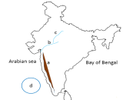
MM Index
Slide# | Thumbnail | Source and Attribution
1 |  | https://pixabay.com/illustrations/test-clock-deadline-time-period-361512/
2 |  | https://pixabay.com/photos/mount-everest-himalayas-nuptse-276995/
4 |  | SSSVV Gallery( Keyword- Map of India) OC_chandranidebhaumik@gmail.com
5 |  | SSSVV Gallery( Keyword- Map of India) OC_chandranidebhaumik@gmail.com
7 |  | https://pixabay.com/photos/earth-soil-arable-field-312794/
8 |  | https://pixabay.com/photos/coral-leather-coral-polyps-2775067/

