Slide 1
Mountains, Plateaus, Plains and Coasts of India
Notes:
Notes for Teacher - < Information for further reference or explanation >
Suggestions: <Ideas/ Images/ Animations / Others – To make better representation of the content >
Source of Multimedia Objects (Image/audio/ Video/Animation) used in this slide -
1. <Short Description> - <SOURCE URL>

Slide 2
Aim and Resources Required
Aim:
The students will form clear idea about the major
physiographic divisions of India.
Resources Required:
Pen, pencil, eraser, Note book
A physical map of India (to be displayed during the activity)
Notes:
Notes for Teacher - < Information for further reference or explanation >
Suggestions: <Ideas/ Images/ Animations / Others – To make better representation of the content >
Source of Multimedia Objects (Image/audio/ Video/Animation) used in this slide -
1. <Short Description> - <SOURCE URL>
Board with Teacher--https://pixabay.com/illustrations/moe-girls-women-manga-anime-3793863/

Slide 3
Topic For Discussion
Group discussion of the students will be able to distinguish between
Mountains
Coasts
Plains
Plateaus
Notes:
Notes for Teacher - < Information for further reference or explanation >
Suggestions: <Ideas/ Images/ Animations / Others – To make better representation of the content >
Source of Multimedia Objects (Image/audio/ Video/Animation) used in this slide -
<Short Description> - <SOURCE URL>
PIC --https://pixabay.com/illustrations/meeting-conference-round-table-1738945/

Slide 4
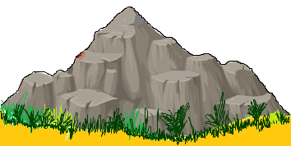
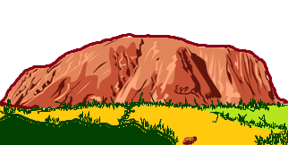
Points to be Discussed
MOUNTAINS
PLATEAU
Physical Features found
Location in India
Economic activity of the region
Physical Features found
Location in India
Economic activity of the region
Notes:
Notes for Teacher - < Information for further reference or explanation >
Suggestions: <Ideas/ Images/ Animations / Others – To make better representation of the content >
Source of Multimedia Objects (Image/audio/ Video/Animation) used in this slide -
<Short Description> - <SOURCE URL>
PLATEAUS -- https://pixabay.com/vectors/uluru-ayers-rock-australia-mountain-307795/
MOUNTAINS --https://pixabay.com/vectors/mountain-hill-view-peak-rock-575619/

Slide 5
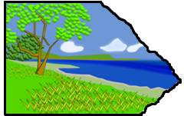
Points to be Discussed
PLAINS
COASTAL AREAS
Physical Features found
Location in India
Economic activity of the region
Physical Features found
Location in India
Economic activity of the region
Notes:
Notes for Teacher - < Information for further reference or explanation >
Suggestions: <Ideas/ Images/ Animations / Others – To make better representation of the content >
Source of Multimedia Objects (Image/audio/ Video/Animation) used in this slide -
<Short Description> - <SOURCE URL>
PLAINS --https://pixabay.com/vectors/landscape-agriculture-hills-plain-307325/
COASTAL AREAS -- https://pixabay.com/vectors/coastline-beach-blue-clouds-coast-155349/

Slide 6
Conclusions
Students will form a clear idea about the major physiographic divisions of India
Notes:
Notes for Teacher – Teacher will click for next slide if necessary.
Suggestions: <Ideas/ Images/ Animations / Others – To make better representation of the content >
Source of Multimedia Objects (Image/audio/ Video/Animation) used in this slide -
<Short Description> - <SOURCE URL>
PLATEAU -- https://pixabay.com/vectors/uluru-ayers-rock-australia-mountain-307795/
MOUNTAINS --https://pixabay.com/vectors/mountain-hill-view-peak-rock-575619/
PLAINS ---https://pixabay.com/vectors/landscape-agriculture-hills-plain-307325/
COASTAL AREAS -- https://pixabay.com/vectors/coastline-beach-blue-clouds-coast-155349/

Slide 7
WORKSHEET
Notes:
Notes for Teacher – Teacher will click for next slides if necessary.

Slide 8
Question & Answers
Write at least 3 sentences about the economic importance of Northern Plains of India
a) Agricultural activity is profitable.
b) Infrastructure construction like roadways and railways are easier.
c) Industries are easily set up.
Notes:
Notes for Teacher – Please click for th e answer
Suggestions: <Ideas/ Images/ Animations / Others – To make better representation of the content >
Source of Multimedia Objects (Image/audio/ Video/Animation) used in this slide -
1. <Short Description> - <SOURCE URL>
Board with Teacher--https://pixabay.com/illustrations/moe-girls-women-manga-anime-3793863/

Slide 9
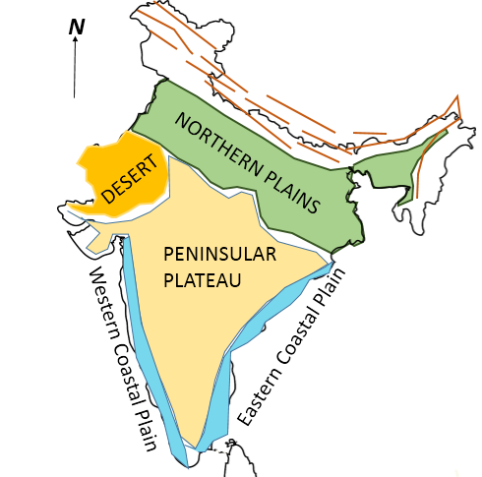
Question & Answers
2. In an outline map of India show all the physiographic divisions.
Notes:
Please Click for the Answer

Slide 10
Question & Answers
3. List for Rivers and Ranges of Peninsular Plateau
Rivers :
Narmada
Tapi
Mahanadi
Godavari
Krishna
Cauvery
Ranges:
Vindyas
Satpura

Slide 11
MM Index
Slide# | Thumbnail | Source and Attribution
4,6 |  | https://pixabay.com/vectors/uluru-ayers-rock-australia-mountain-307795/
3 |  | https://pixabay.com/illustrations/meeting-conference-round-table-1738945/
4,6 |  | https://pixabay.com/vectors/mountain-hill-view-peak-rock-575619/
5,6 |  | https://pixabay.com/vectors/landscape-agriculture-hills-plain-307325/
5,6 |  | https://pixabay.com/vectors/coastline-beach-blue-clouds-coast-155349/
9 |  | SSSVV Gallery – Keyword ( Map of India) OC – chandranidebhaumik@gmail.com

