Slide 1
HEAT CONDUCTORS

Slide 2
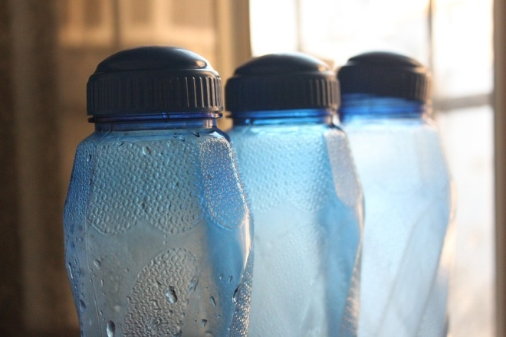
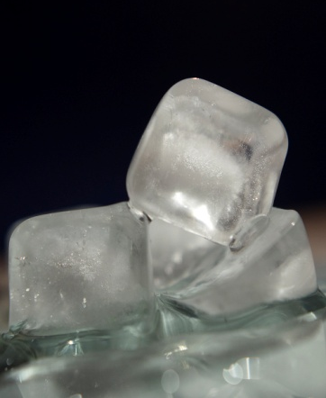
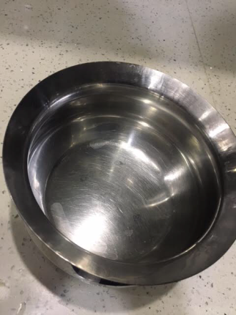
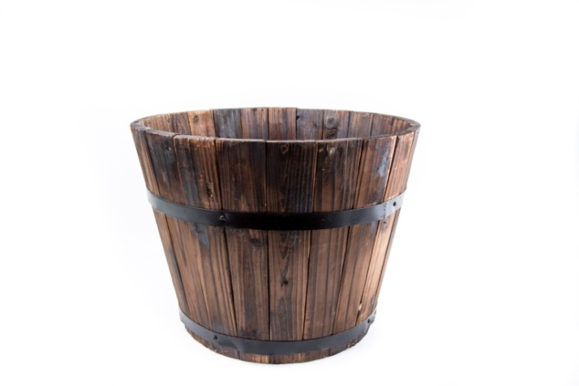
Heat Conductors
Aim:
To measure the rate of conduction in different objects.
Resources Required:
Steel container
Wooden container Plastic container copper container
Ice
Thermometer
Notes:
Setting for the activity: Indoor
Type of activity: Group activity
Image source:
Thermometer – SSSVV Gallery
Tumbler with water, Ice cubes – SSSVV Gallery
Wooden bucket - https://www.publicdomainpictures.net/en/view-image.php?image=171902&picture=wooden-bucket
Copper - https://pixabay.com/illustrations/drink-pot-teapot-old-isolated-2406237/
Plastic bottle - https://pixabay.com/en/bottle-plastic-container-water-166406/

Slide 3
Procedure
Each group will get 4 containers made up of different materials filled with water.
Measure the initial temperature of the water in the container.
Dip these different containers: steel container, wooden container, plastic container, copper container, etc with equal amount of water into the cold water.
Leave the set-up undisturbed for a minute.
Measure the temperature drop of water inside the different containers at 1-2 minute intervals to see the rate of conduction.
Notes:
Notes for Teacher - Divide the students into 3 or 4 groups.

Slide 4
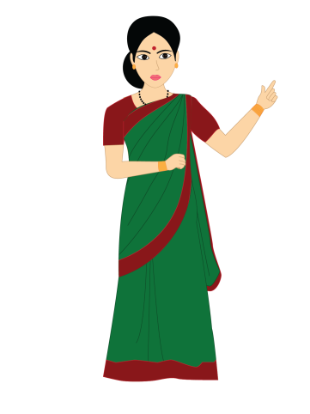
Observation
Fill this table:
Sl. No | Type of Container | Initial temperature | Drop in temperature
1 | Plastic container
2 | Wooden container
3 | Steel container
4 | Copper container
Notes:
Instructions to the teacher:
All materials have to be present before hand
The materials have to be equally distributed among the groups.
Precautions:
Care has to be taken while dealing with water.
Image - SSSVV Gallery

Slide 5
Conclusion
Helps to measure the rate of conduction in different objects.
Notes:
Image - SSSVV Gallery

Slide 6
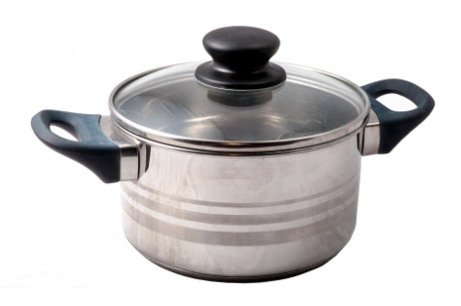
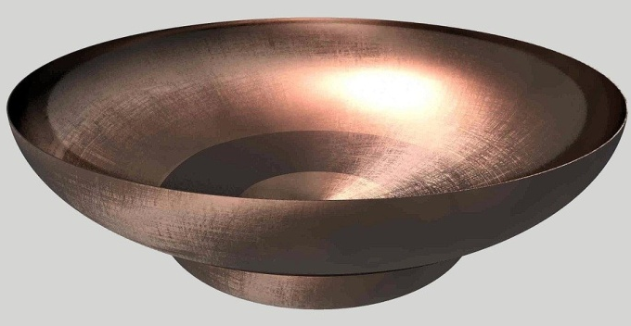
Conclusion
1. Why are the handles of cookers/frying pans made up of plastic?
ANS
The handles of the cooker/frying pan are made up of plastic because it is easy to hold the pan as plastic is a bad conductor of heat.
2. Which is a better conductor of heat- Copper or Steel?
ANS
Copper
Notes:
Copper bowl - https://pixabay.com/illustrations/dish-bowl-copper-shiny-metal-366151/
Steel utensils - https://pixabay.com/photos/pot-cookware-amp-kitchen-utensils-554068/

Slide 7
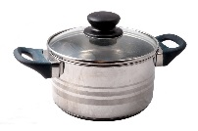
MM Index
Slide# | Thumbnail | Source and Attribution
2 |  | https://www.publicdomainpictures.net/en/view-image.php?image=171902&picture=wooden-bucket
2 |  | https://pixabay.com/illustrations/drink-pot-teapot-old-isolated-2406237/
2 |  | https://pixabay.com/en/bottle-plastic-container-water-166406/
6 |  | https://pixabay.com/photos/pot-cookware-amp-kitchen-utensils-554068/
6 |  | https://pixabay.com/illustrations/dish-bowl-copper-shiny-metal-366151/

