Slide 1
MAGNETISM

Slide 2
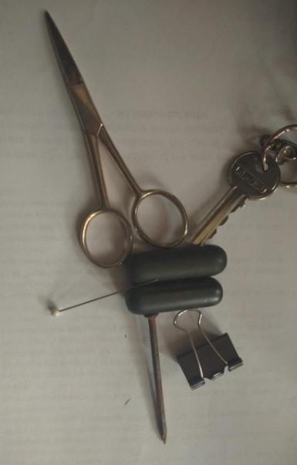
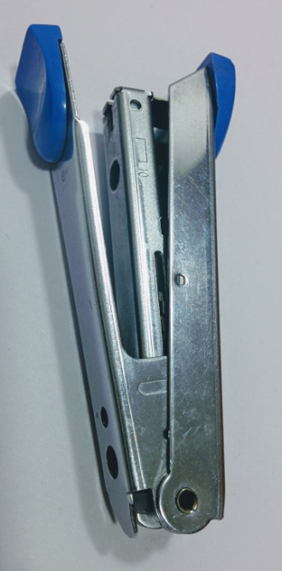
MAGNETISM
Aim:
Finding out Magnetic and Non-magnetic things in the whole school.
Resources required:
Notes:
Setting for the activity: Indoor/Outdoor
Type of activity: Individual / Group (depending upon the availability of the resource materials like magnets) Give a set (2-4) students a magnet each.
Images :
Tap : https://pixabay.com/photos/plumbing-water-pipe-plumbing-pipes-1002110/
Magnet - https://pixabay.com/vectors/magnet-horseshoe-attraction-attract-41167/
Stapler – SSSVV Gallery
Other non-magnetic material – SSSVV Gallery

Slide 3
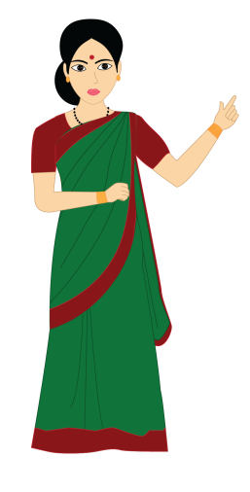
OBSERVATION
With given objects, observe and write up the findings in the below table.
Sl. No | Materials | Magnetic | Non-Magnetic
1
2
3
4
5
Notes:
Procedure:
Divide the class into three or four smaller groups.
Ask the students to make a list of magnetic things and non- magnetic things in the whole school.
The students would be given the magnets in one period and the observations reported in the next period. Students are instructed to record their observations as shown below.
Instruction to the teacher: Discipline should be maintained during the whole activity.
Resources should be equally distributed depending on the availability. All the students have to be engaged during the activity.
Students could list as many things as possible.
Image source:
Lady – SSSVV Gallery

Slide 4
Conclusion
This activity helps to understand which things are magnetic and non-magnetic.
Notes:
Image source:
Lady – SSSVV Gallery
Students : https://pixabay.com/illustrations/school-children-desks-school-4321808/

Slide 5
MAGNETISM
1. Why have you been given a magnet?
Answer
We can separate Iron objects from other materials because magnet attracts Iron.
2. Name some non- magnetic materials?
Answer
Wood, Glass, Copper, Brass etc.

Slide 6
MM Index
Slide# | Thumbnail | Source and Attribution
2 |  | Tap : https://pixabay.com/photos/plumbing-water-pipe-plumbing-pipes-1002110
2 |  | https://pixabay.com/vectors/magnet-horseshoe-attraction-attract-41167/
4 |  | https://pixabay.com/illustrations/school-children-desks-school-4321808/

