Slide 1
Keep Good Company and Become Good
-2
-1
0
+1
+2
Notes:
Students will be able to appreciate the need to discriminate between the company of positive and negative people in real life.
Value – Truth
Sub Value – Discrimination
CBSE Sub value – Insight

Slide 2
Integers
+4
+
-3
=
+1
-4
+
+3
=
-1
Notes:
Value Content:
When one positive and one negative integers are added we subtract them and put the sign of the bigger integer. [e.g. (+4) + (–3) = + 1 and (–4) + (+ 3) = – 1].
Note that association of a positive integer with a smaller negative integer has resulted in a positive integer and association of a higher negative integer with a positive number has resulted in a negative integer.

Slide 3
Integers
When you make friendship only with good people, your positive value will go up.
When you make friendship with negative people, your negative value will go up.
Notes:
Similarly in this world, when you make friendship only with good people, your positive value will go up because the good people’s good qualities will rub off on you.
On the other hand, If we are with negative people all the time, gradually we will find ourselves becoming just like them. Even if we want to maintain a positive outlook, it would be a difficult task in such situations.

Slide 4
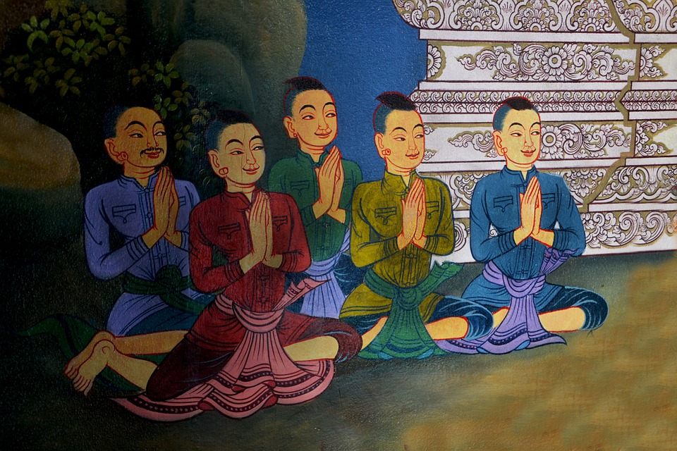
Integers
As is your company,
so you become.
Notes:
It is said, “As is your company, so you become.” The people around us affect the way we live our life.

Slide 5
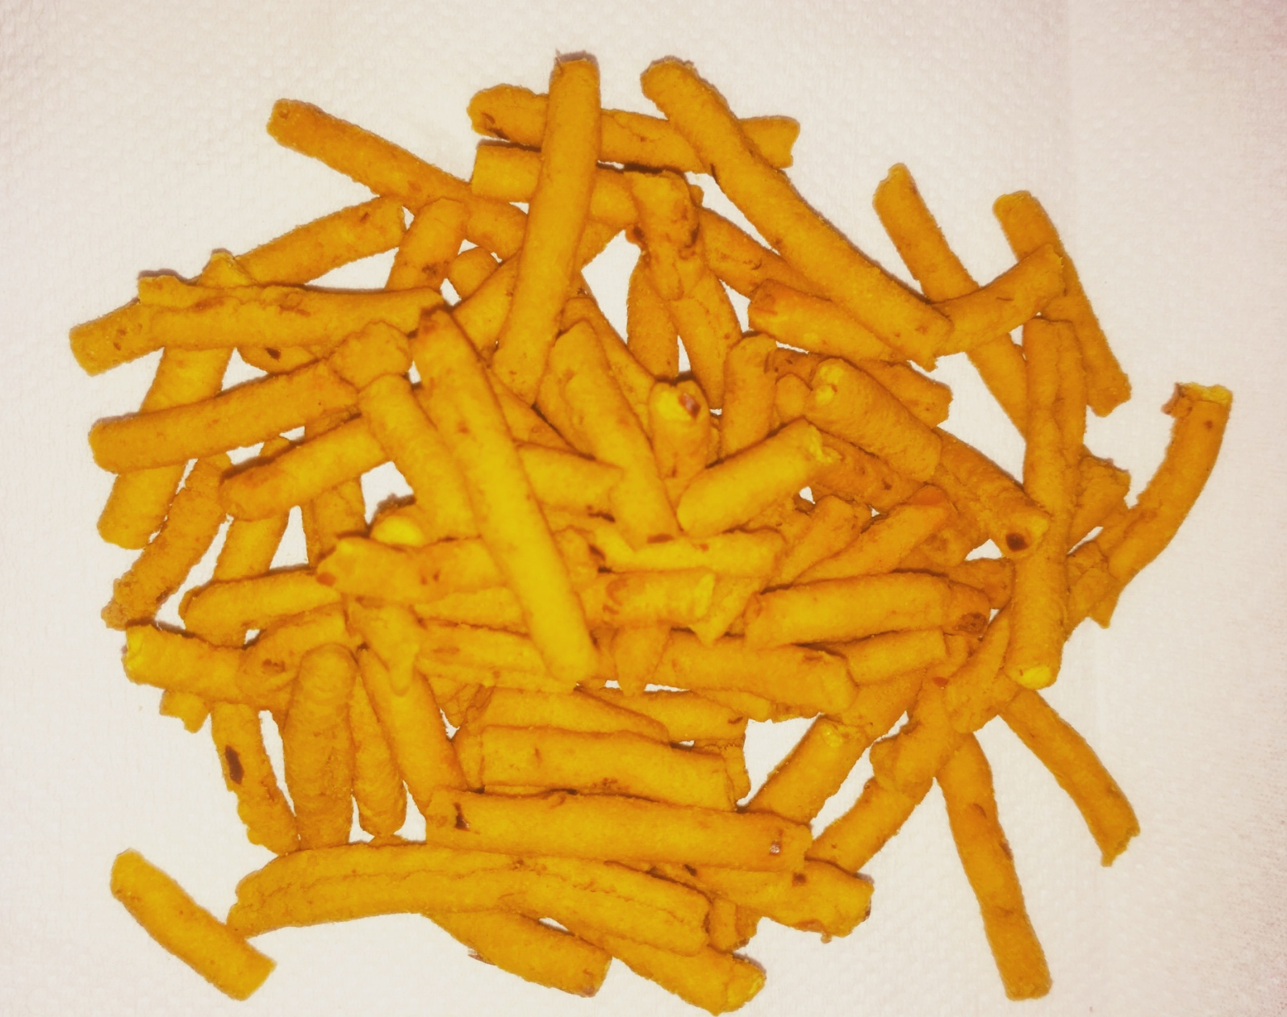
Integers
Notes:
Group Activity:
Materials reqd:
1. A plain paper / tissue paper
2. A paper in which jasmine flower was wrapped and kept over night
3. A paper in which samosa / any good smelling food wrapped and kept over night
4. A paper in which any bad smelling item / any rotten fish / food wrapped and kept over night
Procedure:
Pass the first paper around and ask them if the paper has any aroma / smell
Elicit the answers
Pass the 2nd and 3rd papers and ask them to identify the smell and how it smelt. Good or bad?
Finally pass the last paper and ask them to identify the smell and how it smelt. Good or bad?
Elicit which paper they liked. Paper that smelt good or the one that smelt bad?
To be explained by the Teacher:
A piece of plain paper does not have an aroma of its own. But if the same paper is used to pack samosa or dry fish or jasmine flowers, it picks up the smell associated with them.
However good we are (like the plain paper), we acquire good or bad qualities by our respective association. If we ever do a bad act that ruins our name due to bad association (like the smelly paper), it will be very difficult to get a good name from society again. It takes years to build a good name but can take just a moment to get a bad name.
We can remove the blemish from our names only through the filter of good company and repentance, making a promise never to repeat it again.
Vladimir Lenin, the great leader of Russia said – “Tell me who your friends are and I will tell you who you are”.
Children, always choose your friends carefully. Choose good people as friends so that your friendship can be mutually beneficial. Stay away from negative people.

Slide 6
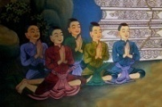
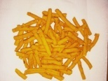
MM Index
Slide# | Thumbnail | Source and Attribution
3 |  | https://pixabay.com/illustrations/businessman-teacher-cartoon-lecture-607834/
4 |  | https://pixabay.com/illustrations/praying-men-five-religion-pray-1051079/
5 |  | https://www.srisathyasaividyavahini.org/alfresco/d/direct/workspace/SpacesStore/e6673a0f-5850-4c77-922d-6e74cc480fb0/TIFFIN?ticket=TICKET_c062b3f670418ac681893dddd6de901e450e6373

