Slide 1
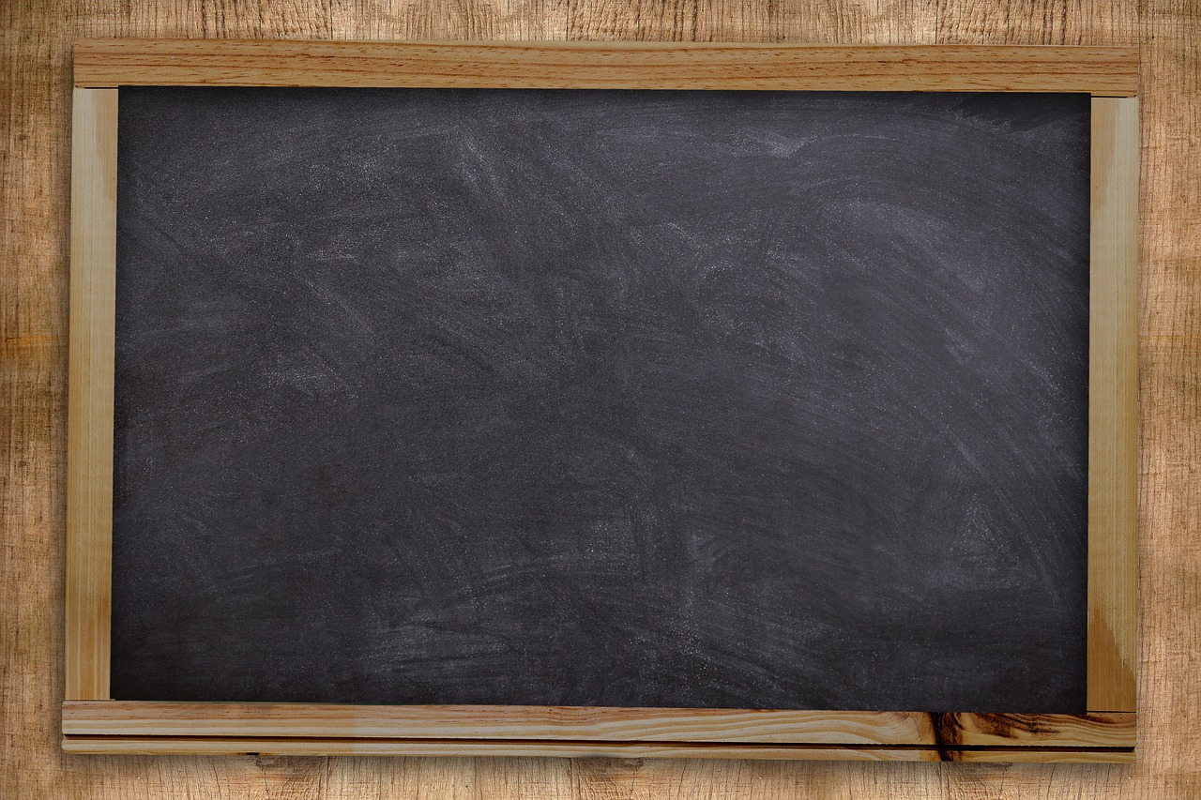
Introduction
To Nouns
Notes:
Notes for Teacher - < Information for further reference or explanation >
Suggestions: <Ideas/ Images/ Animations / Others – To make better representation of the content >
Source of Multimedia used in this slide - <Please provide source URL where we find the image and the license agreement>
<black board> <https://pixabay.com/illustrations/blackboard-board-school-chalkboard-5639925/>

Slide 2
Noun
Noun is a naming word
Names
Person
Thing
Answers the question
What?
Place
Animal
Who?
Notes:
Notes for Teacher - < Information for further reference or explanation >
Suggestions: <Ideas/ Images/ Animations / Others – To make better representation of the content >
Source of Multimedia used in this slide - <Please provide source URL where we find the image and the license agreement>

Slide 3
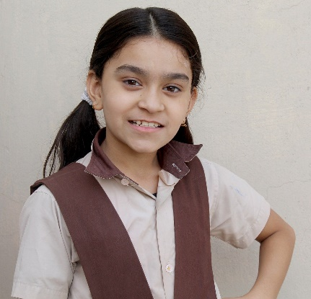
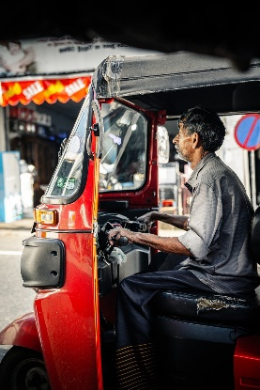
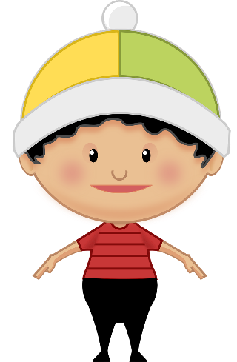
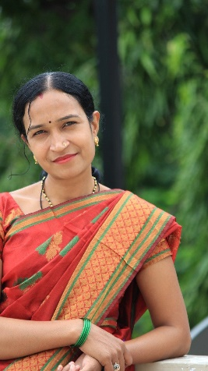
Person
girl
driver
lawyer
Manoj
Dr Rao
Mrs Kusum
Notes:
Notes for Teacher - < Information for further reference or explanation >
Suggestions: <Ideas/ Images/ Animations / Others – To make better representation of the content >
Source of Multimedia used in this slide - <Please provide source URL where we find the image and the license agreement>
<Girl> - <https://pixabay.com/photos/school-indian-school-school-dress-3760340/>
<Driver> - <https://pixabay.com/photos/driver-man-old-adult-tuk-tuk-taxi-5083584/ >
<Lawyer> - <https://pixabay.com/vectors/comic-characters-crime-justice-law-2025788/>
<Boy> - <https://pixabay.com/vectors/boy-kid-child-cartoon-teen-happy-2025729/>
<Doctor> - <https://pixabay.com/illustrations/doctor-laptop-office-medical-male-3212067/>
<Indian lady> - <https://pixabay.com/photos/women-indian-female-mother-woman-4419735/ >

Slide 4
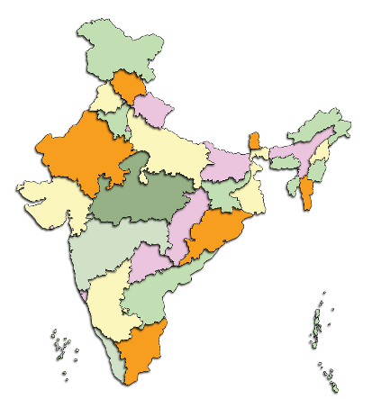
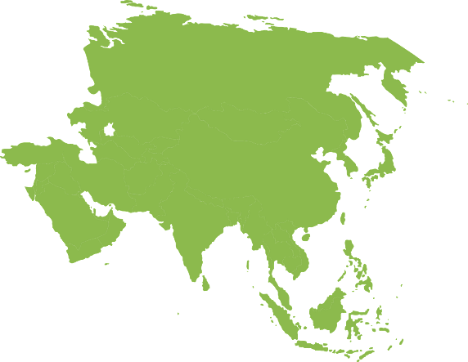
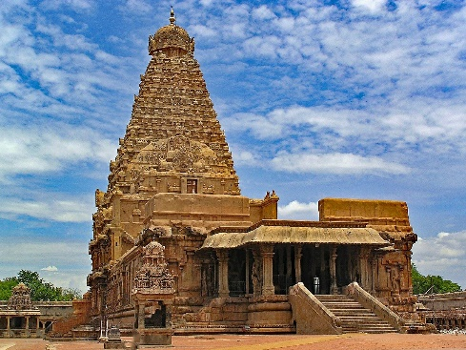
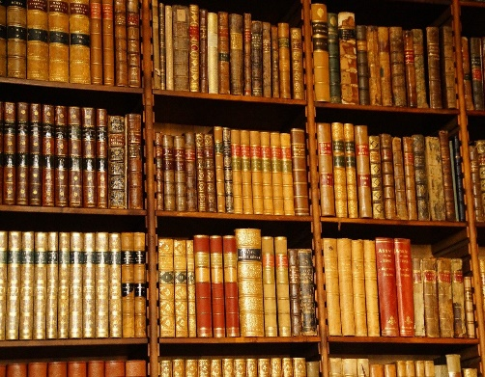
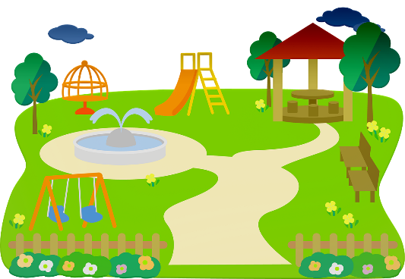
Place
school
India
Asia
playground
temple
library
Notes:
Notes for Teacher - < Information for further reference or explanation >
Suggestions: <Ideas/ Images/ Animations / Others – To make better representation of the content >
Source of Multimedia used in this slide - <Please provide source URL where we find the image and the license agreement>
<School> - <https://pixabay.com/illustrations/school-students-children-board-4527712/ >
<India> - <https://pixabay.com/illustrations/map-india-country-geography-5505725/ >
<Asia> - <https://pixabay.com/vectors/map-asia-continent-rotated-307197/ >
<temple> - <https://pixabay.com/photos/brihadishvara-temple-thanjavur-2358280/>
<Playground> - <https://pixabay.com/illustrations/park-play-slide-children-4257026/>
<Library> - <https://pixabay.com/photos/library-reading-room-books-spine-3776935/>

Slide 5
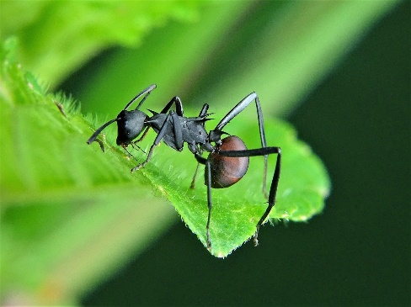
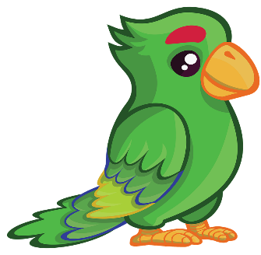
Animal
fish
elephant
butterfly
duck
ant
parrot
Notes:
Notes for Teacher - < Information for further reference or explanation >
Suggestions: <Ideas/ Images/ Animations / Others – To make better representation of the content >
Source of Multimedia used in this slide - <Please provide source URL where we find the image and the license agreement>
<Fish> - <https://pixabay.com/vectors/fish-bubbles-silhouette-eye-look-305723/>
<Elephant> - <https://pixabay.com/illustrations/elephant-cartoon-cute-wildlife-3985060/>
<Butterfly> - <https://pixabay.com/illustrations/butterfly-blue-clip-art-insect-2778480/>
<Duck> - <https://pixabay.com/illustrations/duck-animal-vector-easter-5217739/>
<Ant> - <https://pixabay.com/photos/ant-ants-insect-nature-wildlife-3036843/ >
<Parrot> - <https://pixabay.com/illustrations/bird-parrots-wildlife-animal-3987385/ >

Slide 6
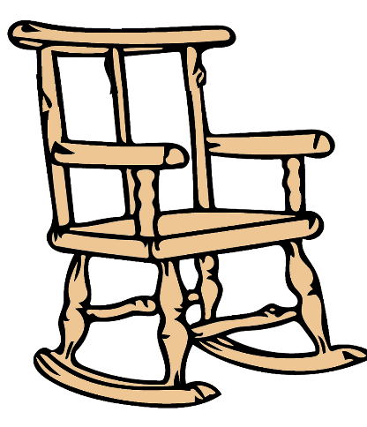
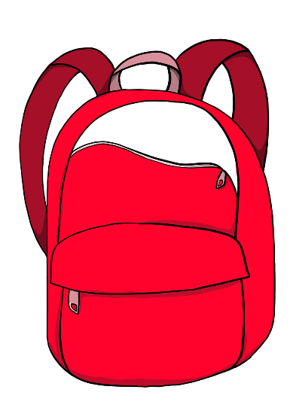
Thing
flowers
chair
bag
trees
fruit
bottle
Notes:
Notes for Teacher - < Information for further reference or explanation >
Suggestions: <Ideas/ Images/ Animations / Others – To make better representation of the content >
Source of Multimedia used in this slide - <Please provide source URL where we find the image and the license agreement>
<Flowers> - <https://pixabay.com/vectors/clip-art-flor-flora-flower-nature-2026797/ >
<Chair> - <https://pixabay.com/illustrations/furniture-chair-back-seats-vector-2315966/>
<Bag> - <https://pixabay.com/illustrations/school-bag-schoolbag-backpack-4308691/>
<Trees> - <https://pixabay.com/illustrations/clipart-tree-green-nature-wood-3419895/>
<Bowl of fruits> - <https://pixabay.com/illustrations/fruit-basket-bowl-cool-cherries-5004282/>
<Bottle> - <https://pixabay.com/illustrations/water-bottle-water-plastic-bottle-3927420/>

Slide 7
MM INDEX
Slide # | Thumbnail | Source link and Attribution
1 |  | <black board> https://pixabay.com/illustrations/blackboard-board-school-chalkboard-5639925/
3 |  | <Girl> - https://pixabay.com/photos/school-indian-school-school-dress-3760340/ <Driver> - https://pixabay.com/photos/driver-man-old-adult-tuk-tuk-taxi-5083584/ <Lawyer> - https://pixabay.com/vectors/comic-characters-crime-justice-law-2025788/ <Boy> - https://pixabay.com/vectors/boy-kid-child-cartoon-teen-happy-2025729/ <Doctor> - https://pixabay.com/illustrations/doctor-laptop-office-medical-male-3212067/ <Indian lady> - https://pixabay.com/photos/women-indian-female-mother-woman-4419735/
4 |  | <School> - https://pixabay.com/illustrations/school-students-children-board-4527712/ <India> - https://pixabay.com/illustrations/map-india-country-geography-5505725/ <Asia> - https://pixabay.com/vectors/map-asia-continent-rotated-307197/ <temple> - https://pixabay.com/photos/brihadishvara-temple-thanjavur-2358280/ <Playground> - https://pixabay.com/illustrations/park-play-slide-children-4257026/ <Library> - https://pixabay.com/photos/library-reading-room-books-spine-3776935/
5 |  | <Fish> - https://pixabay.com/vectors/fish-bubbles-silhouette-eye-look-305723/ <Elephant> - https://pixabay.com/illustrations/elephant-cartoon-cute-wildlife-3985060/ <Butterfly> - https://pixabay.com/illustrations/butterfly-blue-clip-art-insect-2778480/ <Duck> - https://pixabay.com/illustrations/duck-animal-vector-easter-5217739/ <Ant> - https://pixabay.com/photos/ant-ants-insect-nature-wildlife-3036843/ <Parrot> - https://pixabay.com/illustrations/bird-parrots-wildlife-animal-3987385/
6 |  | <Flowers> - https://pixabay.com/vectors/clip-art-flor-flora-flower-nature-2026797/ <Chair> - https://pixabay.com/illustrations/furniture-chair-back-seats-vector-2315966/ <Bag> - https://pixabay.com/illustrations/school-bag-schoolbag-backpack-4308691/ <Trees> - https://pixabay.com/illustrations/clipart-tree-green-nature-wood-3419895/ <Bowl of fruits> - https://pixabay.com/illustrations/fruit-basket-bowl-cool-cherries-5004282/ <Bottle> - https://pixabay.com/illustrations/water-bottle-water-plastic-bottle-3927420/
Notes:
Notes for Teacher - < Information for further reference or explanation >
Suggestions: <Ideas/ Images/ Animations / Others – To make better representation of the content >
Source of Multimedia used in this slide - <Please provide source URL where we find the image and the license agreement>

