Slide 1
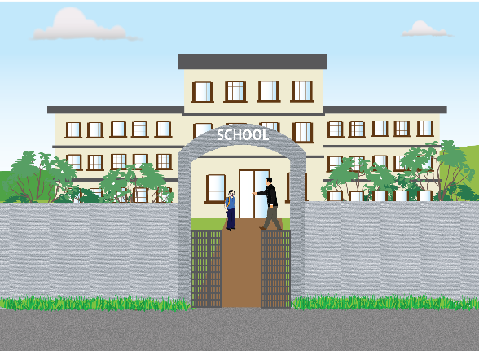
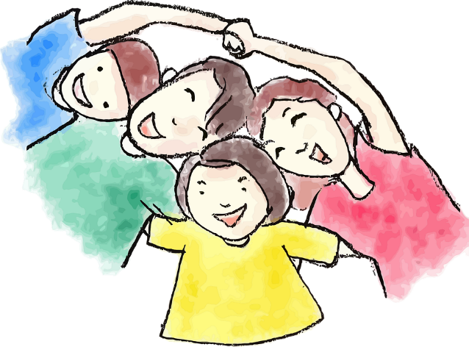
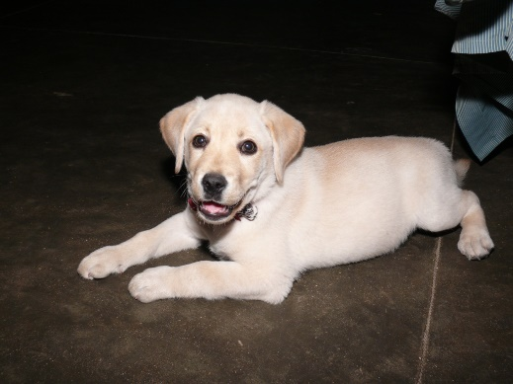
Testing Usage Of Nouns
Notes:
Notes for Teacher - < Information for further reference or explanation >
Suggestions: <Ideas/ Images/ Animations / Others – To make better representation of the content >
Source of Multimedia used in this slide - <Please provide source URL where we find the image and the license agreement>
<School> - <SSSVV Image Gallery: Search Keyword “school”>
<Children> - <https://pixabay.com/vectors/boy-child-comic-characters-dad-1300136/>
<Dog> - <SSSVV Image Gallery: Search Keyword “dog”>
<Ball> - <https://pixabay.com/vectors/football-ball-sport-soccer-round-157930/>

Slide 2
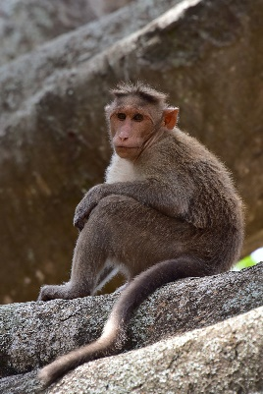
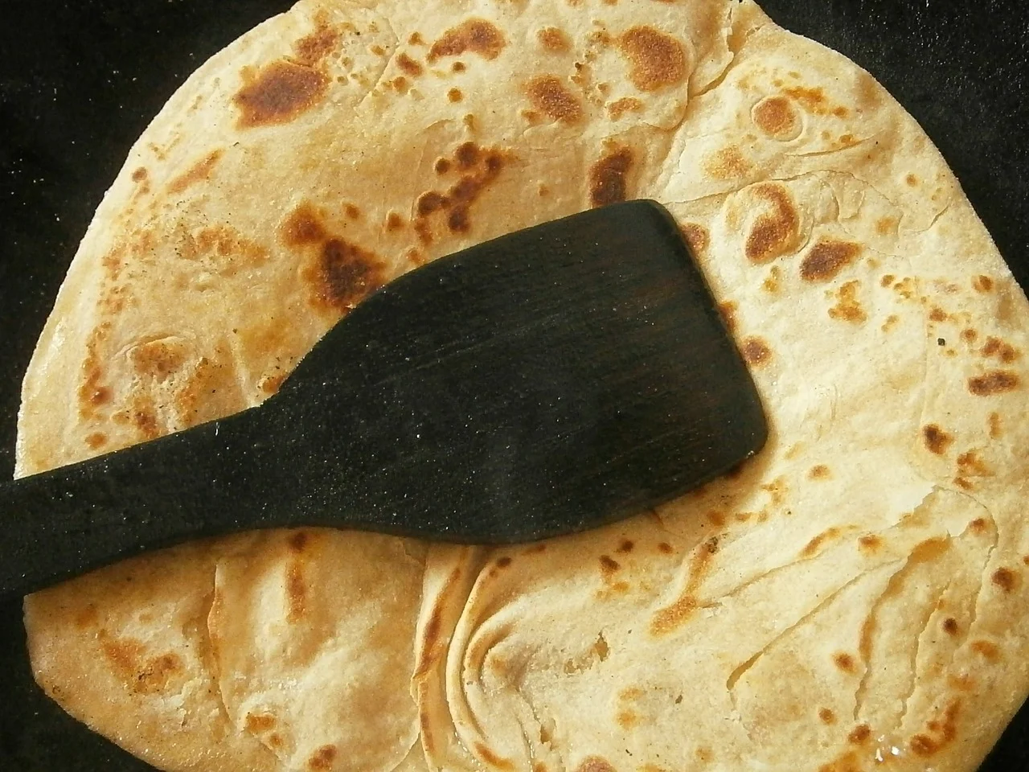
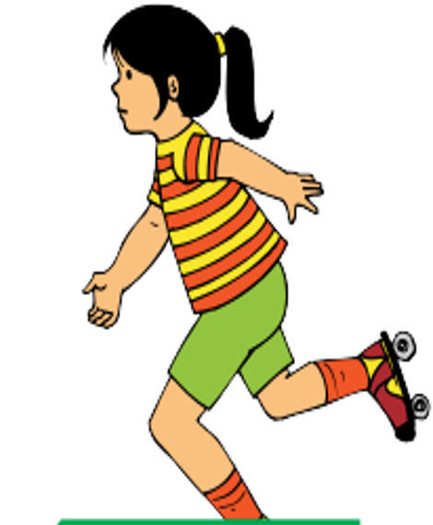
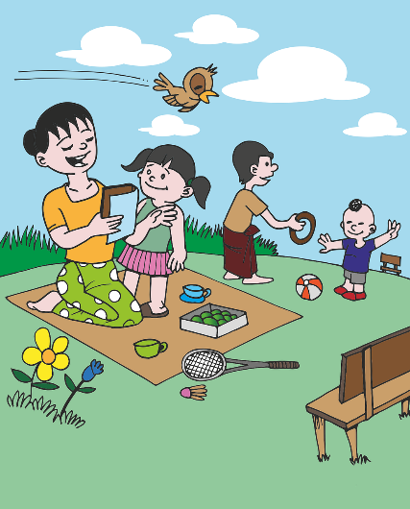
Fill in the blanks
Use the nouns in the help box below.
park
Mr Ali
chapatis
Suma
monkey
I have ________ for my lunch.
He saw a ________ on a tree.
The children played in the _____ .
Her name is ______ .
______ is a postman.
chapatis
monkey
park
Suma
Mr Ali
Notes:
Notes for Teacher - < Information for further reference or explanation >
Suggestions: <Ideas/ Images/ Animations / Others – To make better representation of the content >
Source of Multimedia used in this slide - <Please provide source URL where we find the image and the license agreement>
<Man> <SSSVV- Farmer Story farmer-story-8512 Farmer story, painting, water paint, talking, entrance, father son, boy, permission, entry,>
<chappati> - <https://pixabay.com/photos/chapati-bread-indian-pancakes-food-489254/>
<monkey> <SSSVV - Macaque macaque-6887 Indian Monkey, Bonnet macaque>
<park> <https://pixabay.com/vectors/games-park-child-children-grass-1459575/>
<girl> <SSSVV - skating girl skating-girl-7659 skating girl>

Slide 3
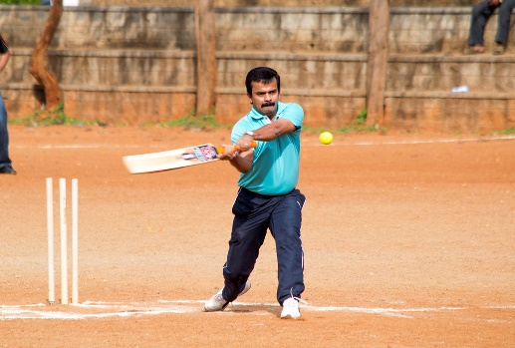
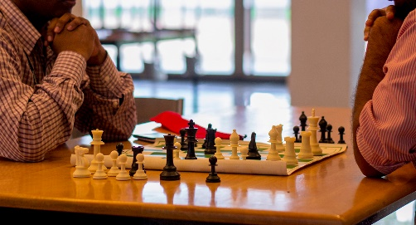
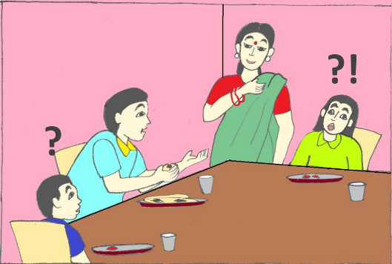
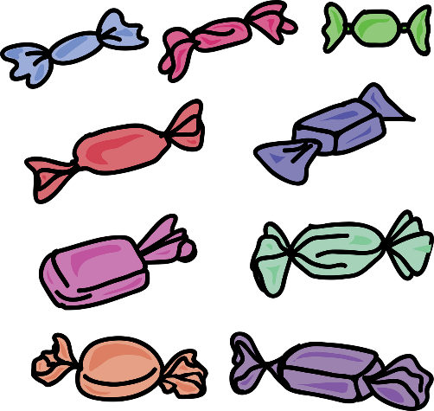
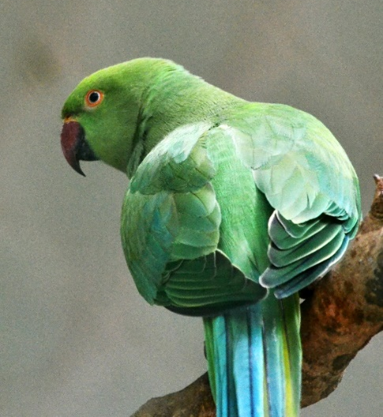
Complete each sentence with a noun
I like to play ______.
The boy has a _____.
The teacher gave me a _________.
He called my _______.
They have a pet ______.
chess
bat
chocolate
parents
parrot
Notes:
Notes for Teacher - < Information for further reference or explanation >
Suggestions: <Ideas/ Images/ Animations / Others – To make better representation of the content >
Source of Multimedia used in this slide - <Please provide source URL where we find the image and the license agreement>
<chess> <SSSVV - Chess chess-5508 Indoor Games. Board Games>
<boy with bat> <SSSVV - Cricket cricket-5505 Outdoor games>
<toffee> <https://pixabay.com/vectors/cartoon-candy-sweet-food-sugar-2462970/>
<parents> <SSSVV - Family family family, father,mother, children, home>
<parrot> <SSSVV - Parrot parrot Animals, Birds, Parrot, red-ringed, green>

Slide 4
Nouns
Underline the nouns. Draw a picture for each noun in each box
1. Look, the bus is coming.
2. The bag is new.
Notes:
Notes for Teacher - < Information for further reference or explanation >
Suggestions: <Ideas/ Images/ Animations / Others – To make better representation of the content >
Source of Multimedia used in this slide - <Please provide source URL where we find the image and the license agreement>
<Bus> - <https://pixabay.com/vectors/schoolbus-city-bus-bus-36952/ >
<Bag> - < https://pixabay.com/vectors/gift-bag-shopping-retail-sale-312761/>

Slide 5
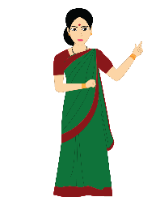
Nouns
Underline the nouns. Draw a picture for each noun in each box
3. I gave a flower to the teacher.
4. The boy ate an apple.
Notes:
Notes for Teacher - < Information for further reference or explanation >
Suggestions: <Ideas/ Images/ Animations / Others – To make better representation of the content >
Source of Multimedia used in this slide - <Please provide source URL where we find the image and the license agreement>
<Woman> - <SSSVV Image Gallery: Search Keyword “teacher”>
<Flower> - <https://pixabay.com/vectors/edelweiss-flower-nature-plant-311579/>
<boy> - <https://pixabay.com/vectors/stick-male-figure-looking-right-29937/>
<Apple> - <https://pixabay.com/vectors/apple-leaf-fresh-fruit-food-sweet-306078/ >

Slide 6
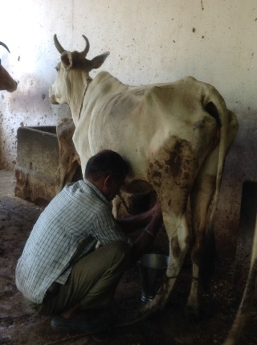
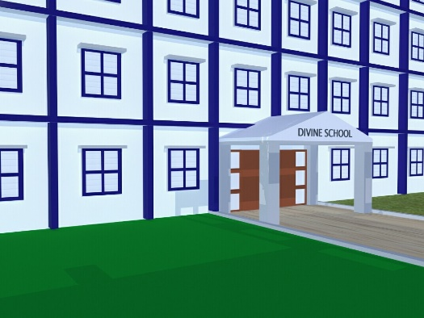
Nouns
1.father: _________________________
2.cow: ________________________
3.school: ________________________
My father goes to the office.
The cow gives us milk.
My school is big.
Notes:
Notes for Teacher - < Information for further reference or explanation >
Suggestions: <Ideas/ Images/ Animations / Others – To make better representation of the content >
Source of Multimedia used in this slide - <Please provide source URL where we find the image and the license agreement>
<Working> - <https://pixabay.com/illustrations/man-work-work-from-home-avatar-5678220/>
<milking cow> <Milking cow, cow, calf, occupation, milking cow by hand, dairy cow, milker, milcher, milk man, animal>
<school building> <SSSVV - School building, Building, Education>

Slide 7
MM INDEX
Slide # | Thumbnail | Source link and Attribution
1 |  | <Children> - https://pixabay.com/vectors/boy-child-comic-characters-dad-1300136/ <Ball> - https://pixabay.com/vectors/football-ball-sport-soccer-round-157930/
2 |  | <chappati> - https://pixabay.com/photos/chapati-bread-indian-pancakes-food-489254/ <park> https://pixabay.com/vectors/games-park-child-children-grass-1459575/
3 |  | <toffee> https://pixabay.com/vectors/cartoon-candy-sweet-food-sugar-2462970/
4 |  | <Bus> - https://pixabay.com/vectors/schoolbus-city-bus-bus-36952/ <Bag> - < https://pixabay.com/vectors/gift-bag-shopping-retail-sale-312761/>
5 |  | <Flower> - https://pixabay.com/vectors/edelweiss-flower-nature-plant-311579/ <boy> - https://pixabay.com/vectors/stick-male-figure-looking-right-29937/ <Apple> - https://pixabay.com/vectors/apple-leaf-fresh-fruit-food-sweet-306078/
6 |  | <Working> - https://pixabay.com/illustrations/man-work-work-from-home-avatar-5678220/
Notes:
Notes for Teacher - < Information for further reference or explanation >
Suggestions: <Ideas/ Images/ Animations / Others – To make better representation of the content >
Source of Multimedia used in this slide - <Please provide source URL where we find the image and the license agreement>

