Slide 1
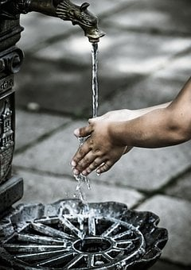
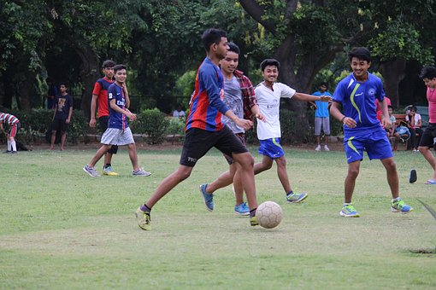
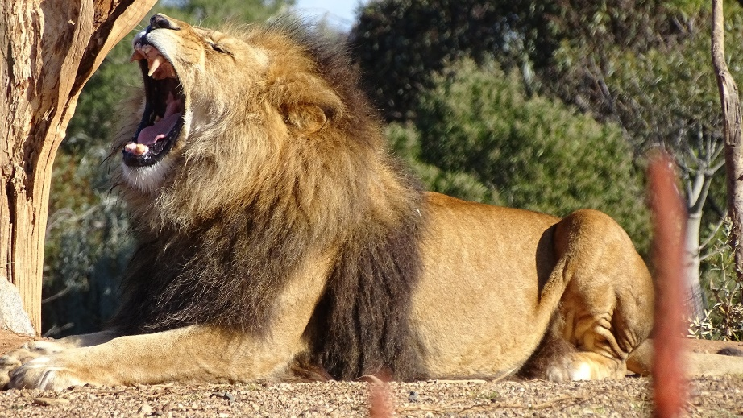
Introduction to Verbs
Notes:
Notes for Teacher - < Information for further reference or explanation >
Suggestions: <Ideas/ Images/ Animations / Others – To make better representation of the content >
Source of Multimedia used in this slide -
Wash: https://pixabay.com/photos/hand-washing-hygiene-health-child-3783004/
Lion: https://pixabay.com/photos/lion-roaring-lion-big-cat-cat-2635913/
Play: https://pixabay.com/photos/children-football-playing-indian-2413413/

Slide 2
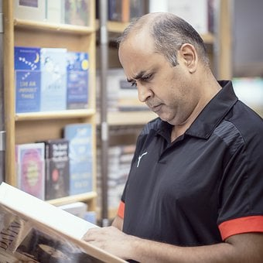
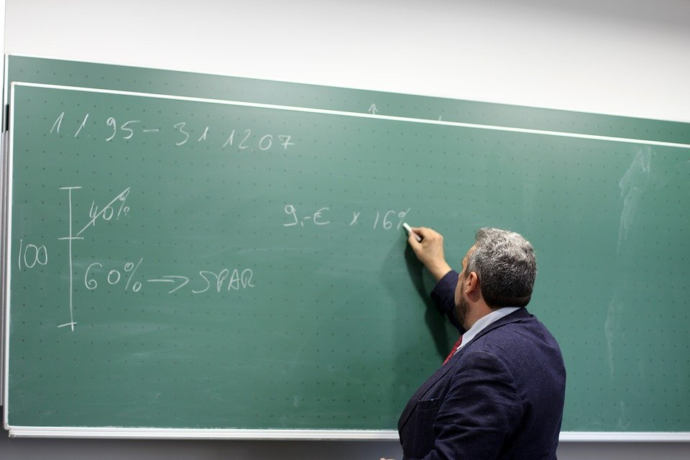
Guess what each person is doing?
Reading a book
Writing on the board
Notes:
Notes for Teacher - < Information for further reference or explanation >
Suggestions: <Ideas/ Images/ Animations / Others – To make better representation of the content >
Source of Multimedia used in this slide –
Reading: https://pixabay.com/photos/dharmendra-rai-mind-map-trainer-6732974/
Writing: https://pixabay.com/photos/teacher-board-tutor-school-2454399/

Slide 3
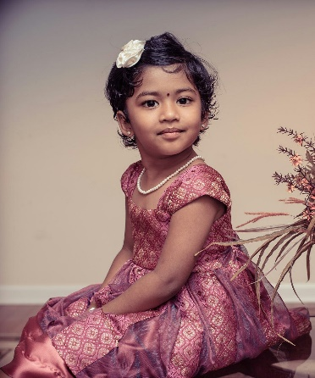
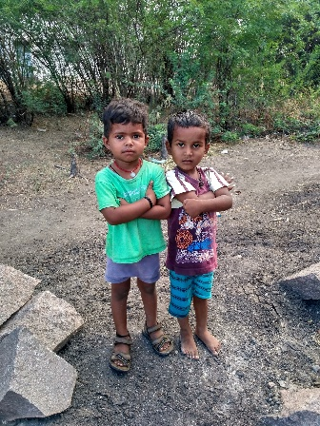
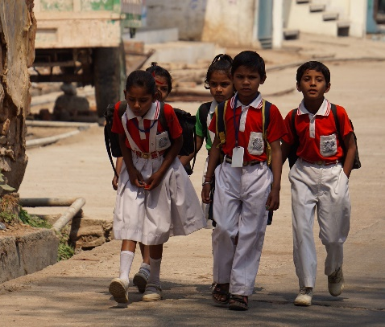
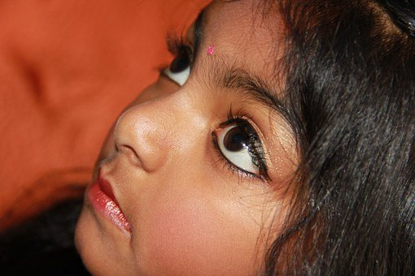
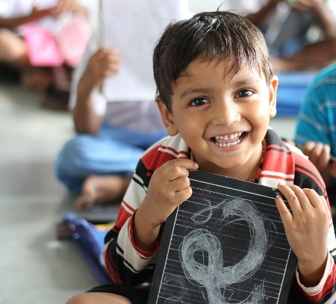
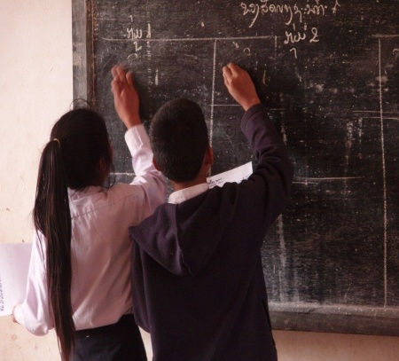
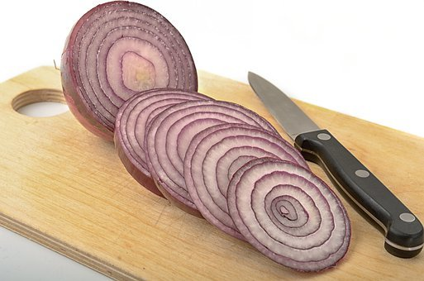
Actions – Daily Activities
Sit
Stand
Walk
Look
Listen
Write
Count
Wash
Cut
Dance
Notes:
Notes for Teacher - < Information for further reference or explanation >
Suggestions: <Ideas/ Images/ Animations / Others – To make better representation of the content >
Source of Multimedia used in this slide -
Sit: https://pixabay.com/photos/children-portrait-artistic-girl-1706121/
Stand: https://pixabay.com/photos/indian-indians-children-poor-boys-3602851/
Walk: https://pixabay.com/photos/indian-holiday-school-children-4393133/
Look: https://pixabay.com/photos/child-children-face-face-indian-193984/
Listen: https://pixabay.com/photos/boy-school-laughing-children-330582/
Write: https://pixabay.com/photos/students-primary-school-town-laos-1177711/
Count: https://pixabay.com/vectors/puzzle-math-logic-mathematics-kids-4757816/
Wash: https://pixabay.com/photos/hand-washing-hygiene-health-child-3783004/
Cut: https://pixabay.com/photos/foods-onion-vegetable-ingredient-4869863/
Dance: https://pixabay.com/vectors/silhouette-indian-dancer-beautiful-3837379/

Slide 4
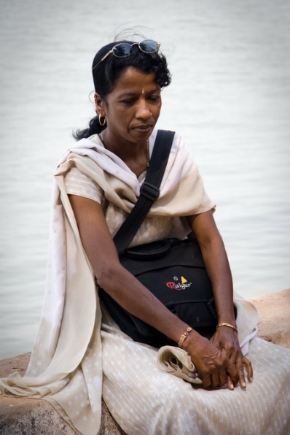
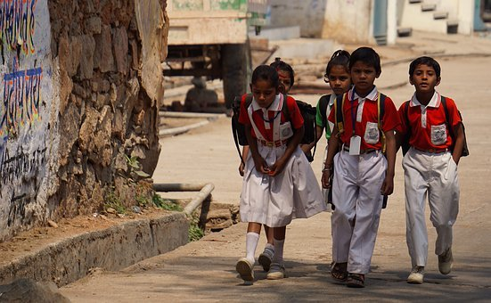
What is a Verb?
Verbs or doing words tell us about actions, movements and feelings
Sit
Walk
Worry
Notes:
Notes for Teacher - < Information for further reference or explanation >
Suggestions: <Ideas/ Images/ Animations / Others – To make better representation of the content >
Source of Multimedia used in this slide -
Sit: https://pixabay.com/photos/children-portrait-artistic-girl-1706121/
Worry: https://www.flickr.com/photos/32021211@N02/3294761927 By Sveta Suvorina
Walk: https://pixabay.com/photos/indian-holiday-school-children-4393133/

Slide 5
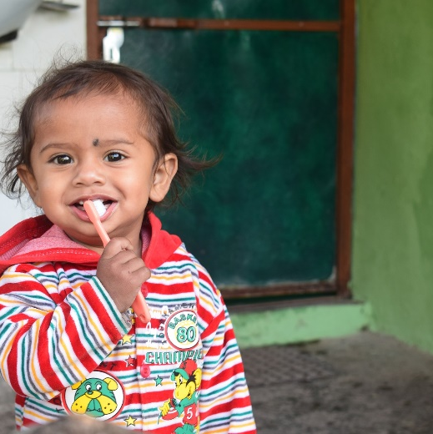
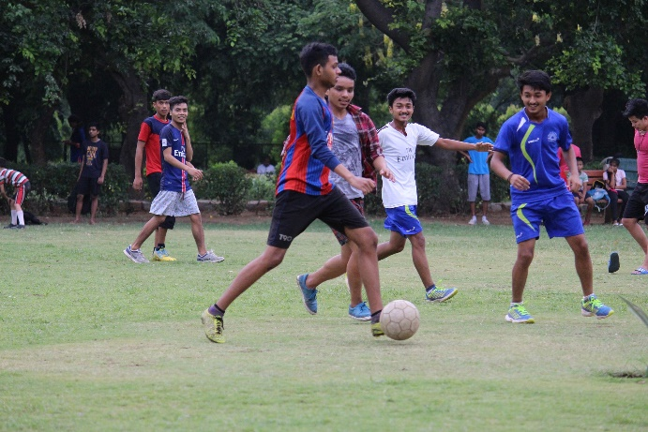
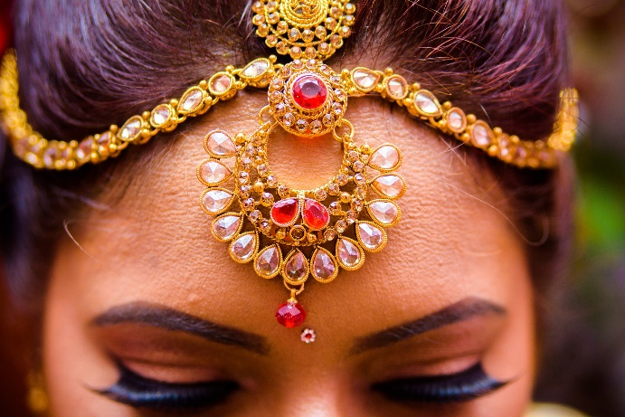
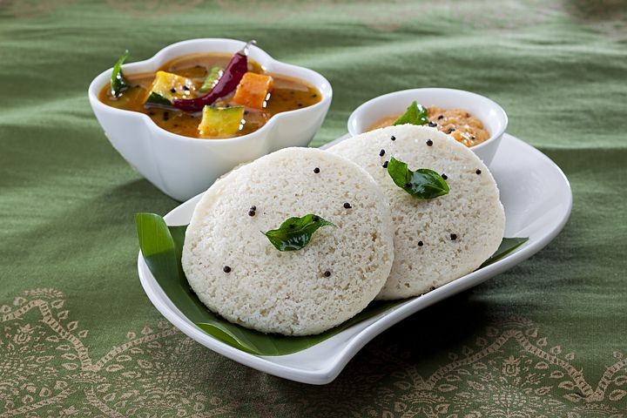
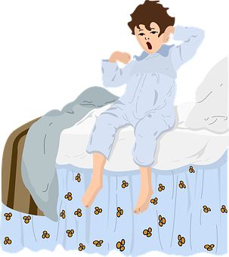
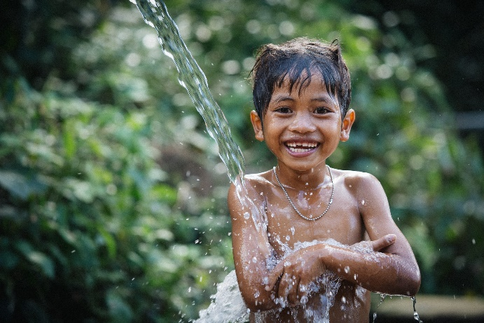
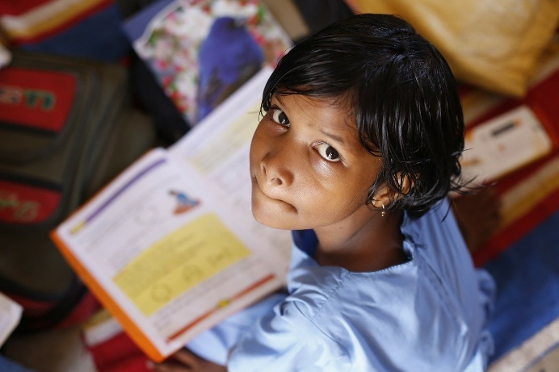
Verbs - Daily Activities
go to school
brush teeth
play
get dressed
eat breakfast
wake up
take a bath
read
Notes:
Notes for Teacher - < Information for further reference or explanation >
Suggestions: <Ideas/ Images/ Animations / Others – To make better representation of the content >
Source of Multimedia used in this slide -
Go to school: https://pixabay.com/photos/indian-holiday-school-children-4393133/
Eat breakfast: https://pixabay.com/photos/breakfast-idli-indian-foods-2408818/
Brush teeth: https://pixabay.com/photos/little-kid-brushing-teeth-child-4178224/
Play: https://pixabay.com/photos/children-football-playing-indian-2413413/
Get dressed: https://pixabay.com/photos/mehendi-bangles-wedding-jewelry-4004298/
Wake up: https://pixabay.com/vectors/blue-in-the-morning-blanket-boy-2759824/
Read: https://pixabay.com/photos/children-infant-girl-school-306607/
Take a bath: https://pixabay.com/photos/child-bath-boy-little-boy-bathing-5706430/

Slide 6
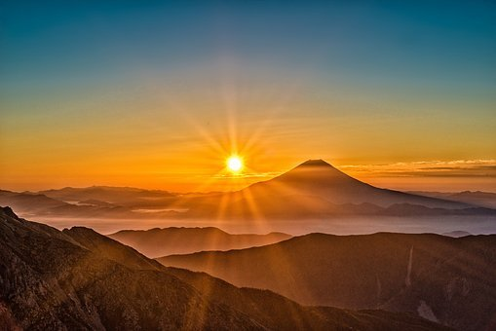
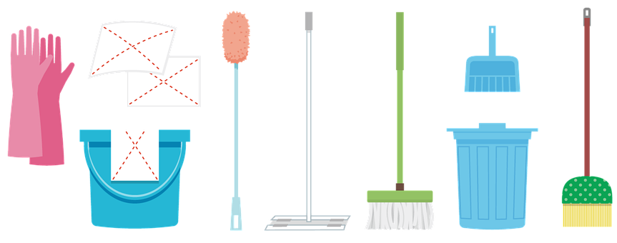
Examples in Sentence Form
Sun rises in the east
I clean my room
I drink milk in the morning
I play with my
friends
Notes:
Notes for Teacher - < Information for further reference or explanation >
Suggestions: <Ideas/ Images/ Animations / Others – To make better representation of the content >
Source of Multimedia used in this slide -
1.Sunrise: https://pixabay.com/photos/mount-fuji-japan-volcano-mountain-2297961/
2.Drink milk: https://pixabay.com/photos/milk-glass-drink-fresh-beverage-435295/
3.Clean: https://pixabay.com/illustrations/gloves-bucket-mop-broom-utensils-5545358/
4.Play: https://pixabay.com/photos/children-football-playing-indian-2413413/

Slide 7
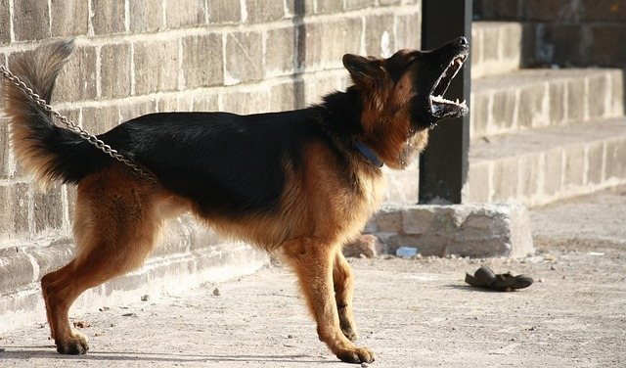
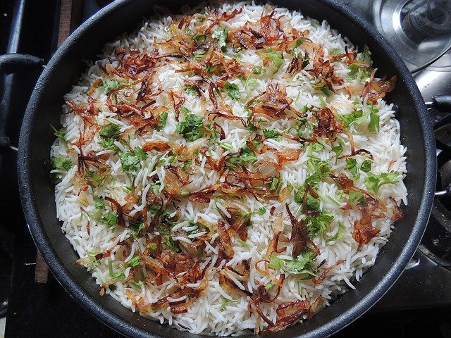
Examples in Sentence Form
Dogs bark at strangers
The lion roars
My brother cooks tasty biryani
Notes:
Notes for Teacher - < Information for further reference or explanation >
Suggestions: <Ideas/ Images/ Animations / Others – To make better representation of the content >
Source of Multimedia used in this slide -
Lion: https://pixabay.com/photos/lion-roaring-lion-big-cat-cat-2635913/
Dog: https://pixabay.com/photos/german-shepherd-dog-barking-guard-166972/
Biriyani: https://pixabay.com/photos/biryani-rice-food-indian-cuisine-1141444/

Slide 8
MM INDEX
Slide # | Thumbnail | Source link and Attribution
1 |  | Wash: https://pixabay.com/photos/hand-washing-hygiene-health-child-3783004/ Lion: https://pixabay.com/photos/lion-roaring-lion-big-cat-cat-2635913/ Play: https://pixabay.com/photos/children-football-playing-indian-2413413/
2 |  | Reading: https://pixabay.com/photos/dharmendra-rai-mind-map-trainer-6732974/ Writing: https://pixabay.com/photos/teacher-board-tutor-school-2454399/
3 |  | Sit: https://pixabay.com/photos/children-portrait-artistic-girl-1706121/ Stand: https://pixabay.com/photos/indian-indians-children-poor-boys-3602851/ Walk: https://pixabay.com/photos/indian-holiday-school-children-4393133/ Look: https://pixabay.com/photos/child-children-face-face-indian-193984/ Listen: https://pixabay.com/photos/boy-school-laughing-children-330582/ Write: https://pixabay.com/photos/students-primary-school-town-laos-1177711/ Count: https://pixabay.com/vectors/puzzle-math-logic-mathematics-kids-4757816/ Wash: https://pixabay.com/photos/hand-washing-hygiene-health-child-3783004/ Cut: https://pixabay.com/photos/foods-onion-vegetable-ingredient-4869863/ Dance: https://pixabay.com/vectors/silhouette-indian-dancer-beautiful-3837379/
4 |  | Sit: https://pixabay.com/photos/children-portrait-artistic-girl-1706121/ Worry: https://www.flickr.com/photos/32021211@N02/3294761927 By Sveta Suvorina Walk: https://pixabay.com/photos/indian-holiday-school-children-4393133/
5 |  | Go to school: https://pixabay.com/photos/indian-holiday-school-children-4393133/ Eat breakfast: https://pixabay.com/photos/breakfast-idli-indian-foods-2408818/ Brush teeth: https://pixabay.com/photos/little-kid-brushing-teeth-child-4178224/ Play: https://pixabay.com/photos/children-football-playing-indian-2413413/ Get dressed: https://pixabay.com/photos/mehendi-bangles-wedding-jewelry-4004298/ Wake up: https://pixabay.com/vectors/blue-in-the-morning-blanket-boy-2759824/ Read: https://pixabay.com/photos/children-infant-girl-school-306607/
6 |  | 1.Sunrise: https://pixabay.com/photos/mount-fuji-japan-volcano-mountain-2297961/ 2.Drink milk: https://pixabay.com/photos/milk-glass-drink-fresh-beverage-435295/ 3.Clean: https://pixabay.com/illustrations/gloves-bucket-mop-broom-utensils-5545358/ 4.Play: https://pixabay.com/photos/children-football-playing-indian-2413413/
7 |  | Lion: https://pixabay.com/photos/lion-roaring-lion-big-cat-cat-2635913/ Dog: https://pixabay.com/photos/german-shepherd-dog-barking-guard-166972/ Biriyani: https://pixabay.com/photos/biryani-rice-food-indian-cuisine-1141444/
Notes:
Notes for Teacher - < Information for further reference or explanation >
Suggestions: <Ideas/ Images/ Animations / Others – To make better representation of the content >
Source of Multimedia used in this slide - <Please provide source URL where we find the image and the license agreement>

