Slide 1
Learning more about VERBS
Notes:
Notes for Teacher - < Information for further reference or explanation >
Suggestions: <Ideas/ Images/ Animations / Others – To make better representation of the content >
Source of Multimedia used in this slide -
1. https://pixabay.com/vectors/business-man-business-entrepreneur-4247424/

Slide 2
Auxiliary / Helping verbs
Auxiliary / helping verbs are used with the main verb to describe action
Auxiliary / helping verbs are in the following forms
be: am, is, are
have: has, have
Notes:
Notes for Teacher - < Information for further reference or explanation >
Suggestions: <Ideas/ Images/ Animations / Others – To make better representation of the content >
Source of Multimedia used in this slide -

Slide 3
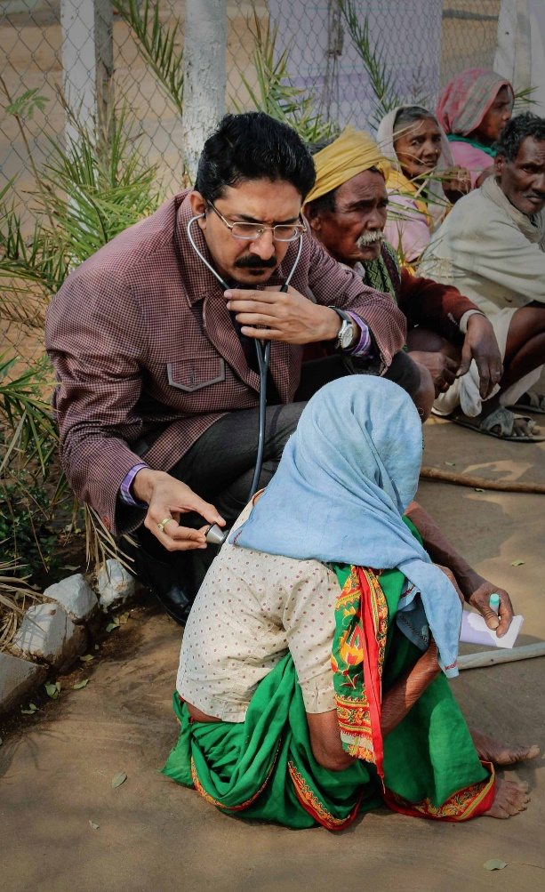
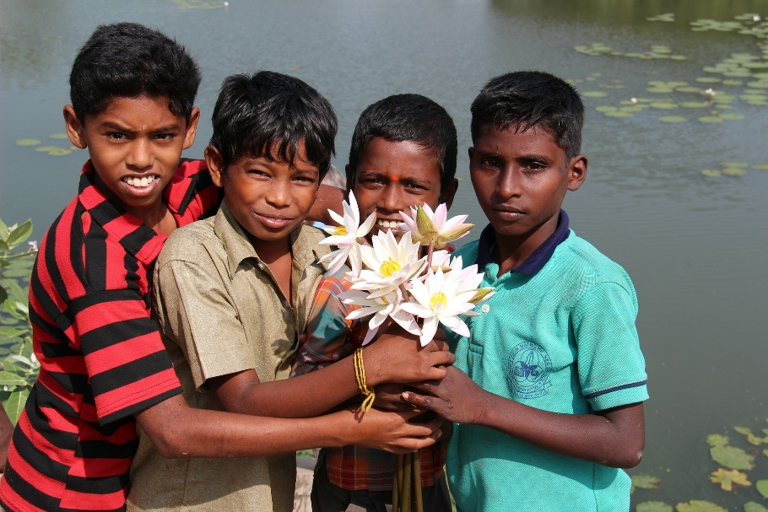
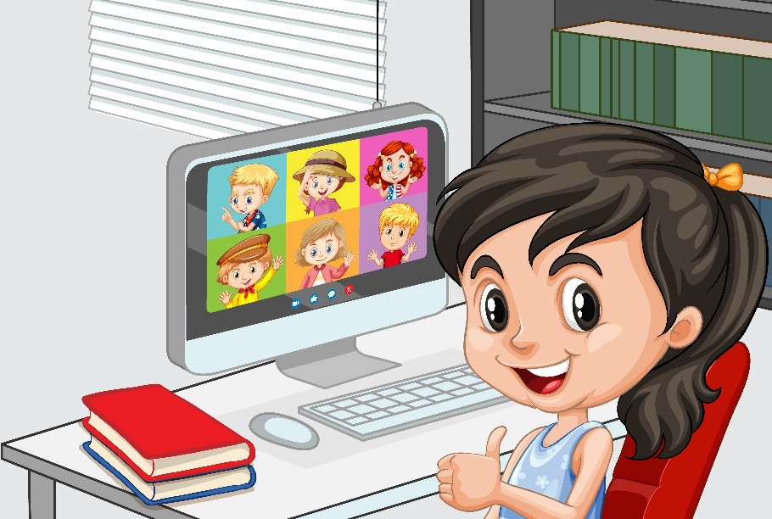
To Be – Form of Verbs ( Being)
They are my best friends
I am a doctor
The girl is at the computer
Notes:
Notes for Teacher - < Information for further reference or explanation >
Suggestions: <Ideas/ Images/ Animations / Others – To make better representation of the content >
Source of Multimedia used in this slide -
Doctor: https://pixabay.com/photos/doctor-rural-rural-health-care-6235356/
Friends: https://pixabay.com/photos/indians-children-guys-india-112610/
Girl: https://www.freepik.com/free-vector/close-up-girl-communicate-video-conference-with-friends-home-scene_11770538.htm#query=girl%20computer&position=10&from_view=search
( Attribution: brgfx)

Slide 4
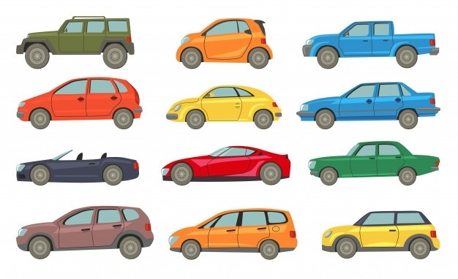
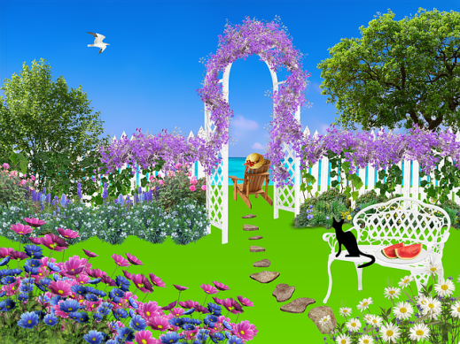
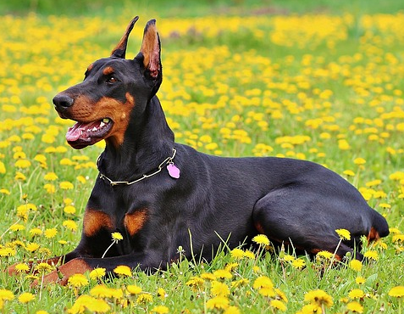
To Have – Form of Verbs
Use ‘have’ for - I, You, We , They
We have many cars
I have a blue bag
They have a beautiful garden
You have a big dog
Notes:
Notes for Teacher - < Information for further reference or explanation >
Suggestions: <Ideas/ Images/ Animations / Others – To make better representation of the content >
Source of Multimedia used in this slide -
Cars: https://www.freepik.com/free-vector/automobiles-models-icon-collection_8270941.htm#query=cars&position=14&from_view=search (Attribution: pch.vector)
Bag: https://www.freepik.com/free-vector/colored-cotton-eco-bags-fabric-tote-different-shapes-vector-realistic-mockup-textile-reusable-ecobags-shopping-beach-with-handles-blank-labels-isolated-white-background_21614306.htm#query=blue%20bag&position=21&from_view=search (Attribution: upklyak)
Garden: https://pixabay.com/illustrations/garden-flowers-nature-plant-1210709/
Dog: https://pixabay.com/photos/doberman-dog-nature-893931/

Slide 5
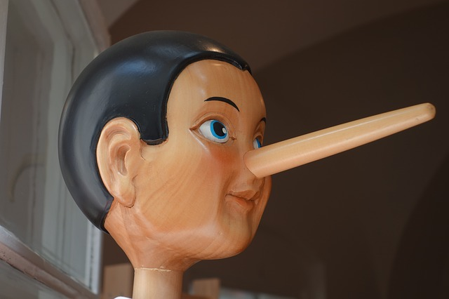
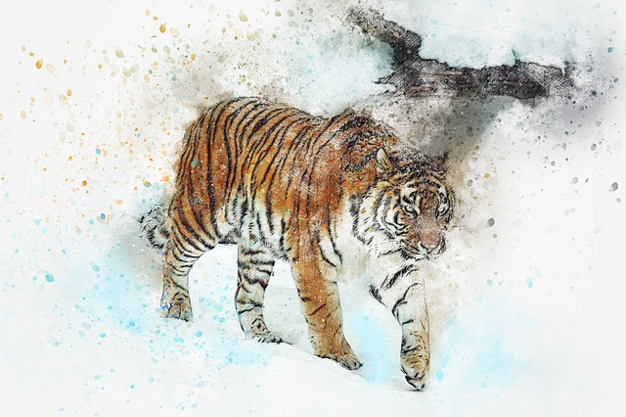
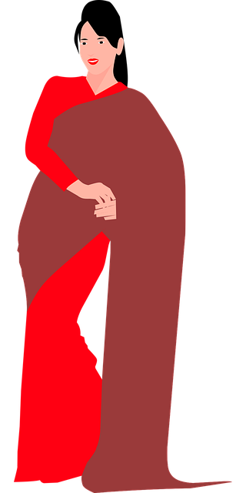
Has – Form of Verbs
Use ‘has’ for - He, She, It
He has a long nose
It has four legs
She has a red saree
Notes:
Notes for Teacher - < Information for further reference or explanation >
Suggestions: <Ideas/ Images/ Animations / Others – To make better representation of the content >
Source of Multimedia used in this slide -
Nose: https://pixabay.com/photos/pinocchio-nose-lying-nose-long-lie-2917652/
Tiger: https://pixabay.com/illustrations/tiger-walking-wild-art-watercolor-3556583/
Saree: https://pixabay.com/vectors/woman-saree-indian-young-fashion-5546375/

Slide 6
MM INDEX
Slide # | Thumbnail | Source link and Attribution
1 |  | 1. https://pixabay.com/vectors/business-man-business-entrepreneur-4247424/
3 |  | Doctor: https://pixabay.com/photos/doctor-rural-rural-health-care-6235356/ Friends: https://pixabay.com/photos/indians-children-guys-india-112610/ Girl: https://www.freepik.com/free-vector/close-up-girl-communicate-video-conference-with-friends-home-scene_11770538.htm#query=girl%20computer&position=10&from_view=search ( Attribution: brgfx)
4 |  | Cars: https://www.freepik.com/free-vector/automobiles-models-icon-collection_8270941.htm#query=cars&position=14&from_view=search (Attribution: pch.vector) Bag: https://www.freepik.com/free-vector/colored-cotton-eco-bags-fabric-tote-different-shapes-vector-realistic-mockup-textile-reusable-ecobags-shopping-beach-with-handles-blank-labels-isolated-white-background_21614306.htm#query=blue%20bag&position=21&from_view=search (Attribution: upklyak) Garden: https://pixabay.com/illustrations/garden-flowers-nature-plant-1210709/ Dog: https://pixabay.com/photos/doberman-dog-nature-893931/
5 |  | Nose: https://pixabay.com/photos/pinocchio-nose-lying-nose-long-lie-2917652/ Tiger: https://pixabay.com/illustrations/tiger-walking-wild-art-watercolor-3556583/ Saree: https://pixabay.com/vectors/woman-saree-indian-young-fashion-5546375/
Notes:
Notes for Teacher - < Information for further reference or explanation >
Suggestions: <Ideas/ Images/ Animations / Others – To make better representation of the content >
Source of Multimedia used in this slide - <Please provide source URL where we find the image and the license agreement>

