Slide 1
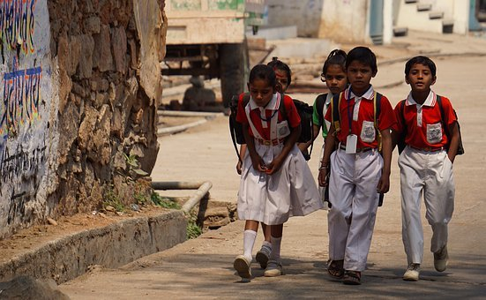
Fun with Verbs
Notes:
Notes for Teacher - < Information for further reference or explanation >
Suggestions: <Ideas/ Images/ Animations / Others – To make better representation of the content >
Source of Multimedia used in this slide –
1. https://pixabay.com/photos/indian-holiday-school-children-4393133/

Slide 2
Instruction
Raghu says...Clap your hands
Rest of the students
Follow instruction
RAGHU
Close your eyes
Don’t follow instruction
You are OUT
Let us begin the game !
Notes:
Notes for Teacher - Venue : Classroom Activity. All the children are involved in this game.
Materials required: The teacher prepares a list of action words written on slips of paper for Bittu to call out for the game. The list of words can be put in a small box .
Procedure
Ask one child to play the role of Bittu .
Ask the other children to stand facing him.
Bittu picks an action word from the box, each time he gives instructions.
Bittu instructs the others to perform the action.
For example: he can say Bittu says, ”Clap Your Hands!” or Bittu says, “Close your eyes.”
The other children are expected to follow the order and act.
If Bittu gives an instruction without starting with “Bittu says” children are not expected to follow, if they follow this instruction they cannot continue to play the game.(They are out).
Once they have understood the game, then Bittu can give his instructions at a faster pace. Students may make noise out of enthusiasm, especially when they see that their friends were unable to perform the action correctly due to their lack of attention.
Note to the teacher.
The teacher with the help of another student can monitor the activity so that they can identify the children who have performed the action incorrectly. The teacher may give prizes to the winners at the end of the game.
List of Action Words:
touch your nose / tap your feet / drink water / fly like a bird / say hello to your partner / cry like a baby / brush your teeth / open a gift / mew like a cat / fly a kite
Source of Multimedia used in this slide -
https://www.freepik.com/free-vector/set-happy-children-different-actions_5874504.htm#query=children&position=4&from_view=search
Uniform boy, girl: https://www.freepik.com/free-vector/boy-girl-school-uniform_6052413.htm#query=children&position=37&from_view=search

Slide 3
MM INDEX
Slide # | Thumbnail | Source link and Attribution
1 |  | 1. https://pixabay.com/photos/indian-holiday-school-children-4393133/
2 |  | https://www.freepik.com/free-vector/set-happy-children-different-actions_5874504.htm#query=children&position=4&from_view=search Uniform boy, girl: https://www.freepik.com/free-vector/boy-girl-school-uniform_6052413.htm#query=children&position=37&from_view=search
Notes:
Notes for Teacher - < Information for further reference or explanation >
Suggestions: <Ideas/ Images/ Animations / Others – To make better representation of the content >
Source of Multimedia used in this slide - <Please provide source URL where we find the image and the license agreement>

