Slide 1
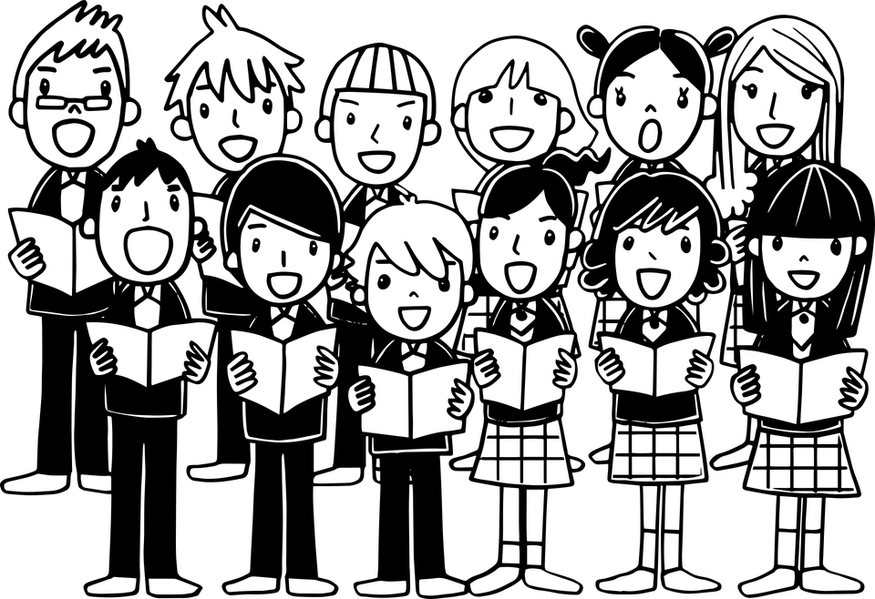
Identification of verbs
Notes:
Notes for Teacher - < Information for further reference or explanation >
Suggestions: <Ideas/ Images/ Animations / Others – To make better representation of the content >
Source of Multimedia used in this slide -
1. Children sing: https://pixabay.com/vectors/choir-children-silhouette-singing-5648277/

Slide 2
Exercise 1
Identify the Doing Words, write the Doing Word on the line
Example:
bicycle read book _________
read
1. car shoe ride ________
ride
2. glass drinks milk ________
drinks
3. dog runs around ________
runs
Notes:
Notes for Teacher - < Information for further reference or explanation >
Suggestions: <Ideas/ Images/ Animations / Others – To make better representation of the content >
Source of Multimedia used in this slide - <Please provide source URL where we find the image and the license agreement>

Slide 3
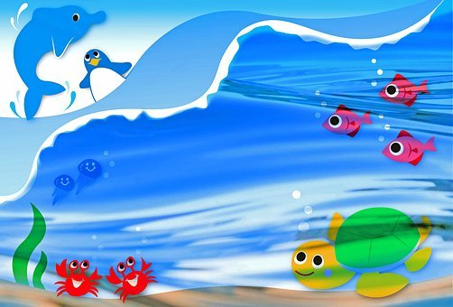
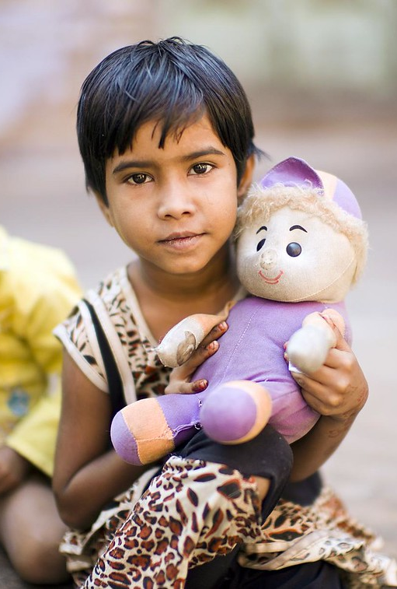
Exercise 2
Underline the Doing Words in these sentences in red colour
1. Fish swims in water
2. Anita plays with her toys
3. There are many stars in the sky
Notes:
Notes for Teacher - < Information for further reference or explanation >
Suggestions: <Ideas/ Images/ Animations / Others – To make better representation of the content >
Source of Multimedia used in this slide -
Fish: https://pixabay.com/illustrations/underwater-ocean-sea-water-nature-3740940/
Girl: https://www.flickr.com/photos/50979393@N00/6334286950 By Christopher Michel
Stars: https://pixabay.com/illustrations/universe-space-astronautics-770329/

Slide 4
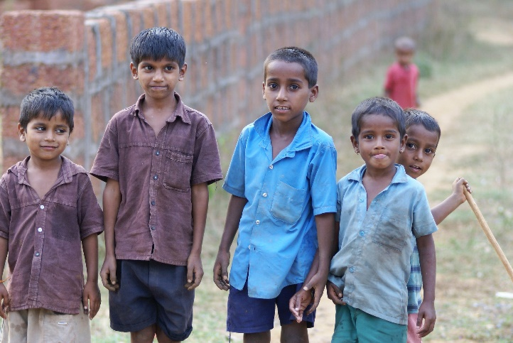
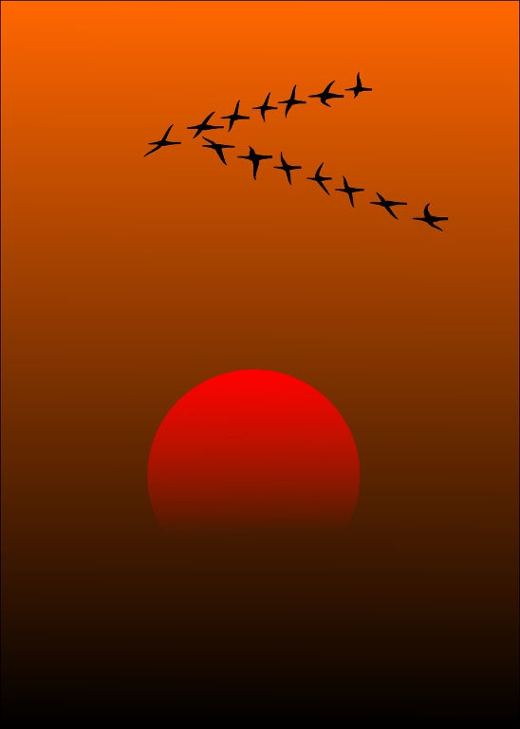
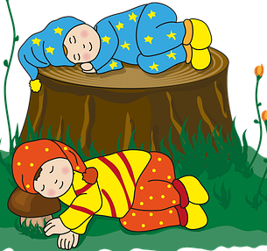
Exercise 3
Fill in the blanks with: is, am or are in the sentences given below
1. I _____ a big boy
am
2. Birds _______ flying in the sky
are
3. The children ______feeling sleepy
are
Notes:
Notes for Teacher - < Information for further reference or explanation >
Suggestions: <Ideas/ Images/ Animations / Others – To make better representation of the content >
Source of Multimedia used in this slide –
Boy: https://pixabay.com/photos/indian-children-mischievous-group-4422461/
Birds: https://pixabay.com/vectors/migratory-birds-birds-sunset-sun-157638/
Sleepy: https://pixabay.com/illustrations/children-sleeping-tree-stump-5870507/

Slide 5
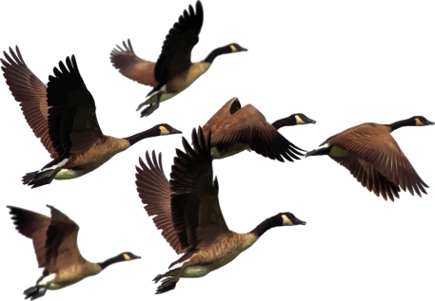
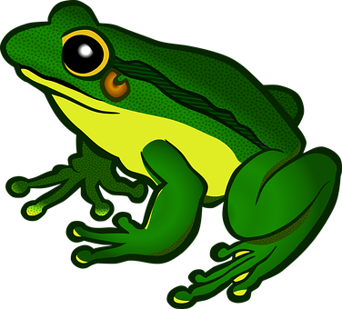
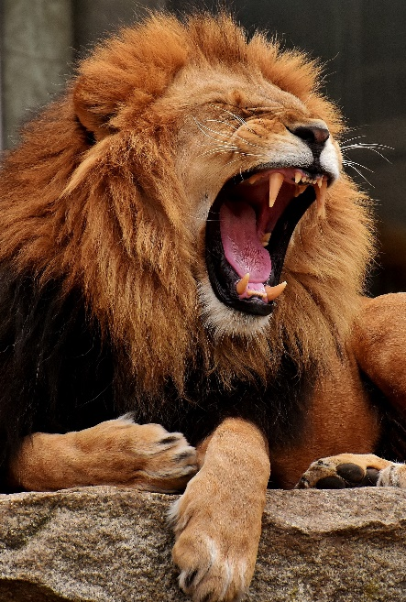
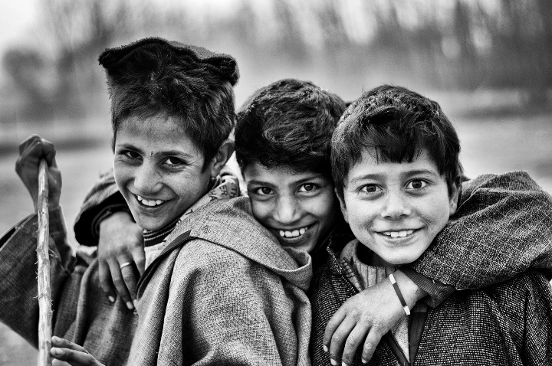
Exercise 4
Provide Doing Words for the Nouns given below
Example: Stars shine
fly
1. Birds _________
jump
2. Frogs _________
3. Lion _________
roars
laugh
4. Children _________
Notes:
Notes for Teacher - < Information for further reference or explanation >
Suggestions: <Ideas/ Images/ Animations / Others – To make better representation of the content >
Source of Multimedia used in this slide -
Birds: https://pixabay.com/vectors/animals-birds-flying-geese-goose-2030018/
Frogs: https://pixabay.com/vectors/amphibian-animal-frog-nature-1295172/
Lion: https://pixabay.com/photos/lion-predator-yawning-dangerous-3317673/
Children: https://pixabay.com/photos/boys-friends-brothers-children-1283786/

Slide 6
Exercise 5
Make sentences of your own with the following words
1. Read:
It is good to read story books
2. Sing:
They sing beautifully together
Notes:
Notes for Teacher - < Information for further reference or explanation >
Suggestions: <Ideas/ Images/ Animations / Others – To make better representation of the content >
Source of Multimedia used in this slide -
1. Children sing: https://pixabay.com/vectors/choir-children-silhouette-singing-5648277/

Slide 7
MM INDEX
Slide # | Thumbnail | Source link and Attribution
1,6 |  | 1. Children sing: https://pixabay.com/vectors/choir-children-silhouette-singing-5648277/
3 |  | Fish: https://pixabay.com/illustrations/underwater-ocean-sea-water-nature-3740940/ Girl: Girl: https://www.flickr.com/photos/50979393@N00/6334286950 By Christopher Michel Stars: https://pixabay.com/illustrations/universe-space-astronautics-770329/
4 |  | Boy: https://pixabay.com/photos/indian-children-mischievous-group-4422461/ Birds: https://pixabay.com/vectors/migratory-birds-birds-sunset-sun-157638/ Sleepy: https://pixabay.com/illustrations/children-sleeping-tree-stump-5870507/
5 |  | Birds: https://pixabay.com/vectors/animals-birds-flying-geese-goose-2030018/ Frogs: https://pixabay.com/vectors/amphibian-animal-frog-nature-1295172/ Lion: https://pixabay.com/photos/lion-predator-yawning-dangerous-3317673/ Children: https://pixabay.com/photos/boys-friends-brothers-children-1283786/
Notes:
Notes for Teacher - < Information for further reference or explanation >
Suggestions: <Ideas/ Images/ Animations / Others – To make better representation of the content >
Source of Multimedia used in this slide - <Please provide source URL where we find the image and the license agreement>

