Slide 1
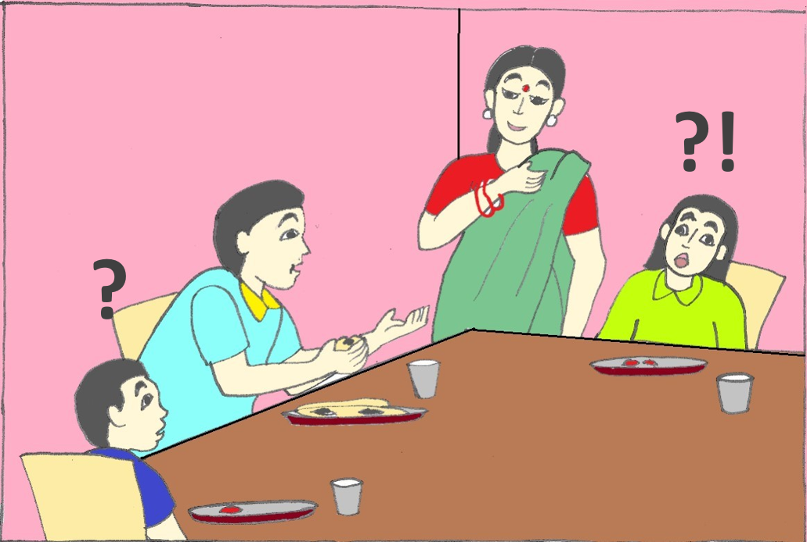
Knowing Genders
Notes:
Notes for Teacher - < Information for further reference or explanation >
Suggestions: <Ideas/ Images/ Animations / Others – To make better representation of the content >
Source of Multimedia used in this slide - <Please provide source URL where we find the image and the license agreement>
<mother and father> <SSSVV Image Gallery: Search Keyword “mother”>

Slide 2
Gender Nouns
Neuter
Feminine
Masculine
Common
Gender Nouns show the difference between male & female
Neuter Nouns refer to things
Common Nouns refer to both male and female
Notes:
Notes for Teacher - < Information for further reference or explanation >
Suggestions: <Ideas/ Images/ Animations / Others – To make better representation of the content >
Source of Multimedia used in this slide - <Please provide source URL where we find the image and the license agreement>

Slide 3
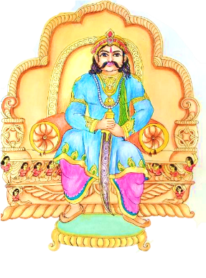
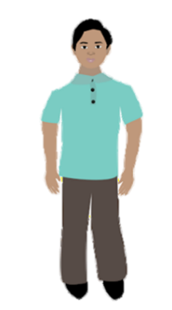
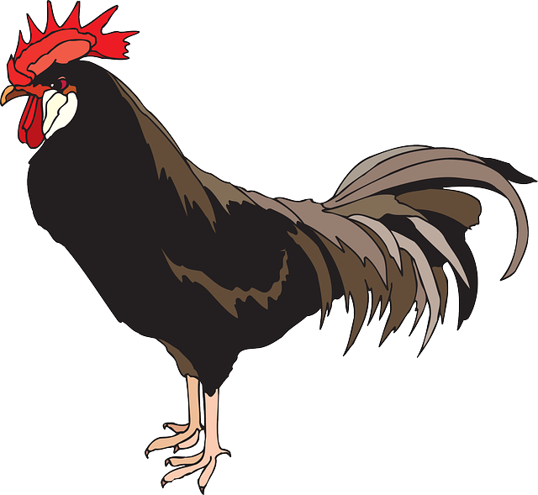
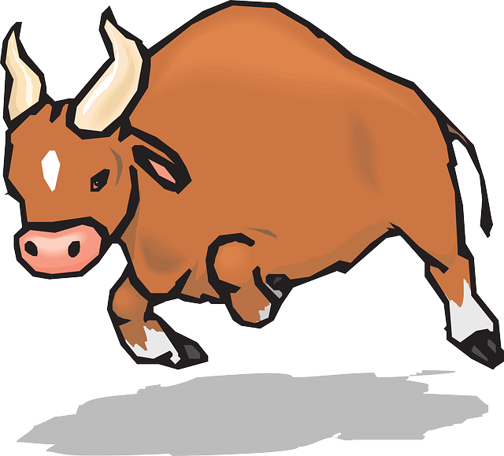
Masculine Gender
Masculine nouns
Men and Boys
Male species (Animals and Birds)
boy
king
grandfather
bull
peacock
rooster
Notes:
Notes for Teacher - < Information for further reference or explanation >
Suggestions: <Ideas/ Images/ Animations / Others – To make better representation of the content >
Source of Multimedia used in this slide - <Please provide source URL where we find the image and the license agreement>
<Boy> - <SSSVV: Search Keyword “farmer story”>
<man> - <SSSVV: Search Keyword “boy”>
<King> - <SSSVV: Search Keyword “king”>
<Bull> - <https://pixabay.com/vectors/bull-horns-charging-matador-angry-45978/>
<Peacock> - <https://pixabay.com/illustrations/peacock-feather-colorful-gorgeous-4948658/>
<Roaster> - <https://pixabay.com/vectors/rooster-cockerel-cock-male-chicken-45940/>

Slide 4
Masculine Gender
Examples
Salim is a seven-year-old boy.
My grandfather is a kind man.
The peacock is our National bird.
The crowing of the rooster can be heard at the break of dawn.
Notes:
Notes for Teacher - < Information for further reference or explanation >
Suggestions: <Ideas/ Images/ Animations / Others – To make better representation of the content >
Source of Multimedia used in this slide - <Please provide source URL where we find the image and the license agreement>

Slide 5
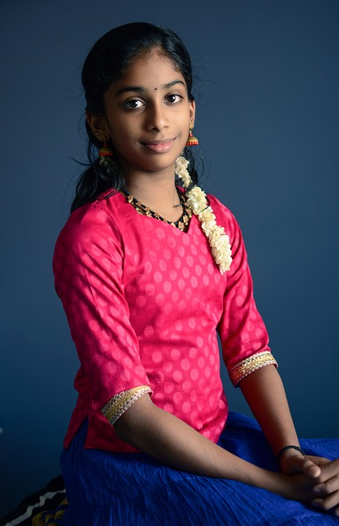
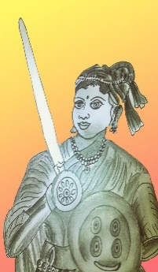
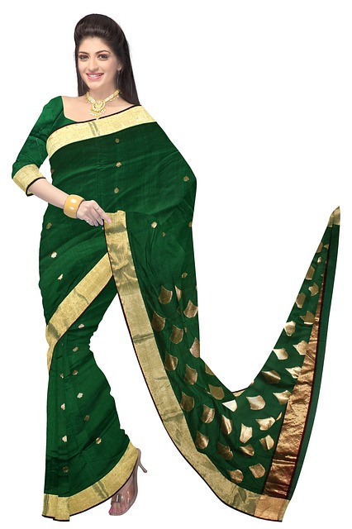
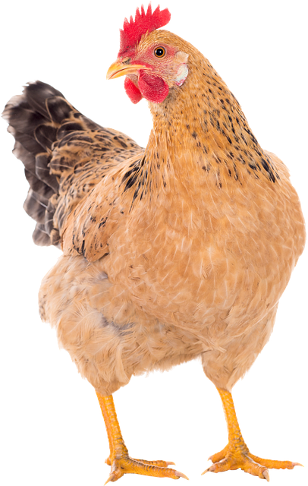
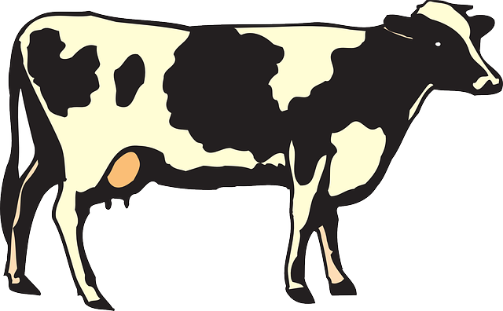
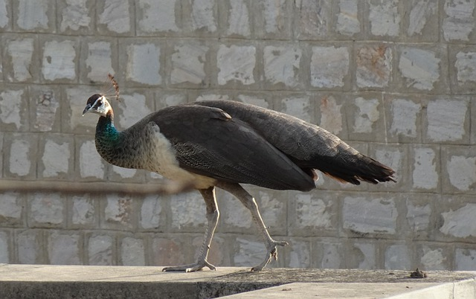
Feminine Gender
Feminine nouns
Women and Girls
Female species (Animals and Birds)
girl
queen
woman
hen
cow
peahen
Notes:
Notes for Teacher - < Information for further reference or explanation >
Suggestions: <Ideas/ Images/ Animations / Others – To make better representation of the content >
Source of Multimedia used in this slide - <Please provide source URL where we find the image and the license agreement>
<queen> <SSSVV - portrait rani-lakshmi-bai-queen-portrait-5368 Rani lakshmi bai, queen, portrait>
<Girl> - <https://pixabay.com/photos/beautiful-young-indian-girl-2271357/>
<woman> - <https://pixabay.com/photos/woman-sari-green-saree-fashion-360377//>
<cow> - <https://pixabay.com/vectors/cow-livestock-cattle-farm-animal-44695/>
<Peahen> - <https://pixabay.com/photos/bird-peahen-peafowl-female-peacock-5156288/>
<hen> - <https://pixabay.com/photos/chicken-hens-pullet-3070851//>

Slide 6
Feminine Gender
Examples
That girl is my sister.
Women love to wear sarees.
The peahen has a short tail.
The cow gives us milk.
Notes:
Notes for Teacher - < Information for further reference or explanation >
Suggestions: <Ideas/ Images/ Animations / Others – To make better representation of the content >
Source of Multimedia used in this slide - <Please provide source URL where we find the image and the license agreement>
<Girl> - <https://pixabay.com/photos/beautiful-young-indian-girl-2271357/>
<woman> - <https://pixabay.com/photos/woman-sari-green-saree-fashion-360377//>
<cow> - <https://pixabay.com/vectors/cow-livestock-cattle-farm-animal-44695/>
<Peahen> - <https://pixabay.com/photos/bird-peahen-peafowl-female-peacock-5156288/>

Slide 7
MM INDEX
Slide # | Thumbnail | Source link and Attribution
1 |  | <mother and father> <SSSVV Image Gallery: Searck Keyword “mother”>
3 |  | <Boy> - <SSSVV Image Gallery: Search Keyword “farmer story”> <Man> - <SSSVV Image Gallery: Search Keyword “boy” > <King> - <SSSVV Image Gallery: Search Keyword “king”> <Bull> - https://pixabay.com/vectors/bull-horns-charging-matador-angry-45978/ <Peacock> - https://pixabay.com/illustrations/peacock-feather-colorful-gorgeous-4948658/ <Rooster> - https://pixabay.com/vectors/rooster-cockerel-cock-male-chicken-45940/
4 |  | <Boy> - <SSSSVV Image Gallery: Search Keyword “farmer story”> <Man> - <SSSVV Image Gallery: Search Keyword “boy” > <Peacock> - https://pixabay.com/illustrations/peacock-feather-colorful-gorgeous-4948658/ <Rooster> - https://pixabay.com/vectors/rooster-cockerel-cock-male-chicken-45940/
5 |  | <queen> <SSSVV Image Gallery: Search Keyword ”Rani lakshmi bai”> <Girl> - https://pixabay.com/photos/beautiful-young-indian-girl-2271357/ <woman> - https://pixabay.com/photos/woman-sari-green-saree-fashion-360377// <cow> - https://pixabay.com/vectors/cow-livestock-cattle-farm-animal-44695/ <Peahen> - https://pixabay.com/photos/bird-peahen-peafowl-female-peacock-5156288/ <hen> - https://pixabay.com/photos/chicken-hens-pullet-3070851//
6 |  | <Girl> - https://pixabay.com/photos/beautiful-young-indian-girl-2271357/ <woman> - https://pixabay.com/photos/woman-sari-green-saree-fashion-360377// <cow> - https://pixabay.com/vectors/cow-livestock-cattle-farm-animal-44695/ <Peahen> - https://pixabay.com/photos/bird-peahen-peafowl-female-peacock-5156288/
Notes:
Notes for Teacher - < Information for further reference or explanation >
Suggestions: <Ideas/ Images/ Animations / Others – To make better representation of the content >
Source of Multimedia used in this slide - <Please provide source URL where we find the image and the license agreement>

