Slide 1
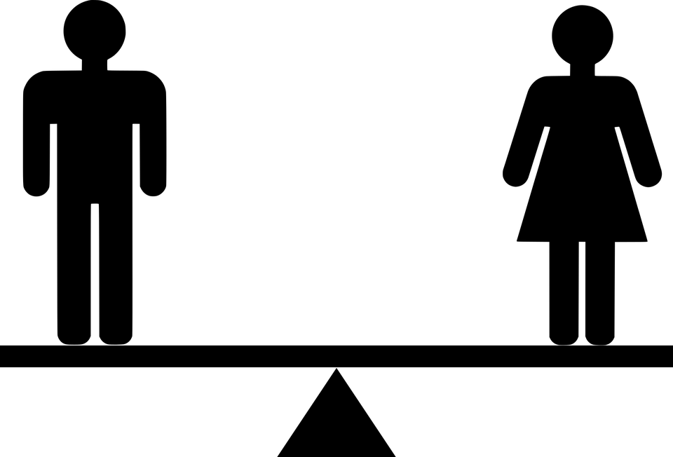
Game of Card for Genders
Notes:
Notes for Teacher - < Information for further reference or explanation >
Suggestions: <Ideas/ Images/ Animations / Others – To make better representation of the content >
Source of Multimedia used in this slide - <Please provide source URL where we find the image and the license agreement>
Silhouette: https://pixabay.com/vectors/equal-equality-equilibrium-gender-5366151/

Slide 2
Genders - Game of Cards
AIM:
Identify nouns as masculine or feminine.
Notes:
Notes for Teacher - < Information for further reference or explanation >
Suggestions: <Ideas/ Images/ Animations / Others – To make better representation of the content >
Source of Multimedia used in this slide - <Please provide source URL where we find the image and the license agreement>
Silhouette: https://pixabay.com/vectors/equal-equality-equilibrium-gender-5366151/
Male/Female: https://pixabay.com/vectors/female-gender-genders-male-sex-1294230/

Slide 3
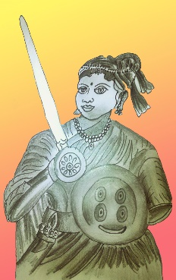
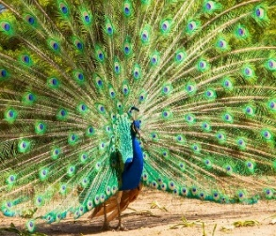
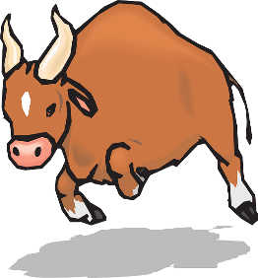
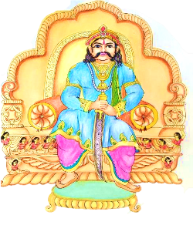
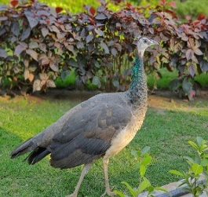
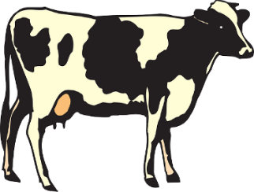
Resources Required
1. Small cards with pictures and words of a variety of nouns.
2. Two bigger cards with Masculine and Feminine written separately on them.
FEMININE
MASCULINE
BOY
MOTHER
FATHER
GIRL
Notes:
Notes for Teacher - < Information for further reference or explanation >
Suggestions: <Ideas/ Images/ Animations / Others – To make better representation of the content >
Source of Multimedia used in this slide - <Please provide source URL where we find the image and the license agreement>
Peacock - <https://pixabay.com/photos/peacock-feather-color-colorful-4237113/>
Peahen - <https://pixabay.com/photos/peahen-bird-peafowl-nature-animal-4859288/>
Cow - <https://pixabay.com/vectors/cow-livestock-cattle-farm-animal-44695/>
Bull - <https://pixabay.com/vectors/bull-horns-charging-matador-angry-45978/>
Queen: SSSVV Image Gallery: Search Keyword “queen”
King: SSSVV Image Gallery: Search Keyword “king”

Slide 4
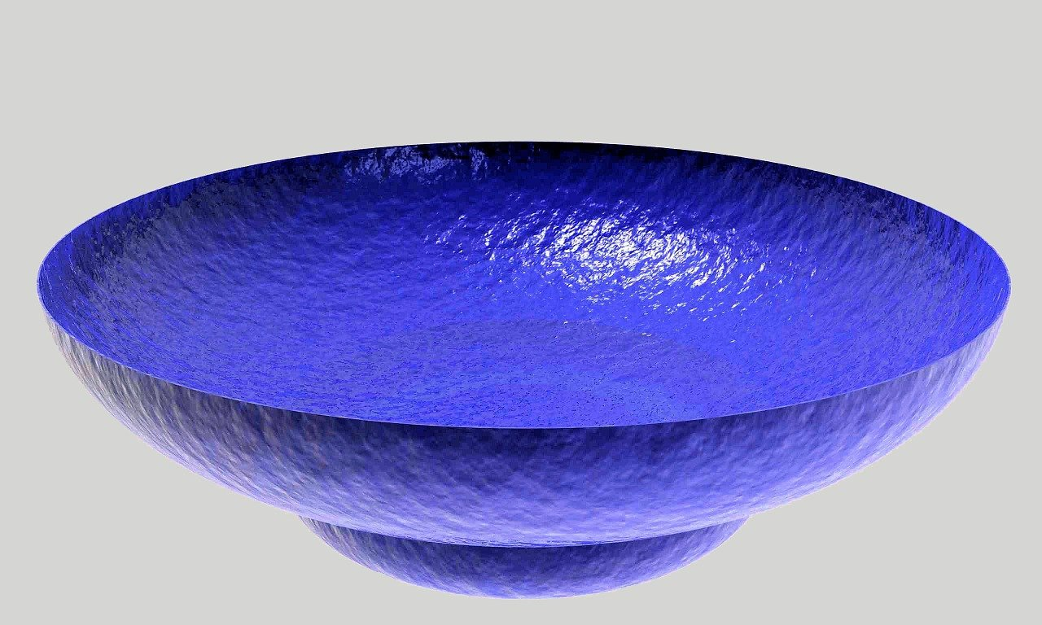
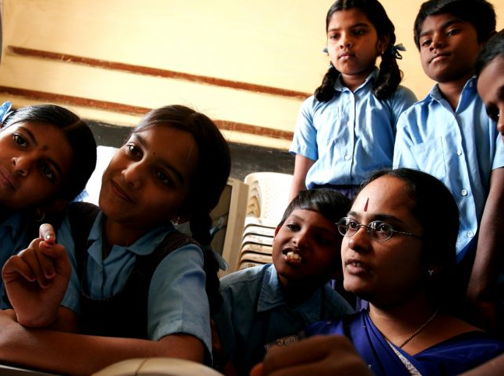
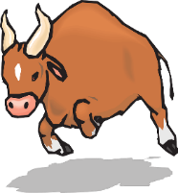
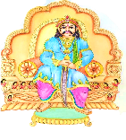
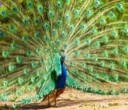
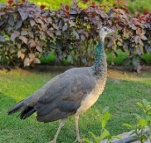
Lets Play
SHE
FATHER
GIRL
MOTHER
BOY
GIRL
Bowl Containing all Cards
Pick a card
Notes:
Notes for Teacher - < Information for further reference or explanation >
Suggestions: <Ideas/ Images/ Animations / Others – To make better representation of the content >
Source of Multimedia used in this slide - <Please provide source URL where we find the image and the license agreement>
sBowl: https://pixabay.com/photos/dish-bowl-glass-colorful-blue-366197/

Slide 5
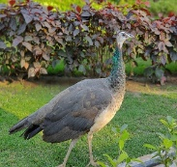
Keep Playing Till Bowl is Empty
FEMININE
MOTHER
GIRL
MASCULINE
BOY
FATHER
Notes:
Notes for Teacher - < Information for further reference or explanation >
Suggestions: <Ideas/ Images/ Animations / Others – To make better representation of the content >
Source of Multimedia used in this slide - <Please provide source URL where we find the image and the license agreement>
Thumbs up emoji: https://pixabay.com/vectors/thumbs-up-smiley-face-emoji-happy-4007573/

Slide 6
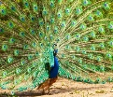
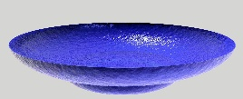
MM INDEX
Slide # | Thumbnail | Source link and Attribution
1, 2 |  | https://pixabay.com/vectors/equal-equality-equilibrium-gender-5366151
1, 2 |  | https://pixabay.com/vectors/female-gender-genders-male-sex-1294230
3, 5 |  | https://pixabay.com/photos/peacock-feather-color-colorful-4237113/ https://pixabay.com/photos/peahen-bird-peafowl-nature-animal-4859288/
3, 4, 5 |  | https://pixabay.com/vectors/bull-horns-charging-matador-angry-45978/ https://pixabay.com/vectors/cow-livestock-cattle-farm-animal-44695/
3, 4, 5 |  | Queen: SSSVV Image Gallery: Search Keyword “queen” King: SSSVV Image Gallery: Search Keyword “king”
4, 5 |  | https://pixabay.com/photos/dish-bowl-glass-colorful-blue-366197/
4 |  | https://pixnio.com/people/crowd/young-indian-girls-with-their-teacher
5 |  | https://pixabay.com/vectors/thumbs-up-smiley-face-emoji-happy-4007573/
Notes:
Notes for Teacher - < Information for further reference or explanation >
Suggestions: <Ideas/ Images/ Animations / Others – To make better representation of the content >
Source of Multimedia used in this slide - <Please provide source URL where we find the image and the license agreement>

