Slide 1
Writing the other Gender
Notes:
Notes for Teacher - < Information for further reference or explanation >
Suggestions: <Ideas/ Images/ Animations / Others – To make better representation of the content >
Source of Multimedia used in this slide - <Please provide source URL where we find the image and the license agreement>

Slide 2
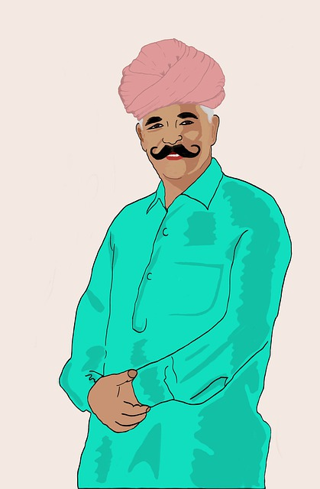
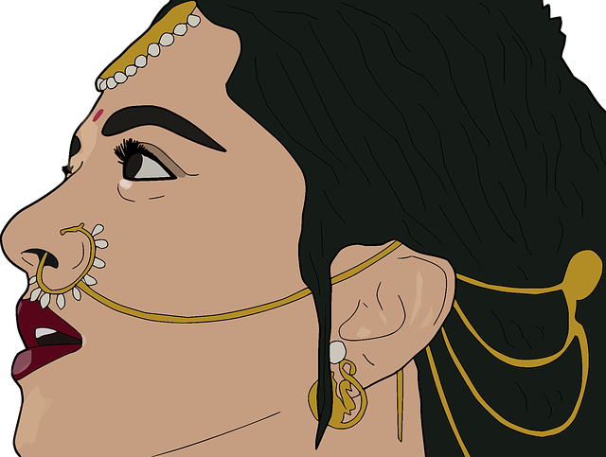
Exercise 1
Match the masculine nouns with the feminine nouns.
father
father
queen
queen
king
king
aunt
aunt
brother
brother
woman
woman
mother
uncle
mother
uncle
man
man
sister
sister
Notes:
Notes for Teacher - < Information for further reference or explanation >
Suggestions: <Ideas/ Images/ Animations / Others – To make better representation of the content >
Source of Multimedia used in this slide - <Please provide source URL where we find the image and the license agreement>
<female> - <https://pixabay.com/vectors/indian-woman-anushka-shetty-indian-3238761/>
<male> - <https://pixabay.com/illustrations/indian-man-rural-people-sketch-4428524/>

Slide 3
Exercise 2
Complete the chart
Masculine | Feminine
prince
 | policewoman
 | cow
peacock
tiger
 | hen
princess
policeman
bull
peahen
tigress
rooster
Notes:
Notes for Teacher - < Information for further reference or explanation >
Suggestions: <Ideas/ Images/ Animations / Others – To make better representation of the content >
Source of Multimedia used in this slide - <Please provide source URL where we find the image and the license agreement>

Slide 4
Exercise 3
Colour the matching masculine and feminine nouns.
Use a different colour for each pair. One example is done for you.
sister
sister
boy
boy
cow elephant
cow elephant
boar
boar
lioness
lioness
husband
husband
lion
lion
sow
sow
brother
brother
wife
wife
bull elephant
bull elephant
girl
girl
Notes:
Notes for Teacher - < Information for further reference or explanation >
Suggestions: <Ideas/ Images/ Animations / Others – To make better representation of the content >
Source of Multimedia used in this slide - <Please provide source URL where we find the image and the license agreement>

Slide 5
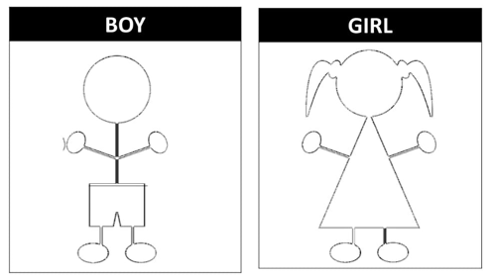
Exercise 4
Draw and Colour
Notes:
Notes for Teacher - < Information for further reference or explanation >
Suggestions: <Ideas/ Images/ Animations / Others – To make better representation of the content >
Source of Multimedia used in this slide - <Please provide source URL where we find the image and the license agreement>
1. <boy and girl> - <https://pixabay.com/vectors/kids-black-boy-silhouette-girl-303544/>

Slide 6
MM INDEX
Slide # | Thumbnail | Source link and Attribution
2 |  | <female> - https://pixabay.com/vectors/indian-woman-anushka-shetty-indian-3238761/
2 |  | <male> - https://pixabay.com/illustrations/indian-man-rural-people-sketch-4428524/
5 |  | <boy and girl> - https://pixabay.com/vectors/kids-black-boy-silhouette-girl-303544/
Notes:
Notes for Teacher - < Information for further reference or explanation >
Suggestions: <Ideas/ Images/ Animations / Others – To make better representation of the content >
Source of Multimedia used in this slide - <Please provide source URL where we find the image and the license agreement>

