Slide 1
Find the opposite Gender
Notes:
Notes for Teacher - < Information for further reference or explanation >
Suggestions: <Ideas/ Images/ Animations / Others – To make better representation of the content >
Source of Multimedia used in this slide - <Please provide source URL where we find the image and the license agreement>
1. Thinking boy https://pixabay.com/vectors/thinker-thinking-person-idea-28741/

Slide 2
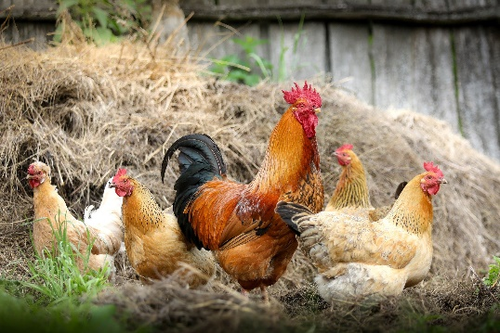
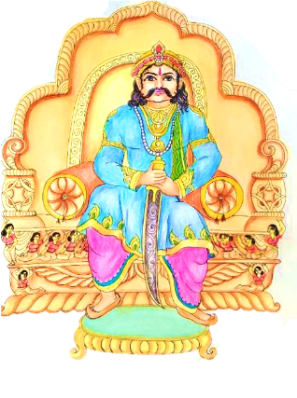
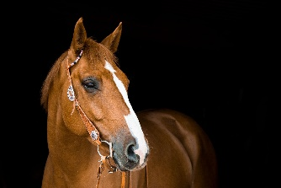
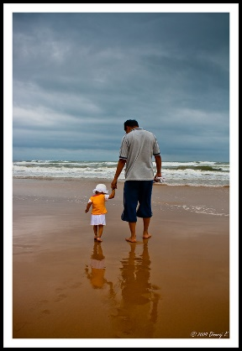
Exercise 1
Complete the Masculine and Feminine genders of the following. Choose from the help box.
Wife | Bride | Lady | Mare | Cow | Aunt | Queen | Niece
Heroine | Vixen | Actress | Madam | Peahen | Cock | Mummy
Hen
C_ _k
King
Qu_ _n
o c
e e
Horse
M_ _e
Papa
M_ __ __y
a r
u m m
Notes:
Notes for Teacher - < Information for further reference or explanation >
Suggestions: <Ideas/ Images/ Animations / Others – To make better representation of the content >
Source of Multimedia used in this slide - <Please provide source URL where we find the image and the license agreement>
Cock: https://pixabay.com/photos/chickens-birds-poultry-rooster-hen-2522623/
Horse: https://pixabay.com/photos/horse-mare-bridle-animal-ride-3390256/
Papa: https://www.flickr.com/photos/8263540@N05/3987932818 By Dinuraj K
King: SSSVV Image Gallery: Search Keyword “king”

Slide 3
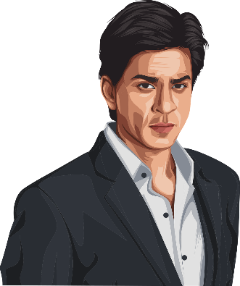
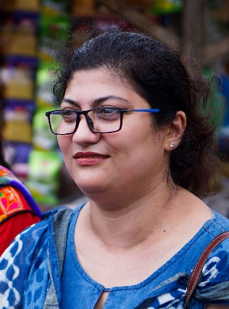
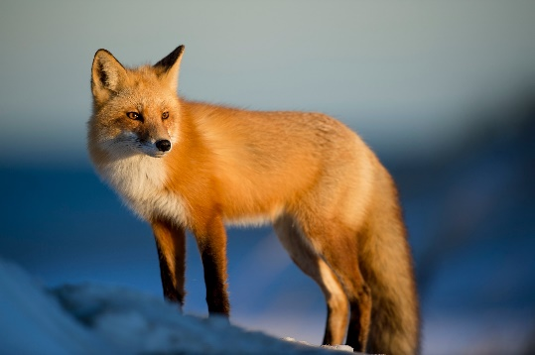
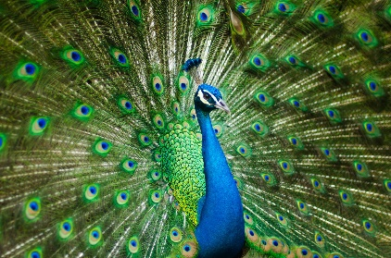
Exercise 1
Complete the Masculine and Feminine genders of the following. Choose from the help box.
Wife | Bride | Lady | Mare | Cow | Aunt | Queen | Niece
Heroine | Vixen | Actress | Madam | Peahen | Cock | Mummy
Hero
He_ _ _ne
Gentleman
a d
r o i
L_ _y
Fox
Vi_ _n
Peacock
P_ _h_ _
x e
e a
e n
Notes:
Notes for Teacher - < Information for further reference or explanation >
Suggestions: <Ideas/ Images/ Animations / Others – To make better representation of the content >
Source of Multimedia used in this slide - <Please provide source URL where we find the image and the license agreement>
Hero: https://pixabay.com/vectors/shahrukh-khan-man-cartoon-actor-5747951/
Fox: https://pixabay.com/photos/fox-animal-wilderness-nature-2597803/
Lady: https://pixabay.com/photos/woman-smile-happy-young-person-6545828/
Peacock: https://pixabay.com/photos/peafowl-peacock-bird-feathers-2363750/

Slide 4
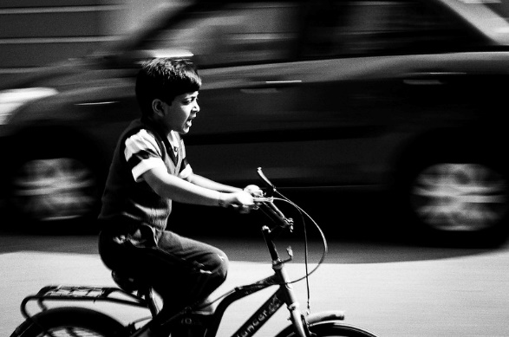
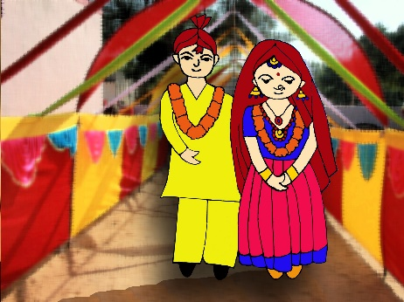
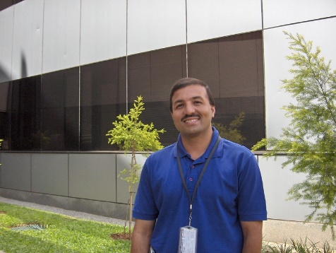
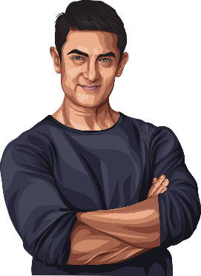
Exercise 1
Complete the Masculine and Feminine genders of the following. Choose from the help box.
Wife | Bride | Lady | Mare | Cow | Aunt | Queen | Niece
Heroine | Vixen | Actress | Madam | Peahen | Cock | Mummy
Nephew
N_ _ce
Husband
W_ _e
i e
i f
Sir
M_ d _m
Actor
Act_ _ _s
a
a
r e s
Notes:
Notes for Teacher - < Information for further reference or explanation >
Suggestions: <Ideas/ Images/ Animations / Others – To make better representation of the content >
Source of Multimedia used in this slide - <Please provide source URL where we find the image and the license agreement>
Nephew: https://www.flickr.com/photos/103799582@N02/16597491746 By:Bhavishya Goel
Sir: https://www.flickr.com/photos/30866445@N00/184047151 By Esther Dyson
Marriage: SSSVV Image Gallery: Search Keyword “marriage”
Actor: https://pixabay.com/vectors/man-actor-celebrity-character-5719980/

Slide 5
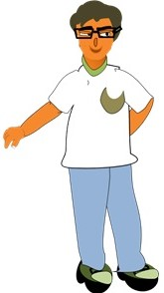
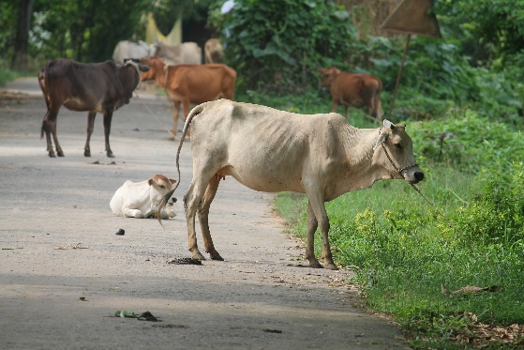
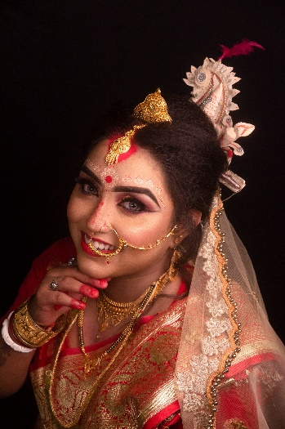
Exercise 1
Complete the Masculine and Feminine genders of the following. Choose from the help box.
Wife | Bride | Lady | Mare | Cow | Aunt | Queen | Niece
Heroine | Vixen | Actress | Madam | Peahen | Cock | Mummy
Uncle
A_ _t
Bull
C_ _
u n
o w
Bridegroom
B_ _de
r i
Notes:
Notes for Teacher - < Information for further reference or explanation >
Suggestions: <Ideas/ Images/ Animations / Others – To make better representation of the content >
Source of Multimedia used in this slide - <Please provide source URL where we find the image and the license agreement>
Cow: https://pixabay.com/photos/cows-village-s-cows-animal-4742330/
Uncle: SSSVV Image Gallery: Search Keyword “man”
Marriage: https://pixabay.com/photos/wedding-indian-bride-indian-woman-5821129/

Slide 6
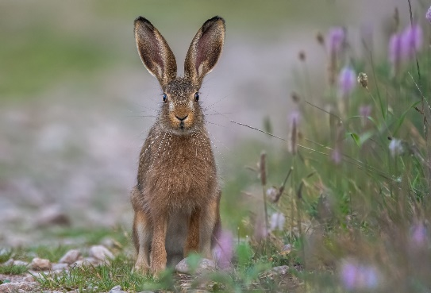
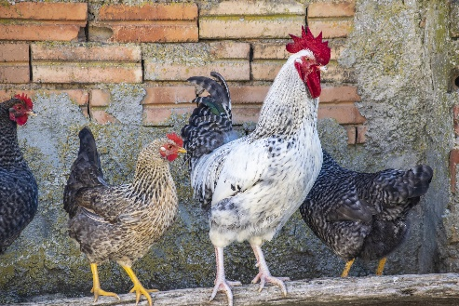
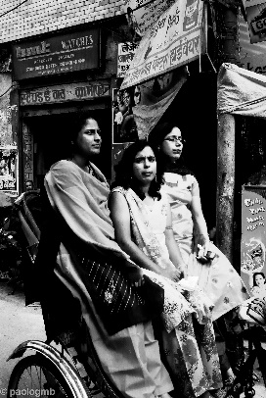
Exercise 2
Give one word for the following.
Choose from the box given below.
Cousin | Bachelor | Hen | Niece
Doe | Nephew | Aunt
A young female rabbit- ____________
Your mother's sister is your- ______
An adult female chicken- __________
Doe
Aunt
Hen
Notes:
Notes for Teacher - < Information for further reference or explanation >
Suggestions: <Ideas/ Images/ Animations / Others – To make better representation of the content >
Source of Multimedia used in this slide - <Please provide source URL where we find the image and the license agreement>
Rabbit: https://pixabay.com/photos/rabbit-field-animal-field-hare-6063733/
Hen: https://pixabay.com/photos/rooster-hens-chickens-birds-7056152/
Sisters: https://www.flickr.com/photos/14012466@N07/19088954653 By Paolo Gamba
Old: https://archive.sssmediacentre.org/www/imagedownloads/SMN_20140606.jpg

Slide 7
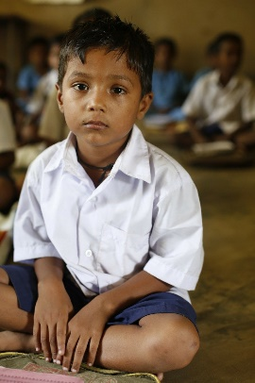
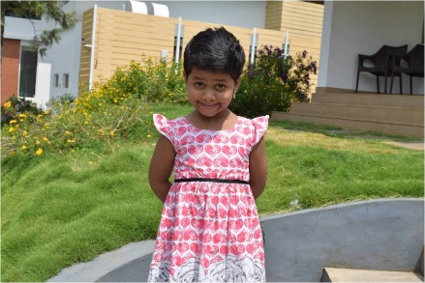
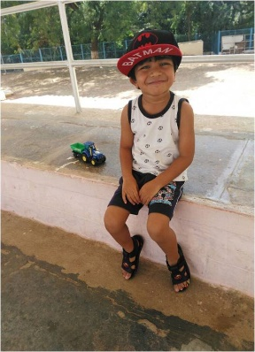
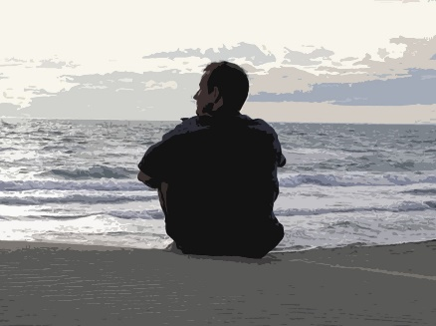
Exercise 2
Give one word for the following.
Choose from the box given below.
Cousin | Bachelor | Widower | Niece
Doe | Nephew | Hen | Aunt
Your aunt's son is your- ____________
Your brother's daughter is your- _______
A man who is not married- __________
Your sister's son is your- _____________
Cousin
Niece
Bachelor
Nephew
Notes:
Notes for Teacher - < Information for further reference or explanation >
Suggestions: <Ideas/ Images/ Animations / Others – To make better representation of the content >
Source of Multimedia used in this slide - <Please provide source URL where we find the image and the license agreement>
Boy: https://pixabay.com/photos/children-infant-boy-india-poor-306602/
Girl: SSSVV Image Gallery: Search Keyword “girl”
Cousin: SSSVV Image Gallery: Search Keyword “boy”
Bachelor: https://archive.sssmediacentre.org/www/imagedownloads/SMN_20151217.jpg

Slide 8
MM INDEX
Slide # | Thumbnail | Source link and Attribution
1 |  | 1. Thinking boy https://pixabay.com/vectors/thinker-thinking-person-idea-28741/
2 |  | Cock: https://pixabay.com/photos/chickens-birds-poultry-rooster-hen-2522623/ Horse: https://pixabay.com/photos/horse-mare-bridle-animal-ride-3390256/ Papa: https://www.flickr.com/photos/8263540@N05/3987932818 By Dinuraj K
3 |  | Hero: https://pixabay.com/vectors/shahrukh-khan-man-cartoon-actor-5747951/ Fox: https://pixabay.com/photos/fox-animal-wilderness-nature-2597803/ Lady: https://pixabay.com/photos/woman-smile-happy-young-person-6545828/ Peacock: https://pixabay.com/photos/peafowl-peacock-bird-feathers-2363750/
4 |  | Nephew: https://www.flickr.com/photos/103799582@N02/16597491746 By:Bhavishya Goel Sir: https://www.flickr.com/photos/30866445@N00/184047151 By Esther Dyson Actor: https://pixabay.com/vectors/man-actor-celebrity-character-5719980/
5 |  | Cow: https://pixabay.com/photos/cows-village-s-cows-animal-4742330/ Marriage: https://pixabay.com/photos/wedding-indian-bride-indian-woman-5821129/
6 |  | Rabbit: https://pixabay.com/photos/rabbit-field-animal-field-hare-6063733/ Hen: https://pixabay.com/photos/rooster-hens-chickens-birds-7056152/ Sisters: https://www.flickr.com/photos/14012466@N07/19088954653 By Paolo Gamba Old: https://archive.sssmediacentre.org/www/imagedownloads/SMN_20140606.jpg
7 |  | Boy: https://pixabay.com/photos/children-infant-boy-india-poor-306602/ Bachelor: https://archive.sssmediacentre.org/www/imagedownloads/SMN_20151217.jpg
Notes:
Notes for Teacher - < Information for further reference or explanation >
Suggestions: <Ideas/ Images/ Animations / Others – To make better representation of the content >
Source of Multimedia used in this slide - <Please provide source URL where we find the image and the license agreement>

