Slide 1
Identification of Vowels
a, e, i, o, u
Notes:
Notes for Teacher - < Information for further reference or explanation >
Suggestions: <Ideas/ Images/ Animations / Others – To make better representation of the content >
Source of Multimedia used in this slide - <Please provide source URL where we find the image and the license agreement>
1. <Black board> - <https://pixabay.com/illustrations/chalkboard-background-decorative-517818/>

Slide 2
English Language
44 sounds
Vowels
Consonants
Notes:
Notes for Teacher - < Information for further reference or explanation >
Suggestions: <Ideas/ Images/ Animations / Others – To make better representation of the content >
Source of Multimedia used in this slide - <Please provide source URL where we find the image and the license agreement>

Slide 3
Vowels and Consonants
Vowels
Consonants
Aa Ee Ii Oo Uu
Yy
Honorary or semi vowel
Bb | Cc | Dd | Ff
Gg | Hh | Jj | Kk
Ll | Mm | Nn | Pp
Qq | Rr | Ss | Tt
Vv | Ww | Xx | Yy
Zz
Notes:
Notes for Teacher - Vowel sounds allow the air to flow freely, causing the chin to drop noticeably, while consonant sounds are produced by restricting the air flow. (instructions for teacher)
Suggestions: <Ideas/ Images/ Animations / Others – To make better representation of the content >
Source of Multimedia used in this slide - <Please provide source URL where we find the image and the license agreement>

Slide 4
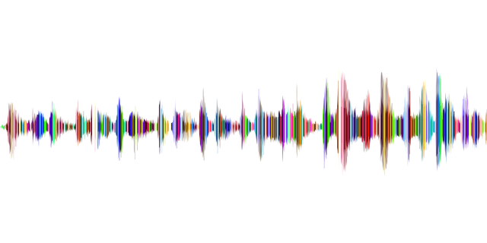
Vowel Sounds
Vowel sounds are usually split into two main categories based on sound quality:
‘Short’ vowel sounds – Ex: at, egg, it, ox, up.
‘Long’ vowel sounds – Ex: ate, each, ice, use.
Notes:
Notes for Teacher - Vowel sounds are usually split into two main categories based on sound quality:
‘Short’ vowel sounds, due to the short duration of the sound being made. The sound cannot be held onto without becoming distorted.
‘Long’ vowel sounds, due to the length of their pronunciation. These can often be held without distorting their sound.
Suggestions: <Ideas/ Images/ Animations / Others – To make better representation of the content >
Source of Multimedia used in this slide -
1. <sound wave> - <https://pixabay.com/vectors/sound-wave-waveform-aural-audio-1781569/>

Slide 5
Vowels
a, e, i, o, u
honorary/semi vowel.
replaces a vowel in words like fly, sky, etc.
Notes:
Notes for Teacher - All words in the English language have at least one vowel sound in them so the written version must have at least one vowel letter in it.
Suggestions: <Ideas/ Images/ Animations / Others – To make better representation of the content >
Source of Multimedia used in this slide - <Please provide source URL where we find the image and the license agreement>
1. <alphabet y> - <https://pixabay.com/illustrations/letters-abc-y-alphabet-learn-2077283/>

Slide 6
Consonants
b, c, d, f, g, h, j, k, l, m,
n, p, q, r, s, t, v, w, x, y, z.
Notes:
Notes for Teacher - Consonant sounds are made when the air flow is being restricted in some way, for example, change in tongue position resulting in the mouth not opening as wide. This means the jaw doesn’t drop noticeably, which is different to vowel sounds.
Suggestions: <Ideas/ Images/ Animations / Others – To make better representation of the content >
Source of Multimedia used in this slide - <Please provide source URL where we find the image and the license agreement>

Slide 7
‘Y’ as a Vowel
As a vowel, it replaces ‘i’.
As a consonant, it is itself.
Example: Sky
Example: Yellow
Notes:
Notes for Teacher –
Suggestions: <Ideas/ Images/ Animations / Others – To make better representation of the content >
Source of Multimedia used in this slide - <Please provide source URL where we find the image and the license agreement>
<alphabet y> - <https://pixabay.com/illustrations/letters-abc-y-alphabet-learn-2077283/>
<Sky>: <https://pixabay.com/photos/clouds-sky-atmosphere-blue-sky-49520/>
<Yellow>: <https://pixabay.com/photos/yellow-wall-concrete-design-gold-1845394/>

Slide 8
Vowels and Consonants
b, c, d, f, g, h, j, k, l, m, n, p, q, r, s, t, v, w, x, z.
a, e, i, o, u
y
Notes:
Notes for Teacher –
Suggestions: <Ideas/ Images/ Animations / Others – To make better representation of the content >
Source of Multimedia used in this slide - <Please provide source URL where we find the image and the license agreement>

Slide 9
MM INDEX
Slide # | Thumbnail | Source link and Attribution
1 |  | <Black board> - https://pixabay.com/illustrations/chalkboard-background-decorative-517818/
4 |  | <sound wave> - https://pixabay.com/vectors/sound-wave-waveform-aural-audio-1781569/
5,7 |  | <alphabet y> - https://pixabay.com/illustrations/letters-abc-y-alphabet-learn-2077283/
7 |  | <Sky>: https://pixabay.com/photos/clouds-sky-atmosphere-blue-sky-49520/ <Yellow>: https://pixabay.com/photos/yellow-wall-concrete-design-gold-1845394/
Notes:
Notes for Teacher - < Information for further reference or explanation >
Suggestions: <Ideas/ Images/ Animations / Others – To make better representation of the content >
Source of Multimedia used in this slide - <Please provide source URL where we find the image and the license agreement>

