Slide 1
Vowel Game with Puppets
i
o
a
e
u
Notes:
Notes for Teacher - < Information for further reference or explanation >
Suggestions: <Ideas/ Images/ Animations / Others – To make better representation of the content >
Source of Multimedia used in this slide - <Please provide source URL where we find the image and the license agreement>

Slide 2
Vowel Game with Puppets
PPY TitleVV
Resources required by each child
Popsicle stick - 5 per child
Glue
Small piece of paper with vowels
a
e
i
o
u
Notes:
Notes for Teacher - < Information for further reference or explanation >
Suggestions: <Ideas/ Images/ Animations / Others – To make better representation of the content > Source of Multimedia used in this slide - <Please provide source URL where we find the image and the license agreement>
Glue - https://pixabay.com/vectors/glue-bottle-orange-blue-fluid-306757/
Popsicle stick: Powerpoint Shapes

Slide 3
PPY TitleVV
Procedure
Fish
a
e
i
o
u
i
i
i
i
Notes:
Notes for Teacher –
Teacher says a word with a short vowel sound aloud.
Students have to listen, repeat the word, identify the correct short vowel
Students hold up the corresponding puppet
Students say the letter name and sound
Suggestions: <Ideas/ Images/ Animations / Others – To make better representation of the content >
Source of Multimedia used in this slide - <Please provide source URL where we find the image and the license agreement>
Teacher – SSSVV gallery
Students - https://pixabay.com/illustrations/school-children-desks-school-4321808/
Board - https://pixabay.com/vectors/chalk-board-school-education-303457/

Slide 4
PPY TitleVV
More Words
a
e
i
o
u
sick
duck
nest
lock
hand
Notes:
Notes for Teacher – This continues with the teacher calling out words with all the vowels
Suggestions: <Ideas/ Images/ Animations / Others – To make better representation of the content >
Source of Multimedia used in this slide - <Please provide source URL where we find the image and the license agreement>
Teacher – SSSVV gallery
Students - https://pixabay.com/illustrations/school-children-desks-school-4321808/
Board - https://pixabay.com/vectors/chalk-board-school-education-303457/

Slide 5
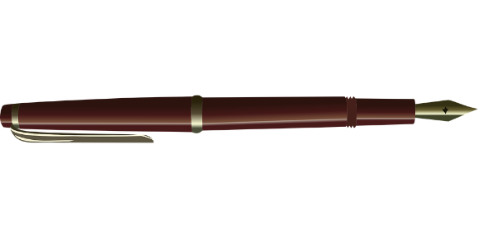
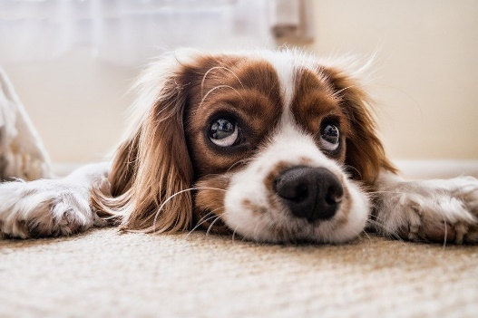
PPY TitleVV
More Words
pen
car
pig
dog
cup
e
a
i
o
u
Notes:
Notes for Teacher - < Information for further reference or explanation >
Revise the vowel sounds and their letter names before commencing the activity.
Encourage all to participate
Precautions:
Teachers should instruct the students that discipline be maintained throughout the activity.
Troubleshooting:
If any student is unable to pick up the sound and associate it to its respective letter, then he/ she should be helped/prompted to do so
Suggestions: <Ideas/ Images/ Animations / Others – To make better representation of the content >
Source of Multimedia used in this slide - <Please provide source URL where we find the image and the license agreement>
Car: SSSVV Image Gallery: Search Keyword “car”
Pen: https://pixabay.com/fr/vectors/stylo-stylo-plume-encrer-%c3%a9crivez-576559/
Pig: https://pixabay.com/fr/vectors/porc-mignonne-langue-le-sourire-308516/
Dog: https://pixabay.com/fr/photos/cocker-chiot-animal-de-compagnie-2785074/
Cup: https://pixabay.com/fr/photos/tasse-point%c3%a9-agresser-tasse-%c3%a0-caf%c3%a9-2315563/

Slide 6
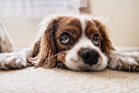
MM INDEX
Slide # | Thumbnail | Source link and Attribution
3, 4 |  | Teacher – SSSVV Image gallery: Search Keyword “teacher” Students - https://pixabay.com/illustrations/school-children-desks-school-4321808/ Board - https://pixabay.com/vectors/chalk-board-school-education-303457/
5 |  | Car: SSSVV Image Gallery: Search Keyword “car” Pen: https://pixabay.com/fr/vectors/stylo-stylo-plume-encrer-%c3%a9crivez-576559/ Pig: https://pixabay.com/fr/vectors/porc-mignonne-langue-le-sourire-308516/ Dog: https://pixabay.com/fr/photos/cocker-chiot-animal-de-compagnie-2785074/ Cup: https://pixabay.com/fr/photos/tasse-point%c3%a9-agresser-tasse-%c3%a0-caf%c3%a9-2315563/
Notes:
Notes for Teacher - < Information for further reference or explanation >
Suggestions: <Ideas/ Images/ Animations / Others – To make better representation of the content >
Source of Multimedia used in this slide - <Please provide source URL where we find the image and the license agreement>

