Slide 1
Differentiate the Vowel Sounds
A
E
I
O
U
Notes:
Notes for Teacher - < Information for further reference or explanation >
Suggestions: <Ideas/ Images/ Animations / Others – To make better representation of the content >
Source of Multimedia used in this slide - <Please provide source URL where we find the image and the license agreement>

Slide 2
Exercise 1
Answer the following questions.
1. Give some words with long ‘ee’ sound and short ‘e’ sounds?
Ans. ‘ee’ sound - sleek, teeth, feet
‘e’ sound - bed, red, Ted, fed.
2. How many vowels are there in the English alphabet?
Ans. There are 5 vowels in the English alphabet.
3. How many consonants are there in the English alphabet?
Ans. There are 21 consonants in the English alphabet.
Notes:
Notes for Teacher - < Information for further reference or explanation >
Suggestions: <Ideas/ Images/ Animations / Others – To make better representation of the content >
Source of Multimedia used in this slide - <Please provide source URL where we find the image and the license agreement>
<alphabets> <https://pixabay.com/illustrations/alphabet-letters-alphabet-letters-909040/>

Slide 3
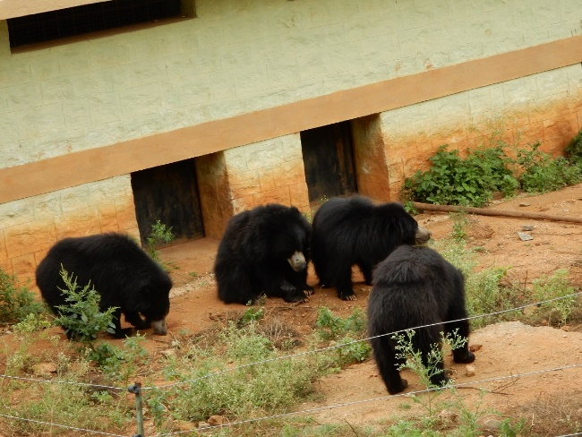
Exercise 2
Fill in the blanks to complete the words using a vowel.
Rishi is playing in a p___k.
Dark clouds bring r___n.
Keep these b___ks on the sh__lf.
Always sp___k the truth.
Don’t t___se the animals.
ar
ai
oo
e
ea
ea
Notes:
Notes for Teacher - < Information for further reference or explanation >
Suggestions: <Ideas/ Images/ Animations / Others – To make better representation of the content >
Source of Multimedia used in this slide - <Please provide source URL where we find the image and the license agreement>
<park> <https://pixabay.com/illustrations/kids-park-fun-swing-happiness-6171602/>
<clouds> <SSSVV Image Gallery: Search Keyword “dark clouds”>
<book shelf> <SSSVV Image Gallery: Search Keyword “book shelf”>
<truth> <https://pixabay.com/vectors/truth-lies-philosophy-wisdom-2069846/>
<zoo> <SSSVV Image Gallery: Search Keyword “zoo”>

Slide 4
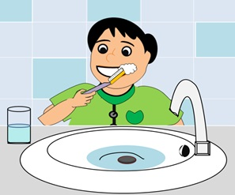
Exercise 2
Fill in the blanks to complete the words using a vowel.
You should brush your t___th twice a day.
N___ce is the opposite of nephew.
A s___d turns into a plant.
Laxmi Bai was a brave qu___n of Jhansi.
Sp___k softly in the library.
ee
ie
ee
ee
ea
Notes:
Notes for Teacher - < Information for further reference or explanation >
Suggestions: <Ideas/ Images/ Animations / Others – To make better representation of the content >
Source of Multimedia used in this slide - <Please provide source URL where we find the image and the license agreement>
<brushing teeth> <SSSVV Image Gallery: Search Keyword “brushing teeth”>
<girl> <SSSVV Image Gallery: Search Keyword “girl”>
<germination> <https://pixabay.com/illustrations/germination-dicotyledon-key-seed-3989959/>
<Library> <SSSVV Image Gallery: Search Keyword “library”>
<Lakshmi Bai> <SSSVV Image Gellery: Search Keyword “Rani lakshmi bai”>

Slide 5
MM INDEX
Slide # | Thumbnail | Source link and Attribution
2 |  | <Alphabets> https://pixabay.com/illustrations/alphabet-letters-alphabet-letters-909040/
3 |  | <Park> https://pixabay.com/illustrations/kids-park-fun-swing-happiness-6171602/ <Truth> https://pixabay.com/vectors/truth-lies-philosophy-wisdom-2069846/
4 |  | <Germination> https://pixabay.com/illustrations/germination-dicotyledon-key-seed-3989959/
Notes:
Notes for Teacher - < Information for further reference or explanation >
Suggestions: <Ideas/ Images/ Animations / Others – To make better representation of the content >
Source of Multimedia used in this slide - <Please provide source URL where we find the image and the license agreement>

