Slide 1
Trial with Vowels
Notes:
Notes for Teacher - < Information for further reference or explanation >
Suggestions: <Ideas/ Images/ Animations / Others – To make better representation of the content >
Source of Multimedia used in this slide - <Please provide source URL where we find the image and the license agreement>
1. <kids> - <https://pixabay.com/illustrations/boy-blackboard-girls-kids-clipart-2782842/>

Slide 2
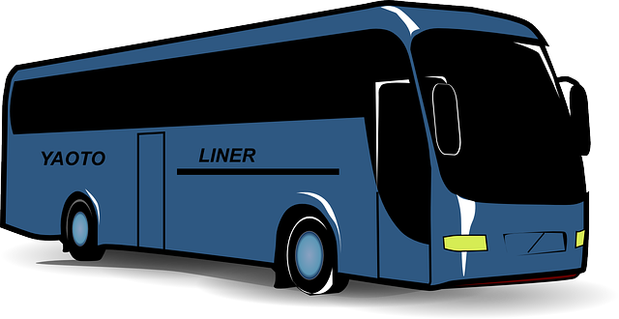
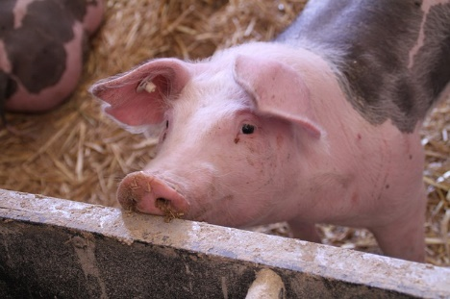
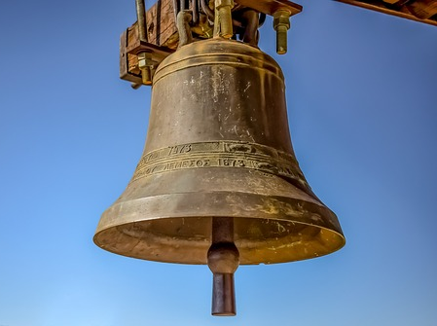
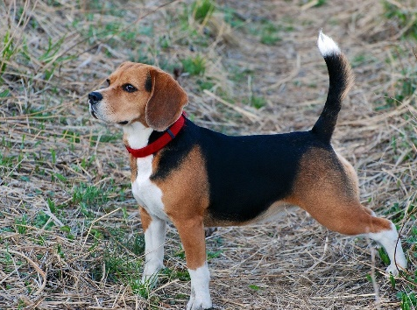
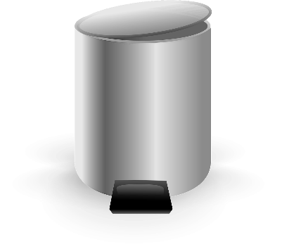
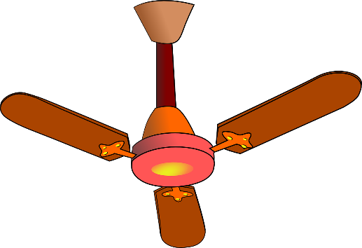
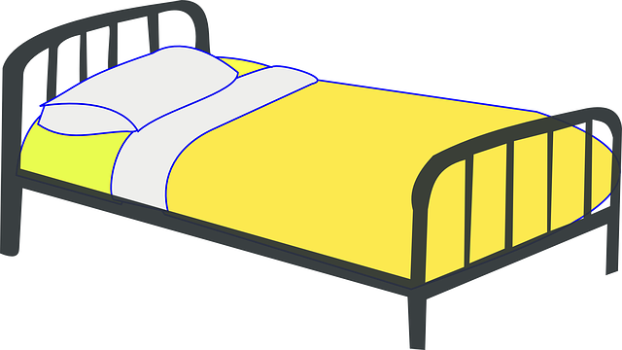
Fill in the Blanks with Vowels
u
i
e
o
a
b__s
p__g
b__ll
d__g
h__t
i
a
o
u
e
b__n
f__n
c__t
s__n
t__n
Click on the Image to see the answer
Notes:
Notes for Teacher - < Information for further reference or explanation >
Suggestions: <Ideas/ Images/ Animations / Others – To make better representation of the content >
Source of Multimedia used in this slide - <Please provide source URL where we find the image and the license agreement>
<bus> - <https://pixabay.com/vectors/bus-public-transport-transport-304845/>
<pig> - <https://pixabay.com/photos/pig-stall-livestock-dirty-piglet-4502063/ >
<bell> - <https://pixabay.com/photos/bell-church-sky-religion-3652226/>
<cot> - <https://pixabay.com/vectors/cot-bed-hospital-patient-care-312424/>
<sun> - <https://pixabay.com/vectors/sun-face-sunshine-smiley-ray-34485/>
<ten> - <https://pixabay.com/vectors/number-ten-mark-traffic-39489/>
<dog> - <https://pixabay.com/photos/dog-walk-pet-beagle-breed-orange-5144663/>
<hat> - <https://pixabay.com/vectors/red-hat-fedora-fashion-style-26734/>
<bin> - <https://pixabay.com/vectors/trash-can-metal-closed-can-garbage-24936/>
<fan> - <https://pixabay.com/vectors/ceiling-fan-fan-house-fan-circulate-33398/>

Slide 3
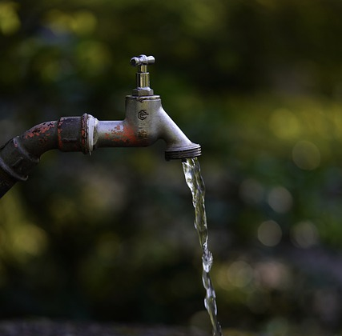
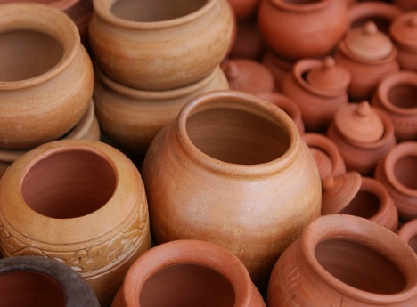
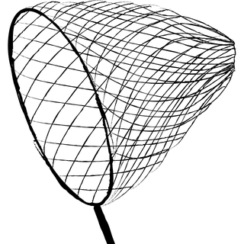
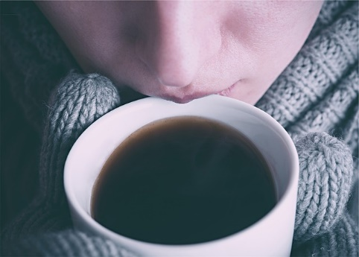
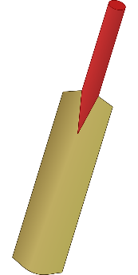
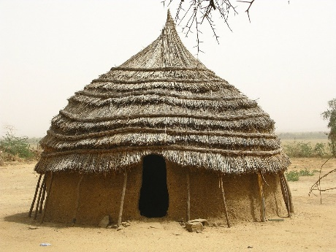
Name the picture and Circle the Vowels
b e d
t a p
p o t
n e t
c u p
s i p
b a t
l i p
h u t
t o p
Click on the Image to see the answer
Notes:
Notes for Teacher - < Information for further reference or explanation >
Suggestions: <Ideas/ Images/ Animations / Others – To make better representation of the content >
Source of Multimedia used in this slide - <Please provide source URL where we find the image and the license agreement>
<tap> - <https://pixabay.com/photos/water-tap-sink-bathtub-drink-pour-5069908/>
<net> - <https://pixabay.com/vectors/net-butterfly-net-net-with-handle-3850048/>
<cup> - <https://pixabay.com/photos/coffee-coffee-cup-hot-coffee-steam-2358388/>
<sip> - <https://pixabay.com/photos/coffee-hot-sipping-mitts-mittens-699431/>
<top> - <https://pixabay.com/photos/raise-challenge-landscape-mountain-3338589/>
<pot> - <https://pixabay.com/photos/claypots-clay-pots-terracotta-1323747/>
<bed> - <https://pixabay.com/vectors/bed-sleeping-sleep-bedroom-pillow-1300388/>
<lip> - <https://pixabay.com/vectors/lip-gloss-lips-lipstick-beauty-151266/>
<hut> - <https://pixabay.com/photos/niger-africa-hut-home-house-mud-80758/>
<bat> - <https://pixabay.com/vectors/bat-cricket-wood-tool-cricketer-25749/>

Slide 4
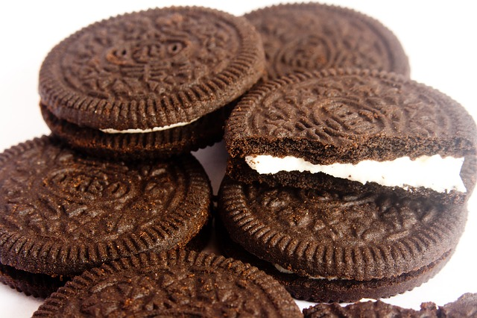
Circle the Vowels
F | L | O | W | E | R
H | O | U | S | E
Click on the Image to see the answer
B | I | S | C | U | I | T
Notes:
Notes for Teacher - < Information for further reference or explanation >
Suggestions: <Ideas/ Images/ Animations / Others – To make better representation of the content >
Source of Multimedia used in this slide - <Please provide source URL where we find the image and the license agreement>
<flower> - <https://pixabay.com/photos/roses-bouquet-of-roses-bouquet-1229148/>
<house> - <https://pixabay.com/illustrations/clip-art-hause-home-roof-design-3418131/>
<biscuit> - <https://pixabay.com/photos/cookies-biscuits-chocolate-cream-167039/ >

Slide 5
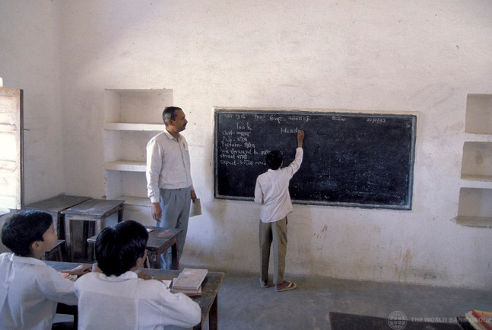
Circle the Vowels
C | L | A | S | S
S | C | H | O | O | L
Click on the Image to see the answer
P | E | N | C | I | L
Notes:
Notes for Teacher - < Information for further reference or explanation >
Suggestions: <Ideas/ Images/ Animations / Others – To make better representation of the content >
Source of Multimedia used in this slide - <Please provide source URL where we find the image and the license agreement>
<class> - <https://www.flickr.com/photos/10816734@N03/2243054578 By World Bank Photo Collection’s Photostream>
<school> - <https://pixabay.com/vectors/school-building-education-property-295210/>
<pencil> - <https://pixabay.com/illustrations/pencil-pen-write-pencil-drawing-913101/>

Slide 6
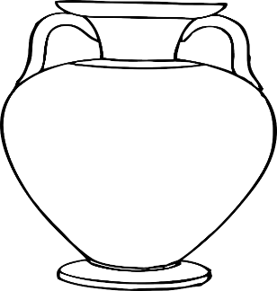
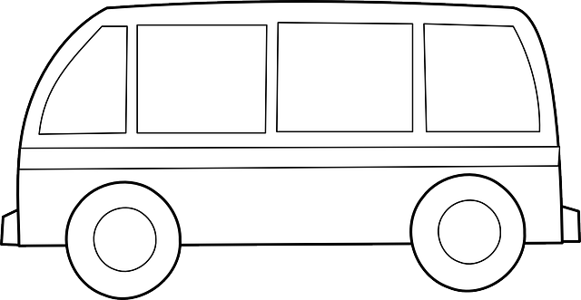
Complete the Word. Draw.
g
p
n
p
n
__u__
__e__
__i__
h
n
p
__e__
__o__
__a__
t
t
v
n
Notes:
Notes for Teacher - < Information for further reference or explanation >
Suggestions: <Ideas/ Images/ Animations / Others – To make better representation of the content >
Source of Multimedia used in this slide - <Please provide source URL where we find the image and the license agreement>
<hug> - <https://pixabay.com/photos/empathy-compassion-friendship-4181896/>
<pen> - <https://pixabay.com/vectors/filler-pen-silhouette-black-1072217/>
<pin> - <https://pixabay.com/vectors/safety-pin-pin-open-sharp-needle-29024/>
<pot> - <https://pixabay.com/vectors/vase-pottery-flower-pot-roman-295341/>
<van> - <https://pixabay.com/vectors/bus-van-vw-volkswagen-car-154865/>
<ten> - <https://pixabay.com/vectors/number-ten-mark-traffic-39489/>

Slide 7
Complete the Word. Make Sentences.
The cat is on the mat.
__a__
______________________________
c
t
b
g
That is a big bag.
__i__
______________________________
__o__
I like dogs.
d
g
______________________________
Notes:
Notes for Teacher - < Information for further reference or explanation >
Suggestions: <Ideas/ Images/ Animations / Others – To make better representation of the content >
Source of Multimedia used in this slide - <Please provide source URL where we find the image and the license agreement>

Slide 8
MM INDEX
Slide # | Thumbnail | Source link and Attribution
1 |  | <kids> - https://pixabay.com/illustrations/boy-blackboard-girls-kids-clipart-2782842/
2 |  | <bus> - https://pixabay.com/vectors/bus-public-transport-transport-304845/ <pig> - https://pixabay.com/photos/pig-stall-livestock-dirty-piglet-4502063/ <bell> - https://pixabay.com/photos/bell-church-sky-religion-3652226/ <cot> - https://pixabay.com/vectors/cot-bed-hospital-patient-care-312424/ <sun> - https://pixabay.com/vectors/sun-face-sunshine-smiley-ray-34485/ <ten> - https://pixabay.com/vectors/number-ten-mark-traffic-39489/ <dog> - https://pixabay.com/photos/dog-walk-pet-beagle-breed-orange-5144663/ <hat> - https://pixabay.com/vectors/red-hat-fedora-fashion-style-26734/ <bin> - https://pixabay.com/vectors/trash-can-metal-closed-can-garbage-24936/ <fan> - https://pixabay.com/vectors/ceiling-fan-fan-house-fan-circulate-33398/
3 |  | <tap> - https://pixabay.com/photos/water-tap-sink-bathtub-drink-pour-5069908/ <net> - https://pixabay.com/vectors/net-butterfly-net-net-with-handle-3850048/ <cup> - https://pixabay.com/photos/coffee-coffee-cup-hot-coffee-steam-2358388/ <sip> - https://pixabay.com/photos/coffee-hot-sipping-mitts-mittens-699431/ <top> - https://pixabay.com/photos/raise-challenge-landscape-mountain-3338589/ <pot> - https://pixabay.com/photos/claypots-clay-pots-terracotta-1323747/ <bed> - https://pixabay.com/vectors/bed-sleeping-sleep-bedroom-pillow-1300388/ <lip> - https://pixabay.com/vectors/lip-gloss-lips-lipstick-beauty-151266/ <hut> - https://pixabay.com/photos/niger-africa-hut-home-house-mud-80758/ <bat> - https://pixabay.com/vectors/bat-cricket-wood-tool-cricketer-25749/
4 |  | <flower> - https://pixabay.com/photos/roses-bouquet-of-roses-bouquet-1229148/ <house> - https://pixabay.com/illustrations/clip-art-hause-home-roof-design-3418131/ <biscuit> - https://pixabay.com/photos/cookies-biscuits-chocolate-cream-167039/
5 |  | <class> - https://www.flickr.com/photos/10816734@N03/2243054578 By World Bank Photo Collection’s Photostream <school> - https://pixabay.com/vectors/school-building-education-property-295210/ <pencil> - https://pixabay.com/illustrations/pencil-pen-write-pencil-drawing-913101/
6 |  | <hug> - https://pixabay.com/photos/empathy-compassion-friendship-4181896/ <pen> - https://pixabay.com/vectors/filler-pen-silhouette-black-1072217/ <pin> - https://pixabay.com/vectors/safety-pin-pin-open-sharp-needle-29024/ <pot> - https://pixabay.com/vectors/vase-pottery-flower-pot-roman-295341/ <van> - https://pixabay.com/vectors/bus-van-vw-volkswagen-car-154865/ <ten> - https://pixabay.com/vectors/number-ten-mark-traffic-39489/
Notes:
Notes for Teacher - < Information for further reference or explanation >
Suggestions: <Ideas/ Images/ Animations / Others – To make better representation of the content >
Source of Multimedia used in this slide - <Please provide source URL where we find the image and the license agreement>

