Slide 1
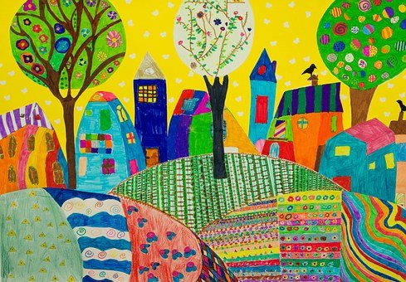
Fun with Picture Composition
Notes:
Notes for Teacher - < Information for further reference or explanation >
Suggestions: <Ideas/ Images/ Animations / Others – To make better representation of the content >
Source of Multimedia used in this slide -
1. https://pixabay.com/photos/children-s-drawings-coloring-town-716340/

Slide 2
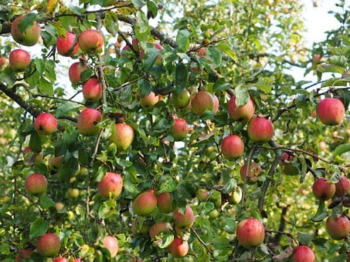
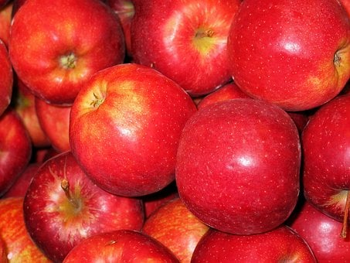
Picture Composition - Apples
Write some sentences about Apples
1. This is an apple tree
2. It has ripe red apples
3. I love to eat apples
Notes:
Notes for Teacher - < Information for further reference or explanation >
Suggestions: <Ideas/ Images/ Animations / Others – To make better representation of the content >
Source of Multimedia used in this slide -
Apple tree: https://pixabay.com/photos/apples-apple-tree-fruit-red-fresh-693969/
Apples: https://pixabay.com/photos/chalkboard-apple-apple-royal-gala-1831158/

Slide 3
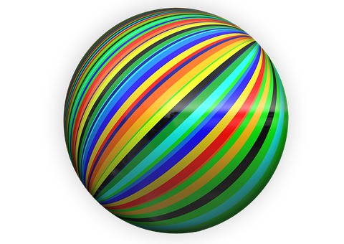
Picture Composition - Colourful Ball
Write some sentences about the Colourful Ball
1. It is a big ball
2. It has red, blue and yellow lines on it
3. I like to play with my ball
Notes:
Notes for Teacher - < Information for further reference or explanation >
Suggestions: <Ideas/ Images/ Animations / Others – To make better representation of the content >
Source of Multimedia used in this slide -
1. Ball: https://pixabay.com/illustrations/to-dye-ball-round-bullet-262808/

Slide 4
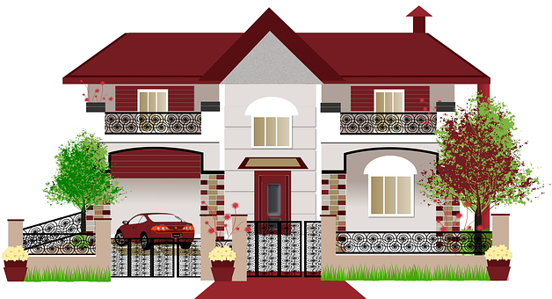
Picture Composition – HOUSE
Write some sentences about the HOUSE
1. This is my house
2. It is a big and beautiful house
3. I live with my parents and
sister in my house
Notes:
Notes for Teacher - < Information for further reference or explanation >
Suggestions: <Ideas/ Images/ Animations / Others – To make better representation of the content >
Source of Multimedia used in this slide -
1. House: https://pixabay.com/illustrations/villa-architecture-design-house-3761006/

Slide 5
MM INDEX
Slide # | Thumbnail | Source link and Attribution
1 |  | 1. https://pixabay.com/photos/children-s-drawings-coloring-town-716340/
2 |  | Apple tree: https://pixabay.com/photos/apples-apple-tree-fruit-red-fresh-693969/ Apples: https://pixabay.com/photos/chalkboard-apple-apple-royal-gala-1831158/
3 |  | 1. Ball: https://pixabay.com/illustrations/to-dye-ball-round-bullet-262808/
4 |  | 1. House: https://pixabay.com/illustrations/villa-architecture-design-house-3761006/
Notes:
Notes for Teacher - < Information for further reference or explanation >
Suggestions: <Ideas/ Images/ Animations / Others – To make better representation of the content >
Source of Multimedia used in this slide - <Please provide source URL where we find the image and the license agreement>

