Slide 1
I enjoy creative writing
Notes:
Notes for Teacher - < Information for further reference or explanation >
Suggestions: <Ideas/ Images/ Animations / Others – To make better representation of the content >
Source of Multimedia used in this slide -
1. https://pixabay.com/illustrations/notes-pencil-abc-writing-card-5729126/

Slide 2
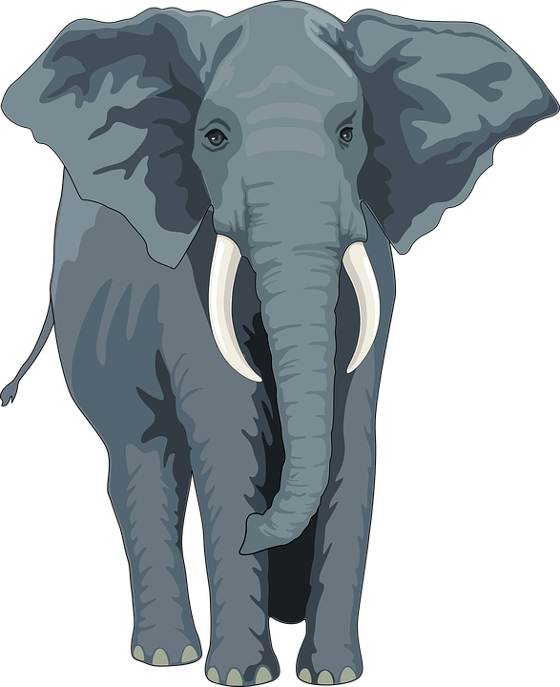
Composition based on image
1
What is the name of the animal?
It is an elephant
Is it a big or a small animal?
2
It is a big animal
Notes:
Notes for Teacher - < Information for further reference or explanation >
Suggestions: <Ideas/ Images/ Animations / Others – To make better representation of the content >
Source of Multimedia used in this slide -
1. Elephant: https://pixabay.com/vectors/elephant-animal-trunk-tusks-wild-48422/

Slide 3
Composition based on image
3
What does the elephant do with its trunk?
It drinks water with its trunk
What does the elephant like to eat?
4
It likes to eat fruits and sugarcane
Notes:
Notes for Teacher - < Information for further reference or explanation >
Suggestions: <Ideas/ Images/ Animations / Others – To make better representation of the content >
Source of Multimedia used in this slide -
1. Elephant: https://pixabay.com/vectors/elephant-animal-trunk-tusks-wild-48422/

Slide 4
Composition based on image
5
What are elephants teeth called?
They are called TUSKS
Notes:
Notes for Teacher - < Information for further reference or explanation >
Suggestions: <Ideas/ Images/ Animations / Others – To make better representation of the content >
Source of Multimedia used in this slide –
1. Elephant: https://pixabay.com/vectors/elephant-animal-trunk-tusks-wild-48422/

Slide 5
Paragraph on ELEPHANT
The elephant is the largest animal on land
It has two small eyes and two big ears
Its teeth are called tusks
It has a long trunk for drinking, breathing
It likes to eat grass, roots and fruits
I like to feed bananas and sugar cane to this huge animal
Notes:
Notes for Teacher - < Information for further reference or explanation >
Suggestions: <Ideas/ Images/ Animations / Others – To make better representation of the content >
Source of Multimedia used in this slide -
1. Elephant: https://pixabay.com/vectors/elephant-animal-trunk-tusks-wild-48422/

Slide 6
MM INDEX
Slide # | Thumbnail | Source link and Attribution
1 |  | https://pixabay.com/illustrations/notes-pencil-abc-writing-card-5729126/
2,3,4,5 |  | https://pixabay.com/vectors/elephant-animal-trunk-tusks-wild-48422/
Notes:
Notes for Teacher - < Information for further reference or explanation >
Suggestions: <Ideas/ Images/ Animations / Others – To make better representation of the content >
Source of Multimedia used in this slide - <Please provide source URL where we find the image and the license agreement>

