Slide 1
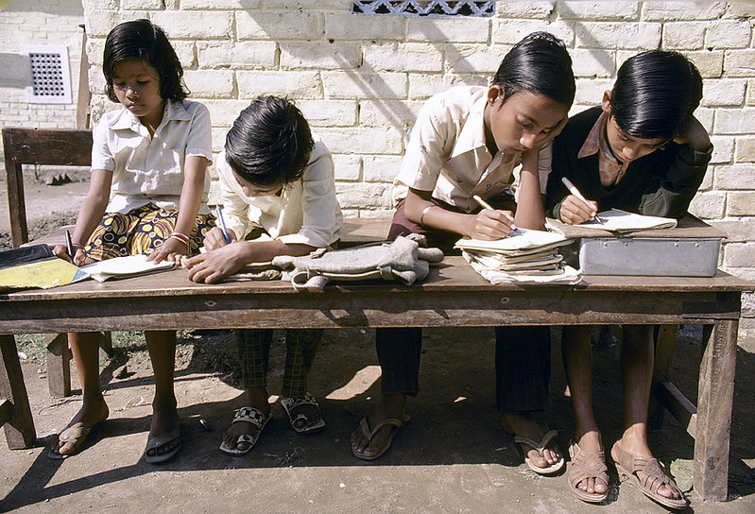
Joy Of Composition Writing
Notes:
Notes for Teacher - < Information for further reference or explanation >
Suggestions: <Ideas/ Images/ Animations / Others – To make better representation of the content >
Source of Multimedia used in this slide -
Students: https://www.flickr.com/photos/10816734@N03/2183733660 By World Bank Photo Collection

Slide 2
Picture Composition
Resources Required:
Pictures of Keywords
1
2
Leading Questions
Notes:
Notes for Teacher – < >
Suggestions: <Ideas/ Images/ Animations / Others – To make better representation of the content >
Source of Multimedia used in this slide - <Please provide source URL where we find the image and the license agreement>

Slide 3
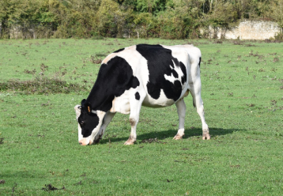
Picture Composition
Q1: Name the animal you see in the picture.
A1: The animal is a cow.
1
Q2: Is it a big or a small animal?
A2: It is a big animal.
2
Q3: How many legs does it have?
COW
A3: It has four legs.
3
cow | four
grass | leaves
milk
A4: It eats grass and leaves of plants and trees.
Q4: What does it eat?
4
A5: It gives us milk.
Q5: How does it help us?
5
Paragraph: This is a cow. It is a big animal. It has four legs. The cow eats grass and leaves of plants and trees. It gives us milk.
Notes:
Notes for Teacher – < Observation: Students can write a paragraph of about 4 to 5 sentences, describing a given picture. They will also remember to start sentences with capital letters and end with full stops. The formation of groups helps in collaborative learning.
Instructions to the teacher:
— Explain what paragraph writing is, using the answers of the leading questions.
— Remind the students that every sentence begins with a capital letter and ends with a full stop.
— Encourage everyone to participate and help in collaborative learning.>
Suggestions: <Precautions: Teacher to instruct the students that discipline is to be maintained throughout the activity.
Troubleshooting: If a particular group is unable to answer the lead questions, the teacher can guide them to get started or help them form a paragraph with those sentences.>
Source of Multimedia used in this slide - <Cow:- https://pixabay.com/photos/cow-cow-grazing-grass-cow-breton-4601552/>

Slide 4
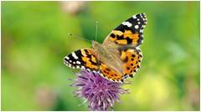
Picture Composition
Q1: What do you see in the picture?
A1: It is a butterfly.
1
Q2: Is it a bird or an insect?
2
A2: It is an insect.
BUTTERFLY
A3: The wings of a butterfly are very beautiful and colourful.
Q3: How are the wings of a butterfly?
3
butterfly | wings
colourful | beautiful
garden | nectar
Q4: Where do you find them?
A4: We find them in the garden where there are flowers.
4
A5: They drink the nectar from the flowers.
5
Q5: What do they eat?
Paragraph: This is a butterfly. It is an insect. The wings of a butterfly are very colourful. We find them in the gardens where there are flowers. They drink the nectar from the flowers.
Notes:
Notes for Teacher – < Observation: Students can write a paragraph of about 4 to 5 sentences, describing a given picture. They will also remember to start sentences with capital letters and end with full stops. The formation of groups helps in collaborative learning.
Instructions to the teacher:
— Explain what paragraph writing is, using the answers of the leading questions.
— Remind the students that every sentence begins with a capital letter and ends with a full stop.
— Encourage everyone to participate and help in collaborative learning.>
Suggestions: <Precautions: Teacher to instruct the students that discipline is to be maintained throughout the activity.
Troubleshooting: If a particular group is unable to answer the lead questions, the teacher can guide them to get started or help them form a paragraph with those sentences.>
Source of Multimedia used in this slide - <Butterfly https://pixabay.com/photos/vanessa-cardui-butterfly-edelfalter-1568926/ >

Slide 5
Picture Composition
Q1: What do you see in the picture?
A1: It is a bag.
1
Q2: What colour is the bag?
2
A2: It is green in colour.
BAG
A3: It is used for carrying books.
3
Q3: What is it used for?
green | carrying
books | children
school | safe
Q4: Who uses this bag?
A4: Children going to school use them.
4
A5: They use the bag to keep
their books safe.
Q5: Why do they use them?
5
Paragraph: This is a school bag. It is green in colour. The bag is used for carrying books. Children going to school use them. They use a bag to keep their books safe.
Notes:
Notes for Teacher – < Observation: Students can write a paragraph of about 4 to 5 sentences, describing a given picture. They will also remember to start sentences with capital letters and end with full stops. The formation of groups helps in collaborative learning.
Instructions to the teacher:
— Explain what paragraph writing is, using the answers of the leading questions.
— Remind the students that every sentence begins with a capital letter and ends with a full stop.
— Encourage everyone to participate and help in collaborative learning.>
Suggestions: <Precautions: Teacher to instruct the students that discipline is to be maintained throughout the activity.
Troubleshooting: If a particular group is unable to answer the lead questions, the teacher can guide them to get started or help them form a paragraph with those sentences.>
Source of Multimedia used in this slide - <School Bag: https://pixabay.com/vectors/backpack-grab-bag-rucksack-hike-311368/>

Slide 6
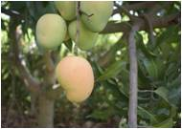
Picture Composition
Q1: What do you see in the picture?
A1: It is a tree.
1
Q2: What do you see on it?
2
A2: We see mangoes on it.
MANGO
A3: Some mangoes are green and some yellow.
Q3: What colour are the mangoes?
3
green | yellow
raw | ripe
mango | love
Q4: Do we eat only the ripe mangoes?
A4: We eat both the ripe and raw mangoes.
4
A5: I love to eat it.
5
Q5: Do you like to eat it?
Paragraph: This is a tree. It is a mango tree. Ripe mangoes are yellow and raw mangoes green in colour. We eat both raw and ripe mangoes. I love to eat mangoes.
Notes:
Notes for Teacher – < Observation: Students can write a paragraph of about 4 to 5 sentences, describing a given picture. They will also remember to start sentences with capital letters and end with full stops. The formation of groups helps in collaborative learning.
Instructions to the teacher:
— Explain what paragraph writing is, using the answers of the leading questions.
— Remind the students that every sentence begins with a capital letter and ends with a full stop.
— Encourage everyone to participate and help in collaborative learning.>
Suggestions: <Precautions: Teacher to instruct the students that discipline is to be maintained throughout the activity.
Troubleshooting: If a particular group is unable to answer the lead questions, the teacher can guide them to get started or help them form a paragraph with those sentences.>
Source of Multimedia used in this slide - < Mango https://pixabay.com/photos/mango-fruit-tropical-tree-branches-5550474/>

Slide 7
Picture Composition
Q1: What do you see in the picture?
A1: It is a school bus.
1
Q2: What is the colour of the bus?
2
A2: It is yellow in colour.
BUS
Q3: How many wheels does it have?
A3: It has four wheels.
3
bus | yellow
wheels | children
driver | school
Q4: Who uses this bus?
4
A4: School children use this bus.
Q5: Why do they use this bus?
A5: They use it to go to school.
5
Paragraph: This is a school bus. The driver drives it. It is yellow in colour. The bus has four wheels. School children use the bus. They use it to go to school.
Notes:
Notes for Teacher – < Observation: Students can write a paragraph of about 4 to 5 sentences, describing a given picture. They will also remember to start sentences with capital letters and end with full stops. The formation of groups helps in collaborative learning.
Instructions to the teacher:
— Explain what paragraph writing is, using the answers of the leading questions.
— Remind the students that every sentence begins with a capital letter and ends with a full stop.
— Encourage everyone to participate and help in collaborative learning.>
Suggestions: <Precautions: Teacher to instruct the students that discipline is to be maintained throughout the activity.
Troubleshooting: If a particular group is unable to answer the lead questions, the teacher can guide them to get started or help them form a paragraph with those sentences.>
Source of Multimedia used in this slide - < School Bus https://pixabay.com/illustrations/school-bus-schoolbus-bus-yellow-163599/>

Slide 8
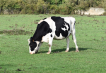
MM INDEX
Slide # | Thumbnail | Source link and Attribution
1 |  | Students: https://www.flickr.com/photos/10816734@N03/2183733660 By World Bank Photo Collection
3 |  | Cow: https://pixabay.com/photos/cow-cow-grazing-grass-cow-breton-4601552/
4 |  | Butterfly: https://pixabay.com/photos/vanessa-cardui-butterfly-edelfalter-1568926/
5 |  | School Bag: https://pixabay.com/vectors/backpack-grab-bag-rucksack-hike-311368/
6 |  | Mango: https://pixabay.com/photos/mango-fruit-tropical-tree-branches-5550474/>
7 |  | School Bus: https://pixabay.com/illustrations/school-bus-schoolbus-bus-yellow-163599/
Notes:
Notes for Teacher - < Information for further reference or explanation >
Suggestions: <Ideas/ Images/ Animations / Others – To make better representation of the content >
Source of Multimedia used in this slide - <Please provide source URL where we find the image and the license agreement>

