Slide 1
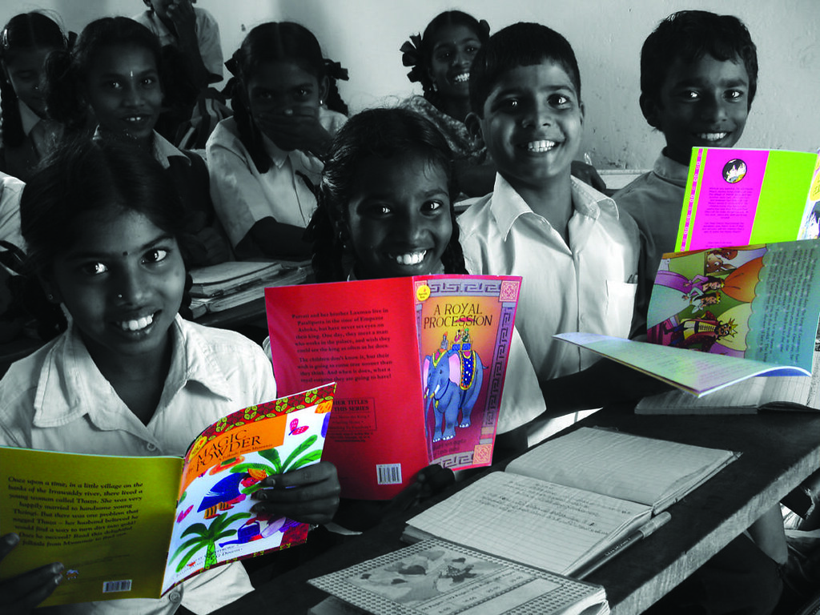
Passage Writing
Notes:
Notes for Teacher - < Information for further reference or explanation >
Suggestions: <Ideas/ Images/ Animations / Others – To make better representation of the content >
Source of Multimedia used in this slide -
1. https://www.flickr.com/photos/35026043@N03/3292581996 (Attribution: Pratham Books)

Slide 2
Composition
Write a paragraph
of 4 to 5 sentences on ‘A Parrot’ with the help of the words in the word bank
Word Bank
beautiful
grains
green
talk
red
nuts
fruits
Notes:
Notes for Teacher - < Information for further reference or explanation >
Suggestions: <Ideas/ Images/ Animations / Others – To make better representation of the content >
Source of Multimedia used in this slide - <Please provide source URL where we find the image and the license agreement>

Slide 3
Draw and Colour
Draw the picture of the parrot and colour it
Notes:
Notes for Teacher - The teacher can draw the parrot on the blackboard for the students to copy and colour.
Suggestions: <Ideas/ Images/ Animations / Others – To make better representation of the content >
Source of Multimedia used in this slide - <Please provide source URL where we find the image and the license agreement>

Slide 4
MM INDEX
Slide # | Thumbnail | Source link and Attribution
1 |  | 1. https://www.flickr.com/photos/35026043@N03/3292581996 (Attribution: Pratham Books)
3 |  | 1. https://pixabay.com/vectors/parrot-bird-era-feathers-plumage-1394537/
Notes:
Notes for Teacher - < Information for further reference or explanation >
Suggestions: <Ideas/ Images/ Animations / Others – To make better representation of the content >
Source of Multimedia used in this slide - <Please provide source URL where we find the image and the license agreement>

