Slide 1
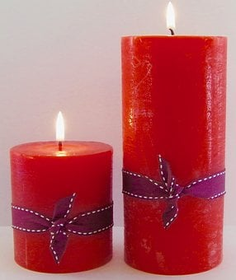
Role of Adjectives
Notes:
Notes for Teacher - < Information for further reference or explanation >
Suggestions: <Ideas/ Images/ Animations / Others – To make better representation of the content >
Source of Multimedia used in this slide -
1. https://pixabay.com/photos/candles-tall-and-short-red-2452985/

Slide 2
ADJECTIVES
Words that describe nouns are called adjectives (describing words). They add more information to nouns
What are adjectives
or describing words?
Notes:
Notes for Teacher - < Information for further reference or explanation >
Suggestions: <Ideas/ Images/ Animations / Others – To make better representation of the content >
Source of Multimedia used in this slide -
Teacher: SSSVV Gallery ( Key word teacher , mother)
Boy and girl: https://www.hiclipart.com/free-transparent-background-png-clipart-labdq

Slide 3
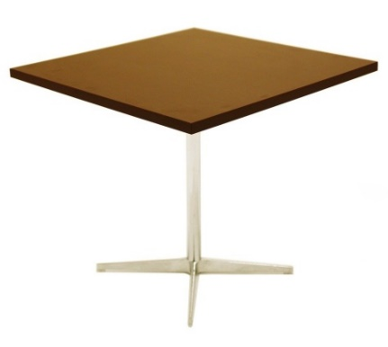
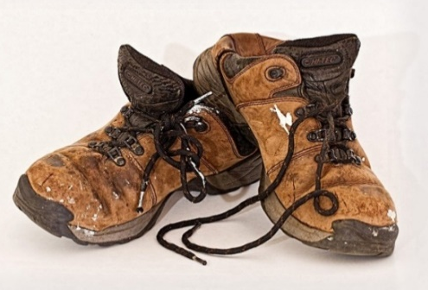
Types of Adjectives or Describing words
Quality
1
2
Size
Shape
3
4
Age
Number
5
6
Colour
Notes:
Notes for Teacher - < Information for further reference or explanation >
Suggestions: <Ideas/ Images/ Animations / Others – To make better representation of the content >
Source of Multimedia used in this slide -
Quality: Hot milk - https://pixabay.com/vectors/fire-flame-pot-burn-boil-stew-40252/
Size:Fat Frog - https://pixabay.com/illustrations/frog-fat-fat-frog-amphibian-toad-5310806/
Shape: Square Table- https://pixabay.com/photos/table-wood-fibre-boards-decor-3703577/
Colour: Green grass - https://pixabay.com/vectors/grass-lawn-green-nature-meadow-303714/
Age: Old shoe- https://pixabay.com/photos/old-shoes-labourer-footwear-used-374935/
Number: https://pixabay.com/photos/candles-bokeh-highlights-3798374/

Slide 4
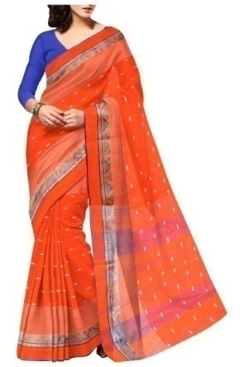
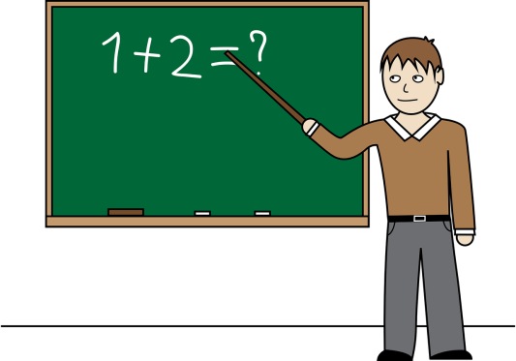
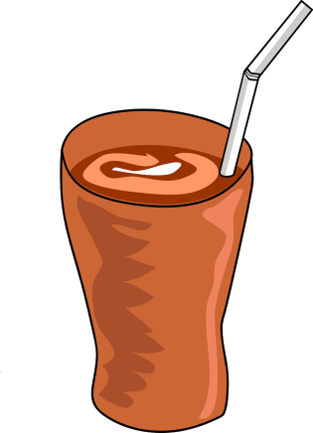
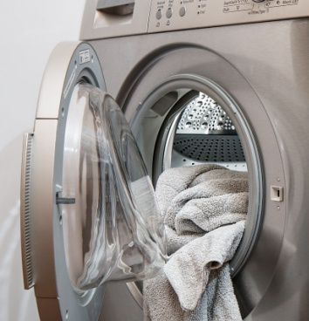
Adjectives of Quality
pretty doll
lovely saree
smart teacher
hot milk
cold coffee
dirty clothes
Notes:
Notes for Teacher - < Information for further reference or explanation >
Suggestions: <Ideas/ Images/ Animations / Others – To make better representation of the content >
Source of Multimedia used in this slide –
Doll - https://pixabay.com/vectors/baby-child-childhood-children-doll-161937/
Dress - https://pixabay.com/photos/saree-indian-ethnic-clothing-734917/
Teacher- https://pixabay.com/vectors/teacher-classroom-chalk-board-man-651318/
Hot milk - https://pixabay.com/vectors/fire-flame-pot-burn-boil-stew-40252/
Cold coffee - https://pixabay.com/vectors/iced-coffee-coffee-takeaway-cocoa-149720/
Dirty clothes - https://pixabay.com/photos/washing-machine-laundry-tumble-drier-2668472/

Slide 5
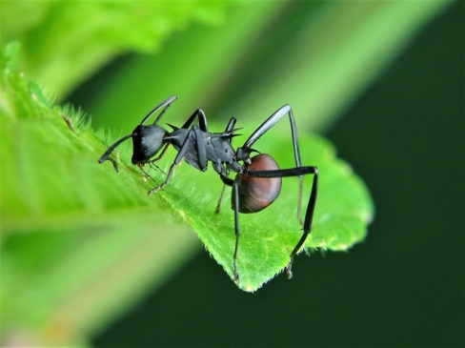
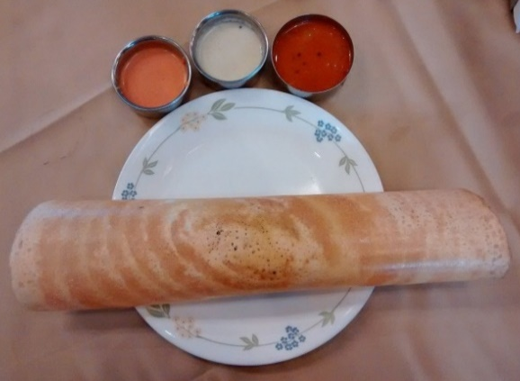
Adjectives of Size
big book
small ant
huge building
tall tree
thin dosa
fat frog
Notes:
Notes for Teacher - < Information for further reference or explanation >
Suggestions: <Ideas/ Images/ Animations / Others – To make better representation of the content >
Source of Multimedia used in this slide -
Book - https://pixabay.com/vectors/books-library-education-literature-42701/
Ant - https://pixabay.com/photos/ant-ants-insect-nature-wildlife-3036843/
Skyscraper - https://pixabay.com/vectors/city-buildings-skyscrapers-towers-48851/
Palm Tree - https://pixabay.com/illustrations/palm-tree-beach-sea-scenery-2300041/
Dosa - https://pixabay.com/photos/dosa-masala-dosa-food-india-kerala-2069313/
Fat Frog - https://pixabay.com/illustrations/frog-fat-fat-frog-amphibian-toad-5310806/

Slide 6
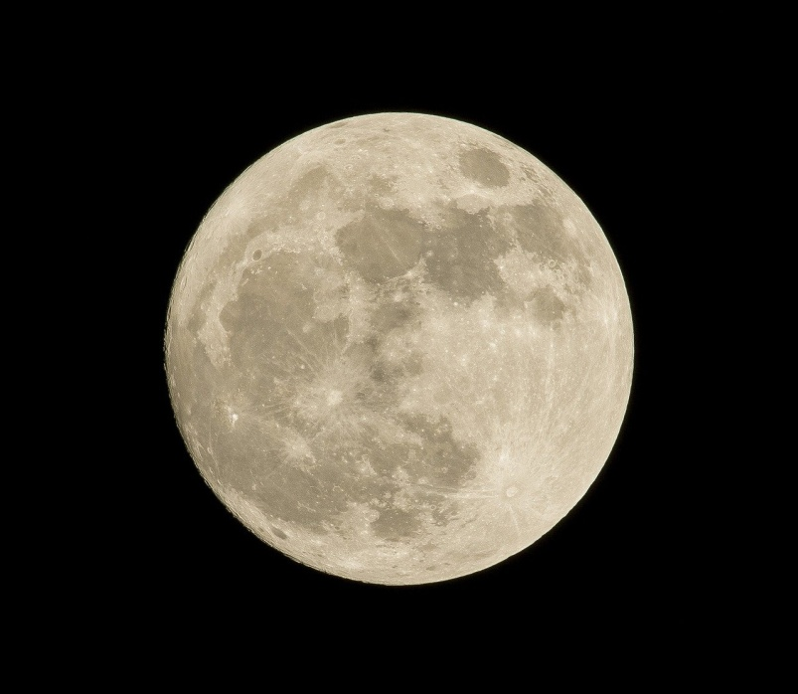
Adjectives of Shape
round moon
square table
Notes:
Notes for Teacher - < Information for further reference or explanation >
Suggestions: <Ideas/ Images/ Animations / Others – To make better representation of the content >
Source of Multimedia used in this slide -
Full moon - https://pixabay.com/photos/astronomy-full-moon-luna-moon-1869760/
Square Table- https://pixabay.com/photos/table-wood-fibre-boards-decor-3703577/

Slide 7
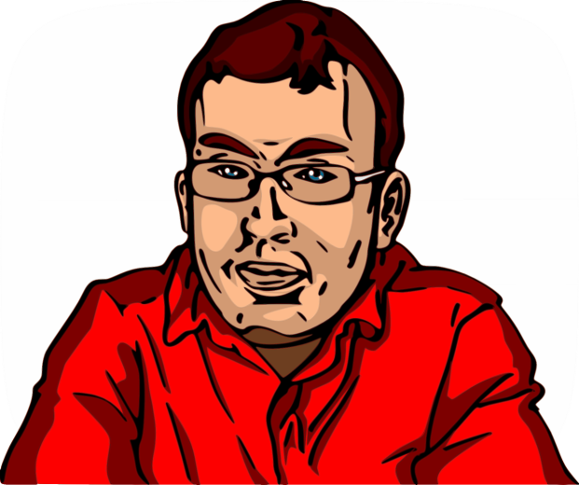
Adjectives of Age
old shoe
new house
young man
Notes:
Notes for Teacher - < Information for further reference or explanation >
Suggestions: <Ideas/ Images/ Animations / Others – To make better representation of the content >
Source of Multimedia used in this slide -
Old shoe- https://pixabay.com/photos/old-shoes-labourer-footwear-used-374935/
New house- https://pixabay.com/illustrations/modern-house-flat-home-background-4423814/
Young man - https://pixabay.com/vectors/man-glasses-guy-red-shirt-smile-160449/

Slide 8
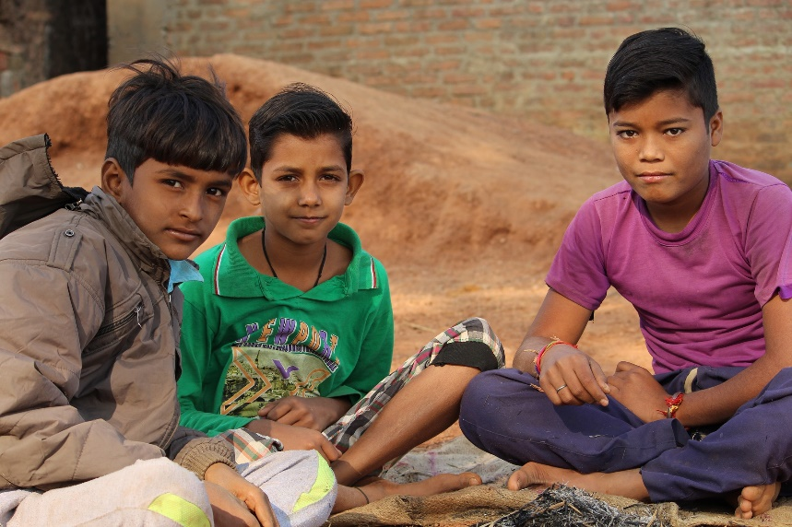
Adjectives of Number
five candles
three children
Notes:
Notes for Teacher - < Information for further reference or explanation >
Suggestions: <Ideas/ Images/ Animations / Others – To make better representation of the content >
Source of Multimedia used in this slide -
Five Candles - https://pixabay.com/photos/candles-bokeh-highlights-3798374/
Boys - https://pixabay.com/photos/poor-boy-cute-village-boy-child-4133640/

Slide 9
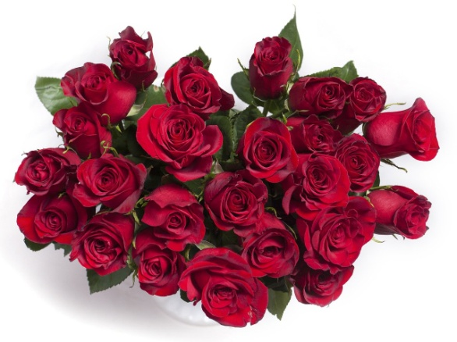
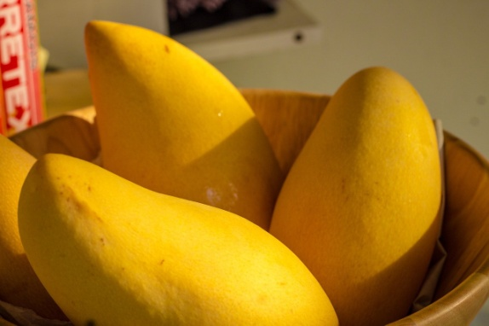
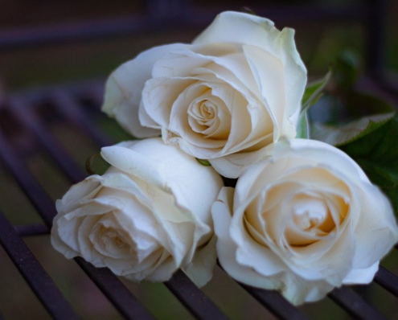
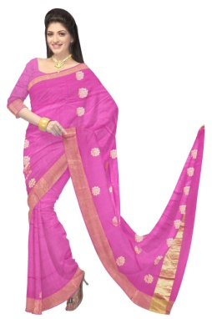
Adjectives of Colour
green grass
blue sky
red roses
yellow mangoes
white roses
pink saree
Notes:
Notes for Teacher - < Information for further reference or explanation >
Suggestions: <Ideas/ Images/ Animations / Others – To make better representation of the content >
Source of Multimedia used in this slide -
Green grass - https://pixabay.com/vectors/grass-lawn-green-nature-meadow-303714/
Blue sky - https://pixabay.com/photos/roses-red-roses-red-bouquet-982829/
Red Roses- https://pixabay.com/vectors/city-buildings-skyscrapers-towers-48851/
Mangoes- https://pixabay.com/photos/mango-fruit-food-healthy-fresh-5171744/
white roses - https://pixabay.com/photos/rose-white-rose-roses-plant-bloom-4441608/
Pink saree - https://pixabay.com/photos/saree-fashion-silk-dress-woman-360374/

Slide 10
Adjectives
In the sentences given below, nouns are in bold font and the underlined words are adjectives that describe the nouns
The sun is hot.
The box is heavy.
There is a brown dog in the kennel.
She is a clever girl.
His shoes are dirty.
Notes:
Notes for Teacher - < Information for further reference or explanation >
Suggestions: <Ideas/ Images/ Animations / Others – To make better representation of the content >
Source of Multimedia used in this slide - <Please provide source URL where we find the image and the license agreement>

Slide 11
MM INDEX
Slide # | Thumbnail | Source link and Attribution
1 |  | 1. https://pixabay.com/photos/candles-tall-and-short-red-2452985/
2 |  | Teacher: SSSVV Gallery ( Key word teacher , mother) Boy and girl: https://www.hiclipart.com/free-transparent-background-png-clipart-labdq
3 |  | Quality: Hot milk - https://pixabay.com/vectors/fire-flame-pot-burn-boil-stew-40252/ Size:Fat Frog - https://pixabay.com/illustrations/frog-fat-fat-frog-amphibian-toad-5310806/ Shape: Square Table- https://pixabay.com/photos/table-wood-fibre-boards-decor-3703577/ Colour: Green grass - https://pixabay.com/vectors/grass-lawn-green-nature-meadow-303714/ Age: Old shoe- https://pixabay.com/photos/old-shoes-labourer-footwear-used-374935/ Number: https://pixabay.com/photos/candles-bokeh-highlights-3798374/
4 |  | Doll - https://pixabay.com/vectors/baby-child-childhood-children-doll-161937/ Dress - https://pixabay.com/photos/saree-indian-ethnic-clothing-734917/ Teacher- https://pixabay.com/vectors/teacher-classroom-chalk-board-man-651318/ Hot milk - https://pixabay.com/vectors/fire-flame-pot-burn-boil-stew-40252/ Cold coffee - https://pixabay.com/vectors/iced-coffee-coffee-takeaway-cocoa-149720/ Dirty clothes - https://pixabay.com/photos/washing-machine-laundry-tumble-drier-2668472/
5 |  | Book - https://pixabay.com/vectors/books-library-education-literature-42701/ Ant - https://pixabay.com/photos/ant-ants-insect-nature-wildlife-3036843/ Skyscraper - https://pixabay.com/vectors/city-buildings-skyscrapers-towers-48851/ Palm Tree - https://pixabay.com/illustrations/palm-tree-beach-sea-scenery-2300041/ Dosa - https://pixabay.com/photos/dosa-masala-dosa-food-india-kerala-2069313/ Fat Frog - https://pixabay.com/illustrations/frog-fat-fat-frog-amphibian-toad-5310806/
6 |  | Full moon - https://pixabay.com/photos/astronomy-full-moon-luna-moon-1869760/ Square Table- https://pixabay.com/photos/table-wood-fibre-boards-decor-3703577/
7 |  | Old shoe- https://pixabay.com/photos/old-shoes-labourer-footwear-used-374935/ New house- https://pixabay.com/illustrations/modern-house-flat-home-background-4423814/ Young man - https://pixabay.com/vectors/man-glasses-guy-red-shirt-smile-160449/
8 |  | Five Candles - https://pixabay.com/photos/candles-bokeh-highlights-3798374/ Boys - https://pixabay.com/photos/poor-boy-cute-village-boy-child-4133640/
9 |  | Green grass - https://pixabay.com/vectors/grass-lawn-green-nature-meadow-303714/ Blue sky - https://pixabay.com/photos/roses-red-roses-red-bouquet-982829/ Red Roses- https://pixabay.com/vectors/city-buildings-skyscrapers-towers-48851/ Mangoes- https://pixabay.com/photos/mango-fruit-food-healthy-fresh-5171744/ white roses - https://pixabay.com/photos/rose-white-rose-roses-plant-bloom-4441608/ Pink saree - https://pixabay.com/photos/saree-fashion-silk-dress-woman-360374/
Notes:
Notes for Teacher - < Information for further reference or explanation >
Suggestions: <Ideas/ Images/ Animations / Others – To make better representation of the content >
Source of Multimedia used in this slide - <Please provide source URL where we find the image and the license agreement>

