Slide 1
Describing Words
Notes:
Notes for Teacher – N/A
Suggestions: N/A
Source of Multimedia used in this slide - N/A

Slide 2
Describing Words
Aim
To learn about Adjectives through Rhymes
Notes:
Notes for Teacher – N/A
Suggestions: N/A
Source of Multimedia used in this slide - N/A

Slide 3
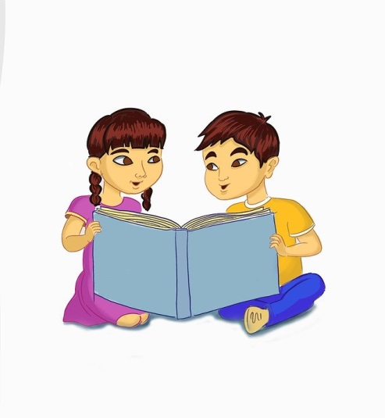
Procedure
1
Take a look at the DESCRIBING words given in the next slides
2
Read and repeat the poem to recognize the DESCRIBING words
Notes:
Notes for Teacher – N/A
Suggestions: N/A
Source of Multimedia used in this slide -
Reading: https://www.maxpixel.net/Girl-Kids-Boy-Happy-Asian-Uzbek-Read-Book-6487815

Slide 4
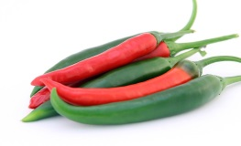
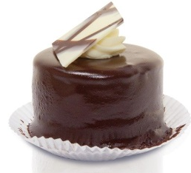
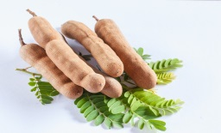
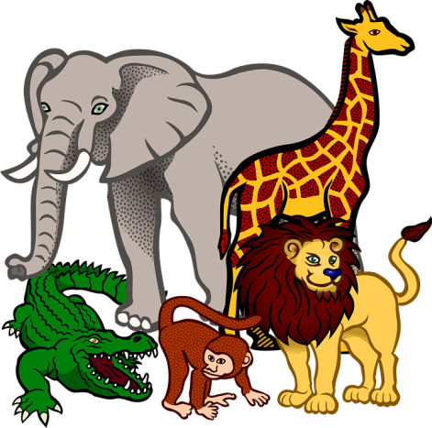
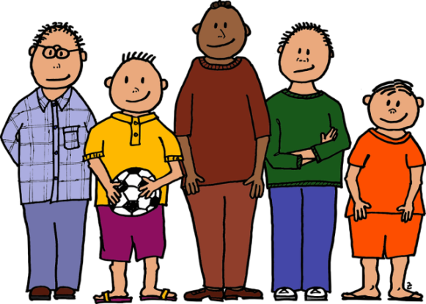
Describing Words
How things taste
(hot, sweet, sour)
1
2
How things look
(big, small, short, tall, long)
How many
(numbers and also colours)
3
Notes:
Notes for Teacher – N/A
Suggestions: N/A
Source of Multimedia used in this slide -
Chillies: https://pixabay.com/photos/appetite-banana-calories-catering-1238240/
Cake: https://pixabay.com/photos/tart-cakes-small-four-to-bake-66107/
Tamarind: https://pixabay.com/photos/tamarind-fruits-food-fresh-natural-636962/
Animals: https://pixabay.com/vectors/africa-animal-animals-books-del-sur-1300602/
Boys: https://pixabay.com/vectors/ball-colour-five-young-boys-1300645/

Slide 5
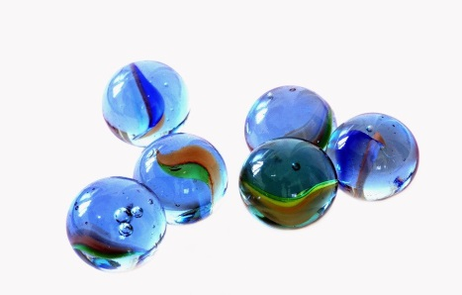
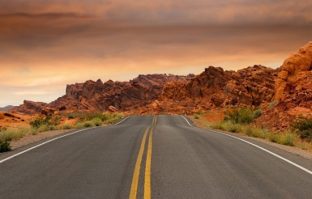
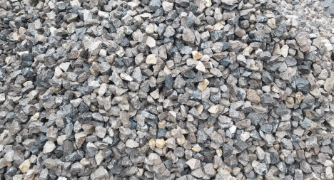
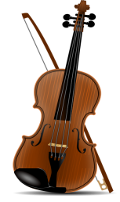
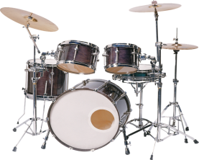
Describing Words
How do things feel?
(soft, hard, rough, coarse)
4
How do things sound?
(sweet, pleasant, rough, loud)
5
Notes:
Notes for Teacher – N/A
Suggestions: N/A
Source of Multimedia used in this slide -
Rose: https://pixabay.com/illustrations/red-rose-flower-bloom-plant-flora-1649142/
Marbles: https://pixabay.com/photos/blue-glass-marbles-kids-games-199261/
Road: https://pixabay.com/photos/road-sandstone-sunset-pavement-1303617/
Coarse: https://pxhere.com/en/photo/714980
Drums: https://pixabay.com/photos/drums-tools-percussion-music-1696802/
Violin: https://pixabay.com/vectors/violin-classic-music-opera-156558/
Music: https://pixabay.com/vectors/silhouette-musical-note-clef-bass-3275055/

Slide 6
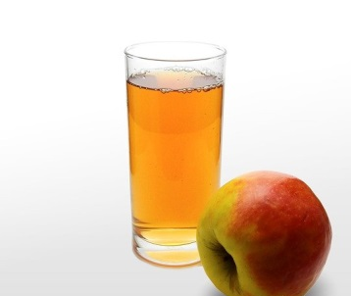
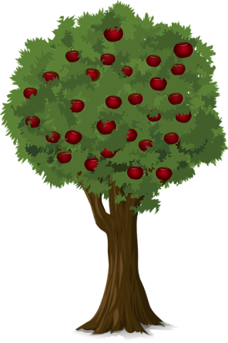
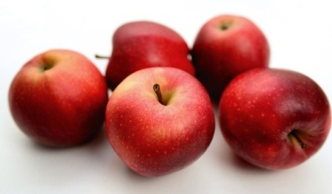
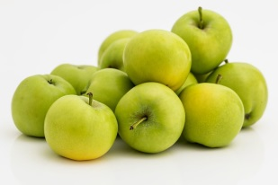
Lets Read Along
The colour and shape of a noun,
I have an apple, JUICY and ROUND
On a big tree they are found
An adjective can tell us
The number and size of a noun,
TEN Apples GREEN, FIVE Apples RED
BIG or SMALL I like them all
On a big tree they are found
Adjectives, adjectives,
Let’s see what we can learn now
Notes:
Notes for Teacher – Emphasize on BOLD letters of the poem which are Adjectives
BOLD letters can be repeated
Suggestions: N/A
Source of Multimedia used in this slide -
Apple Juice: https://pixabay.com/photos/juice-apple-glass-drink-1584209/
Apple Tree: https://pixabay.com/vectors/tree-apple-apple-tree-nature-fruit-923776/
Green Apple: https://pixabay.com/photos/apple-fruit-green-healthy-fresh-662003/
Red Apple: https://pixabay.com/photos/apples-fruits-food-red-apples-5977243/

Slide 7
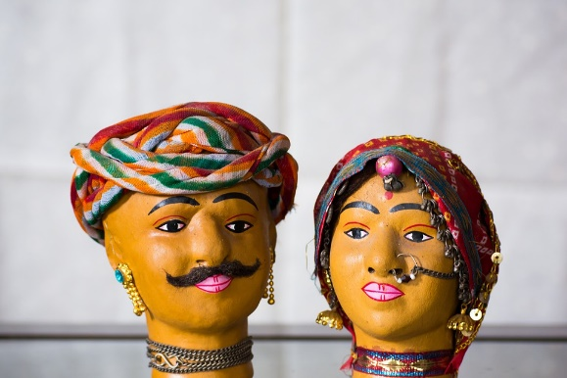
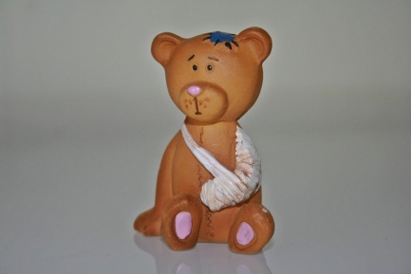
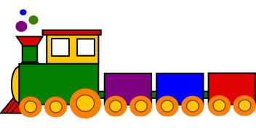
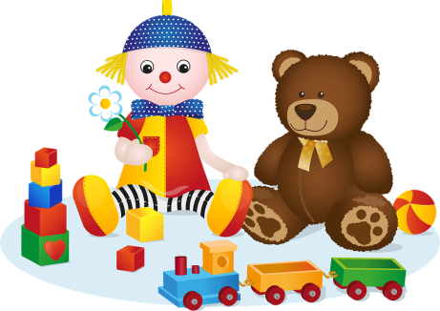
Lets Read Along
Describing Words
An ADJECTIVE describes a noun
Let’s describe a TOY now…
It’s a PRETTY toy
BROKEN toy, a LONG toy…
TALL, SHORT, BIG, SMALL …
MANY toys, TWO toys, FOUR toys…
ANY colour or size I can…..
Play with them all
Notes:
Notes for Teacher – Emphasize on BOLD letters of the poem which are Adjectives
BOLD letters can be repeated
Suggestions: N/A
Source of Multimedia used in this slide -
Toy: https://pixabay.com/fr/photos/artisanat-poup%c3%a9e-inde-rajasthan-3614568/
Teddy Bear: https://pixabay.com/photos/injured-teddy-toy-plastic-figure-330607/
Train: https://pixabay.com/vectors/train-toy-colorful-locomotive-308471/
Toys: https://pixabay.com/vectors/toy-toys-doll-teddy-bear-5262311/

Slide 8
MM INDEX
Slide # | Thumbnail | Source link and Attribution
3 |  | Reading: https://www.maxpixel.net/Girl-Kids-Boy-Happy-Asian-Uzbek-Read-Book-6487815
4 |  | Chillies: https://pixabay.com/photos/appetite-banana-calories-catering-1238240/ Cake: https://pixabay.com/photos/tart-cakes-small-four-to-bake-66107/ Tamarind: https://pixabay.com/photos/tamarind-fruits-food-fresh-natural-636962/ Animals: https://pixabay.com/vectors/africa-animal-animals-books-del-sur-1300602/ Boys: https://pixabay.com/vectors/ball-colour-five-young-boys-1300645/
5 |  | Rose: https://pixabay.com/illustrations/red-rose-flower-bloom-plant-flora-1649142/ Marbles: https://pixabay.com/photos/blue-glass-marbles-kids-games-199261/ Road: https://pixabay.com/photos/road-sandstone-sunset-pavement-1303617/ Coarse: https://pxhere.com/en/photo/714980 Drums: https://pixabay.com/photos/drums-tools-percussion-music-1696802/ Violin: https://pixabay.com/vectors/violin-classic-music-opera-156558/ Music: https://pixabay.com/vectors/silhouette-musical-note-clef-bass-3275055/
6 |  | Apple Juice: https://pixabay.com/photos/juice-apple-glass-drink-1584209/ Apple Tree: https://pixabay.com/vectors/tree-apple-apple-tree-nature-fruit-923776/ Green Apple: https://pixabay.com/photos/apple-fruit-green-healthy-fresh-662003/ Red Apple: https://pixabay.com/photos/apples-fruits-food-red-apples-5977243/
7 |  | Toy: https://pixabay.com/fr/photos/artisanat-poup%c3%a9e-inde-rajasthan-3614568/ Teddy Bear: https://pixabay.com/photos/injured-teddy-toy-plastic-figure-330607/ Train: https://pixabay.com/vectors/train-toy-colorful-locomotive-308471/ Toys: https://pixabay.com/vectors/toy-toys-doll-teddy-bear-5262311/

