Slide 1
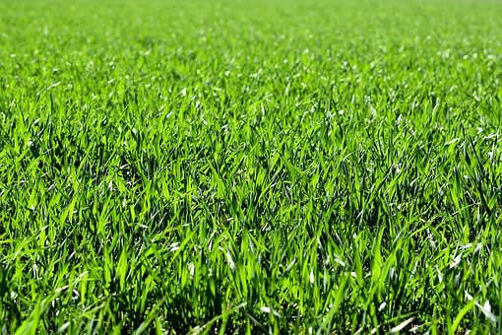
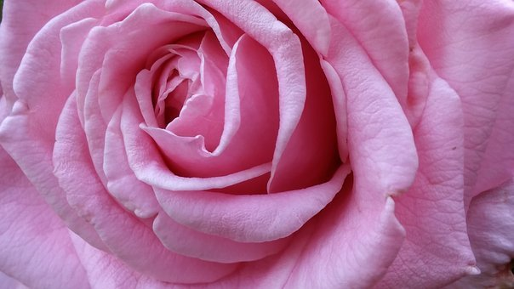
Testing Time - Adjectives
Notes:
Notes for Teacher - < Information for further reference or explanation >
Suggestions: <Ideas/ Images/ Animations / Others – To make better representation of the content >
Source of Multimedia used in this slide -
Green grass: https://pixabay.com/photos/meadow-field-nature-grass-2184989/
Big Rose. Flower: https://pixabay.com/photos/pretty-beautiful-pink-rose-big-2411027/

Slide 2
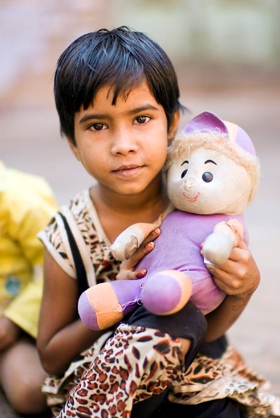
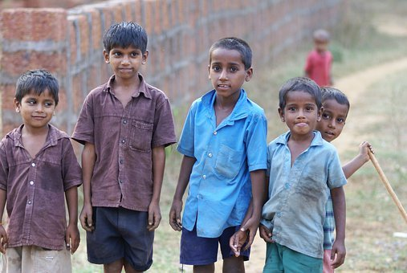
Adjectives - Exercise 1
Underline the adjectives in these sentences
Example: My mother bought a beautiful bag today
1. The little girl was playing with her doll
2. I love my soft pillow
VIKAS
3. Vikas is a tall boy
4. It was a hot day yesterday
Notes:
Notes for Teacher - < Information for further reference or explanation >
Suggestions: <Ideas/ Images/ Animations / Others – To make better representation of the content >
Source of Multimedia used in this slide -
Girl: https://www.flickr.com/photos/50979393@N00/6334286950 By Christopher Michel
Doll: https://pixabay.com/vectors/toys-kids-playing-childhood-child-2411790/
Pillow: https://pixabay.com/photos/pillows-pile-of-pillows-textile-655245/
Boy: https://pixabay.com/photos/indian-children-mischievous-group-4422461/
Hot: https://pixabay.com/vectors/summer-heat-weather-temperature-6125976/

Slide 3
Match the Columns - Exercise 2
Match the Describing words (Adjectives) in column A with the Naming words (Nouns) in column B.
Column A
Column B
smart
smart
potato
potato
sweet
sweet
crow
crow
thirsty
thirsty
student
student
fast
fast
crayons
crayons
yellow
yellow
train
train
Notes:
Notes for Teacher - < Information for further reference or explanation >
Suggestions: <Ideas/ Images/ Animations / Others – To make better representation of the content >
Source of Multimedia used in this slide - <Please provide source URL where we find the image and the license agreement>

Slide 4
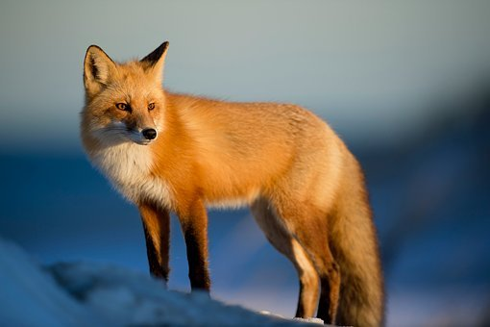
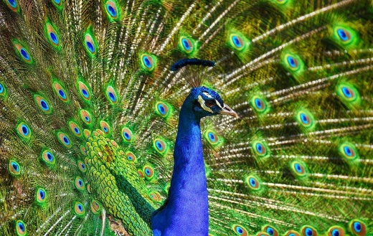
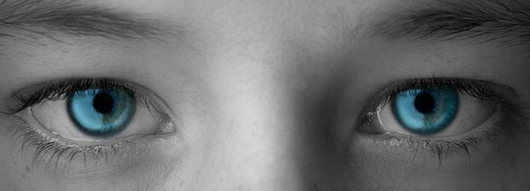
Adjectives - Exercise 3
Choose the correct adjective given in the brackets and fill in the blanks
long
Example: Rita has ________hair. (big, long)
1. My brother wants to buy a _________ phone. (new, old)
new
clever
2. The fox is a ___________ animal. (huge, clever)
beautiful
3. The peacock is a _____________ bird. (beautiful, ugly)
4. My friend has _________ eyes. (blue, pink)
blue
Notes:
Notes for Teacher - < Information for further reference or explanation >
Suggestions: <Ideas/ Images/ Animations / Others – To make better representation of the content >
Source of Multimedia used in this slide -
Phone: https://pixabay.com/vectors/iphone-6s-plus-iphone-smart-phone-1534380/
Fox: https://pixabay.com/photos/fox-animal-wilderness-nature-2597803/
Peacock: https://pixabay.com/photos/peafowl-peacock-bird-feathers-3617385/
Blue eyes: https://pixabay.com/photos/eyes-blue-vision-sight-eyelashes-6926035/

Slide 5
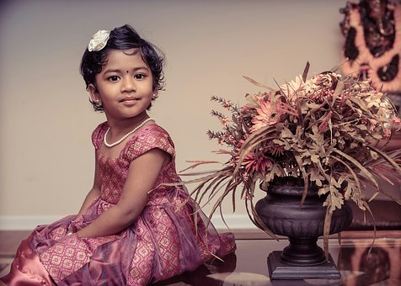
Adjectives - Exercise 4
Make sentences of your own with the describing words given below
round
good
green
1. The ball is round
2. She is a good girl
3. The grass is green
Notes:
Notes for Teacher - < Information for further reference or explanation >
Suggestions: <Ideas/ Images/ Animations / Others – To make better representation of the content >
Source of Multimedia used in this slide -
Ball: https://pixabay.com/photos/soccer-ball-football-ball-sports-2844880/
Girl: https://pixabay.com/photos/children-portrait-artistic-girl-1706121/
Grass: https://pixabay.com/photos/meadow-field-nature-grass-2184989/

Slide 6
MM INDEX
Slide # | Thumbnail | Source link and Attribution
1 |  | Green grass: https://pixabay.com/photos/meadow-field-nature-grass-2184989/ Big Rose. Flower: https://pixabay.com/photos/pretty-beautiful-pink-rose-big-2411027/
2 |  | Girl: https://www.flickr.com/photos/50979393@N00/6334286950 By Christopher Michel Pillow: https://pixabay.com/photos/pillows-pile-of-pillows-textile-655245/ Boy: https://pixabay.com/photos/indian-children-mischievous-group-4422461/ Hot: https://pixabay.com/vectors/summer-heat-weather-temperature-6125976/
4 |  | Phone: https://pixabay.com/vectors/iphone-6s-plus-iphone-smart-phone-1534380/ Fox: https://pixabay.com/photos/fox-animal-wilderness-nature-2597803/ Peacock: https://pixabay.com/photos/peafowl-peacock-bird-feathers-3617385/ Blue eyes: https://pixabay.com/photos/eyes-blue-vision-sight-eyelashes-6926035/
5 |  | Ball: https://pixabay.com/photos/soccer-ball-football-ball-sports-2844880/ Girl: https://pixabay.com/photos/children-portrait-artistic-girl-1706121/ Grass: https://pixabay.com/photos/meadow-field-nature-grass-2184989/
Notes:
Notes for Teacher - < Information for further reference or explanation >
Suggestions: <Ideas/ Images/ Animations / Others – To make better representation of the content >
Source of Multimedia used in this slide - <Please provide source URL where we find the image and the license agreement>

