Slide 1
All About Punctuation Marks
Notes:
Notes for Teacher - < Information for further reference or explanation >
Suggestions: <Ideas/ Images/ Animations / Others – To make better representation of the content >
Source of Multimedia used in this slide - <Please provide source URL where we find the image and the license agreement>
<punctuation marks> <https://pixabay.com/illustrations/symbols-grammatical-marks-726776/>

Slide 2
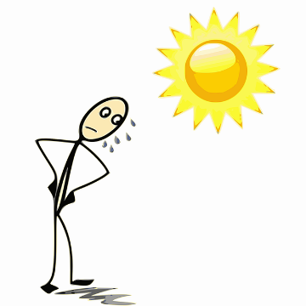
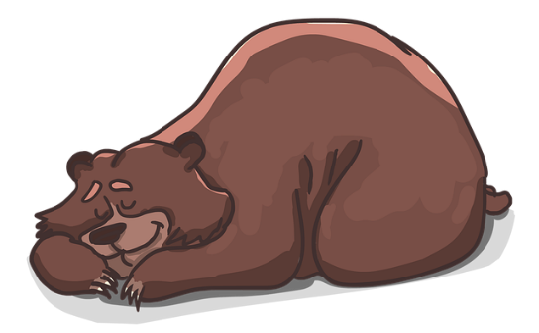
Capital Letters: Rule 1
I saw a big bear in the zoo.
It is very hot today.
Capital Letters are used at the beginning of a sentence
She went to buy bread from the baker’s shop.
Notes:
Notes for Teacher - < Information for further reference or explanation >
Suggestions: <Ideas/ Images/ Animations / Others – To make better representation of the content >
Source of Multimedia used in this slide - <Please provide source URL where we find the image and the license agreement>
<Bear> - <https://pixabay.com/illustrations/bear-lies-sleeps-sleep-resting-2079672/>
<bakery bread> - <https://pixabay.com/vectors/bread-bakery-bun-loaf-baguette-306914/ >
<Hot day> - <https://pixabay.com/vectors/expressions-fran%C3%A7aises-sun-sweat-1300623/>

Slide 3
Capital Letters: Rule 2
Names of Animals
Names of Places
Months of year
Capital Letters are used for Proper Nouns
Names of Persons
Days of week
Names of Things
Notes:
Notes for Teacher - < Information for further reference or explanation >
Suggestions: <Ideas/ Images/ Animations / Others – To make better representation of the content >
Source of Multimedia used in this slide - <Please provide source URL where we find the image and the license agreement>
<Taj Mahal> - <https://pixabay.com/vectors/taj-mahal-orient-sunset-building-392565/ >
<Yoga> - <https://pixabay.com/vectors/exercise-female-girl-pose-posing-1801507/>

Slide 4
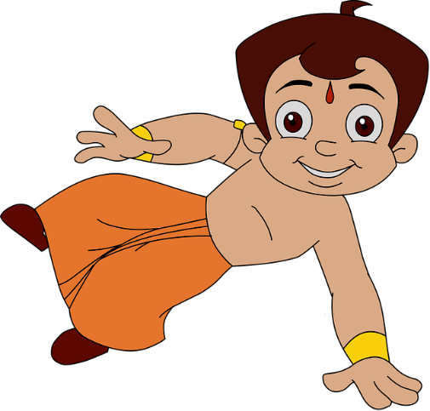
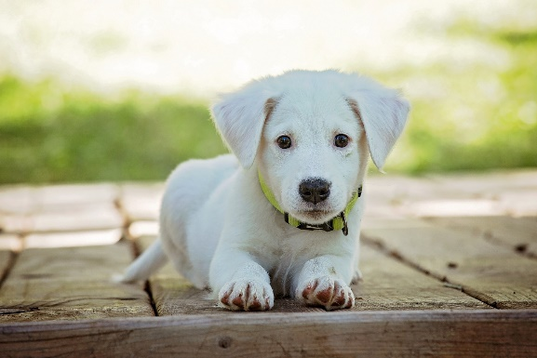
Capital Letters Rule 2 - Examples
I went to Agra to see the Taj Mahal.
Chota Bheem is a strong and clever boy.
Every Tuesday we have yoga classes.
14th November is Children’s Day.
My pet dog’s name is Buddy
Notes:
Notes for Teacher - < Information for further reference or explanation >
Suggestions: <Ideas/ Images/ Animations / Others – To make better representation of the content >
Source of Multimedia used in this slide - <Please provide source URL where we find the image and the license agreement>
<Taj Mahal> - https://pixabay.com/vectors/taj-mahal-orient-sunset-building-392565/
<Yoga> - https://pixabay.com/vectors/exercise-female-girl-pose-posing-1801507/
<Chota Bheem> - https://pixabay.com/illustrations/cartoon-character-funny-3854292/
<Calendar> - https://pixabay.com/vectors/calendar-monthly-office-schedule-23684/
<Dog> - https://pixabay.com/photos/puppy-dog-pet-collar-dog-collar-1903313/

Slide 5
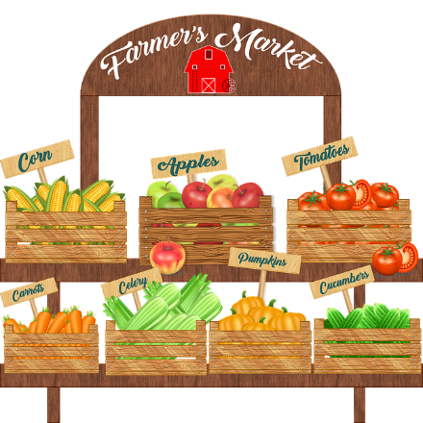
Capital Letters: Rule 3
I like to eat ice cream.
Capitalise ‘I’ wherever we use it
My sister and I went to the market.
Notes:
Notes for Teacher - < Information for further reference or explanation >
Suggestions: <Ideas/ Images/ Animations / Others – To make better representation of the content >
Source of Multimedia used in this slide - <Please provide source URL where we find the image and the license agreement>
<Ice cream> - <https://pixabay.com/illustrations/ice-cream-icecream-desserts-frozen-3571774/>
<market> - <https://pixabay.com/illustrations/farmer-s-market-selling-vegetables-4567943/ >

Slide 6
Full Stop (.) Rule
It is a sunny day today.
Use a full stop at the end of a sentence
Meera likes to draw flowers and fruits.
Notes:
Notes for Teacher - < Information for further reference or explanation >
Suggestions: <Ideas/ Images/ Animations / Others – To make better representation of the content >
Source of Multimedia used in this slide - <Please provide source URL where we find the image and the license agreement>
<Hot day> - <https://pixabay.com/vectors/expressions-fran%C3%A7aises-sun-sweat-1300623/>
<girl drawing> - <https://www.flickr.com/photos/13657368@N00/3335503224 By Simply CVR>

Slide 7
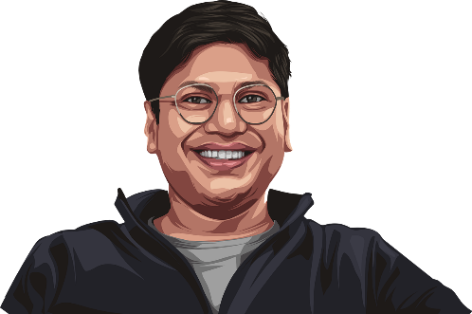
Question Mark (?) Rule
What is your name?
Question Marks are used when asking questions
How old are you?
Why did you take my book?
Notes:
Notes for Teacher - < Information for further reference or explanation >
Suggestions: <Ideas/ Images/ Animations / Others – To make better representation of the content >
Source of Multimedia used in this slide - <Please provide source URL where we find the image and the license agreement>
<conversation> - <https://pixabay.com/vectors/questions-question-mark-quiz-6988157/>
<age> - <https://pixabay.com/vectors/peyush-bansal-shark-tank-india-6995125/>
<book> - <https://pixabay.com/illustrations/read-book-knowledge-study-of-kids-2799820/>

Slide 8
MM INDEX
Slide # | Thumbnail | Source link and Attribution
1 |  | <punctuation marks> https://pixabay.com/illustrations/symbols-grammatical-marks-726776/
2 |  | <Bear> - https://pixabay.com/illustrations/bear-lies-sleeps-sleep-resting-2079672/ <Bakery bread> - https://pixabay.com/vectors/bread-bakery-bun-loaf-baguette-306914/ <Hot day> - https://pixabay.com/vectors/expressions-fran%C3%A7aises-sun-sweat-1300623/
4 |  | <Taj Mahal> - https://pixabay.com/vectors/taj-mahal-orient-sunset-building-392565/ <Yoga> - https://pixabay.com/vectors/exercise-female-girl-pose-posing-1801507/ <Chota Bheem> - https://pixabay.com/illustrations/cartoon-character-funny-3854292/ <Calendar> - https://pixabay.com/vectors/calendar-monthly-office-schedule-23684/ <Dog> - https://pixabay.com/photos/puppy-dog-pet-collar-dog-collar-1903313/
5 |  | <Ice cream> - https://pixabay.com/illustrations/ice-cream-icecream-desserts-frozen-3571774/ <Market> - https://pixabay.com/illustrations/farmer-s-market-selling-vegetables-4567943/
6 |  | <Hot day> - https://pixabay.com/vectors/expressions-fran%C3%A7aises-sun-sweat-1300623/ <girl drawing> - https://www.flickr.com/photos/13657368@N00/3335503224 By Simply CVR
7 |  | <conversation> - https://pixabay.com/vectors/questions-question-mark-quiz-6988157/ <age> - https://pixabay.com/vectors/peyush-bansal-shark-tank-india-6995125/ <book> - https://pixabay.com/illustrations/read-book-knowledge-study-of-kids-2799820/
Notes:
Notes for Teacher - < Information for further reference or explanation >
Suggestions: <Ideas/ Images/ Animations / Others – To make better representation of the content >
Source of Multimedia used in this slide - <Please provide source URL where we find the image and the license agreement>

