Slide 1
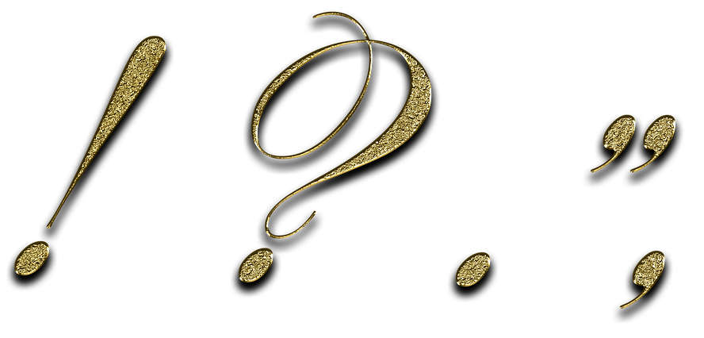
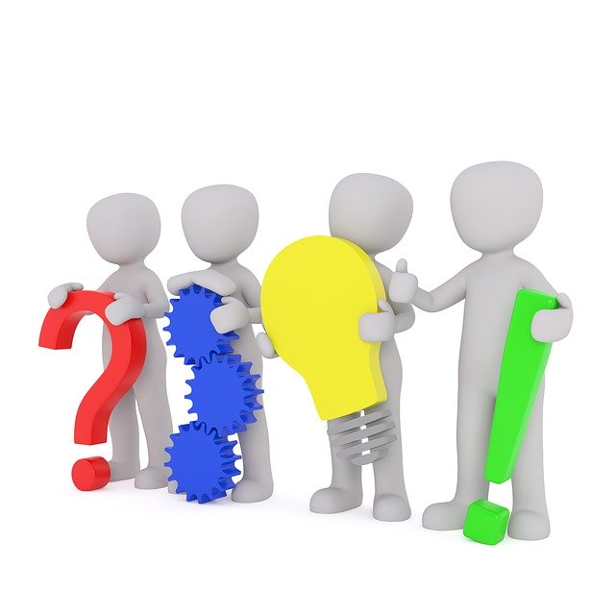
Punctuation Identification
Notes:
Notes for Teacher – N/A
Suggestions: N/A
Source of Multimedia used in this slide -
Punctuation marks: https://pixabay.com/illustrations/punctuation-marks-gold-point-3038383/
Punctuation marks: https://pixabay.com/illustrations/punctuation-marks-word-language-2999583/

Slide 2
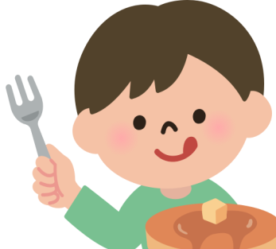
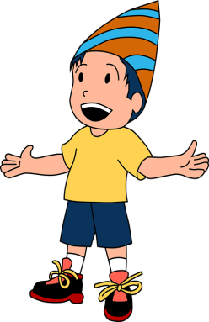
Exercise 1
Rewrite the following sentences using Capital Letters in the correct places.
Examples:
on saturday my brother and i ate a cake.
On Saturday, my brother and I ate a cake.
deepak is doing his homework.
Deepak is doing his homework.
Notes:
Notes for Teacher – N/A ]
Suggestions: N/A
Source of Multimedia used in this slide -
Cake: https://freesvg.org/1545744617
Boy: https://www.maxpixel.net/Birthday-Boy-Cute-Child-5146012
Homework: https://freesvg.org/1553684715

Slide 3
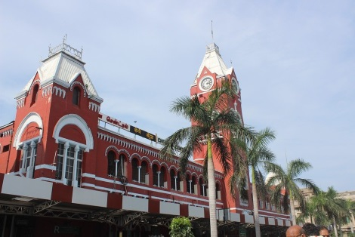
Exercise 1
Rewrite the following sentences using Capital Letters in the correct places.
chennai is the capital of tamil nadu.
Click for answer
Chennai is the capital of Tamil Nadu.
I was born on the 10 of july 2015.
Click for answer
I was born on the 10th of July 2015.
Notes:
Notes for Teacher – N/A
Suggestions: N/A
Source of Multimedia used in this slide –
Click: https://pixabay.com/vectors/hand-click-click-here-finger-touch-1367746/
Railway Station: https://pixabay.com/photos/chennai-station-tamil-nadu-india-3405413/
Cake: https://pixabay.com/illustrations/birthday-cake-balloons-6144064/

Slide 4
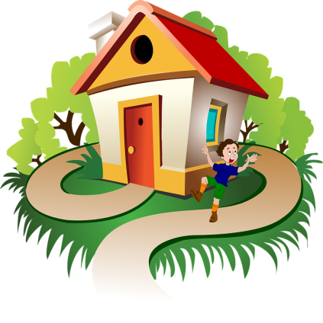
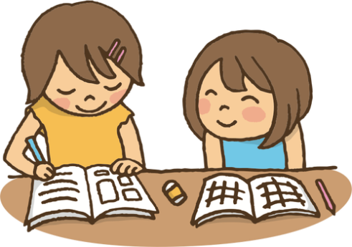
Exercise 1
Rewrite the following sentences using Capital Letters in the correct places
where do you live ?
Click for answer
Where do you live?
geeta and rita are good friends.
Click for answer
Geeta and Rita are good friends.
Notes:
Notes for Teacher – N/A
Suggestions: N/A
Source of Multimedia used in this slide -
Click: https://pixabay.com/vectors/hand-click-click-here-finger-touch-1367746/
House: https://pixabay.com/illustrations/house-boy-drawing-trees-path-6001425/
Girls: https://publicdomainvectors.org/en/free-clipart/Studying-together/72481.html

Slide 5
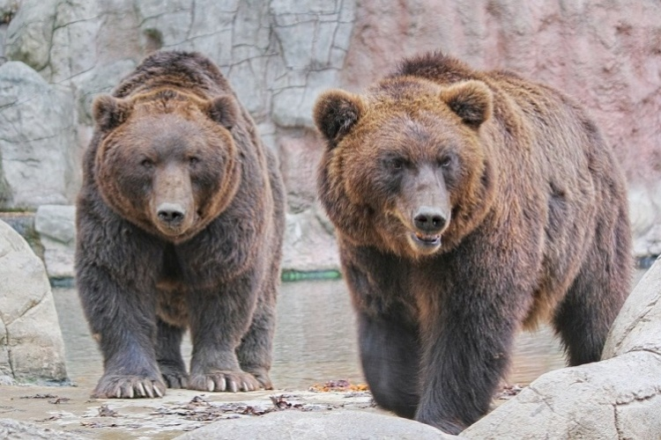
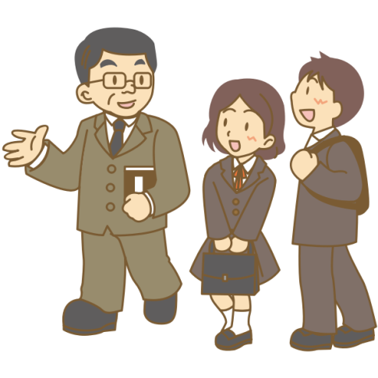
Exercise 2
Read the sentences and fill in the blanks with a full stop or a question mark.
Examples:
a) These bears are so big_
.
These bears are so big__
b) What is your name _____
?
What is your name__
.
Notes:
Notes for Teacher – N/A
Suggestions: N/A
Source of Multimedia used in this slide -
Bears: https://pixabay.com/photos/bears-animals-zoo-brown-bears-5961984/
Teacher: https://freesvg.org/1549325432

Slide 6
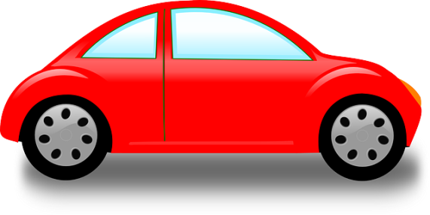
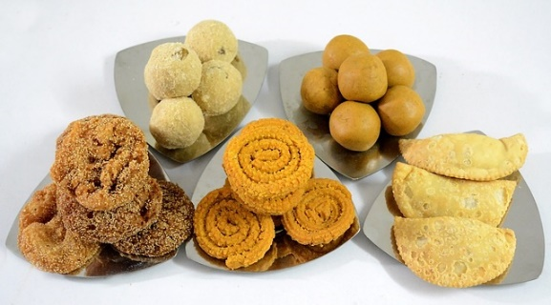
Exercise 2
Read the sentences and fill in the blanks with a full stop or a question mark.
The car is red ____
Click for answer
.
The car is red__
What do you like to eat ____
Click for answer
?
What do you like to eat__
Notes:
Notes for Teacher – N/A
Suggestions: N/A
Source of Multimedia used in this slide -
Click: https://pixabay.com/vectors/hand-click-click-here-finger-touch-1367746/
Car: https://pixabay.com/vectors/car-vehicle-automobile-one-door-308456/
Diwali: https://pixabay.com/photos/indian-diwali-food-laddu-sweet-2290593/

Slide 7
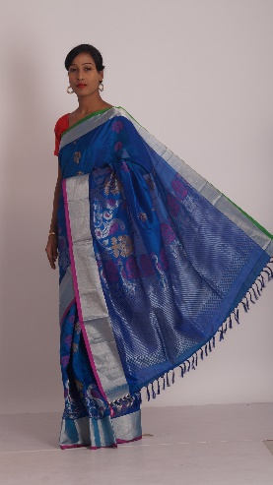
Exercise 2
Read the sentences and fill in the blanks with a full stop or a question mark.
She is wearing a blue dress ______
Click for answer
.
She is wearing a blue dress__
Where did you go yesterday _____
Click for answer
?
Where did you go yesterday__
Notes:
Notes for Teacher – N/A
Suggestions: N/A
Source of Multimedia used in this slide -
Click: https://pixabay.com/vectors/hand-click-click-here-finger-touch-1367746/
Blue dress: https://pixabay.com/photos/sarees-blue-color-saris-womens-wear-852431/
Dance: https://pixabay.com/vectors/silhouette-indian-dancer-beautiful-3837379/

Slide 8
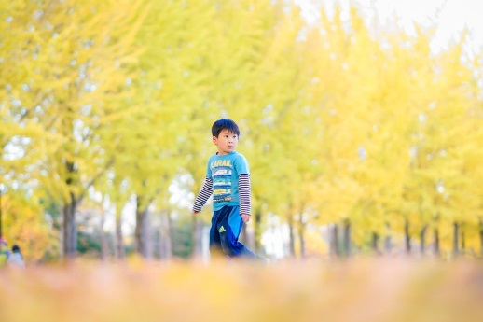
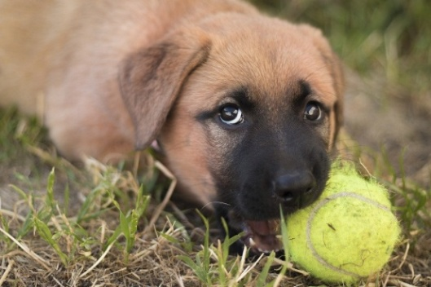
Exercise 3
Rewrite the sentences using the correct punctuation marks like Capital Letters, Full Stop and Question Mark.
Examples:
a) ayush goes to the park everyday
Ayush goes to the park everyday.
b) what is the dog chewing
What is the dog chewing?
Notes:
Notes for Teacher – N/A
Suggestions: N/A
Source of Multimedia used in this slide -
Park: https://pixabay.com/photos/kid-boy-park-child-young-playing-5778657/
Dog chewing: https://pixabay.com/photos/puppy-dog-german-shepherd-ridgeback-4573844/

Slide 9
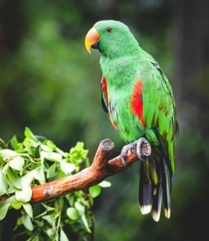
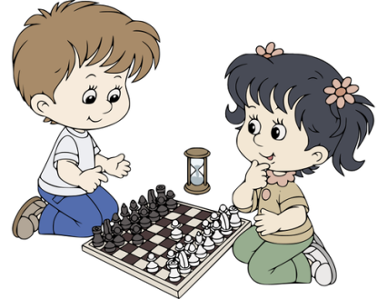
Exercise 3
Rewrite the following sentences using Capital Letters at the correct places
the parrot is on the tree
Click for answer
The parrot is on the tree.
i like to play chess with my sister
Click for answer
I like to play chess with my sister.
Notes:
Notes for Teacher – N/A
Suggestions: N/A
Source of Multimedia used in this slide -
Click: https://pixabay.com/vectors/hand-click-click-here-finger-touch-1367746/
Parrot: https://pixabay.com/photos/parrot-bird-animal-green-parrot-5436363/
Chess: https://publicdomainvectors.org/en/free-clipart/Cartoon-kids-playing-chess/60923.html

Slide 10
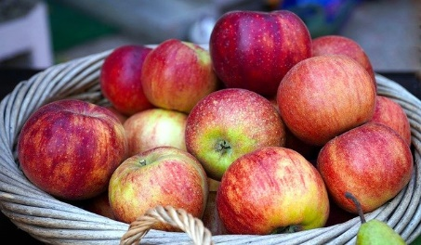
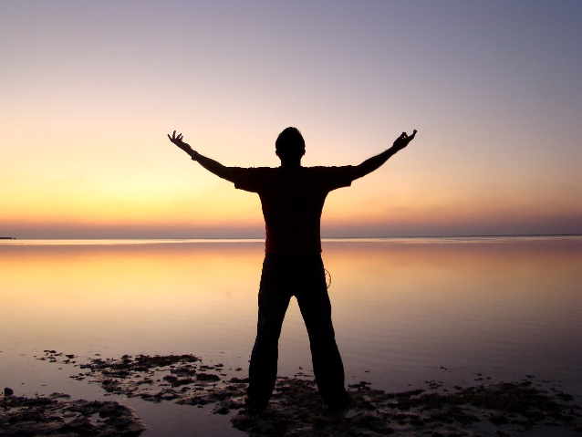
Exercise 3
Rewrite the sentences using the correct punctuation marks like Capital Letters, Full Stop and Question Mark.
how many apples are there
Click for answer
How many apples are there?
sunday is a holiday for us
Click for answer
Sunday is a holiday for us.
Notes:
Notes for Teacher – N/A
Suggestions: N/A
Source of Multimedia used in this slide -
Click: https://pixabay.com/vectors/hand-click-click-here-finger-touch-1367746/
Apples: https://pixabay.com/photos/apples-basket-basket-of-apples-5567884/
Sunday: https://pixabay.com/photos/man-silhouette-beach-sunset-dusk-1835195/

Slide 11
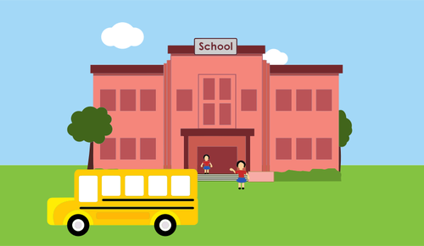
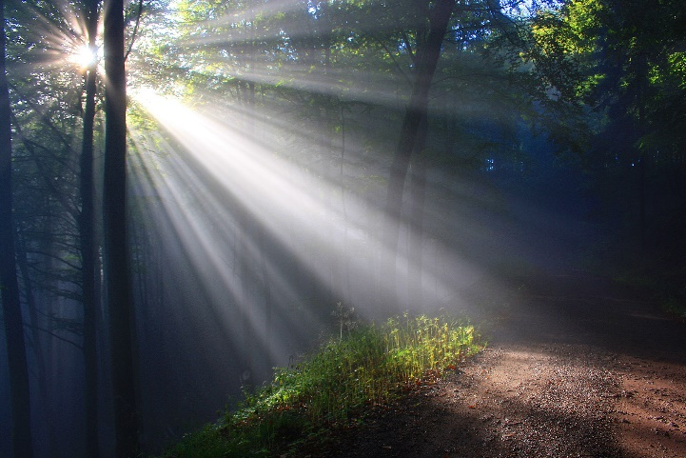
Exercise 3
Rewrite the sentences using the correct punctuation marks like Capital Letters, Full Stop and Question Mark.
how do you go to school
Click for answer
How do you go to school?
the sun shines in the sky
Click for answer
The sun shines in the sky.
Notes:
Notes for Teacher – N/A
Suggestions: N/A
Source of Multimedia used in this slide -
Click: https://pixabay.com/vectors/hand-click-click-here-finger-touch-1367746/
School: https://publicdomainvectors.org/en/free-clipart/School/40808.html
Sun: https://pixabay.com/photos/sunbeams-autumn-fog-autumn-forest-2761911/

Slide 12
MM INDEX
Slide # | Thumbnail | Source link and Attribution
1 |  | Punctuation marks: https://pixabay.com/illustrations/punctuation-marks-gold-point-3038383/ Punctuation marks: https://pixabay.com/illustrations/punctuation-marks-word-language-2999583/
3, 4, 6, 7, 9, 10, 11 |  | Click: https://pixabay.com/vectors/hand-click-click-here-finger-touch-1367746/
2 |  | Cake: https://freesvg.org/1545744617 Boy: https://www.maxpixel.net/Birthday-Boy-Cute-Child-5146012 Homework: https://freesvg.org/1553684715
3 |  | Railway Station: https://pixabay.com/photos/chennai-station-tamil-nadu-india-3405413/ Cake: https://pixabay.com/illustrations/birthday-cake-balloons-6144064/
4 |  | House: https://pixabay.com/illustrations/house-boy-drawing-trees-path-6001425/ Girls: https://publicdomainvectors.org/en/free-clipart/Studying-together/72481.html
5 |  | Bears: https://pixabay.com/photos/bears-animals-zoo-brown-bears-5961984/ Teacher: https://freesvg.org/1549325432
6 |  | Car: https://pixabay.com/vectors/car-vehicle-automobile-one-door-308456/ Diwali: https://pixabay.com/photos/indian-diwali-food-laddu-sweet-2290593/
7 |  | Blue dress: https://pixabay.com/photos/sarees-blue-color-saris-womens-wear-852431/ Dance: https://pixabay.com/vectors/silhouette-indian-dancer-beautiful-3837379/
8 |  | Park: https://pixabay.com/photos/kid-boy-park-child-young-playing-5778657/ Dog chewing: https://pixabay.com/photos/puppy-dog-german-shepherd-ridgeback-4573844/
9 |  | Parrot: https://pixabay.com/photos/parrot-bird-animal-green-parrot-5436363/ Chess: https://publicdomainvectors.org/en/free-clipart/Cartoon-kids-playing-chess/60923.html
10 |  | Apples: https://pixabay.com/photos/apples-basket-basket-of-apples-5567884/ Sunday: https://pixabay.com/photos/man-silhouette-beach-sunset-dusk-1835195/
11 |  | School: https://publicdomainvectors.org/en/free-clipart/School/40808.html Sun: https://pixabay.com/photos/sunbeams-autumn-fog-autumn-forest-2761911/

