Slide 1
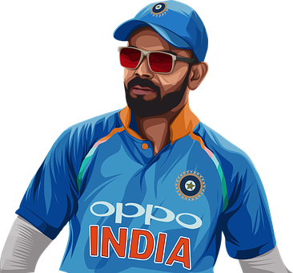
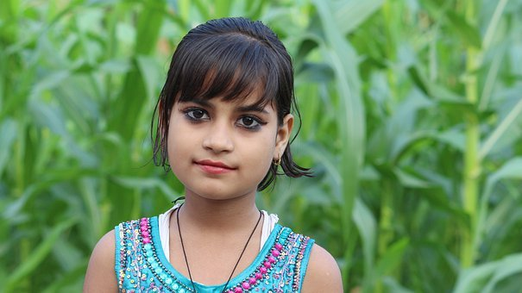
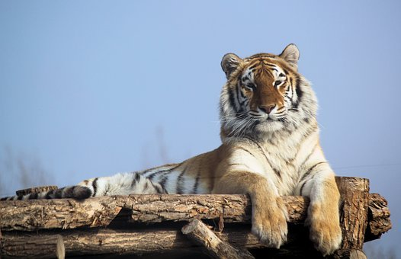
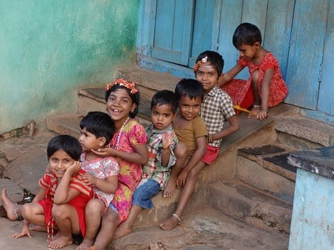
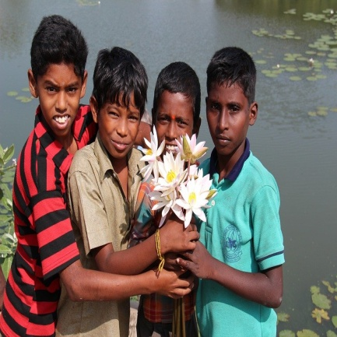
Learning with Pronouns
Notes:
Notes for Teacher - < Information for further reference or explanation >
Suggestions: <Ideas/ Images/ Animations / Others – To make better representation of the content >
Source of Multimedia used in this slide -
He: https://pixabay.com/vectors/virat-kohli-cricketer-player-man-5835741/
She: https://pixabay.com/photos/nature-summer-beautiful-outdoors-3119178/
It: https://pixabay.com/photos/a-tiger-indian-beast-feline-4044938/
They: https://pixabay.com/photos/children-fun-playing-happy-254287/
We: https://pixabay.com/photos/indians-children-guys-india-112610/

Slide 2
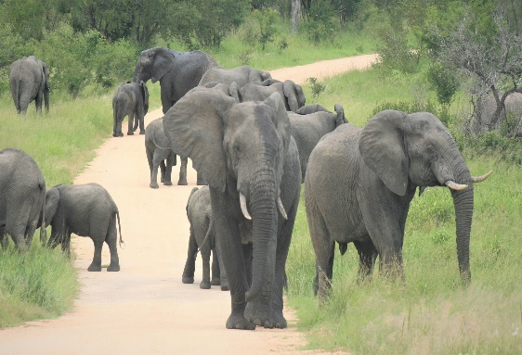
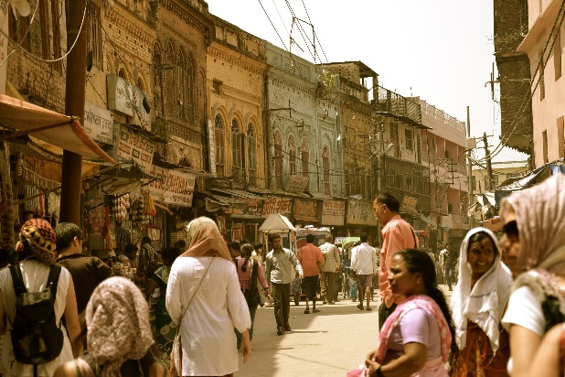
Pronouns
A PRONOUN is a word that takes the place of a NOUN
he she it they we
PRONOUNS take the place of words for
Places
Animals
People
Things
Notes:
Notes for Teacher –
< Information for further reference or explanation >
Suggestions: <Ideas/ Images/ Animations / Others – To make better representation of the content >
Source of Multimedia used in this slide -
1. People: https://pixabay.com/photos/street-road-people-crowd-buildings-5703332/
2. Animals: https://pixabay.com/photos/african-elephants-herd-approaching-4905544/
3. Places: https://pixabay.com/photos/earth-planet-space-world-universe-11009/
4. Things: https://pixabay.com/illustrations/art-objects-stuff-things-everyday-5002506/

Slide 3
Types of Pronouns
Pronouns can be:
Singular or Plural
Masculine or Feminine
Pronouns do the same work as nouns to avoid repetition
Pronouns are substitute words
Notes:
Notes for Teacher - < Information for further reference or explanation >
Suggestions: <Ideas/ Images/ Animations / Others – To make better representation of the content >
Source of Multimedia used in this slide –

Slide 4
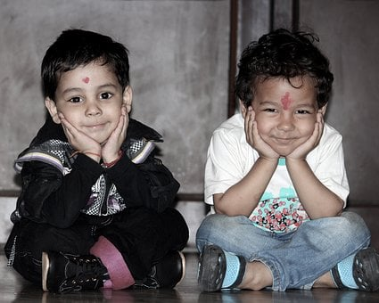
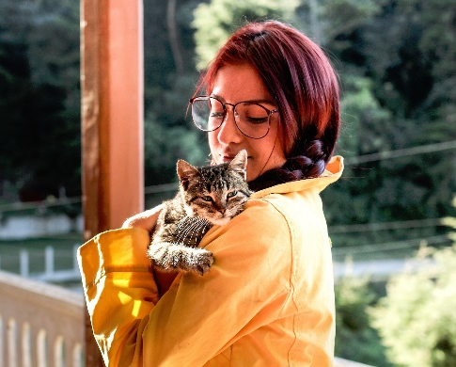
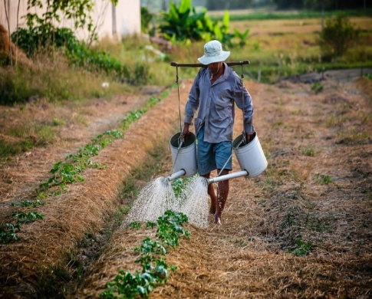
Pronouns - ‘He’ and ‘She’
Pronoun ‘He’ is used for male nouns.
Pronoun ‘She’ is used for female nouns.
Raju is my friend.
He is my friend.
Kavitha has a cat.
She has a cat.
John waters the plants.
He waters the plants.
My mother loves me.
She loves me.
Notes:
Notes for Teacher - < Information for further reference or explanation >
Suggestions: <Ideas/ Images/ Animations / Others – To make better representation of the content >
Source of Multimedia used in this slide -
2 boys: https://pixabay.com/photos/kids-smile-children-indian-baby-2277827/
Watering: https://pixabay.com/photos/watering-watering-can-man-vietnam-1501209/
Girl: https://pixabay.com/photos/people-girl-lady-woman-animals-2570587/
Mother: https://pixabay.com/photos/indian-mother-child-woman-mom-4419624/

Slide 5
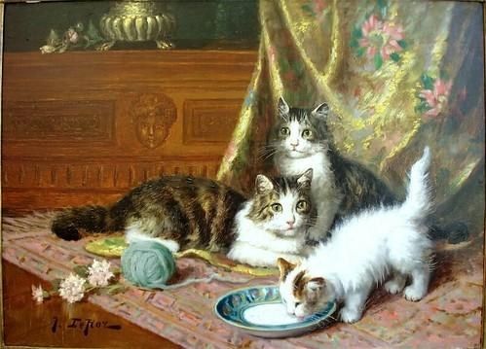
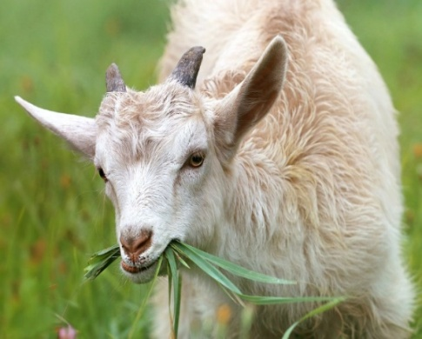
Pronouns - ‘It’ and ‘They’
Pronoun ‘it’ is used instead of an animal, a place or a thing.
Pronoun ‘they’ is used instead of plural nouns.
The bag is blue.
It is blue.
Cats like to drink milk.
They like to drink milk.
Tina and Sonia enjoy playing together.
They enjoy playing together.
The goat is eating grass.
It is eating grass.
Notes:
Notes for Teacher - < Information for further reference or explanation >
Suggestions: <Ideas/ Images/ Animations / Others – To make better representation of the content >
Source of Multimedia used in this slide -
Bag: https://www.freepik.com/free-vector/colored-cotton-eco-bags-fabric-tote-different-shapes-vector-realistic-mockup-textile-reusable-ecobags-shopping-beach-with-handles-blank-labels-isolated-white-background_21614306.htm#query=blue%20bag&position=21&from_view=search (Attribution: upklyak)
2. Goat : https://pixabay.com/photos/goat-lamb-little-grass-livestock-1596880/
3. Cats: https://www.flickr.com/photos/38205659@N03/49717160533 ( Attribution:
Irina)
4. Girl: https://pixabay.com/photos/girls-beach-india-kids-ocean-1006214/

Slide 6
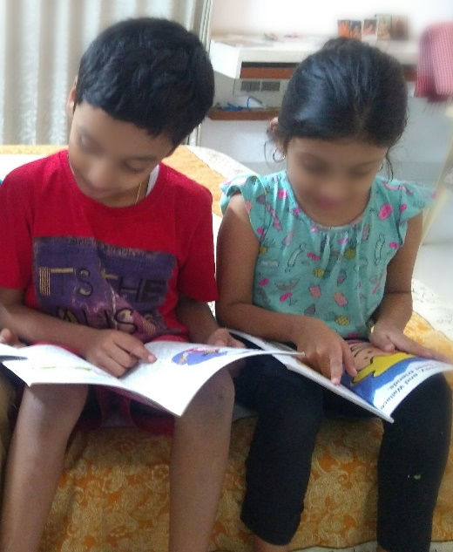
Pronouns – ‘we’
Pronoun ‘we’ is used to refer to a group of people that includes us.
My mother and I sat on the bench.
We sat on the bench.
Pinky and I are reading a book.
We are reading a book.
Notes:
Notes for Teacher - < Information for further reference or explanation >
Suggestions: <Ideas/ Images/ Animations / Others – To make better representation of the content >
Source of Multimedia used in this slide -
Reading: SSSVV Image Gallery: Search Keyword “read”
Mother: https://pixabay.com/vectors/silhouette-child-mother-daughter-3299372/

Slide 7
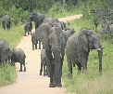
MM INDEX
Slide # | Thumbnail | Source link and Attribution
1 |  | He: https://pixabay.com/vectors/virat-kohli-cricketer-player-man-5835741/ She: https://pixabay.com/photos/nature-summer-beautiful-outdoors-3119178/ It: https://pixabay.com/photos/a-tiger-indian-beast-feline-4044938/ They: https://pixabay.com/photos/children-fun-playing-happy-254287/ We: https://pixabay.com/photos/indians-children-guys-india-112610/
2 |  | People: https://pixabay.com/photos/street-road-people-crowd-buildings-5703332/ Animals: https://pixabay.com/photos/african-elephants-herd-approaching-4905544/ Places: https://pixabay.com/photos/earth-planet-space-world-universe-11009/ Things: https://pixabay.com/illustrations/art-objects-stuff-things-everyday-5002506/
4 |  | 2 boys: https://pixabay.com/photos/kids-smile-children-indian-baby-2277827/ Watering: https://pixabay.com/photos/watering-watering-can-man-vietnam-1501209/ Girl: https://pixabay.com/photos/people-girl-lady-woman-animals-2570587/ Mother: https://pixabay.com/photos/indian-mother-child-woman-mom-4419624/
5 |  | Bag: https://www.freepik.com/free-vector/colored-cotton-eco-bags-fabric-tote-different-shapes-vector-realistic-mockup-textile-reusable-ecobags-shopping-beach-with-handles-blank-labels-isolated-white-background_21614306.htm#query=blue%20bag&position=21&from_view=search (Attribution: upklyak) Goat : https://pixabay.com/photos/goat-lamb-little-grass-livestock-1596880/ Cats: https://www.flickr.com/photos/38205659@N03/49717160533 (Attribution: Irina) Girl: https://pixabay.com/photos/girls-beach-india-kids-ocean-1006214/
6 |  | Reading: SSSVV Image Gallery: Search Keyword “read” Mother: https://pixabay.com/vectors/silhouette-child-mother-daughter-3299372/
Notes:
Notes for Teacher - < Information for further reference or explanation >
Suggestions: <Ideas/ Images/ Animations / Others – To make better representation of the content >
Source of Multimedia used in this slide - <Please provide source URL where we find the image and the license agreement>

