Slide 1
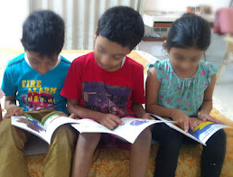
Choosing Right Pronouns
Notes:
Notes for Teacher - < Information for further reference or explanation >
Suggestions: <Ideas/ Images/ Animations / Others – To make better representation of the content >
Source of Multimedia used in this slide -
1. Children: SSSVV GALLERY -keyword-books

Slide 2
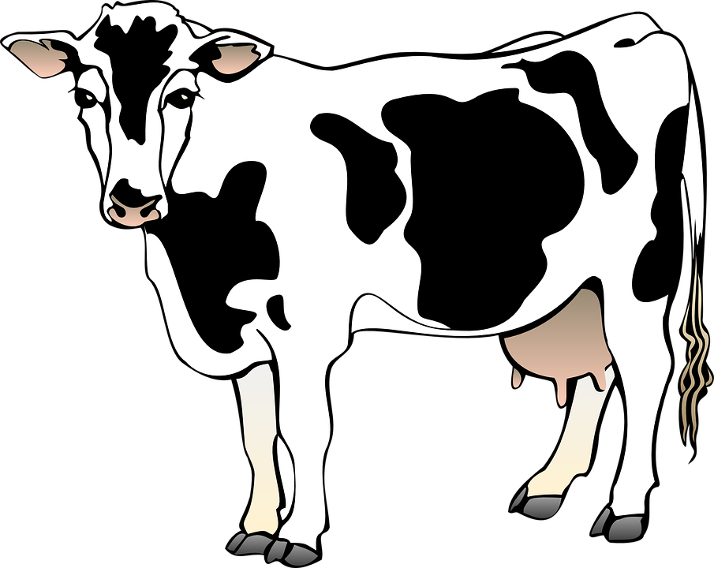
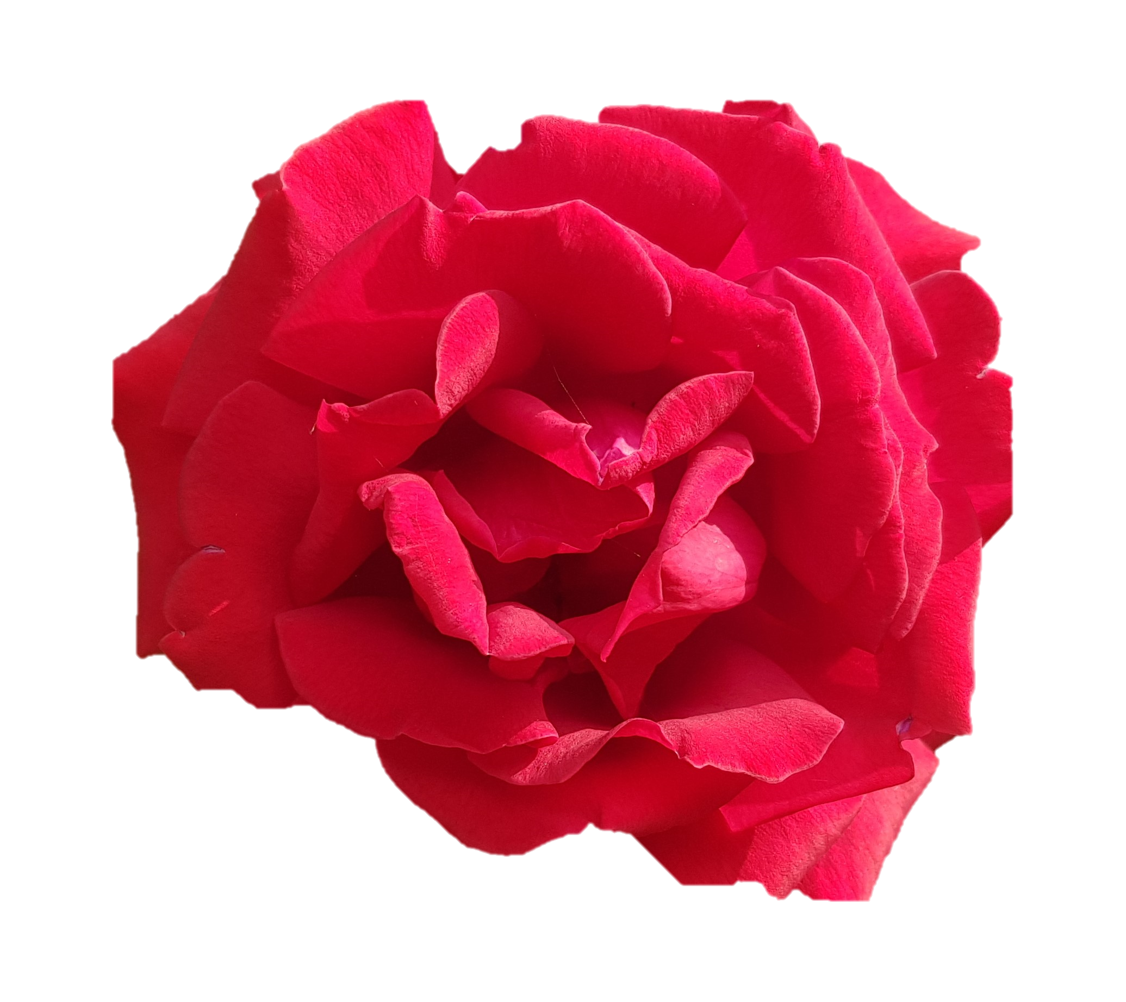
Exercise 1
Underline the pronouns in the following sentences:
This is Ajay. He is a football player.
Click
Viraj and Vinay are good friends. They like to play video games.
Click
This is a cow. It is eating grass.
Click
This is Kanta. She is holding a flower.
Click
Notes:
Notes for Teacher – Kindly click on the CLICK BUTTON for answer to appear
Suggestions: <Ideas/ Images/ Animations / Others – To make better representation of the content >
Source of Multimedia used in this slide -
Football: https://pixabay.com/vectors/soccer-ball-sport-game-team-34898/
Video games: https://pixabay.com/vectors/video-game-controller-game-computer-147039/
Cow: https://pixabay.com/vectors/cow-barn-farm-standing-animal-48435/
Rose: OC- supriya.prabhu17@gmail.com

Slide 3
Exercise 2
Match the words with the pronouns:
Words
Pronouns
Ravi
We
Click
The big truck
She
Click
Preeti
They
Click
Karthik and I
It
Click
Meena and Beena
He
Click
Notes:
Notes for Teacher - Kindly click on the CLICK BUTTON for answer to appear
Suggestions: <Ideas/ Images/ Animations / Others – To make better representation of the content >
Source of Multimedia used in this slide - N/A

Slide 4
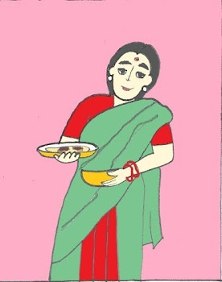
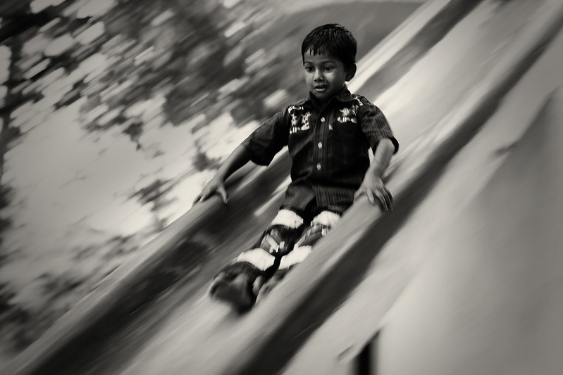
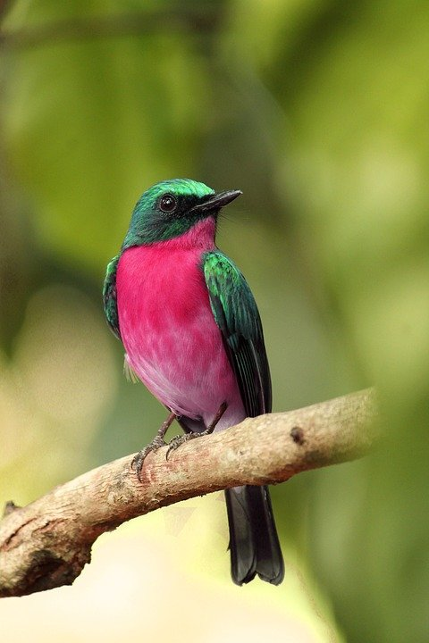
Exercise 3
Choose the correct pronoun from the box and fill in the blanks:
She
He
We
They
It
Click
She
a) My mother is a good cook. ___ makes tasty food.
Click
b) Where is Gopal? ___ is on the slide in the park.
He
Click
They
c) My sisters do not like cats. _____ like birds.
Notes:
Notes for Teacher - Kindly click on the CLICK BUTTON for answer to appear. The next question will appear on the screen after the answer is shown on the screen.
Suggestions: <Ideas/ Images/ Animations / Others – To make better representation of the content >
Source of Multimedia used in this slide -
Slide: https://www.flickr.com/photos/44345361@N06/4472813704 By Vinoth Chandar
Bird: https://pixabay.com/photos/kerala-india-manipulated-bird-4087736/
Mother: SSSVV GALLERY-Keyword-mother

Slide 5
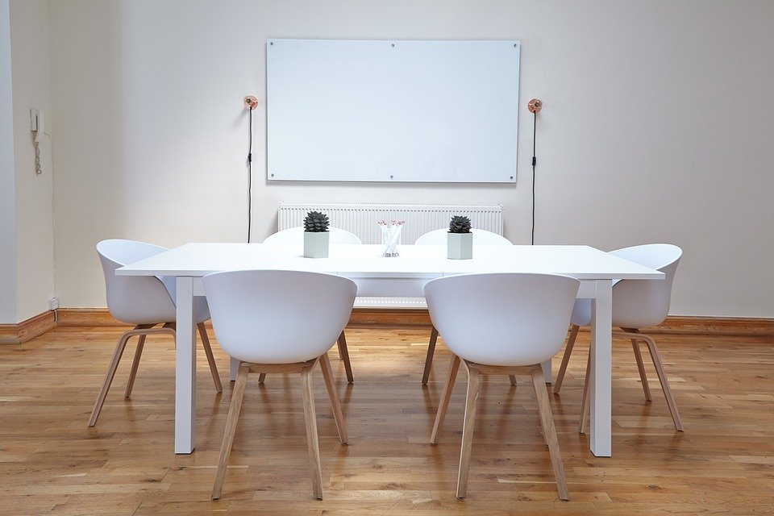
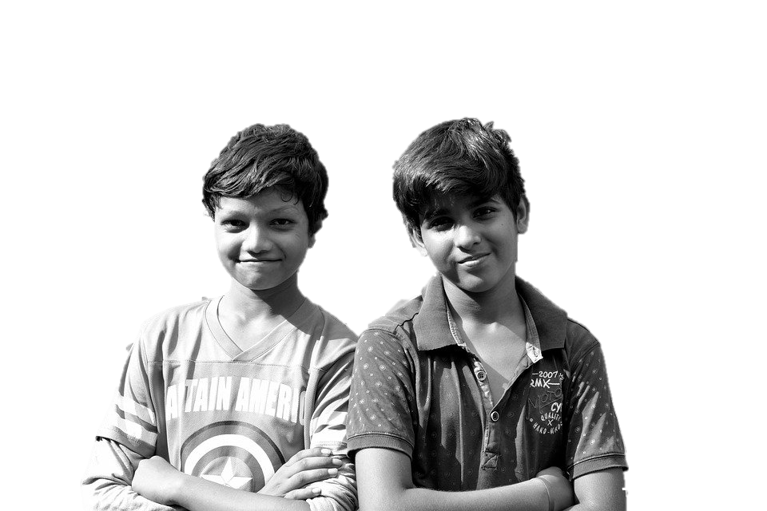
Exercise 3
Make sentences of your own with the following pronouns:
She
He
We
They
It
it
Click
d) The table is big. Six people can sit around __.
We
Click
e) My friend and I walk to school everyday. ___ like to walk.
Notes:
Notes for Teacher - Kindly click on the CLICK BUTTON for answer to appear. The next question will appear on the screen after the answer is shown on the screen.
Suggestions: <Ideas/ Images/ Animations / Others – To make better representation of the content >
Source of Multimedia used in this slide -
Table: https://pixabay.com/photos/chairs-table-empty-interior-design-2181977/
Boys: https://pixabay.com/photos/brothers-kids-boys-happy-portrait-2735909/

Slide 6
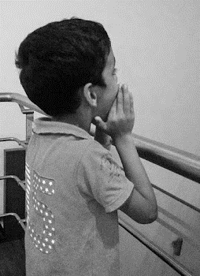
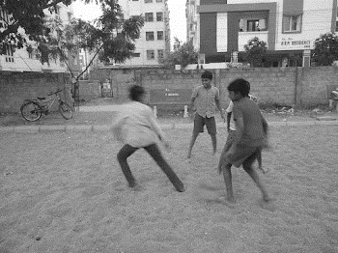
Exercise 4
Rewrite the following sentences using pronouns in place of the nouns:
Amit was hungry. Amit asked his mother for a fruit.
Click
Amit was hungry. He asked his mother for a fruit.
Raj and Kiran were in the garden. Raj and Kiran were playing football.
Click
Raj and Kiran were in the garden. They were playing football.
Notes:
Notes for Teacher -Kindly click on the CLICK BUTTON for answer to appear. The next question will appear on the screen after the answer is shown on the screen.
Suggestions: <Ideas/ Images/ Animations / Others – To make better representation of the content >
Source of Multimedia used in this slide -
Boy: SSSVV GALLERY -keyword-boy
Playing: SSSVV GALLERY -keyword- football

Slide 7
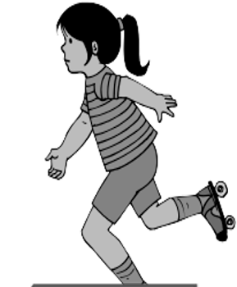
Exercise 4
Rewrite the following sentences using pronouns in place of the nouns:
Virat and I ate laddoos. Then, Virat and I read the story called “The Hare and the Tortoise”.
Click
Virat and I ate laddoos. Then, we read the story called “The Hare and the Tortoise”.
Sita loves to play. Sita plays in the evening.
Click
Sita loves to play. She plays in the evening.
Notes:
Notes for Teacher - Kindly click on the CLICK BUTTON for answer to appear. The next question will appear on the screen after the answer is shown on the screen.
Suggestions: <Ideas/ Images/ Animations / Others – To make better representation of the content >
Source of Multimedia used in this slide -
Boys: https://pixabay.com/photos/brothers-kids-boys-happy-portrait-2735909/
Girl: SSSVV GALLERY- keyword- girl

Slide 8
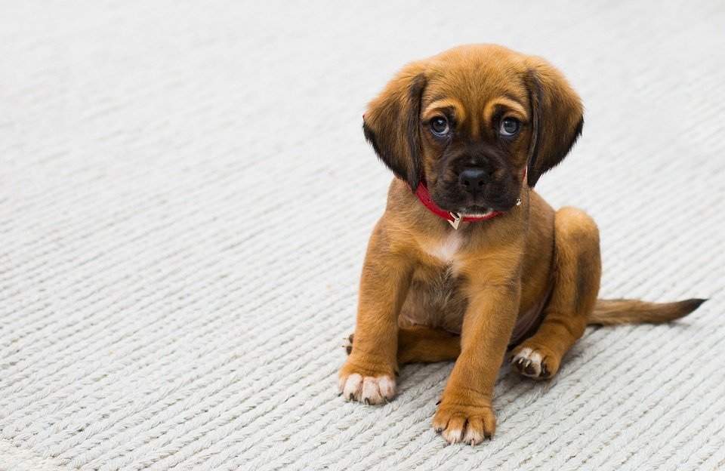
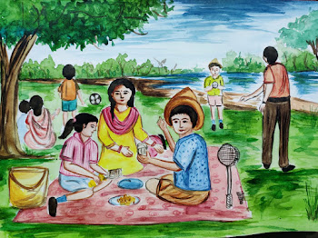
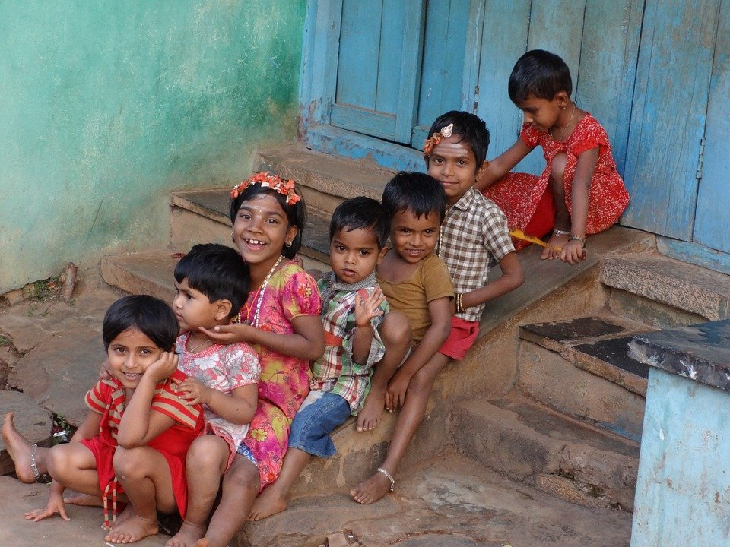
Exercise 5
Make sentences of your own with the following pronouns:
Click
It
Priya has a puppy, it is brown in colour.
We
We are going on a picnic on Sunday.
Click
They
They play together.
Click
Notes:
Notes for Teacher - Kindly click on the CLICK BUTTON for answer to appear.
Suggestions: <Ideas/ Images/ Animations / Others – To make better representation of the content >
Source of Multimedia used in this slide -
Brown puppy: https://pixabay.com/photos/pet-dog-puppy-sad-eyes-animal-1284307/
Picnic: SSSVV GALLERY- keyword- picnic
Play: https://pixabay.com/photos/children-fun-playing-happy-254287/

Slide 9
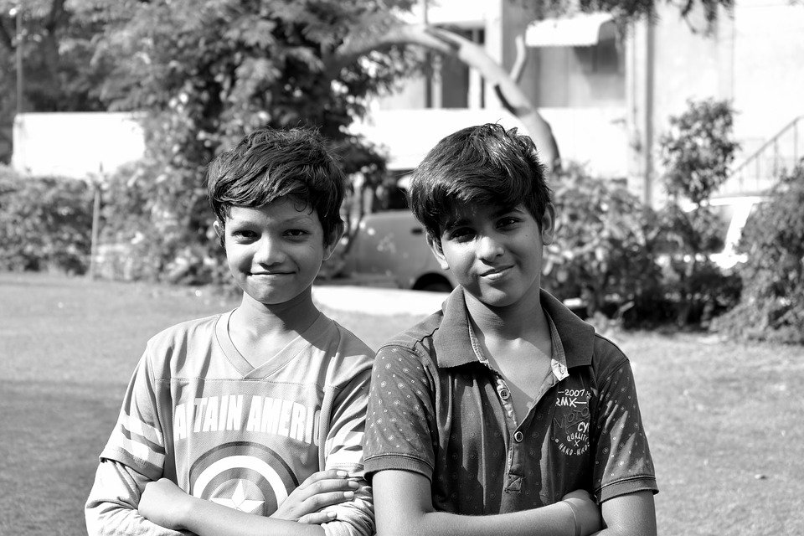
MM INDEX
Slide # | Thumbnail | Source link and Attribution
2 |  | Football: https://pixabay.com/vectors/soccer-ball-sport-game-team-34898/ Video games: https://pixabay.com/vectors/video-game-controller-game-computer-147039/ Cow: https://pixabay.com/vectors/cow-barn-farm-standing-animal-48435/
4 |  | Slide: https://www.flickr.com/photos/44345361@N06/4472813704 By Vinoth Chandar Bird: https://pixabay.com/photos/kerala-india-manipulated-bird-4087736/
5 |  | Table: https://pixabay.com/photos/chairs-table-empty-interior-design-2181977/
5, 7 |  | Boys: https://pixabay.com/photos/brothers-kids-boys-happy-portrait-2735909/
8 |  | Brown puppy: https://pixabay.com/photos/pet-dog-puppy-sad-eyes-animal-1284307/ Play: https://pixabay.com/photos/children-fun-playing-happy-254287/

