Slide 1
LEARNING MORE ABOUT VERBS
Notes:
Notes for Teacher - < Information for further reference or explanation >
Suggestions: <Ideas/ Images/ Animations / Others – To make better representation of the content >
Source of Multimedia used in this slide - <Please provide source URL where we find the image and the license agreement>
<action> <https://pixabay.com/vectors/man-person-shouting-action-160088/>

Slide 2
VERBS
Verbs are action words that explains what a noun is doing.
We use ‘s’ and ‘ing’ form of verbs in our daily conversation.
His uncle lives in a palace.
She bakes tasty cakes.
She is baking a cake.
He is drinking apple juice.
Notes:
Notes for Teacher - < Information for further reference or explanation >
Suggestions: <Ideas/ Images/ Animations / Others – To make better representation of the content >
Source of Multimedia used in this slide - <Please provide source URL where we find the image and the license agreement>
<palace> <https://pixabay.com/vectors/palace-parliament-huge-power-old-306126/>
<cake> <https://pixabay.com/vectors/cake-birthday-cake-chocolate-cake-5429757/>
<baking> <https://pixabay.com/vectors/bake-cake-comic-characters-2026382/>
<apple juice> <https://pixabay.com/vectors/juice-box-apple-straw-tetra-pack-306748/>

Slide 3
VERB
Examples:
He plays.
She plays.
It plays.
We use a Verb without adding ‘s’ with:
I
You
We
They
Ajay plays.
Kavita plays.
The dog plays with the bone.
Plural Nouns and Pronouns
We use a Verb by adding ‘s’ with:
Examples:
He
She
It
I play.
You play.
We play.
Singular Nouns and Pronouns
They play.
Boys and girls play.
Above ‘play’ is the verb and we have seen how this verb changes its form according to the Singular and Plural form of the nouns.
Notes:
Notes for Teacher - < Information for further reference or explanation >
Suggestions: <Ideas/ Images/ Animations / Others – To make better representation of the content >
Source of Multimedia used in this slide - <Please provide source URL where we find the image and the license agreement>

Slide 4
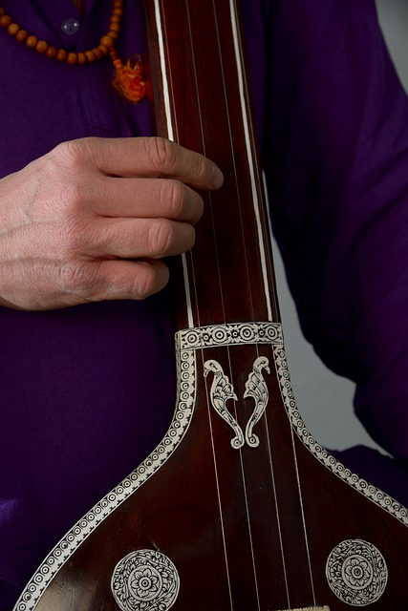
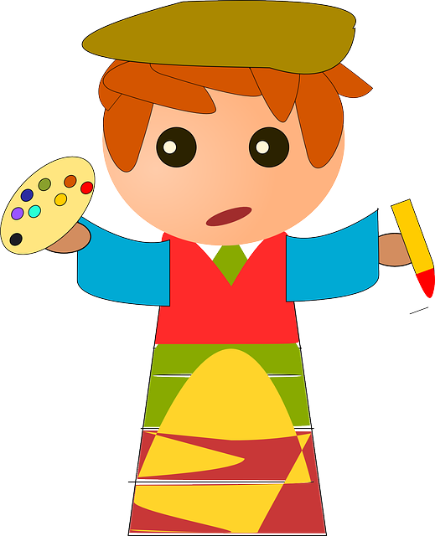
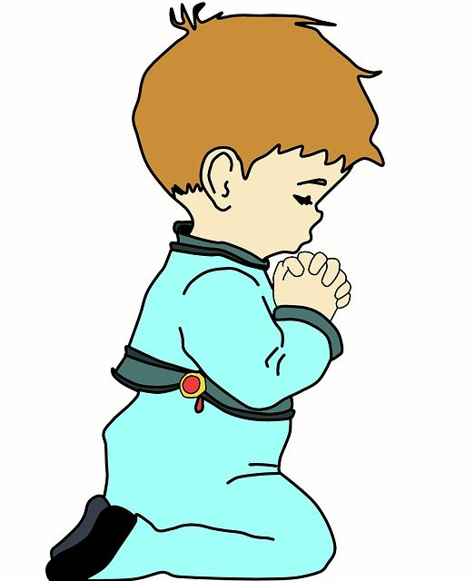
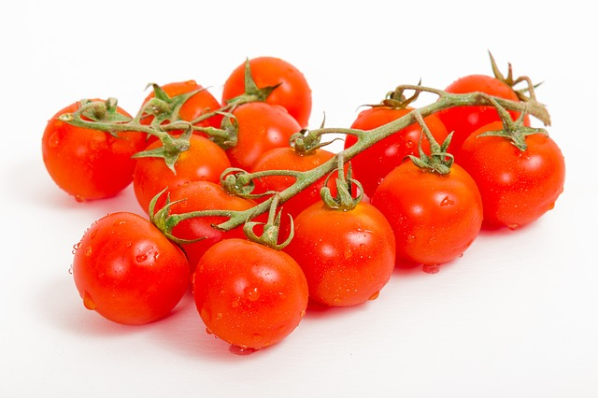
VERB - EXAMPLES
She plays the sitar very well.
He can draw beautiful pictures.
They write neatly.
I pray to God everyday.
The girl buys tomatoes from the green grocer.
Notes:
Notes for Teacher - < Information for further reference or explanation >
Suggestions: <Ideas/ Images/ Animations / Others – To make better representation of the content >
Source of Multimedia used in this slide - <Please provide source URL where we find the image and the license agreement>
<painter> <https://pixabay.com/vectors/artist-painter-painting-colors-154354/>
<sitar> <https://pixabay.com/photos/tambura-sitar-india-raga-4952939/>
<handwriting> <https://pixabay.com/illustrations/notes-pencil-abc-writing-card-5729126/>
<praying> <https://pixabay.com/illustrations/child-praying-prayer-religion-1929443/>
<tomatoes> <https://pixabay.com/photos/food-tomatoes-vegetables-harvest-2029900/>

Slide 5
VERB (USING ‘ING’)
The usage of ‘ing’ form of the verb for showing actions that are in progress and have not finished.
work
working
sit
sitting
write
writing
Notes:
Notes for Teacher - < Information for further reference or explanation >
Suggestions: <Ideas/ Images/ Animations / Others – To make better representation of the content >
Source of Multimedia used in this slide - <Please provide source URL where we find the image and the license agreement>
<work> <https://pixabay.com/vectors/home-office-at-home-work-internet-4948054/>
<sit> <https://pixabay.com/vectors/man-sitting-chair-waiting-295475/>
<write> <https://pixabay.com/vectors/hand-pencil-pen-edit-eraser-write-160538/>

Slide 6
VERB (USING ‘ING’) - EXAMPLES
Sentences
My friends are playing in the park.
The girls are singing a song.
They are reading story books.
My father is watering the plants.
I am waiting for the bus at the bus stand.
She is writing a letter to her grandfather.
Verb + ing
play + ing
sing + ing
read + ing
water + ing
wait + ing
write + ing
Notes:
Notes for Teacher - < Information for further reference or explanation >
Suggestions: <Ideas/ Images/ Animations / Others – To make better representation of the content >
Source of Multimedia used in this slide - <Please provide source URL where we find the image and the license agreement>

Slide 7
MM INDEX
Slide # | Thumbnail | Source link and Attribution
1 |  | <action> <https://pixabay.com/vectors/man-person-shouting-action-160088/>
2 |  | <palace> <https://pixabay.com/vectors/palace-parliament-huge-power-old-306126/>
2 |  | <cake> <https://pixabay.com/vectors/cake-birthday-cake-chocolate-cake-5429757/>
2 |  | <baking> <https://pixabay.com/vectors/bake-cake-comic-characters-2026382/>
2 |  | <apple juice> <https://pixabay.com/vectors/juice-box-apple-straw-tetra-pack-306748/>
4 |  | <painter> <https://pixabay.com/vectors/artist-painter-painting-colors-154354/>
4 |  | <sitar> <https://pixabay.com/photos/tambura-sitar-india-raga-4952939/>
4 |  | <handwriting> <https://pixabay.com/illustrations/notes-pencil-abc-writing-card-5729126/>
4 |  | <praying> <https://pixabay.com/illustrations/child-praying-prayer-religion-1929443/>
4 |  | <tomatoes> <https://pixabay.com/photos/food-tomatoes-vegetables-harvest-2029900/>
5 |  | <work> <https://pixabay.com/vectors/home-office-at-home-work-internet-4948054/>
5 |  | <sit> <https://pixabay.com/vectors/man-sitting-chair-waiting-295475/>
5 |  | <write> <https://pixabay.com/vectors/hand-pencil-pen-edit-eraser-write-160538/>
Notes:
Notes for Teacher - < Information for further reference or explanation >
Suggestions: <Ideas/ Images/ Animations / Others – To make better representation of the content >
Source of Multimedia used in this slide - <Please provide source URL where we find the image and the license agreement>

