Slide 1
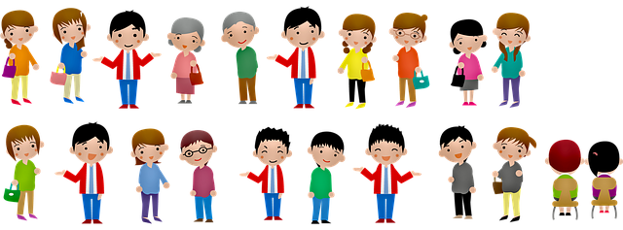
Game of Dumb Charades
Notes:
Notes for Teacher - < Information for further reference or explanation >
Suggestions: <Ideas/ Images/ Animations / Others – To make better representation of the content >
Source of Multimedia used in this slide - <Please provide source URL where we find the image and the license agreement>
<charades> <https://pixabay.com/illustrations/people-man-women-grandma-grandpa-4035403/>

Slide 2
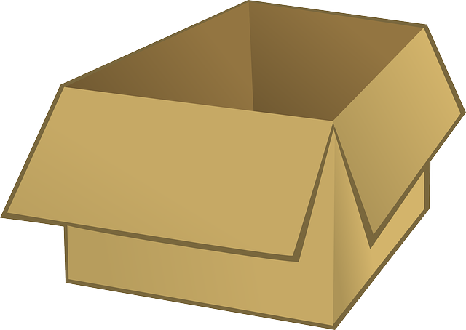
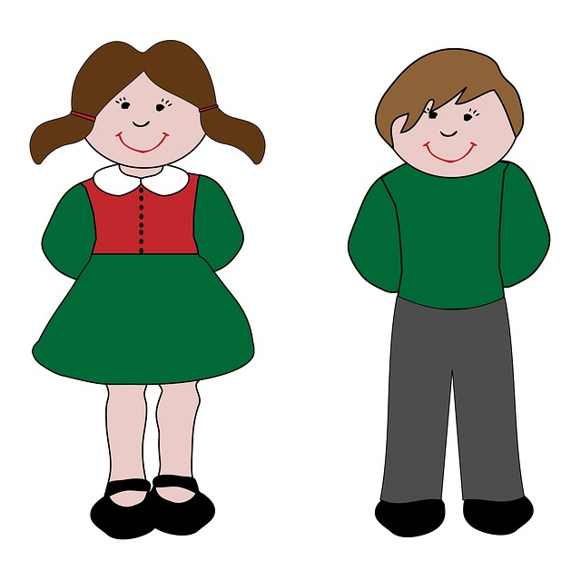
Dumb Charades
Example Chits
Team A
Team B
dance
eat
Box with chits
Notes:
Notes for Teacher - < Information for further reference or explanation >
Suggestions: <Ideas/ Images/ Animations / Others – To make better representation of the content >
Source of Multimedia used in this slide - <Please provide source URL where we find the image and the license agreement>
<cardboard box> <https://pixabay.com/vectors/box-cardboard-packing-office-23649/>
<paper> <https://pixabay.com/illustrations/paper-paper-clip-torn-lined-paper-5615944/>
<boy and girl> <https://pixabay.com/illustrations/children-kids-child-girl-boy-163541/>

Slide 3
Let’s Play Dumb Charades
Jump
????
Team A
Notes:
Notes for Teacher - < Information for further reference or explanation >
Suggestions: <Ideas/ Images/ Animations / Others – To make better representation of the content >
Source of Multimedia used in this slide - <Please provide source URL where we find the image and the license agreement>
<dancing> <https://pixabay.com/vectors/silhouette-indian-dancer-beautiful-3837379/>
<paper> <https://pixabay.com/illustrations/paper-paper-clip-torn-lined-paper-5615944/>
<classroom> <https://pixabay.com/illustrations/school-children-desks-school-4321808/>

Slide 4
MM INDEX
Slide # | Thumbnail | Source link and Attribution
1 |  | <charades> https://pixabay.com/illustrations/people-man-women-grandma-grandpa-4035403
2 |  | <cardboard box> https://pixabay.com/vectors/box-cardboard-packing-office-23649/ <paper> https://pixabay.com/illustrations/paper-paper-clip-torn-lined-paper-5615944/ <boy and girl> https://pixabay.com/illustrations/children-kids-child-girl-boy-163541/
3 |  | <classroom> https://pixabay.com/illustrations/school-children-desks-school-4321808/ <child> https://pixabay.com/illustrations/little-boy-boy-black-boy-4255616/ <tick> https://pixabay.com/vectors/check-mark-tick-mark-check-correct-1292787/
Notes:
Notes for Teacher - < Information for further reference or explanation >
Suggestions: <Ideas/ Images/ Animations / Others – To make better representation of the content >
Source of Multimedia used in this slide - <Please provide source URL where we find the image and the license agreement>

