Slide 1
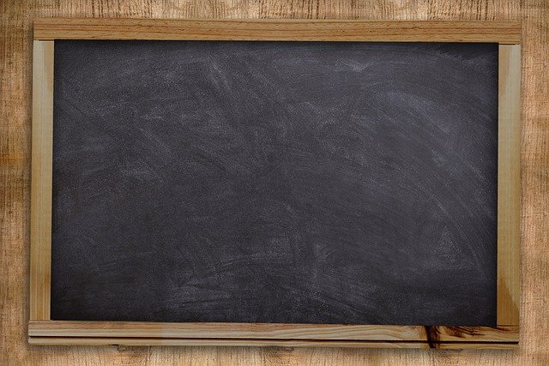
APPLICATION OF VERBS
Notes:
Notes for Teacher - < Information for further reference or explanation >
Suggestions: <Ideas/ Images/ Animations / Others – To make better representation of the content >
Source of Multimedia used in this slide - <Please provide source URL where we find the image and the license agreement>
<black board> <https://pixabay.com/illustrations/blackboard-board-school-chalkboard-5639925/>

Slide 2
EXERCISE 1
Add ‘s’ and ‘ing’ at the end of each verb and make a new word.
Example - finish - finishes finishing
1. sleep __________ __________
2. run __________ __________
3. jump __________ __________
4. hit __________ __________
5. look __________ __________
6. climb __________ __________
7. talk __________ __________
sleeps
sleeping
runs
running
jumps
jumping
hits
hitting
looks
looking
climbs
climbing
talks
talking
Notes:
Notes for Teacher - < Information for further reference or explanation >
Suggestions: <Ideas/ Images/ Animations / Others – To make better representation of the content >
Source of Multimedia used in this slide - <Please provide source URL where we find the image and the license agreement>
<jumps> <https://pixabay.com/vectors/people-jump-silhouette-group-male-4894818/>

Slide 3
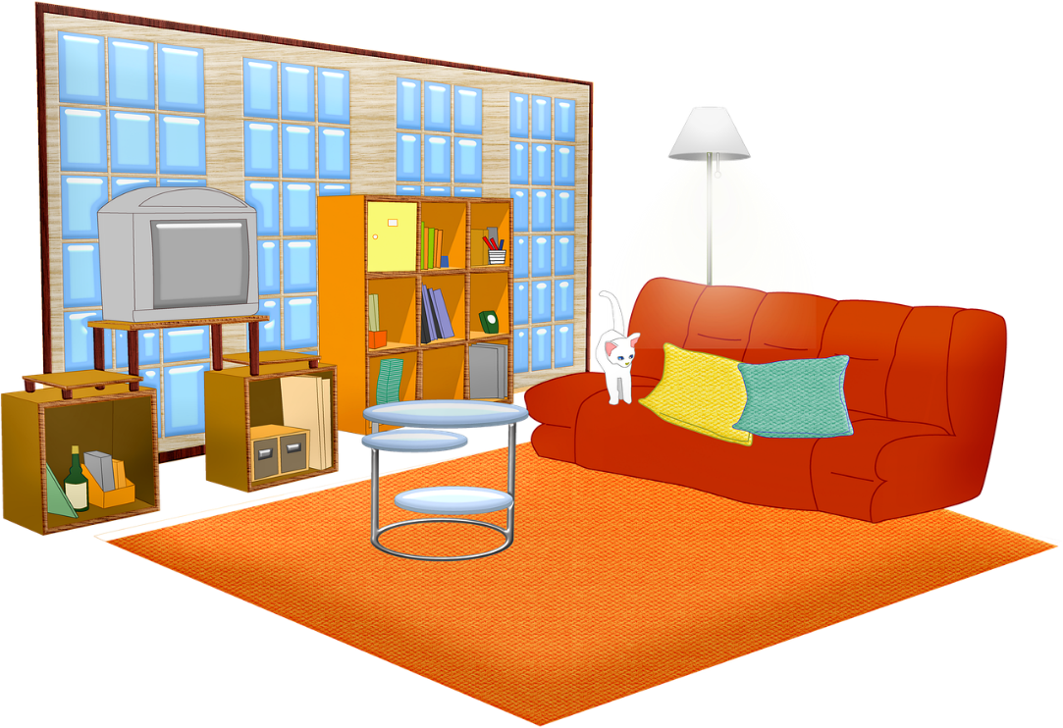
EXERCISE 2
Circle the verbs and underline the nouns in the table given below.
buy | table | speaks
day | write | sitting
washing | learning | lamp
read | teeth | climbing
hair | eats | sings
clean | enter | wall
walk | cupboard | throws
run | floor | window
Notes:
Notes for Teacher - < Information for further reference or explanation >
Suggestions: <Ideas/ Images/ Animations / Others – To make better representation of the content >
Source of Multimedia used in this slide - <Please provide source URL where we find the image and the license agreement>
<furniture> <https://pixabay.com/illustrations/living-room-windows-sofa-cat-5112176/>

Slide 4
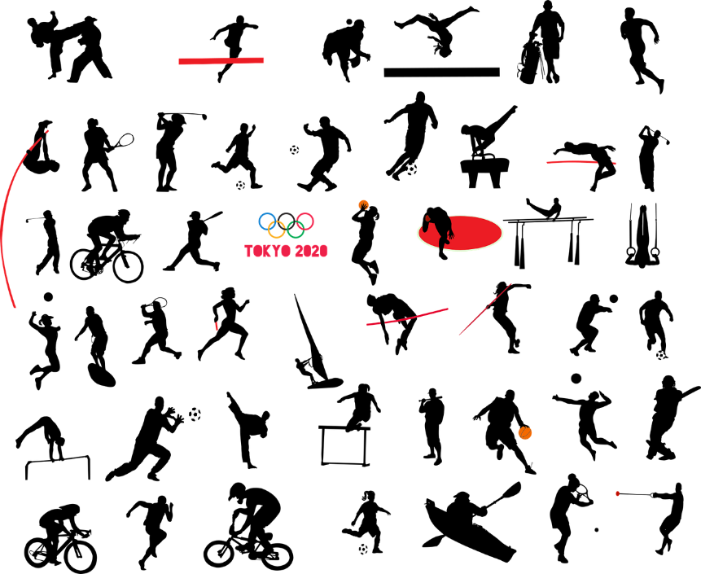
EXERCISE 3
Underline the verb/verbs in each sentence.
Anil is playing table tennis.
Raghu catches the ball and passes it to Rajan.
My friend reads books about wild animals.
My father works in the field.
Our teacher gives us homework.
The book is lying on the table.
My aunt is combing her hair.
Anil runs home after school.
Notes:
Notes for Teacher - < Information for further reference or explanation >
Suggestions: <Ideas/ Images/ Animations / Others – To make better representation of the content >
Source of Multimedia used in this slide - <Please provide source URL where we find the image and the license agreement>
<sports> <https://pixabay.com/vectors/tokyo-summer-olympics-silhouettes-4770145/>

Slide 5
EXERCISE 4
A set of nouns and verbs are given below, use them to make sentences. Example: Words - mother, love.
Sentence - Mother always loves her children. (mother is noun and loves is a verb)
a) frogs, live _________________
b) teacher, writing __________________________________
c) children, playing ______________________________
d) Aakash, reads _________________________
e) parrots, eat ______________________
Frogs live in ponds.
The teacher is writing on the blackboard.
The children are playing in the park.
Aakash reads the newspaper.
Parrots eat green chillies.
Notes:
Notes for Teacher - < Information for further reference or explanation >
Suggestions: <Ideas/ Images/ Animations / Others – To make better representation of the content >
Source of Multimedia used in this slide - <Please provide source URL where we find the image and the license agreement>

Slide 6
MM INDEX
Slide # | Thumbnail | Source link and Attribution
1 |  | <black board> <https://pixabay.com/illustrations/blackboard-board-school-chalkboard-5639925/>
2 |  | <jumps> <https://pixabay.com/vectors/people-jump-silhouette-group-male-4894818/>
3 |  | <furniture> <https://pixabay.com/illustrations/living-room-windows-sofa-cat-5112176/>
4 |  | <sports> <https://pixabay.com/vectors/tokyo-summer-olympics-silhouettes-4770145/>
Notes:
Notes for Teacher - < Information for further reference or explanation >
Suggestions: <Ideas/ Images/ Animations / Others – To make better representation of the content >
Source of Multimedia used in this slide - <Please provide source URL where we find the image and the license agreement>

