Slide 1
Importance of Adjectives
Notes:
Notes for Teacher - < Information for further reference or explanation >
Suggestions: <Ideas/ Images/ Animations / Others – To make better representation of the content >
Source of Multimedia used in this slide - <Please provide source URL where we find the image and the license agreement>
1. Boy : https://pixabay.com/illustrations/children-boys-girls-study-1716239/

Slide 2
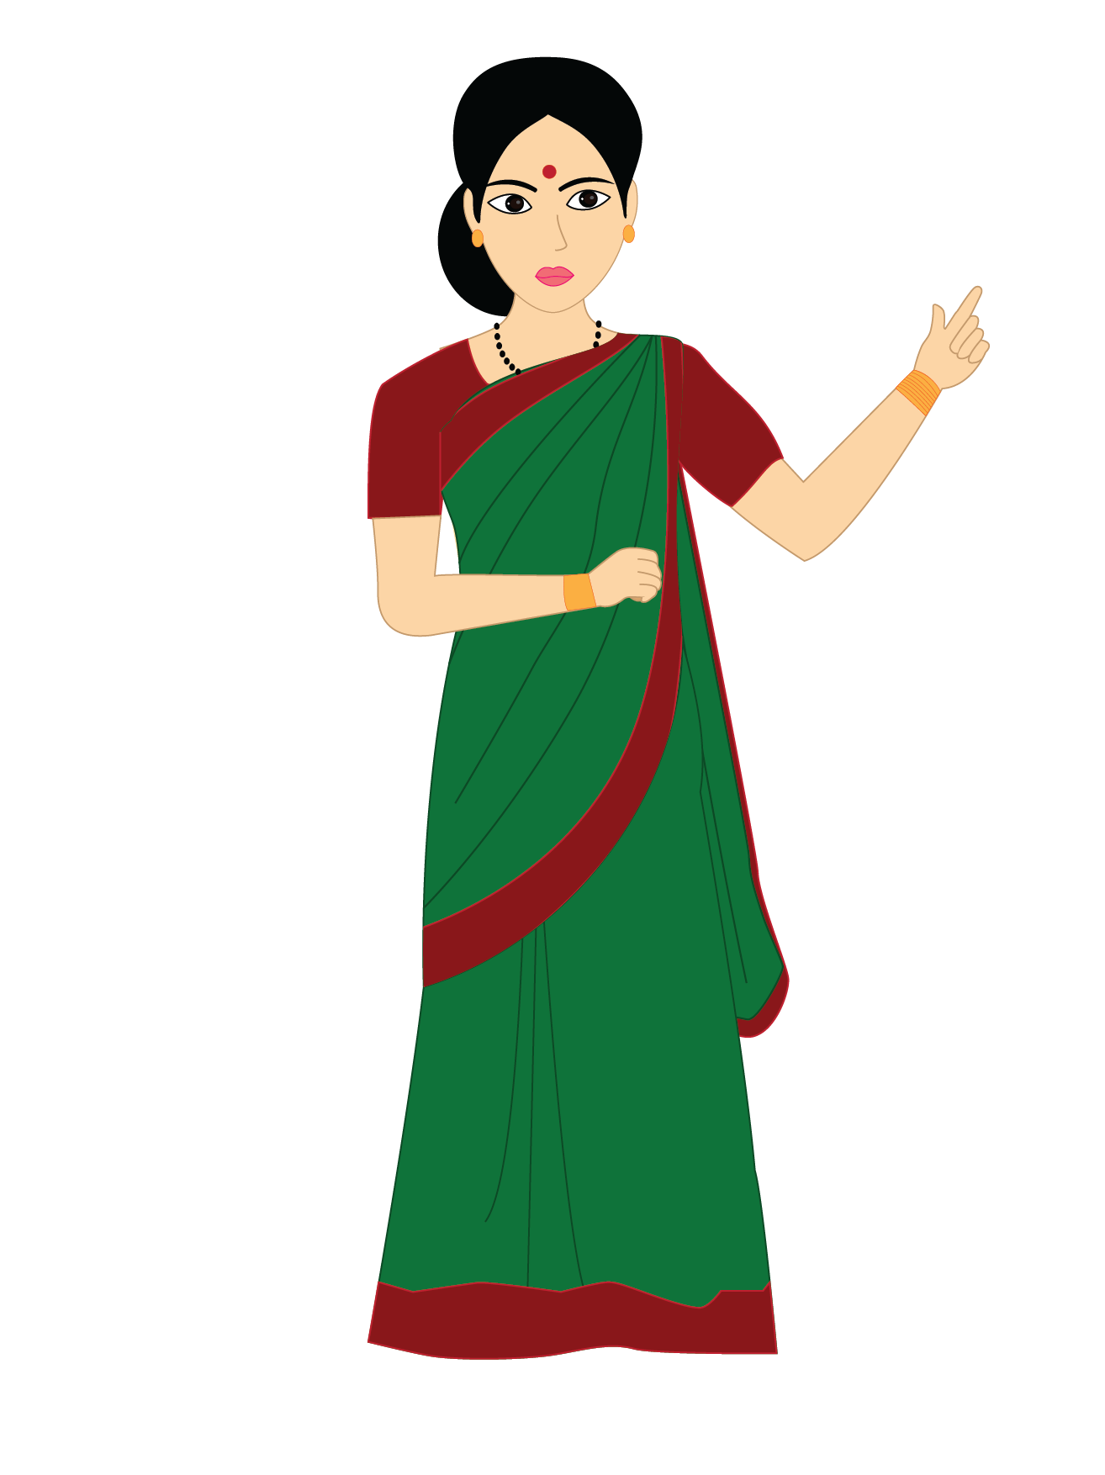
Adjectives of Quality and Quantity
Adjectives are words that describe or modify other words like nouns and pronouns.
Now, we will learn about
Adjectives of Quality and Quantity
Notes:
Notes for Teacher – The teacher can start the class with a quick recapitulation exercise on what they have learnt on Adjectives by showing them some pictures and asking them to provide describing words for them. Example: Pictures of: Apple, Teddy bear, Sun, Football , Girl , Night.
The teacher can write their responses on the Blackboard and also elicit the definition of Adjectives -- Adjectives are words that describe or modify other words like nouns and pronouns.
After this initial exercise the teacher can introduce the types of Adjectives like Adjectives of Quality and Quantity
Suggestions: <Ideas/ Images/ Animations / Others – To make better representation of the content >
Source of Multimedia used in this slide - <Please provide source URL where we find the image and the license agreement>
1. Teacher : SSSVV Gallery

Slide 3
Adjectives of Quality
Size
Place
Adjectives of Quality refer to
Kind
Person
Shape
Animal
Colour
Thing
We can have more than one adjective to describe the nouns
Notes:
Notes for Teacher – The teacher can start the class with a quick recapitulation exercise on what they have learnt on Adjectives by showing them some pictures and asking them to provide describing words for them. Example: Pictures of: Apple, Teddy bear, Sun, Football , Girl , Night.
The teacher can write their responses on the Blackboard and also elicit the definition of Adjectives -- Adjectives are words that describe or modify other words like nouns and pronouns.
After this initial exercise the teacher can introduce the types of Adjectives like Adjectives of Quality and Quantity
Suggestions: <Ideas/ Images/ Animations / Others – To make better representation of the content >
Source of Multimedia used in this slide - <Please provide source URL where we find the image and the license agreement>

Slide 4
Adjectives of Quality - Examples
This library has old books.
This library has old and new books.
Asha has a small bag.
Asha has a small, blue bag.
A big box was kept in the room.
A big, square box was kept in the room.
Notes:
Notes for Teacher –
Suggestions: <Ideas/ Images/ Animations / Others – To make better representation of the content >
Source of Multimedia used in this slide - <Please provide source URL where we find the image and the license agreement>
Girl : https://pixabay.com/illustrations/girl-reading-library-student-5843652/
Bag : https://pixabay.com/illustrations/school-bag-back-pack-bag-classroom-4878120/
Girl : https://pixabay.com/illustrations/laughing-girl-cartoon-happy-3704801/
Box : https://pixabay.com/illustrations/present-package-gift-celebration-1893642/

Slide 5
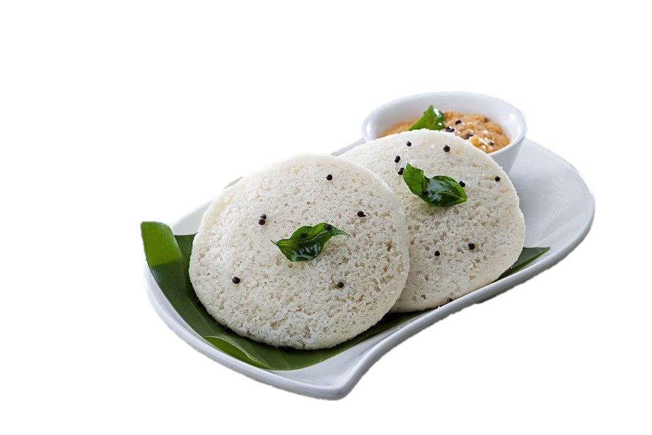
Adjectives of Quality - Examples
Nitin is a tall boy.
Nitin is a tall and handsome boy
My mother made soft idlis for lunch.
My mother made soft, white idlis for lunch.
Notes:
Notes for Teacher –
Suggestions: <Ideas/ Images/ Animations / Others – To make better representation of the content >
Source of Multimedia used in this slide - <Please provide source URL where we find the image and the license agreement>
Boy : https://pixabay.com/illustrations/child-little-boy-person-boy-wave-5765632/
Idly : https://pixabay.com/photos/breakfast-idli-indian-foods-2408818/

Slide 6
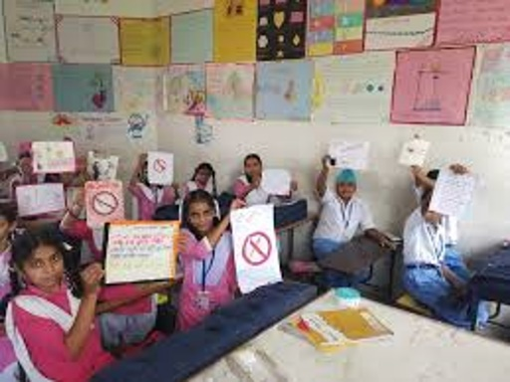
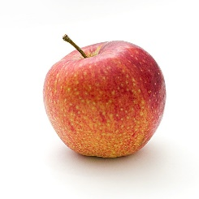
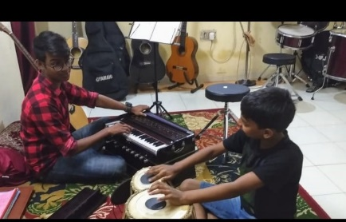
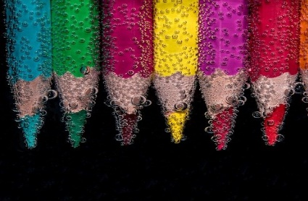
Adjectives of Quantity
Answers the question: How much? How many?
Shows the exact number of nouns
Or shows their exact position
There are forty students in this classroom.
He was the first to join the music class.
I ate two apples.
I bought six pencils from the shop.
Examples
Notes:
Notes for Teacher –
Suggestions: <Ideas/ Images/ Animations / Others – To make better representation of the content >
Source of Multimedia used in this slide - <Please provide source URL where we find the image and the license agreement>
1. Girls : SSSVV Image Gallery: Search Keyword “classroom”
2. Tabla: SSSVV Image Gallery: Search Keyword “instrument”
3. Apple: https://pixabay.com/photos/apple-red-fruit-food-fresh-ripe-1834639/
4. Pencil: https://pixabay.com/photos/colorful-pencils-submerged-2137080/

Slide 7
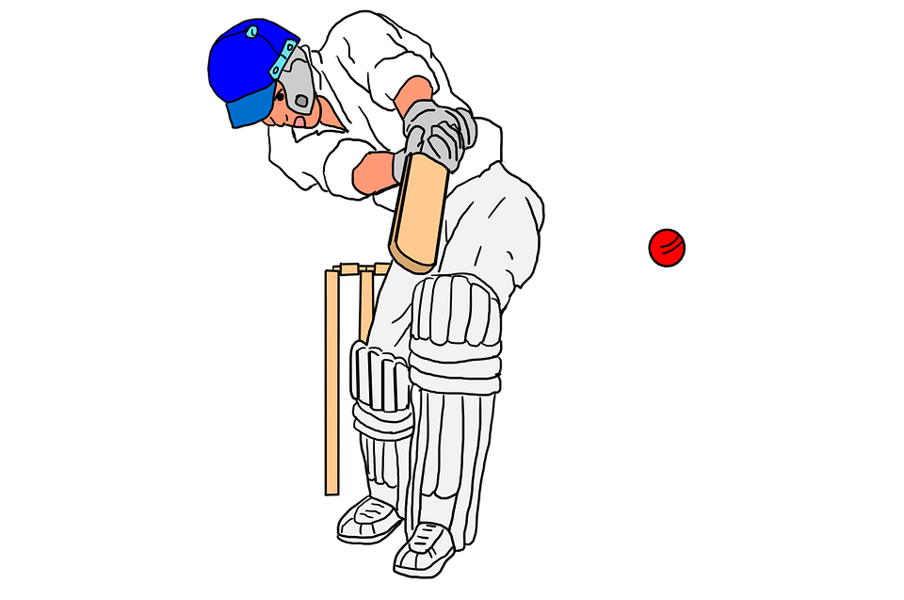
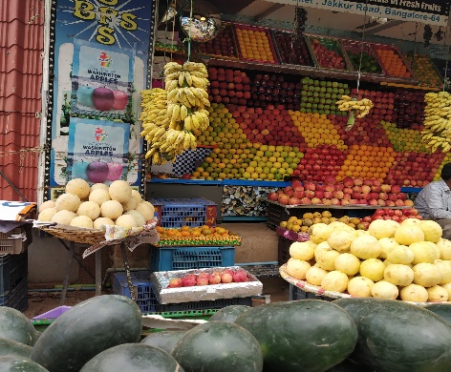
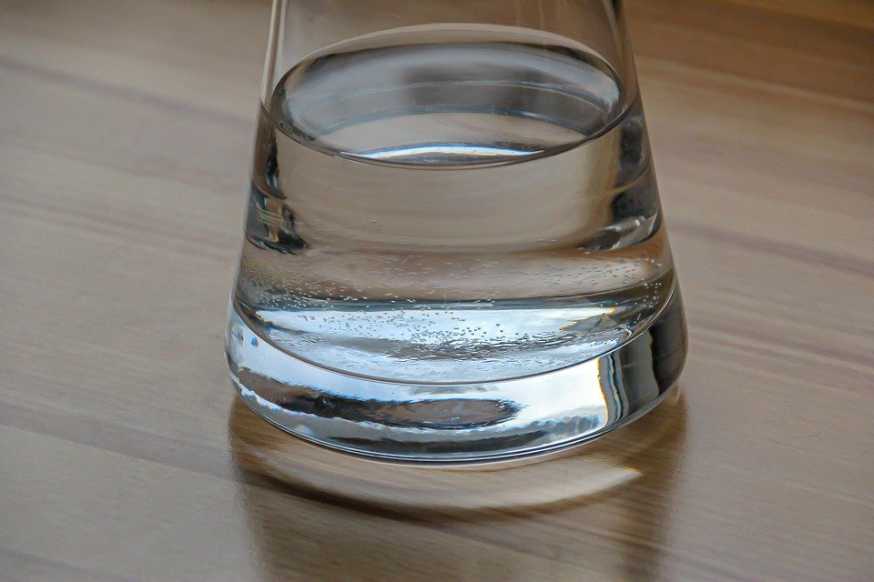
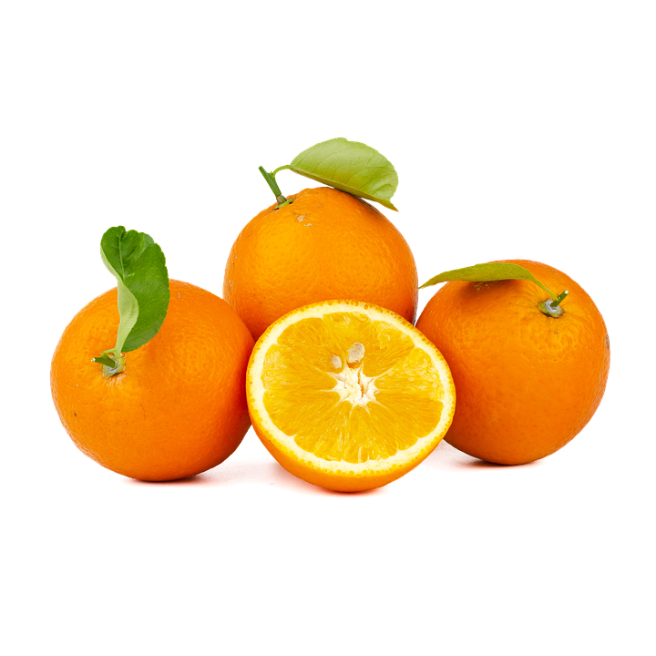
Adjectives of Quantity
Also tell us about the approximate quantity,
not the exact amount
Like: many, some, a few, enough, few all, any
Many people went to see the cricket match
There is little water left in the jug.
They bought some fruits
He gave me a few oranges.
Examples
Notes:
Notes for Teacher – The teacher when he/she does the revision or recapitulation activity may encourage the students to give more than one adjective to describe the nouns.
Examples
Teddy Bear---- a big, brown Teddy Bear.
Sun ------- a bright , yellow ball of fire.
Girl-------- a slim ,pretty girl.
Suggestions: <Ideas/ Images/ Animations / Others – To make better representation of the content >
Source of Multimedia used in this slide - <Please provide source URL where we find the image and the license agreement>
Water : https://pixabay.com/photos/glass-water-filling-water-jug-4126848/
Oranges : https://pixabay.com/illustrations/orange-navel-fruit-oranges-5012167/
Cricket : https://pixabay.com/illustrations/cricket-cricket-sport-ball-game-3311473/
Fruits : SSSVV Image Gallery: Search Keyword “fruits”

Slide 8
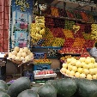
MM INDEX
Slide # | Thumbnail | Source link and Attribution
1 |  | https://pixabay.com/illustrations/children-boys-girls-study-1716239/
4 |  | Reading: https://pixabay.com/illustrations/read-reading-literacy-education-652384/ Bag : https://pixabay.com/illustrations/school-bag-back-pack-bag-classroom-4878120/ Girl : https://pixabay.com/illustrations/laughing-girl-cartoon-happy-3704801/ Box : https://pixabay.com/illustrations/present-package-gift-celebration-1893642/
5 |  | Boy : https://pixabay.com/illustrations/child-little-boy-person-boy-wave-5765632/ Idly : https://pixabay.com/photos/breakfast-idli-indian-foods-2408818/
6 |  | Classroom: SSSVV Image Gallery: Search Keyword “classroom” Tabla: SSSVV Image Gallery: Search Keyword “instrument” Apple: https://pixabay.com/photos/apple-red-fruit-food-fresh-ripe-1834639/ Pencil: https://pixabay.com/photos/colorful-pencils-submerged-2137080/
7 |  | Water : https://pixabay.com/photos/glass-water-filling-water-jug-4126848/ Oranges : https://pixabay.com/illustrations/orange-navel-fruit-oranges-5012167/ Cricket : https://pixabay.com/illustrations/cricket-cricket-sport-ball-game-3311473/ Fruits : SSSVV Image Gallery: Search Keyword “fruits”
Notes:
Notes for Teacher - < Information for further reference or explanation >
Suggestions: <Ideas/ Images/ Animations / Others – To make better representation of the content >
Source of Multimedia used in this slide - <Please provide source URL where we find the image and the license agreement>

