Slide 1
Describing Pictures with Adjectives
Notes:
Notes for Teacher - < Information for further reference or explanation >
Suggestions: <Ideas/ Images/ Animations / Others – To make better representation of the content >
Source of Multimedia used in this slide -
<boy and girl> - <https://pixabay.com/illustrations/school-students-education-teaching-2707947/>

Slide 2
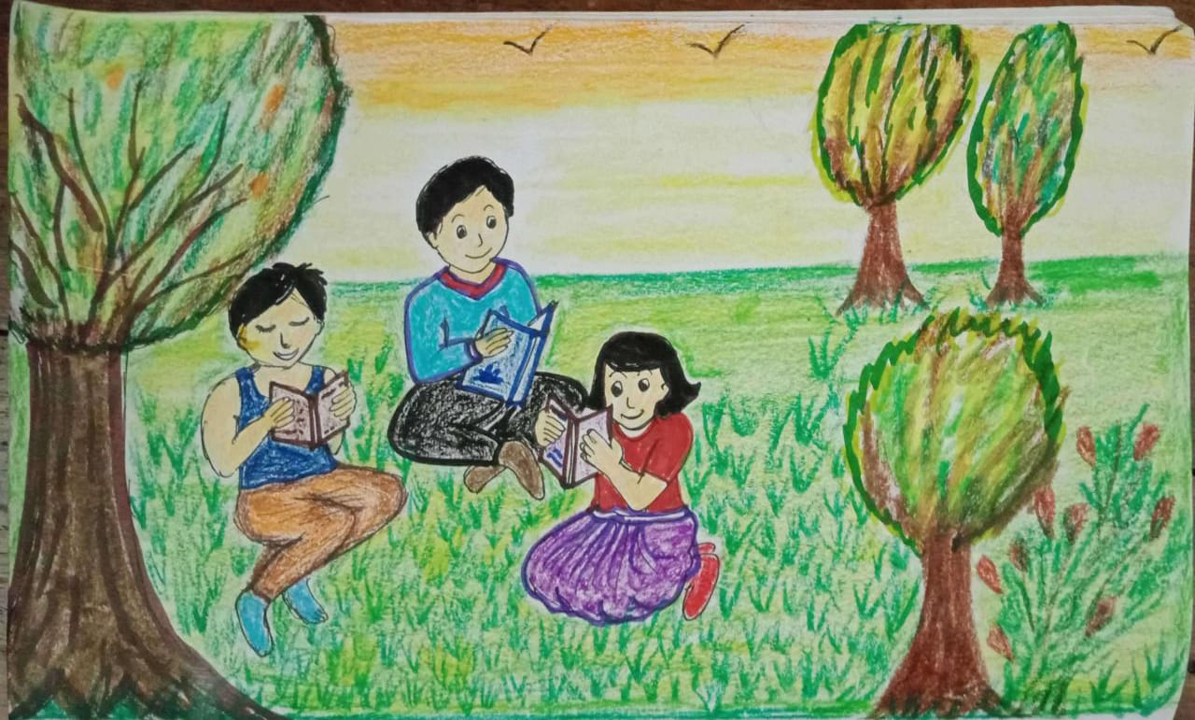
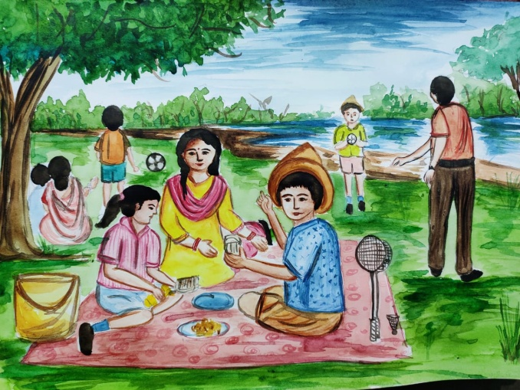
Materials Required
1 picture for a pair of students.
Notes:
Notes for Teacher - < Information for further reference or explanation >
Suggestions: <Ideas/ Images/ Animations / Others – To make better representation of the content >
Source of Multimedia used in this slide -
<studying on the grass> - <SSSVV Gallery – tag studying on the grass>
<Family time, outdoor picnic> - < SSSVV Gallery – outdoor picnic>

Slide 3
Nouns and Adjectives in the Image
NOUNS
ADJECTIVES
1. boys
2. books
3. grass
4. girl
5. trees
1. grey
2. blue
3. soft
4. two
5. brown
Notes:
Notes for Teacher - < Information for further reference or explanation >
Suggestions: <Ideas/ Images/ Animations / Others – To make better representation of the content >
Source of Multimedia used in this slide -
<studying on the grass> - <SSSVV Gallery – tag studying on the grass>

Slide 4
Nouns and Adjectives in the Image
NOUNS
ADJECTIVES
1. shirt
2. sky
3. river
4. girl
5. children
1. pink
2. blue
3. cool
4. one
5. five
Notes:
Notes for Teacher - < Information for further reference or explanation >
Suggestions: <Ideas/ Images/ Animations / Others – To make better representation of the content >
Source of Multimedia used in this slide -
<Family time, outdoor picnic> - < SSSVV Gallery – outdoor picnic>

Slide 5
Examples of Sentences
There are two boys and a girl in this picture
They are holding books that have blue, grey and brown covers.
They are sitting on the soft grass.
The girl is wearing a pretty dress.
Notes:
Notes for Teacher - ( The teacher can accept any suitable adjectives provided by the students.)
Troubleshooting
If the teacher observes that some students are unable to make sentences then he/she can accept describing words (at least two adjectives) for the nouns given in the sample picture.
Suggestions: <Ideas/ Images/ Animations / Others – To make better representation of the content >
Source of Multimedia used in this slide -
<studying on the grass> - <SSSVV Gallery – tag studying on the grass>

Slide 6
MM INDEX
Slide # | Thumbnail | Source link and Attribution
1 |  | <boy and girl> - https://pixabay.com/illustrations/school-students-education-teaching-2707947/
2, 3, 5 |  | <studying on the grass> - <SSSVV Gallery – tag studying on the grass>
2, 4 |  | <Family time, outdoor picnic> - < SSSVV Gallery – outdoor picnic>
Notes:
Notes for Teacher - < Information for further reference or explanation >
Suggestions: <Ideas/ Images/ Animations / Others – To make better representation of the content >
Source of Multimedia used in this slide - <Please provide source URL where we find the image and the license agreement>

