Slide 1
Assessment Time on Adjectives
Notes:
Notes for Teacher - < Information for further reference or explanation >
Suggestions: <Ideas/ Images/ Animations / Others – To make better representation of the content >
Source of Multimedia used in this slide - <Please provide source URL where we find the image and the license agreement>
Thinking - https://www.freepik.com/free-vector/ethical-dilemma-illustration_10893549.htm#page=1&query=thinking&position=27
Attribution Credit - freepik

Slide 2
Exercise 1
Circle the adjectives and underline the noun it describes.
Example - He was wearing a red shirt.
He is an honest man.
The big dog sat down on the carpet.
I bought a new dress for my birthday.
I have five fingers on my hand.
He slipped on the wet ground.
Notes:
Notes for Teacher - < Information for further reference or explanation >
Suggestions: <Ideas/ Images/ Animations / Others – To make better representation of the content >
Source of Multimedia used in this slide -
Balloons - https://www.freepik.com/free-vector/light-bulb-doodle-drawing-paper_4562002.htm#page=1&query=%20thinking&position=24
Attribution Credit – rawpixel.com

Slide 3
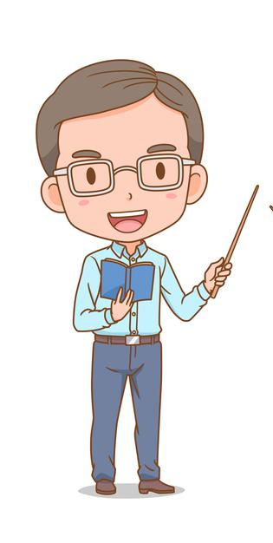
Exercise 2
Use the adjectives in the box to complete the sentences.
many, curly, hungry, juicy, helpful, sour, cruel
1. There was a _______dog in the kennel.
2. Rita has ______ hair.
3. We plucked ______ apples from the tree.
4. She is a kind and ________ child.
hungry
curly
juicy
helpful
Notes:
Notes for Teacher - < Information for further reference or explanation >
Suggestions: <Ideas/ Images/ Animations / Others – To make better representation of the content >
Source of Multimedia used in this slide -
Teacher - https://www.freepik.com/free-vector/cute-couple-cartoon-teachers_11791326.htm#page=1&query=male%20teacher&position=0
Attribution Credit – lek_suwarin

Slide 4
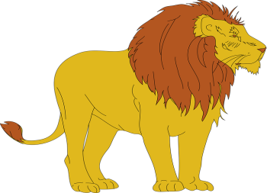
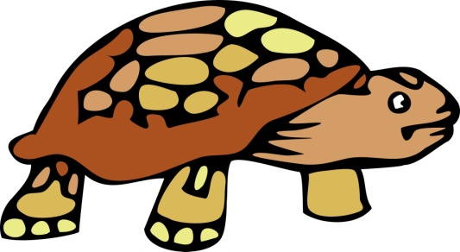
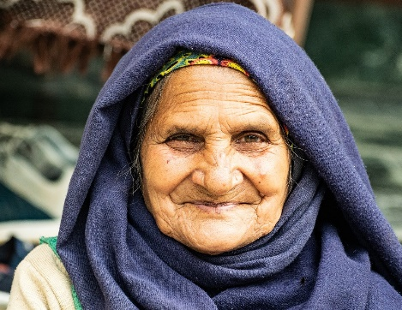
Exercise 3
Look at the pictures and write two describing words for each of them.
Example
strong, brave
slow, old, heavy
strong, new, big
pretty, pink, beautiful
wise, kind, happy, loving
Grandma
Notes:
Notes for Teacher - < Information for further reference or explanation >
Suggestions: <Ideas/ Images/ Animations / Others – To make better representation of the content >
Source of Multimedia used in this slide -
Lion - https://pixabay.com/vectors/lion-animal-mammal-standing-48160/
Tortoise - https://www.publicdomainpictures.net/en/view-image.php?image=73293&picture=cartoon-tortoise-clipart
Rose - https://www.publicdomainpictures.net/en/view-image.php?image=375589&picture=rose-painted-art-clipart
Grandma - https://pixabay.com/photos/elderly-woman-old-elderly-5919192/
School - https://publicdomainvectors.org/en/free-clipart/School-building/84933.html

Slide 5
MM INDEX
Slide # | Thumbnail | Source link and Attribution
1 |  | Thinking - https://www.freepik.com/free-vector/ethical-dilemma-illustration_10893549.htm#page=1&query=thinking&position=27 Attribution Credit - freepik
2 |  | Balloons - https://www.freepik.com/free-vector/light-bulb-doodle-drawing-paper_4562002.htm#page=1&query=%20thinking&position=24 Attribution Credit – rawpixel.com
3 |  | https://www.freepik.com/free-vector/cute-couple-cartoon-teachers_11791326.htm#page=1&query=male%20teacher&position=0 Attribution Credit – lek_suwarin
4 |  | Lion - https://pixabay.com/vectors/lion-animal-mammal-standing-48160/ Tortoise - https://www.publicdomainpictures.net/en/view-image.php?image=73293&picture=cartoon-tortoise-clipart Rose - https://www.publicdomainpictures.net/en/view-image.php?image=375589&picture=rose-painted-art-clipart Grandma - https://pixabay.com/photos/elderly-woman-old-elderly-5919192/ School - https://publicdomainvectors.org/en/free-clipart/School-building/84933.html
Notes:
Notes for Teacher - < Information for further reference or explanation >
Suggestions: <Ideas/ Images/ Animations / Others – To make better representation of the content >
Source of Multimedia used in this slide - <Please provide source URL where we find the image and the license agreement>

