Slide 1
Usage of Adjectives
Notes:
Notes for Teacher - < Information for further reference or explanation >
Suggestions: <Ideas/ Images/ Animations / Others – To make better representation of the content >
Source of Multimedia used in this slide - <Please provide source URL where we find the image and the license agreement>
Adjectives - https://www.freepik.com/free-vector/set-adjective-words-with-children-expressing-their-feelings_6459051.htm#page=1&query=adjectives&position=8
Attribution Credit - brgfx

Slide 2
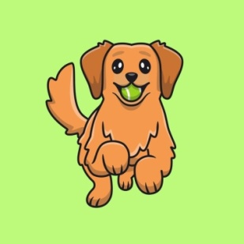
Exercise 1
Underline the adjectives in the paragraph given below.
One sunny day my little puppy jumped on our blue sofa and played with his new toy. I liked to watch him play and it made me feel happy. Soon my playful puppy got tired. I picked up my sleepy puppy and laid him on his soft, round bed.
Notes:
Notes for Teacher - < Information for further reference or explanation >
Suggestions: <Ideas/ Images/ Animations / Others – To make better representation of the content >
Source of Multimedia used in this slide -
Sofa - https://www.freepik.com/free-vector/collection-different-chairs_1175533.htm#page=1&query=blue%20sofa%20clipart&position=0
Attribution Credit – brgfx
Puppy - https://www.freepik.com/free-vector/cute-golden-retriever-playing-ball_10576725.htm#page=1&query=puppy%20playing&position=13
Attribution Credit – catalyststuff
Puppy sleeping - https://www.freepik.com/free-vector/cute-shiba-inu-dog-sushi-cartoon-icon-illustration_11759971.htm#query=puppy%20sleeping&position=3
Attribution Credit - catalyststuff

Slide 3
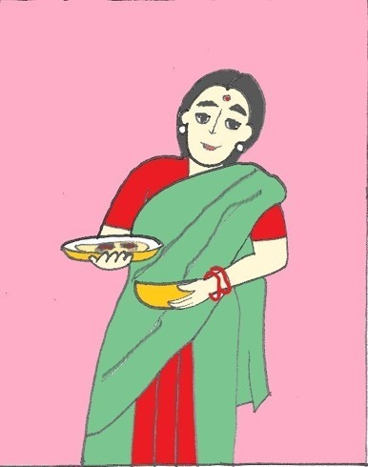
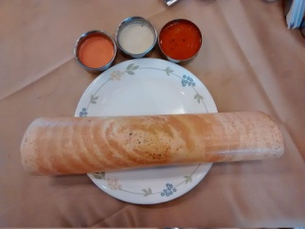
Exercise 2
Fill in the blanks with suitable adjectives using the words given below:
tasty, favourite, thin, many, crispy, wonderful
We all love to eat ______ food.
There are so ______varieties of food, which are available all over the world.
My __________food is Masala Dosa.
My mother makes ______and ________ dosas.
They have a ___________ taste.
tasty
many
favourite
thin
crispy
wonderful
Notes:
Notes for Teacher - < Information for further reference or explanation >
Suggestions: <Ideas/ Images/ Animations / Others – To make better representation of the content >
Source of Multimedia used in this slide -
Dosa - https://pixabay.com/photos/dosa-masala-dosa-food-india-kerala-2069313/
Mother: SSSVV Image Gallery: Search Keyword “mother”

Slide 4
MM INDEX
Slide # | Thumbnail | Source link and Attribution
1 |  | Adjectives - https://www.freepik.com/free-vector/set-adjective-words-with-children-expressing-their-feelings_6459051.htm#page=1&query=adjectives&position=8 Attribution Credit - brgfx
2 |  | Sofa - https://www.freepik.com/free-vector/collection-different-chairs_1175533.htm#page=1&query=blue%20sofa%20clipart&position=0 Attribution Credit – brgfx Puppy - https://www.freepik.com/free-vector/cute-golden-retriever-playing-ball_10576725.htm#page=1&query=puppy%20playing&position=13 Attribution Credit – catalyststuff Puppy sleeping - https://www.freepik.com/free-vector/cute-shiba-inu-dog-sushi-cartoon-icon-illustration_11759971.htm#query=puppy%20sleeping&position=3 Attribution Credit - catalyststuff
3 |  | Dosa - https://pixabay.com/photos/dosa-masala-dosa-food-india-kerala-2069313/ Mother: SSSVV Image Gallery: Search Keyword “mother”
Notes:
Notes for Teacher - < Information for further reference or explanation >
Suggestions: <Ideas/ Images/ Animations / Others – To make better representation of the content >
Source of Multimedia used in this slide - <Please provide source URL where we find the image and the license agreement>

