Slide 1
Functions of Prepositions
in
above
on
at
between
behind
under
Notes:
Notes for Teacher - < Information for further reference or explanation >
Suggestions: <Ideas/ Images/ Animations / Others – To make better representation of the content >
Source of Multimedia used in this slide - <Please provide source URL where we find the image and the license agreement>

Slide 2
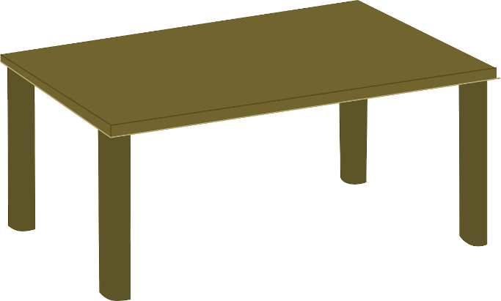
Suggested Exercise
The book is under the table.
The book is on the table.
The book is behind the table.
The book is above the table.
Notes:
Notes for Teacher - < Information for further reference or explanation >
Suggestions: <Ideas/ Images/ Animations / Others – To make better representation of the content >
Source of Multimedia used in this slide - <Please provide source URL where we find the image and the license agreement>
<table> <https://pixabay.com/vectors/furniture-table-wood-livingroom-147619/>
<book> <https://pixabay.com/vectors/book-open-blank-reading-library-149474/>

Slide 3
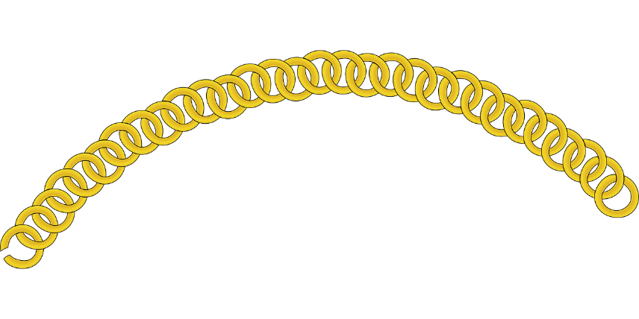
Prepositions
nouns, pronouns,
phrases
remaining part of the sentences
prepositions
Some show place or where something happens
Notes:
Notes for Teacher - < Information for further reference or explanation >
Suggestions: <Ideas/ Images/ Animations / Others – To make better representation of the content >
Source of Multimedia used in this slide - <Please provide source URL where we find the image and the license agreement>
<link> <https://pixabay.com/vectors/chain-gold-jewelry-necklace-links-25487/>

Slide 4
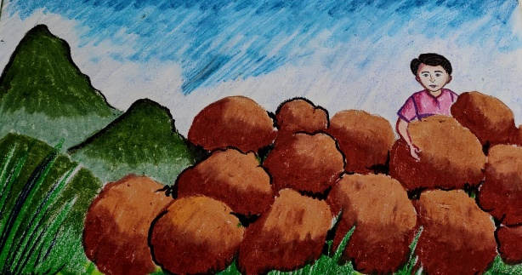
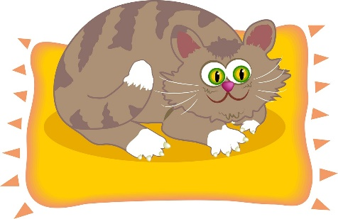
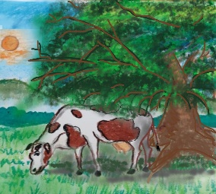
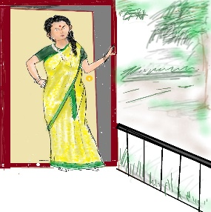
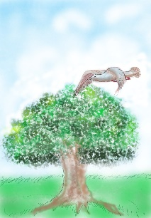
Examples
The boy hid behind the rock.
The cat is sitting on the mat.
The book is in the bag.
The cow is resting under the tree.
The book is between the bags.
My mother stood at the door.
The bird flew over the tree.
Notes:
Notes for Teacher - < Information for further reference or explanation >
Suggestions: <Ideas/ Images/ Animations / Others – To make better representation of the content >
Source of Multimedia used in this slide - <Please provide source URL where we find the image and the license agreement>
<cat on mat> <https://pixabay.com/illustrations/graphic-cartoon-cat-cats-pet-pets-268414/>
<boy behind rocks> <SSSVV>
<book> <https://pixabay.com/vectors/book-open-blank-reading-library-149474/>
<bag> <https://pixabay.com/vectors/shopping-bag-orange-empty-big-308552/>
<cow under a tree> <SSSVV>
<mother at the door> <SSSVV>
<bird over the tree> <SSSVV>

Slide 5
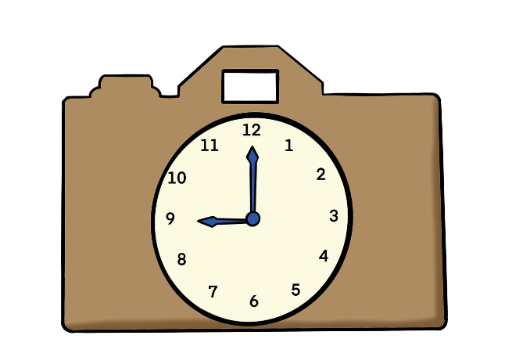
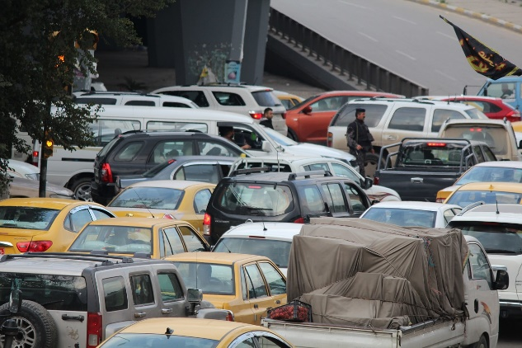
Prepositions
show time or when something happens
in, on, at
Banks close on Sundays.
School starts at nine o’clock.
The traffic is heavy in the morning.
Notes:
Notes for Teacher - < Information for further reference or explanation >
Suggestions: <Ideas/ Images/ Animations / Others – To make better representation of the content >
Source of Multimedia used in this slide - <Please provide source URL where we find the image and the license agreement>
<clock> <https://pixabay.com/illustrations/clock-watch-time-hours-timepiece-3600351/>
<9 am> <https://pixabay.com/illustrations/clock-9-o-clock-nine-o-clock-time-4739768/>
<traffic jam> <https://pixabay.com/photos/traffic-traffic-jam-baghdad-iraq-677106/>
<bank> <https://pixabay.com/vectors/sign-closed-retail-store-shop-5932976/>

Slide 6
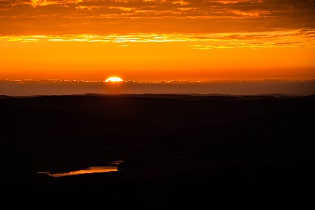
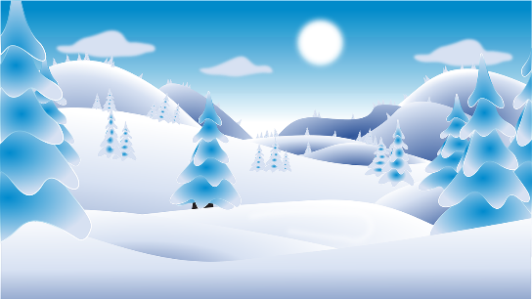
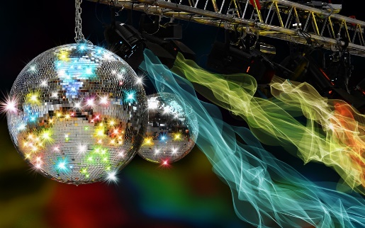
Prepositions of Time - ‘In’
the morning
February
(the) summer
2015
the afternoon
(the) winter
2015
The 90s
Example: My grandfather was born in 1970.
the 1990s
the evening
Notes:
Notes for Teacher - < Information for further reference or explanation >
Suggestions: <Ideas/ Images/ Animations / Others – To make better representation of the content >
Source of Multimedia used in this slide - <Please provide source URL where we find the image and the license agreement>
<morning> <https://pixabay.com/photos/sunrise-early-cloud-morning-1107408/>
<February> <https://pixabay.com/vectors/calendar-date-february-january-4855253/>
<summer> <https://pixabay.com/illustrations/summer-clipart-nature-storytelling-5350229/>
<noon> <https://pixabay.com/vectors/clock-time-face-roman-twelve-33989/>
<winter> <https://pixabay.com/vectors/snow-winter-christmas-cold-season-4329741/>
<disco> <https://pixabay.com/photos/disco-party-celebration-mirror-ball-2722995/>
<twilight> <https://pixabay.com/illustrations/twilight-sunset-moon-landscape-4572987/>

Slide 7
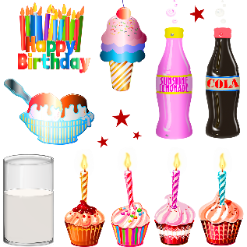
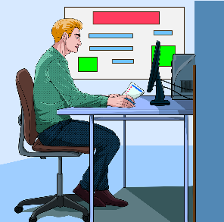
Prepositions of Time - ‘On’
Sunday
Monday morning
Tuesday afternoon
June 5
June 5
my birthday
a holiday
Example: I usually go to the temple on Fridays.
Wednesday evening
a weekday
Notes:
Notes for Teacher - < Information for further reference or explanation >
Suggestions: <Ideas/ Images/ Animations / Others – To make better representation of the content >
Source of Multimedia used in this slide - <Please provide source URL where we find the image and the license agreement>
<morning> <https://pixabay.com/photos/sunrise-early-cloud-morning-1107408/>
<Sunday> <https://pixabay.com/illustrations/sunday-wordpress-type-font-res-1084365/>
<summer> <https://pixabay.com/illustrations/summer-clipart-nature-storytelling-5350229/>
<twilight> <https://pixabay.com/illustrations/twilight-sunset-moon-landscape-4572987/> <birthday> <https://pixabay.com/illustrations/birthday-party-happy-birthday-cake-3748885/>
<holiday> <https://pixabay.com/illustrations/diwali-festival-poster-banner-diya-5725650/>
<office> <https://pixabay.com/vectors/office-computer-business-4811929/>

Slide 8
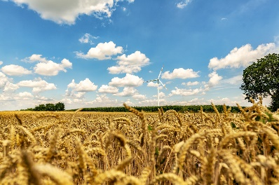
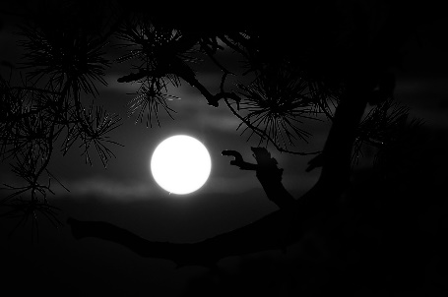
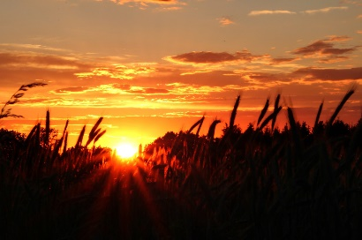
Prepositions of Time - ‘At’
9:30
sight
9.30
noon/midday
midnight
bedtime
sunrise/sunset
Example: He always gets up at seven o’clock in the morning.
the weekend
Notes:
Notes for Teacher - < Information for further reference or explanation >
Suggestions: <Ideas/ Images/ Animations / Others – To make better representation of the content >
Source of Multimedia used in this slide - <Please provide source URL where we find the image and the license agreement>
<eyes> <https://pixabay.com/illustrations/eyes-eye-woman-female-girl-163692/>
<noon/midday> <https://pixabay.com/photos/wheat-field-summer-sun-palatinate-4508378/>
<midnight> <https://pixabay.com/photos/midnight-full-moon-moon-night-571595/>
<sunrise/sunset> <https://pixabay.com/photos/sunset-field-agriculture-grain-4275587/>
<bedtime> <https://pixabay.com/vectors/star-sleeping-tired-cloud-girl-161973/>
<days of the week> <https://pixabay.com/illustrations/saturday-sunday-monday-tuesday-2296766/>

Slide 9
MM INDEX
Slide # | Thumbnail | Source link and Attribution
2 |  | <table> https://pixabay.com/vectors/furniture-table-wood-livingroom-147619/
2,4 |  | <book> https://pixabay.com/vectors/book-open-blank-reading-library-149474/
3 |  | <link> https://pixabay.com/vectors/chain-gold-jewelry-necklace-links-25487/
4 |  | <cat on mat> https://pixabay.com/illustrations/graphic-cartoon-cat-cats-pet-pets-268414/ <bag> https://pixabay.com/vectors/shopping-bag-orange-empty-big-308552/
5 |  | <clock> https://pixabay.com/illustrations/clock-watch-time-hours-timepiece-3600351/ <9 am> https://pixabay.com/illustrations/clock-9-o-clock-nine-o-clock-time-4739768/ <traffic jam> https://pixabay.com/photos/traffic-traffic-jam-baghdad-iraq-677106/ <bank> https://pixabay.com/vectors/sign-closed-retail-store-shop-5932976/
6 |  | <morning> https://pixabay.com/photos/sunrise-early-cloud-morning-1107408/ <February> https://pixabay.com/vectors/calendar-date-february-january-4855253/ <summer> https://pixabay.com/illustrations/summer-clipart-nature-storytelling-5350229/ <noon> https://pixabay.com/vectors/clock-time-face-roman-twelve-33989/ <winter> https://pixabay.com/vectors/snow-winter-christmas-cold-season-4329741/ <disco> https://pixabay.com/photos/disco-party-celebration-mirror-ball-2722995/ <twilight> https://pixabay.com/illustrations/twilight-sunset-moon-landscape-4572987/
7 |  | <morning> https://pixabay.com/photos/sunrise-early-cloud-morning-1107408/ <Sunday> https://pixabay.com/illustrations/sunday-wordpress-type-font-res-1084365/ <summer> https://pixabay.com/illustrations/summer-clipart-nature-storytelling-5350229/ <twilight> https://pixabay.com/illustrations/twilight-sunset-moon-landscape-4572987/ <birthday> https://pixabay.com/illustrations/birthday-party-happy-birthday-cake-3748885/ <holiday> https://pixabay.com/illustrations/diwali-festival-poster-banner-diya-5725650/ <office> https://pixabay.com/vectors/office-computer-business-4811929/
8 |  | <eyes> https://pixabay.com/illustrations/eyes-eye-woman-female-girl-163692/ <noon/midday> https://pixabay.com/photos/wheat-field-summer-sun-palatinate-4508378/ <midnight> https://pixabay.com/photos/midnight-full-moon-moon-night-571595/ <sunrise/sunset> https://pixabay.com/photos/sunset-field-agriculture-grain-4275587/ <bedtime> https://pixabay.com/vectors/star-sleeping-tired-cloud-girl-161973/ <days of the week> https://pixabay.com/illustrations/saturday-sunday-monday-tuesday-2296766/
Notes:
Notes for Teacher - < Information for further reference or explanation >
Suggestions: <Ideas/ Images/ Animations / Others – To make better representation of the content >
Source of Multimedia used in this slide - <Please provide source URL where we find the image and the license agreement>

