Slide 1
Check Time For Prepositions
Notes:
Notes for Teacher - < Information for further reference or explanation >
Suggestions: <Ideas/ Images/ Animations / Others – To make better representation of the content >
Source of Multimedia used in this slide - <Please provide source URL where we find the image and the license agreement>
<countdown> <https://pixabay.com/illustrations/clock-15-min-wait-countdown-plan-4022296/>

Slide 2
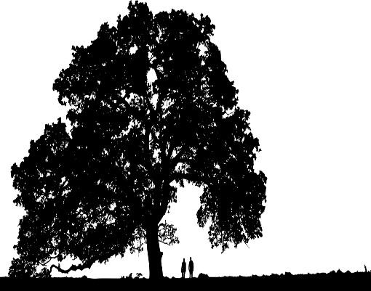
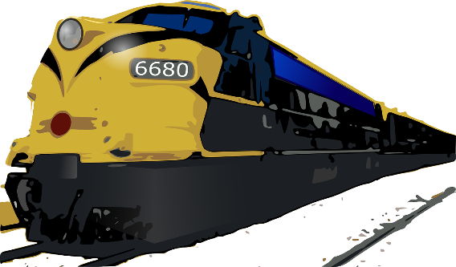
Exercise 1
Circle the preposition in each sentence.
We played in the park.
The child stood under a tree.
We love to eat ice cream in summer.
The train leaves at five in the evening.
What time does he go to school in the morning?
Rohan hid behind the door.
She is going to Mysore on Thursday.
The rabbit jumped over the bushes.
Notes:
Notes for Teacher - < Information for further reference or explanation >
Suggestions: <Ideas/ Images/ Animations / Others – To make better representation of the content >
Source of Multimedia used in this slide - <Please provide source URL where we find the image and the license agreement>
<tree> <https://pixabay.com/vectors/tree-landscape-silhouette-plant-5371804/>
<ice cream> <https://pixabay.com/illustrations/ice-cream-icecream-desserts-frozen-3571774/> <train> <https://pixabay.com/vectors/train-rail-railway-161015/>
<rabbit> <https://pixabay.com/vectors/bunny-clipart-issue-fast-icon-1298864/>

Slide 3
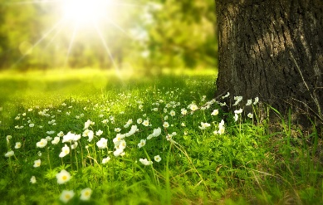
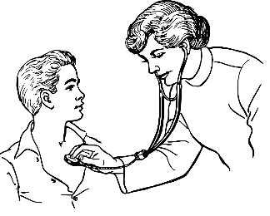
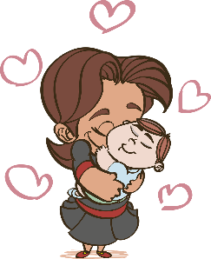
Exercise 2
Choose the correct prepositions.
Let’s meet ___ noon. a.at b.on c.in
The doctor will be back ____ half an hour. a.on b.in c.at
He won’t be working ____ Saturdays. a.at b.on c.in
Please leave your shoes ____ the door. a.in b.on c.at
The baby sat _____ its mother’s lap. a.in b.on c.at
at
in
on
at
on
Notes:
Notes for Teacher - < Information for further reference or explanation >
Suggestions: <Ideas/ Images/ Animations / Others – To make better representation of the content >
Source of Multimedia used in this slide - <Please provide source URL where we find the image and the license agreement>
<noon> <https://pixabay.com/photos/tree-flowers-meadow-tree-trunk-276014/>
<doctor> <https://pixabay.com/vectors/doctor-lady-examine-child-kid-37707/>
<shoes> <https://pixabay.com/illustrations/shoes-clipart-ribbon-graphic-1973283/>
<mother> <https://pixabay.com/vectors/mom-love-family-baby-maternity-4839682/>

Slide 4
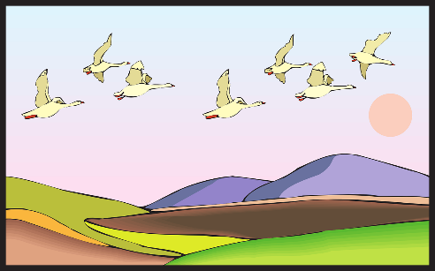
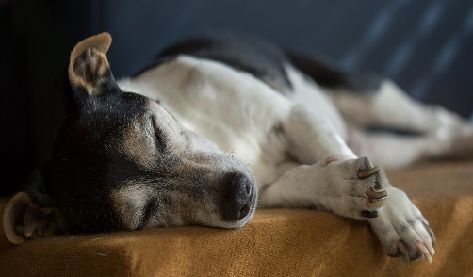
EXERCISE 3
Fill in the blanks with prepositions from the word bank.
at
in
on
under
over
between
I saw him ____ the morning.
The birds flew ____ the trees.
The toy was hidden ________ the books.
We wrote ____ a sheet of paper.
The dog was sleeping _____ the cot.
School starts ____ nine o’clock.
in
over
between
on
under
at
Notes:
Notes for Teacher - < Information for further reference or explanation >
Suggestions: <Ideas/ Images/ Animations / Others – To make better representation of the content >
Source of Multimedia used in this slide - <Please provide source URL where we find the image and the license agreement>
<birds flying> <https://pixabay.com/vectors/land-birds-flying-sunset-mountains-46566/>
<bookshelf> <https://pixabay.com/vectors/bookshelf-bookcase-furniture-32811/>
<writing> <https://pixabay.com/illustrations/notes-pencil-abc-writing-card-5729126/>
<dog sleeping> <https://pixabay.com/photos/jack-russell-dog-old-terrier-2310391/>

Slide 5
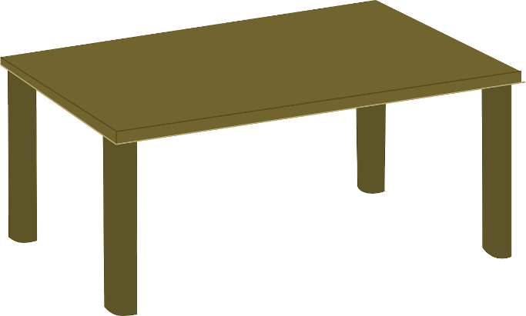
Exercise 3
Make sentences with the following words.
at: __________________
____________________
I wake up at six in the morning
on: _____________________
_____________________
The books are on the table.
Notes:
Notes for Teacher - < Information for further reference or explanation >
Suggestions: <Ideas/ Images/ Animations / Others – To make better representation of the content >
Source of Multimedia used in this slide - <Please provide source URL where we find the image and the license agreement>
<clock> <https://pixabay.com/vectors/clock-time-six-six-o--clock-26101/>
<table> <https://pixabay.com/vectors/furniture-table-wood-livingroom-147619/>
<books> <https://pixabay.com/vectors/book-books-library-books-reading-2022464/>

Slide 6
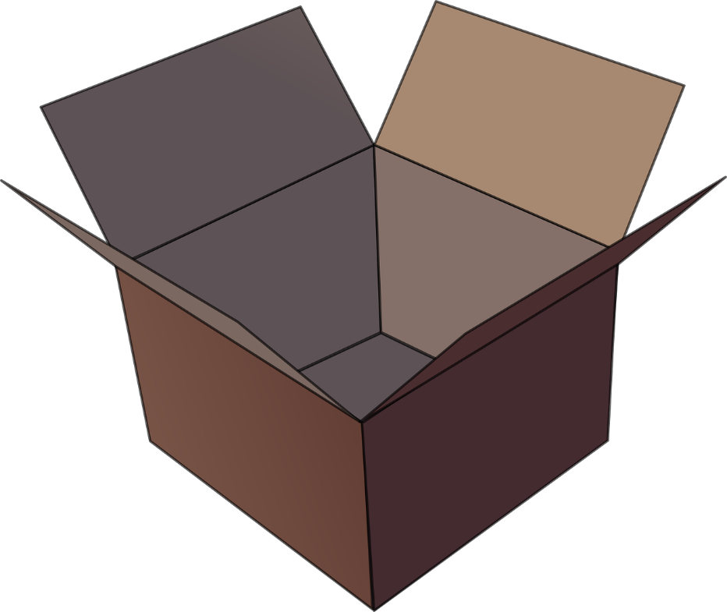
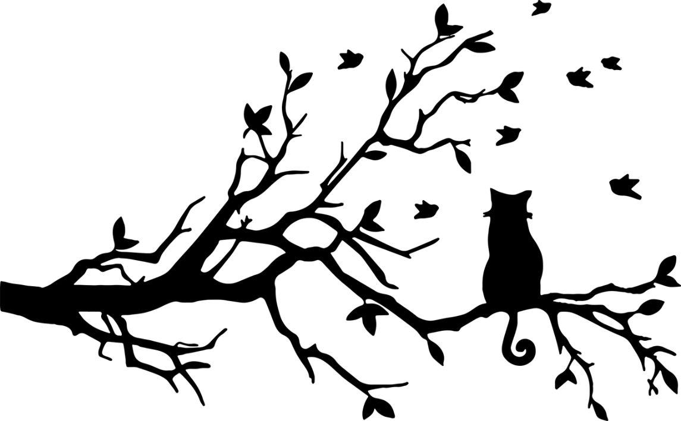
Exercise 5
Draw the following
Draw a ball in a box | Draw a cat on a tree
Notes:
Notes for Teacher - < Information for further reference or explanation >
Suggestions: <Ideas/ Images/ Animations / Others – To make better representation of the content >
Source of Multimedia used in this slide - <Please provide source URL where we find the image and the license agreement>
<ball> <https://pixabay.com/vectors/football-soccer-ball-sport-147854/>
<box> <https://pixabay.com/vectors/package-empty-box-carton-packaging-25067/>
<cat on a tree> <https://pixabay.com/vectors/cat-feline-animal-pet-birds-tree-1781611/>

Slide 7
MM INDEX
Slide # | Thumbnail | Source link and Attribution
1 |  | <countdown> https://pixabay.com/illustrations/clock-15-min-wait-countdown-plan-4022296/
2 |  | <tree> https://pixabay.com/vectors/tree-landscape-silhouette-plant-5371804/ <ice cream> https://pixabay.com/illustrations/ice-cream-icecream-desserts-frozen-3571774/ <train> https://pixabay.com/vectors/train-rail-railway-161015/ <rabbit> https://pixabay.com/vectors/bunny-clipart-issue-fast-icon-1298864/
3 |  | <noon> https://pixabay.com/photos/tree-flowers-meadow-tree-trunk-276014/ <doctor> https://pixabay.com/vectors/doctor-lady-examine-child-kid-37707/ <shoes> https://pixabay.com/illustrations/shoes-clipart-ribbon-graphic-1973283/ <mother> https://pixabay.com/vectors/mom-love-family-baby-maternity-4839682/
4 |  | <birds flying> https://pixabay.com/vectors/land-birds-flying-sunset-mountains-46566/ <bookshelf> https://pixabay.com/vectors/bookshelf-bookcase-furniture-32811/ <writing> https://pixabay.com/illustrations/notes-pencil-abc-writing-card-5729126/ <dog sleeping> https://pixabay.com/photos/jack-russell-dog-old-terrier-2310391/
5 |  | <clock> https://pixabay.com/vectors/clock-time-six-six-o--clock-26101/ <table> https://pixabay.com/vectors/furniture-table-wood-livingroom-147619/ <books> https://pixabay.com/vectors/book-books-library-books-reading-2022464/
6 |  | <ball> https://pixabay.com/vectors/football-soccer-ball-sport-147854/ <box> https://pixabay.com/vectors/package-empty-box-carton-packaging-25067/ <cat on a tree> https://pixabay.com/vectors/cat-feline-animal-pet-birds-tree-1781611/
Notes:
Notes for Teacher - < Information for further reference or explanation >
Suggestions: <Ideas/ Images/ Animations / Others – To make better representation of the content >
Source of Multimedia used in this slide - <Please provide source URL where we find the image and the license agreement>

