Slide 1
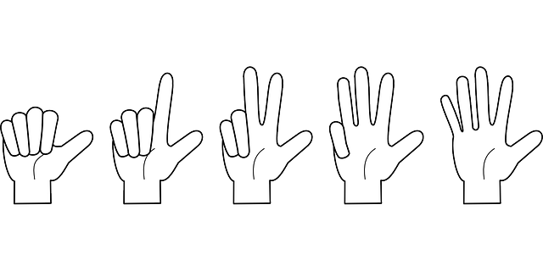
All About Countable And Uncountable Nouns
Notes:
Notes for Teacher - < Information for further reference or explanation >
Suggestions: <Ideas/ Images/ Animations / Others – To make better representation of the content >
Source of Multimedia used in this slide - <Please provide source URL where we find the image and the license agreement>
<countables> <https://pixabay.com/vectors/hand-counting-fingers-one-two-162127/>

Slide 2
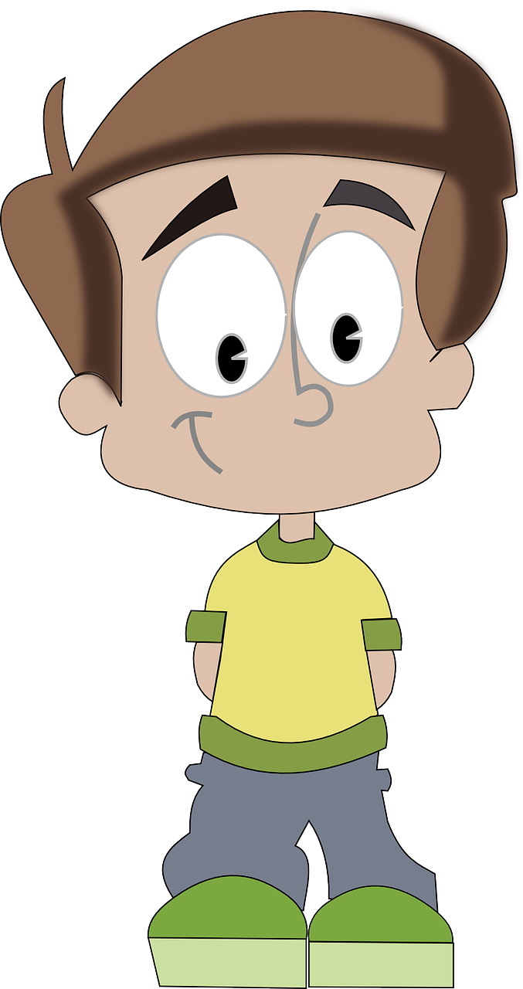
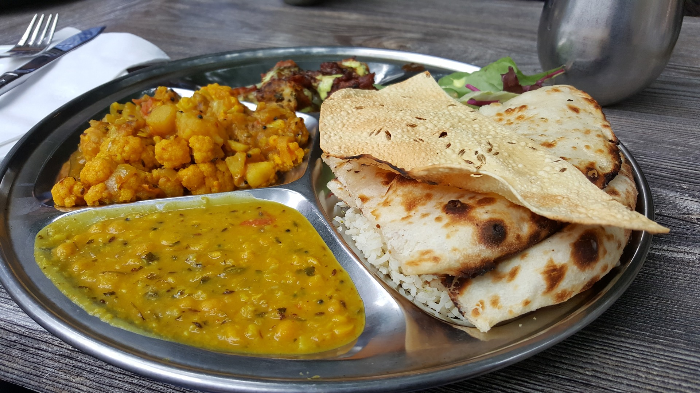
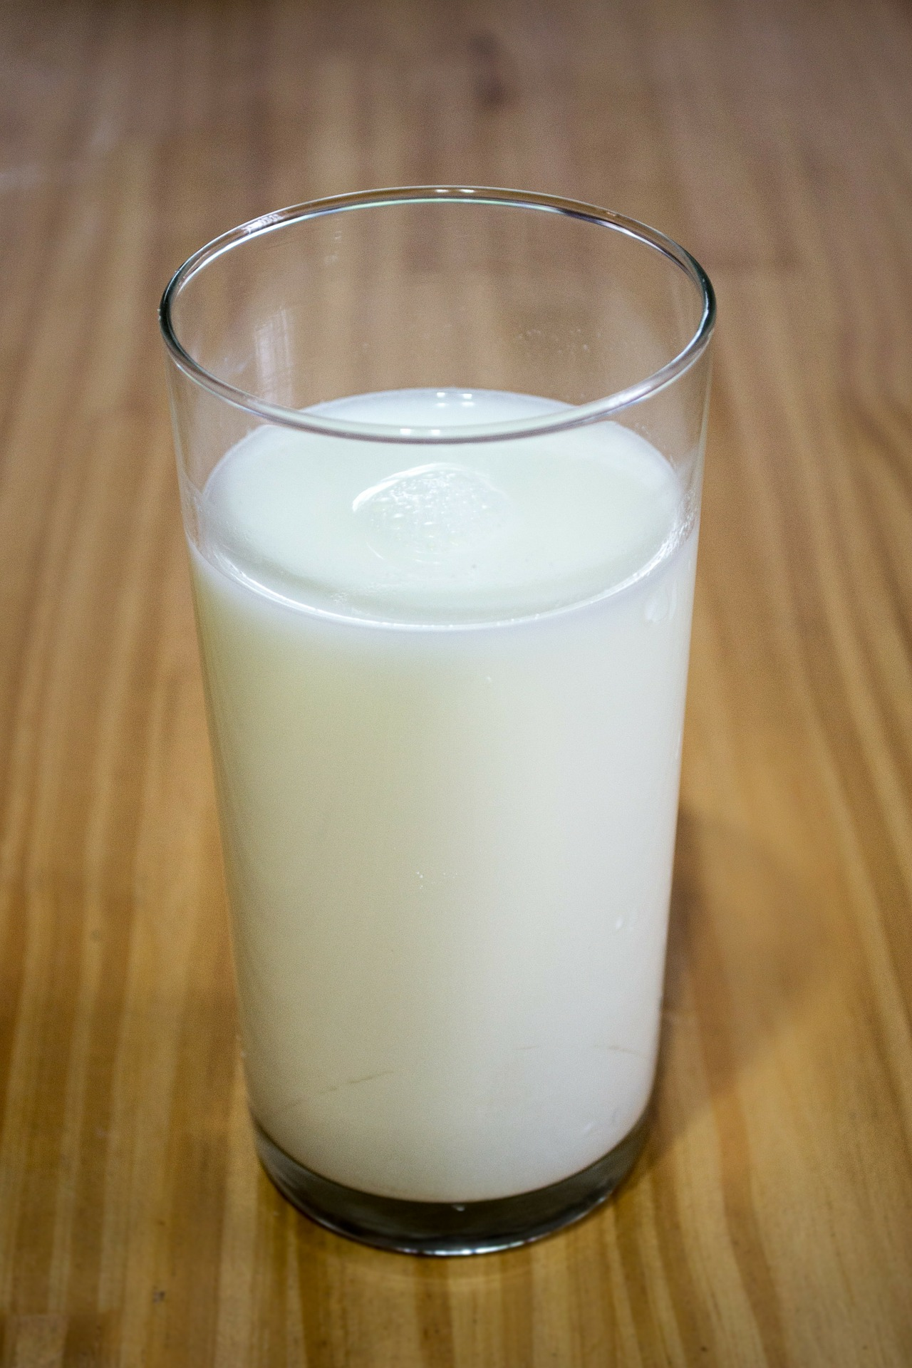
Nouns
Countable Nouns | Uncountable Nouns
boy | food
cats | juice
books | milk
children | water
Nouns not only name persons, places, animals or things but also tell us whether they are countable or uncountable.
Notes:
Notes for Teacher - < Information for further reference or explanation >
Suggestions: <Ideas/ Images/ Animations / Others – To make better representation of the content >
Source of Multimedia used in this slide - <Please provide source URL where we find the image and the license agreement>

Slide 3
Countable Nouns
+
NOUN
=
Countable nouns
Example: Kala ate two apples.
Countable number
Plural noun
Notes:
Notes for Teacher - < Information for further reference or explanation >
Suggestions: <Ideas/ Images/ Animations / Others – To make better representation of the content >
Source of Multimedia used in this slide - <Please provide source URL where we find the image and the license agreement>

Slide 4
Countable Nouns
Countable Nouns may have singular or plural form.
an apple
two apples
Countable Nouns use a singular verb or a plural verb.
The apple is fresh.
The apples are fresh.
Countable Nouns use a, an or a number before them.
Hari ate a banana.
Gita has an apple in her bag.
Bina gave three books to her friend.
Notes:
Notes for Teacher - < Information for further reference or explanation >
Suggestions: <Ideas/ Images/ Animations / Others – To make better representation of the content >
Source of Multimedia used in this slide - <Please provide source URL where we find the image and the license agreement>
<apple> <https://pixabay.com/vectors/apple-red-fruit-fresh-ripe-juicy-25236/>

Slide 5
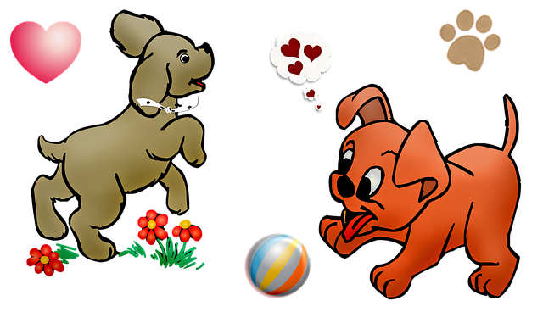
Countable Nouns (Examples)
There are three candles on the cake.
Anil has two pencils in his box.
Those four chairs are broken.
Gowri has two dogs as pets.
Hari ate a banana now.
Notes:
Notes for Teacher - < Information for further reference or explanation >
Suggestions: <Ideas/ Images/ Animations / Others – To make better representation of the content >
Source of Multimedia used in this slide - <Please provide source URL where we find the image and the license agreement>
<cake> <https://pixabay.com/vectors/cake-birthday-candles-celebration-306042/>
<pencil> <https://pixabay.com/vectors/draw-hand-pencil-write-1297723/>
<chair> <https://pixabay.com/illustrations/faulty-system-chair-broken-team-4295549/>
<two dogs> <https://pixabay.com/illustrations/dogs-puppies-playing-ball-pet-5715026/>
<banana> <https://pixabay.com/illustrations/banana-fruit-exotic-peel-4505334/>

Slide 6
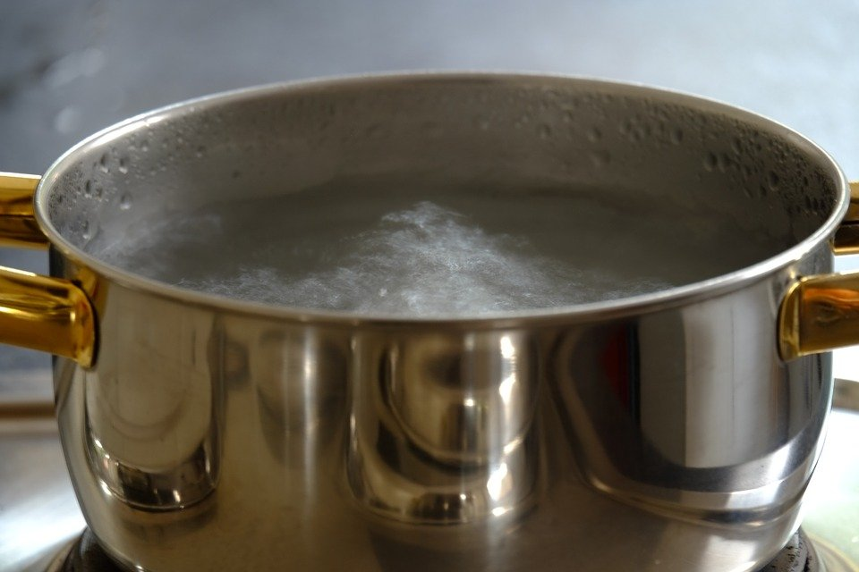
Uncountable Nouns
+
NOUN
=
Uncountable nouns
Example: The water is hot.
Uncountable number
Notes:
Notes for Teacher - < Information for further reference or explanation >
Suggestions: <Ideas/ Images/ Animations / Others – To make better representation of the content >
Source of Multimedia used in this slide -
Water: https://pixabay.com/photos/pot-boiling-water-hot-water-883036/

Slide 7
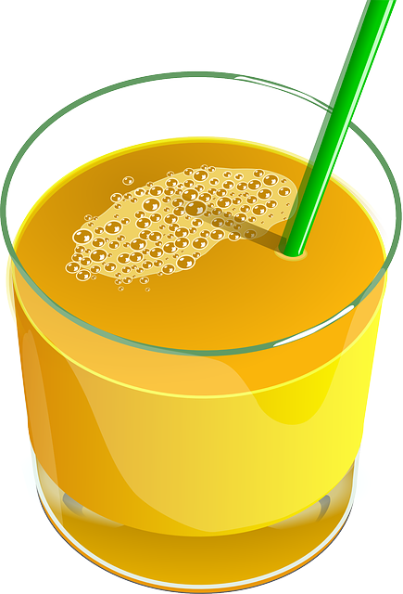
Uncountable Nouns
Uncountable nouns have only one form (no plural).
juice - not juices
Uncountable nouns always use a singular verb.
Uncountable nouns don’t use ‘a’, ‘an’ or a number before them.
juice - We don’t say ‘a juice’ or ‘an juice’ nor ‘two juices’
Juice is fresh.
Uncountable nouns take the word ‘some’ before them.
There is some water in the jug.
Notes:
Notes for Teacher - < Information for further reference or explanation >
Suggestions: <Ideas/ Images/ Animations / Others – To make better representation of the content >
Source of Multimedia used in this slide - <Please provide source URL where we find the image and the license agreement>
<juice> <https://pixabay.com/vectors/juice-orange-drink-orange-juice-42560/>
<water jug> <https://pixabay.com/vectors/water-bottle-jar-1838304/>

Slide 8
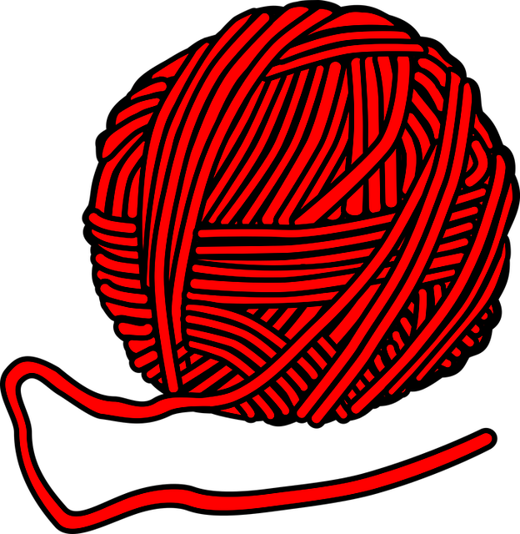
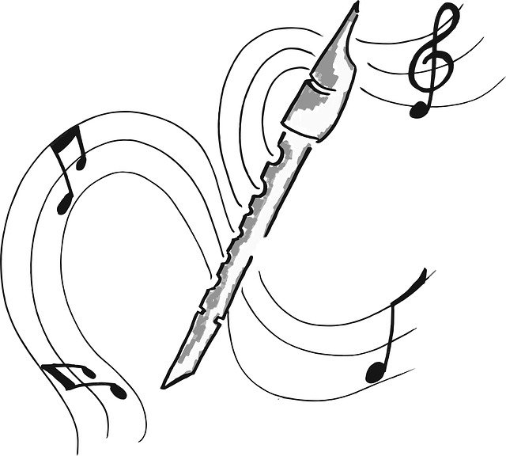
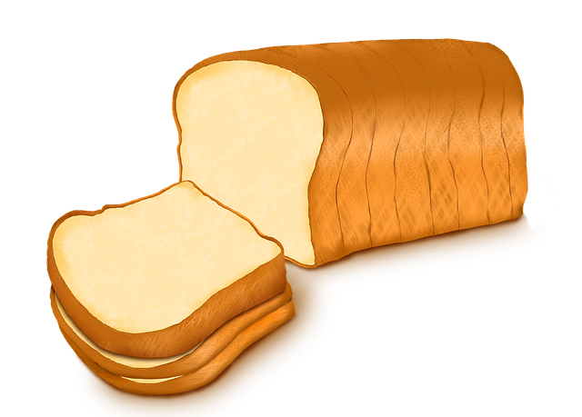
Uncountable Nouns
Air is all around us.
We get wool from sheep.
Music from the flute is very pleasant.
There is some water in the jug.
I like to eat bread in the morning.
Notes:
Notes for Teacher - < Information for further reference or explanation >
Suggestions: <Ideas/ Images/ Animations / Others – To make better representation of the content >
Source of Multimedia used in this slide - <Please provide source URL where we find the image and the license agreement>
<water jug> <https://pixabay.com/vectors/water-bottle-jar-1838304/>
<air> <https://pixabay.com/vectors/wind-blowing-cloud-air-cartoon-1295105/>
<wool> <https://pixabay.com/vectors/wool-knitting-handmade-craft-1295263/>
<flute> <https://pixabay.com/illustrations/flute-music-touch-591715/>
<bread> <https://pixabay.com/illustrations/bread-a-slice-of-bread-bakery-baked-3182199/>

Slide 9
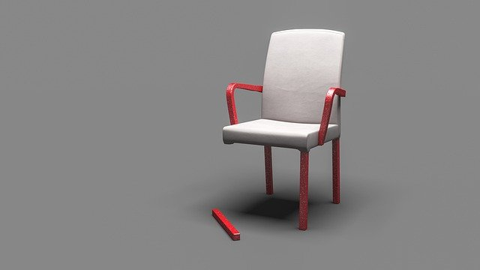
MM INDEX
Slide # | Thumbnail | Source link and Attribution
1, 3, 6 |  | <countables> https://pixabay.com/vectors/hand-counting-fingers-one-two-162127/
2 |  | <food> https://pixabay.com/photos/india-food-indian-meal-2731812/ <books> https://pixabay.com/vectors/book-books-library-books-reading-2022464 <milk> https://pixabay.com/photos/milk-glass-of-milk-calcium-266997/ <boy> https://pixabay.com/vectors/boy-child-kid-teenager-teen-male-160014/
4 |  | <apple> https://pixabay.com/vectors/apple-red-fruit-fresh-ripe-juicy-25236/
5 |  | <cake> https://pixabay.com/vectors/cake-birthday-candles-celebration-306042/ <pencil> https://pixabay.com/vectors/draw-hand-pencil-write-1297723/ <chair> https://pixabay.com/illustrations/faulty-system-chair-broken-team-4295549/ <two dogs> https://pixabay.com/illustrations/dogs-puppies-playing-ball-pet-5715026/ <banana> https://pixabay.com/illustrations/banana-fruit-exotic-peel-4505334/
6 |  | <Water>: https://pixabay.com/photos/pot-boiling-water-hot-water-883036/
7 |  | <juice> https://pixabay.com/vectors/juice-orange-drink-orange-juice-42560/
7,8 |  | <water jug> https://pixabay.com/vectors/water-bottle-jar-1838304/
8 |  | <air> https://pixabay.com/vectors/wind-blowing-cloud-air-cartoon-1295105/ <wool> https://pixabay.com/vectors/wool-knitting-handmade-craft-1295263/ <flute> https://pixabay.com/illustrations/flute-music-touch-591715/ <bread> https://pixabay.com/illustrations/bread-a-slice-of-bread-bakery-baked-3182199/
Notes:
Notes for Teacher - < Information for further reference or explanation >
Suggestions: <Ideas/ Images/ Animations / Others – To make better representation of the content >
Source of Multimedia used in this slide - <Please provide source URL where we find the image and the license agreement>

