Slide 1
Word Building For Uncountable Nouns
Notes:
Notes for Teacher - < Information for further reference or explanation >
Suggestions: <Ideas/ Images/ Animations / Others – To make better representation of the content >
Source of Multimedia used in this slide - <Please provide source URL where we find the image and the license agreement>
<word building> <https://pixabay.com/vectors/scrabble-crossword-crosswords-148971/>

Slide 2
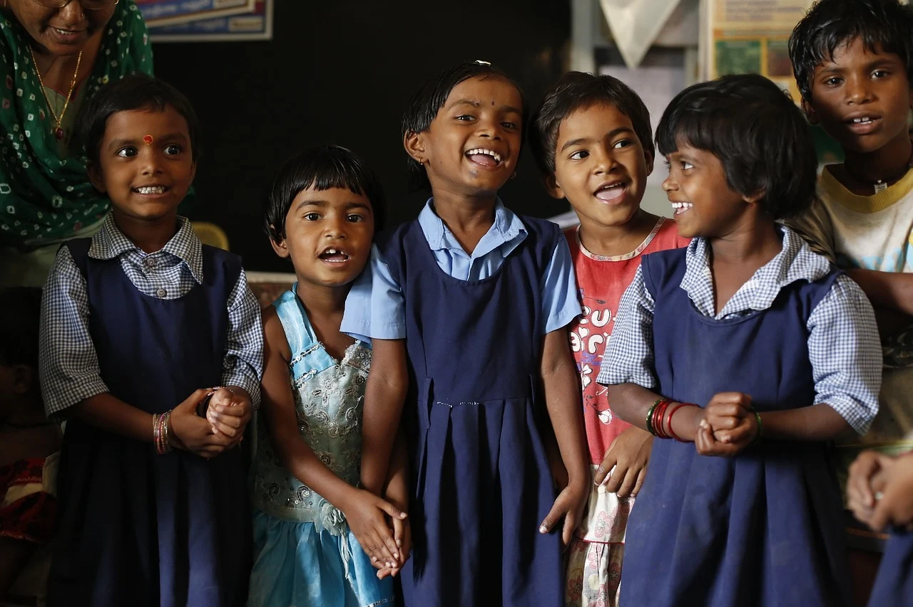
Activity
Group A
Group B
Group C
Group D
Group E
Letters
a, b, c, d, e
Letters
f, g, h, i, j
Letters
k, l, m, n, o
Letters
p, q, r, s, t
Letters
u, v, w, y, z
Notes:
Notes for Teacher - < Information for further reference or explanation >
Suggestions: <Ideas/ Images/ Animations / Others – To make better representation of the content >
Source of Multimedia used in this slide - <Please provide source URL where we find the image and the license agreement>
<group of kids> <https://pixabay.com/photos/children-india-education-classroom-876543/>

Slide 3
Group A
Letter
a
b
c
d
e
Countable Nouns
apple
ball
cat
desk
egg
Uncountable Nouns
air
bread
coffee
dirt
energy/electricity
Notes:
Notes for Teacher - < Information for further reference or explanation >
Suggestions: <Ideas/ Images/ Animations / Others – To make better representation of the content >
Source of Multimedia used in this slide - <Please provide source URL where we find the image and the license agreement>
<apple> <https://pixabay.com/vectors/apple-red-fruit-fresh-ripe-juicy-25236/>
<ball> <https://pixabay.com/vectors/football-ball-sport-soccer-round-157930/>
<air> <https://pixabay.com/vectors/wind-blowing-cloud-air-cartoon-1295105/>
<coffee> <https://pixabay.com/vectors/drinks-coffee-coffee-mug-hot-coffee-1477040/>

Slide 4
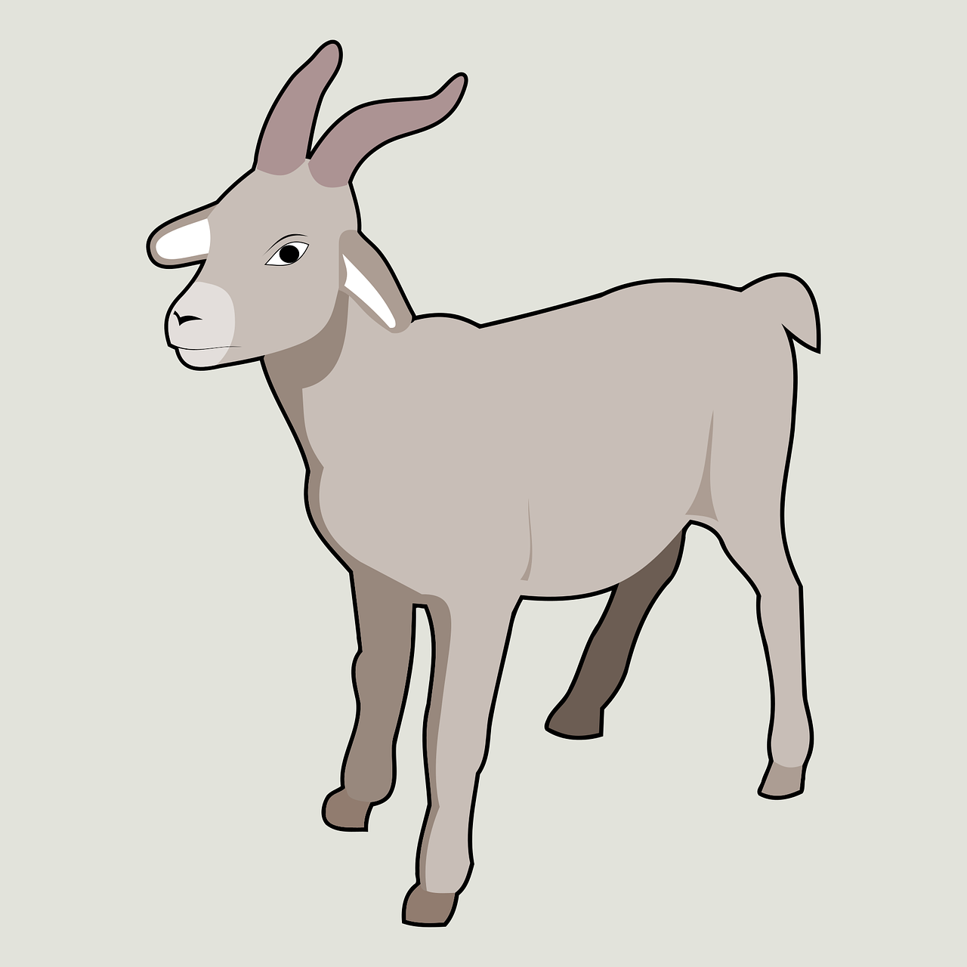
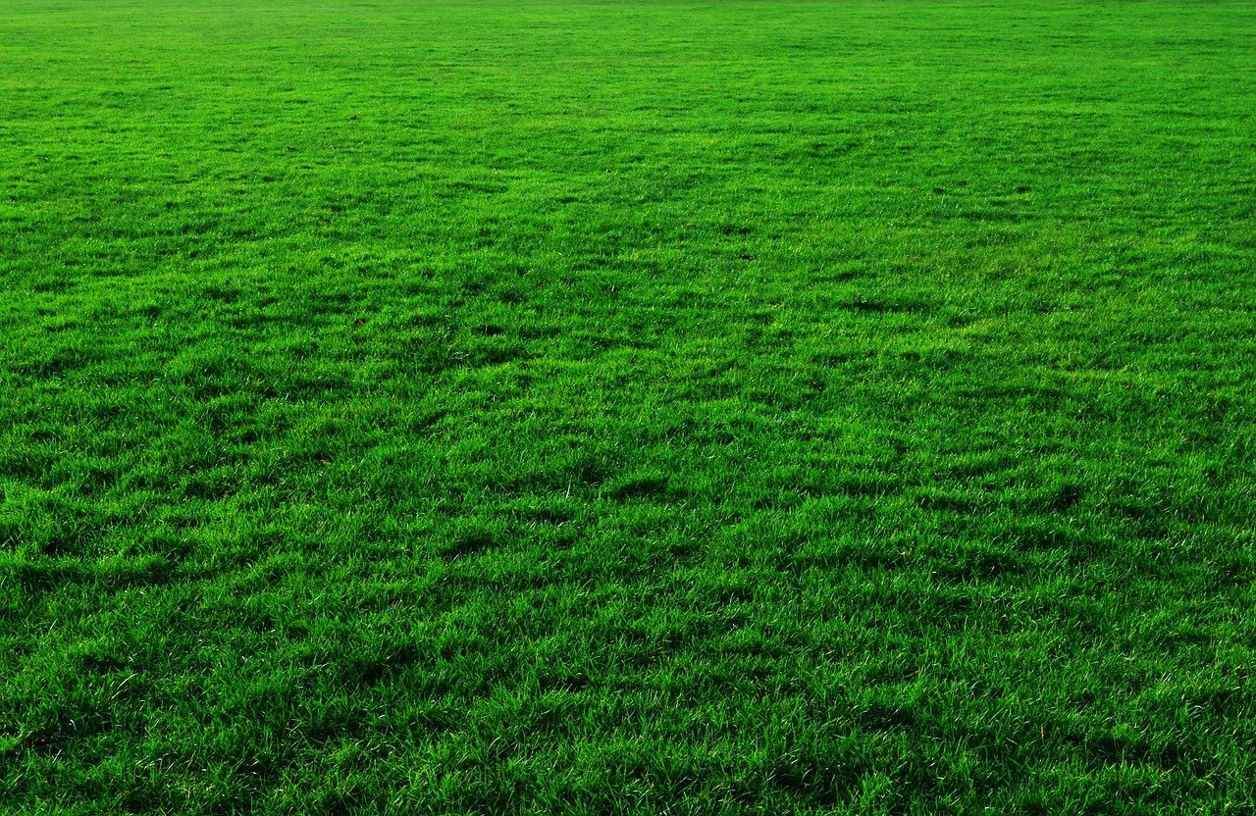
Group B
Letter
f
g
h
i
j
Countable Nouns
fan
goat
hat
igloo
jug
Uncountable Nouns
fumes
grass
honey
iron(metal)
jam
Notes:
Notes for Teacher - < Information for further reference or explanation >
Suggestions: <Ideas/ Images/ Animations / Others – To make better representation of the content >
Source of Multimedia used in this slide - <Please provide source URL where we find the image and the license agreement>
<goat> <https://pixabay.com/vectors/goat-farm-animals-horns-mammals-5933692/>
<igloo> <https://pixabay.com/vectors/igloo-eskimo-home-polar-ice-snow-28130/>
<grass> <https://pixabay.com/photos/background-green-grass-lawn-19861/>
<fumes> <https://pixabay.com/vectors/factory-building-smoke-industry-48781/>

Slide 5
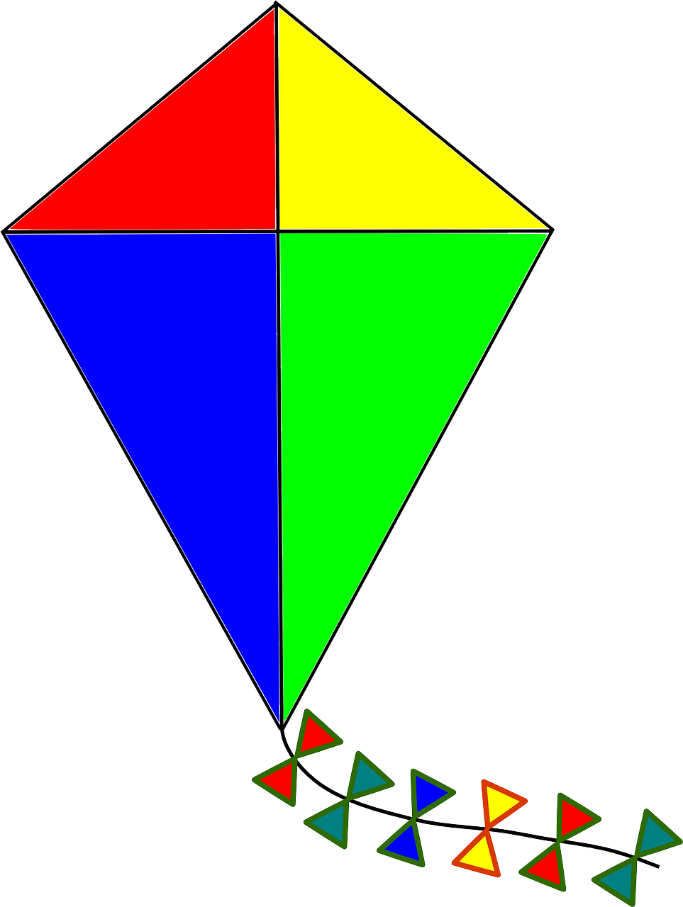
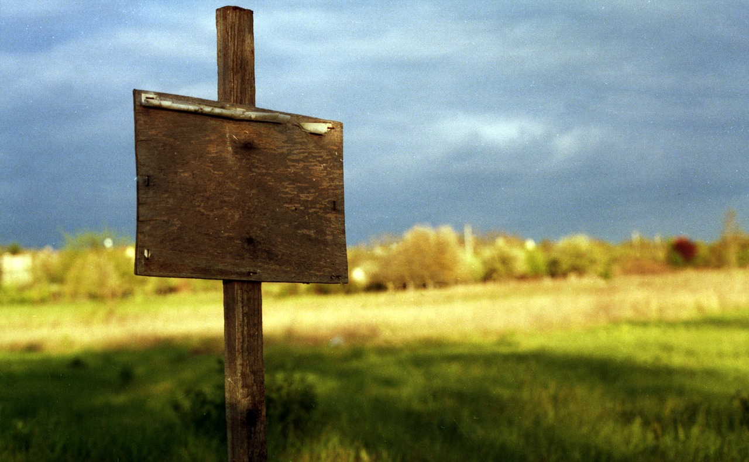
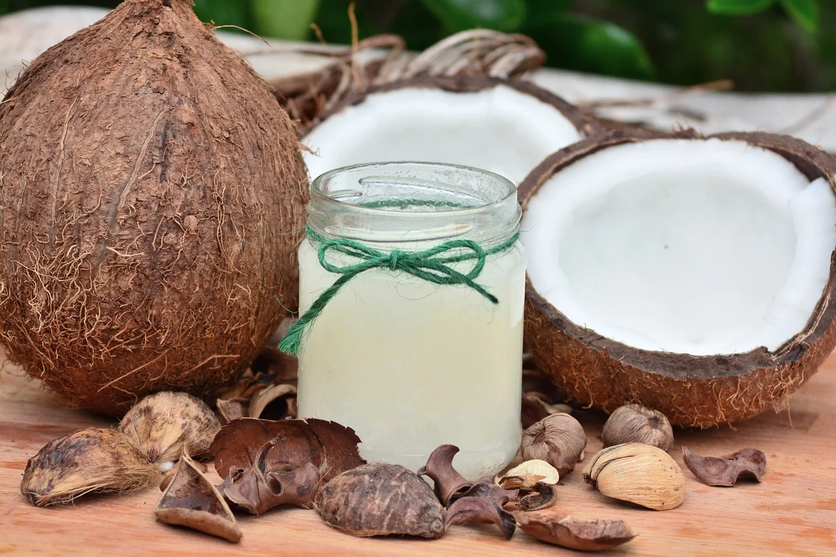
Group C
Letter
k
l
m
n
o
Countable Nouns
kite
lemon
mask
net
orange
Uncountable Nouns
ketchup
land
mud
nature
oil
Notes:
Notes for Teacher - < Information for further reference or explanation >
Suggestions: <Ideas/ Images/ Animations / Others – To make better representation of the content >
Source of Multimedia used in this slide - <Please provide source URL where we find the image and the license agreement>
<kite> <https://pixabay.com/vectors/kite-autumn-fall-wind-146609/>
<mask> <https://pixabay.com/vectors/face-mask-mask-coronavirus-5588047/>
<land> <https://pixabay.com/photos/sign-sale-plot-ground-1279558/>
<coconut oil> <https://pixabay.com/photos/food-coconut-fruit-healthy-3062139/>

Slide 6
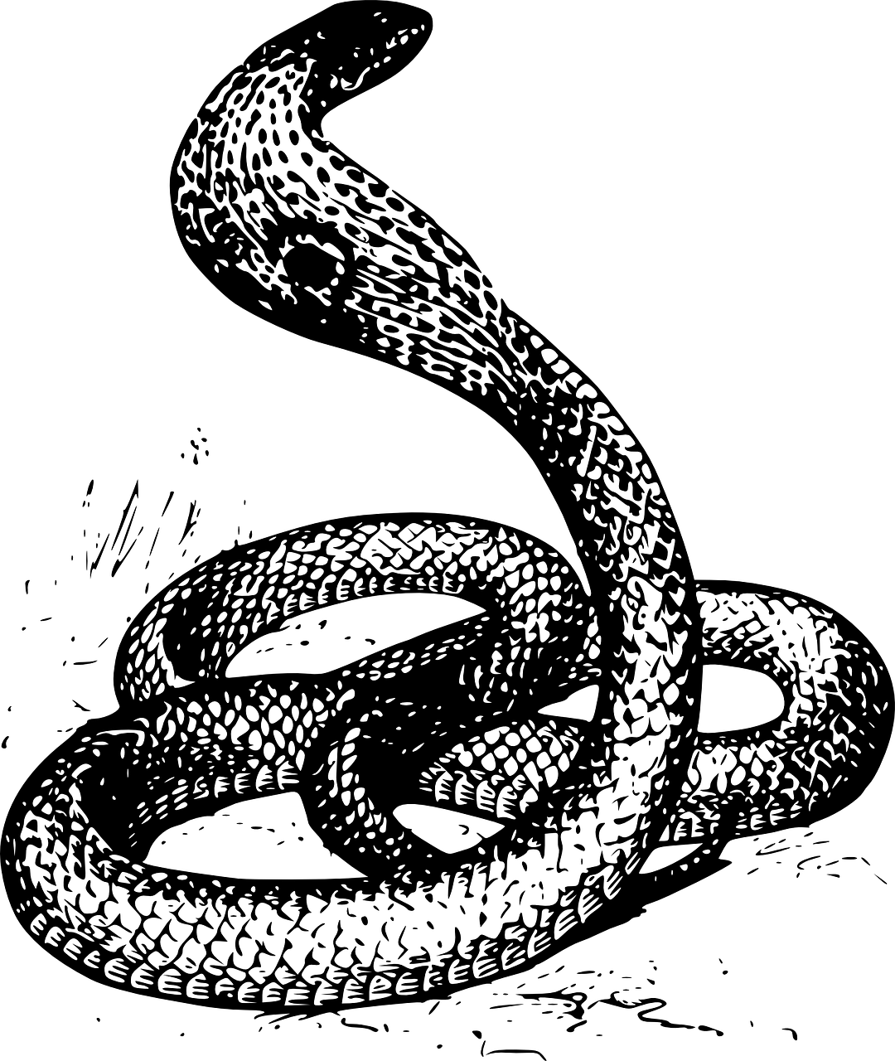
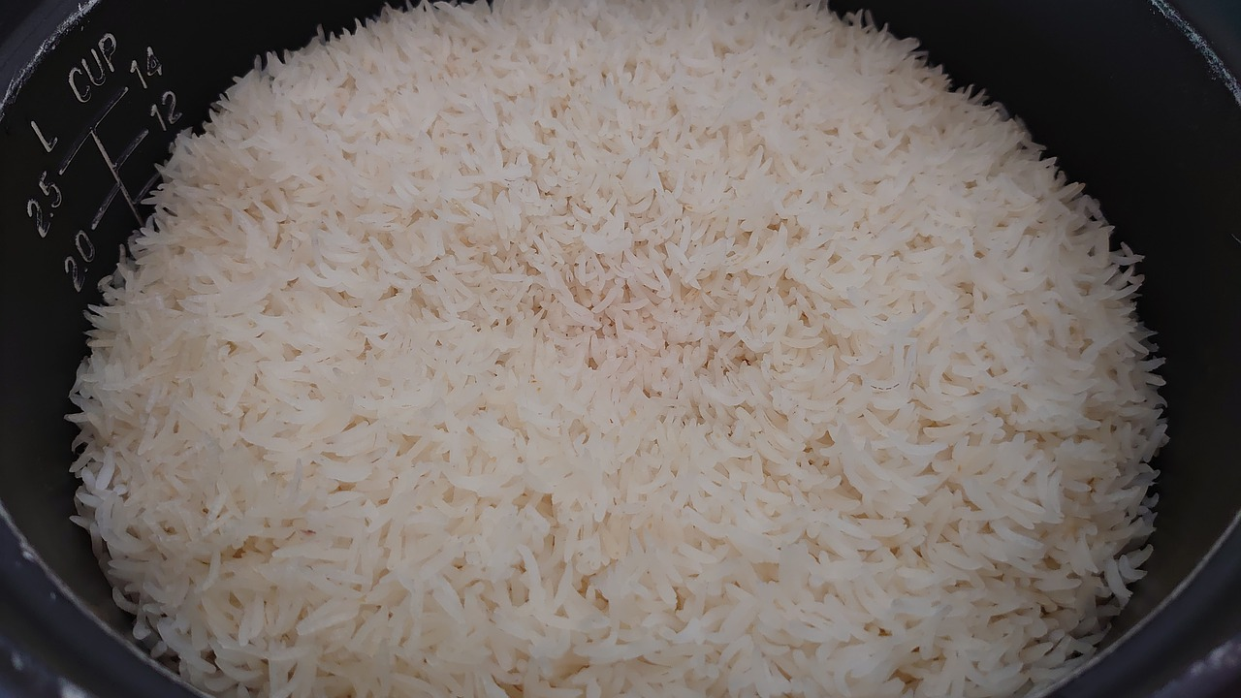
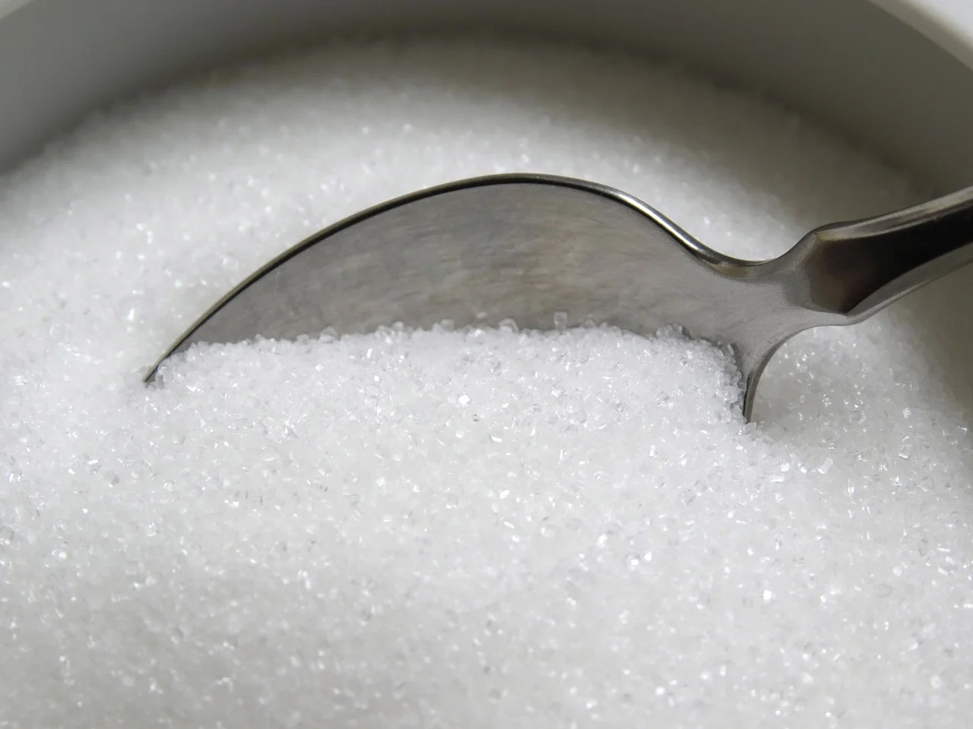
Group D
Letter
p
q
r
s
t
Countable Nouns
pen
quilt
rose
snake
tiger
Uncountable Nouns
pepper
quality
rice
sugar
traffic
Notes:
Notes for Teacher - < Information for further reference or explanation >
Suggestions: <Ideas/ Images/ Animations / Others – To make better representation of the content >
Source of Multimedia used in this slide - <Please provide source URL where we find the image and the license agreement>
<pen> <https://pixabay.com/vectors/pen-black-ink-ballpoint-feather-33077/>
<rice> <https://pixabay.com/photos/rice-basmati-food-delicious-6081867/>
<sugar> <https://pixabay.com/photos/sugar-spoon-cutlery-sweeteners-485045/>
<snake> <https://pixabay.com/vectors/cobra-snake-reptile-head-angry-48131/>

Slide 7
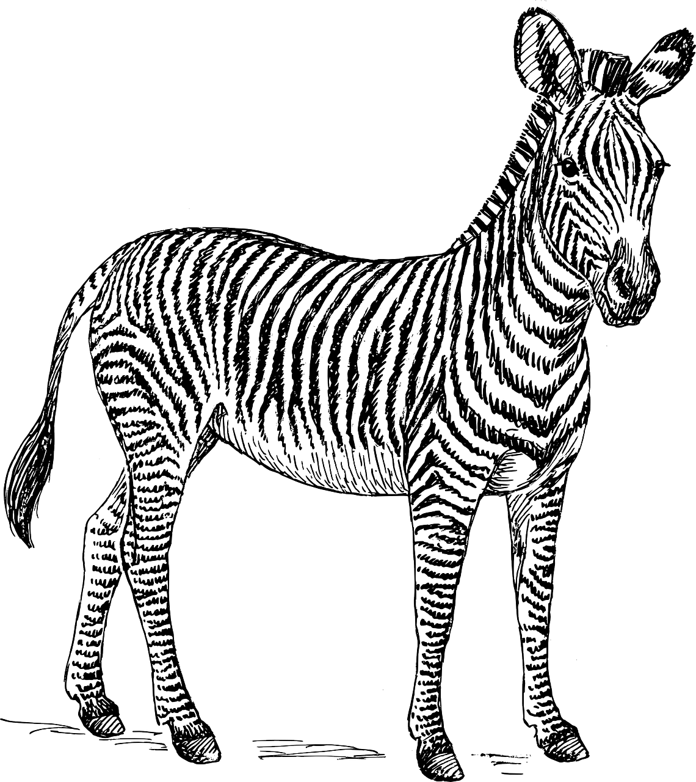
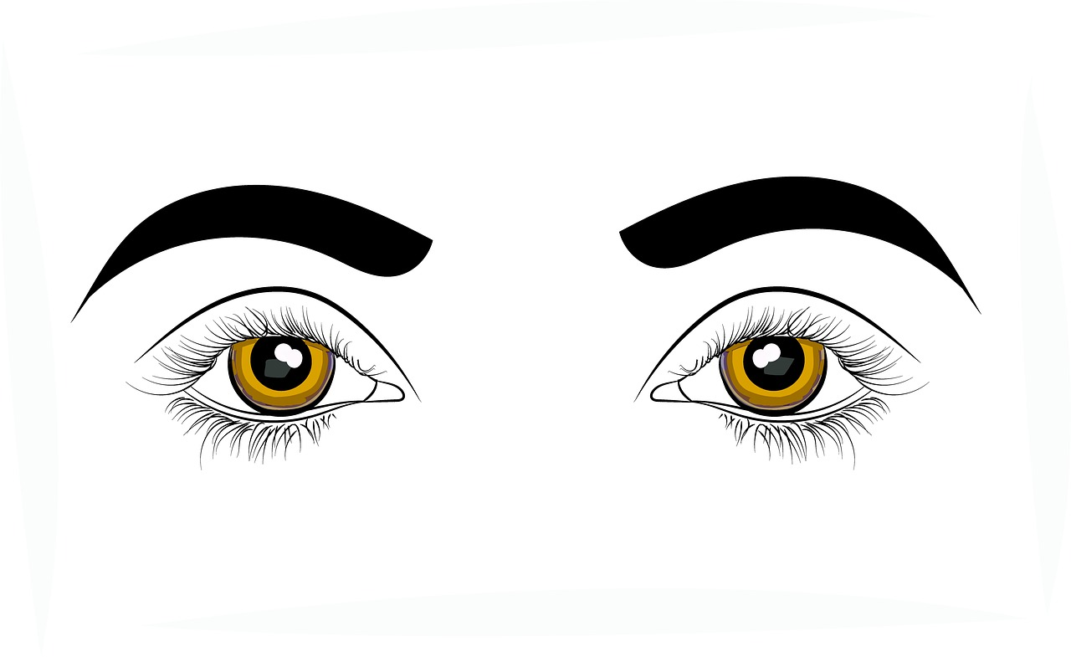
Group E
Letter
u
v
w
y
z
Countable Nouns
umbrella
van
whip
year
zebra
Uncountable Nouns
unity
vision
water
youth
zinc (metal)
Notes:
Notes for Teacher - < Information for further reference or explanation >
Suggestions: <Ideas/ Images/ Animations / Others – To make better representation of the content >
Source of Multimedia used in this slide - <Please provide source URL where we find the image and the license agreement>
<umbrella> <https://pixabay.com/vectors/umbrella-rainbow-colorful-310049/>
<zebra> <https://pixabay.com/vectors/zebra-safari-africa-animal-biology-153811/>
<water> <https://pixabay.com/vectors/water-pour-jug-pouring-liquid-295492/>
<vision> <https://pixabay.com/illustrations/eyes-sight-vision-health-optical-2643569/>

Slide 8
MM INDEX
Slide # | Thumbnail | Source link and Attribution
1 |  | <word building> https://pixabay.com/vectors/scrabble-crossword-crosswords-148971/
2 |  | <group of kids> https://pixabay.com/photos/children-india-education-classroom-876543/
3 |  | <apple> https://pixabay.com/vectors/apple-red-fruit-fresh-ripe-juicy-25236/ <ball> https://pixabay.com/vectors/football-ball-sport-soccer-round-157930/ <air> https://pixabay.com/vectors/wind-blowing-cloud-air-cartoon-1295105/ <coffee> https://pixabay.com/vectors/drinks-coffee-coffee-mug-hot-coffee-1477040/
4 |  | <goat> https://pixabay.com/vectors/goat-farm-animals-horns-mammals-5933692/ <igloo> https://pixabay.com/vectors/igloo-eskimo-home-polar-ice-snow-28130/ <grass> https://pixabay.com/photos/background-green-grass-lawn-19861/ <fumes> https://pixabay.com/vectors/factory-building-smoke-industry-48781/
5 |  | <kite> https://pixabay.com/vectors/kite-autumn-fall-wind-146609/ <mask> https://pixabay.com/vectors/face-mask-mask-coronavirus-5588047/ <land> https://pixabay.com/photos/sign-sale-plot-ground-1279558/ <coconut oil> https://pixabay.com/photos/food-coconut-fruit-healthy-3062139/
6 |  | <pen> https://pixabay.com/vectors/pen-black-ink-ballpoint-feather-33077/ <rice> https://pixabay.com/photos/rice-basmati-food-delicious-6081867/ <sugar> https://pixabay.com/photos/sugar-spoon-cutlery-sweeteners-485045/ <snake> https://pixabay.com/vectors/cobra-snake-reptile-head-angry-48131/
7 |  | <umbrella> https://pixabay.com/vectors/umbrella-rainbow-colorful-310049/ <zebra> https://pixabay.com/vectors/zebra-safari-africa-animal-biology-153811/ <water> https://pixabay.com/vectors/water-pour-jug-pouring-liquid-295492/ <vision> https://pixabay.com/illustrations/eyes-sight-vision-health-optical-2643569/
Notes:
Notes for Teacher - < Information for further reference or explanation >
Suggestions: <Ideas/ Images/ Animations / Others – To make better representation of the content >
Source of Multimedia used in this slide - <Please provide source URL where we find the image and the license agreement>

