Slide 1
Word Search With Uncountable Nouns
Notes:
Notes for Teacher - < Information for further reference or explanation >
Suggestions: <Ideas/ Images/ Animations / Others – To make better representation of the content >
Source of Multimedia used in this slide - <Please provide source URL where we find the image and the license agreement>
<word search> <https://pixabay.com/photos/explore-word-letters-boggle-game-1945678/>

Slide 2
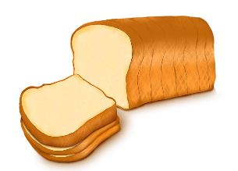
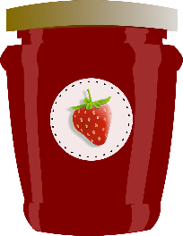
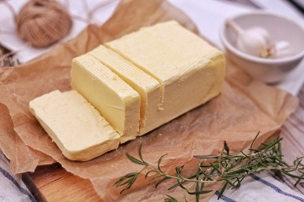
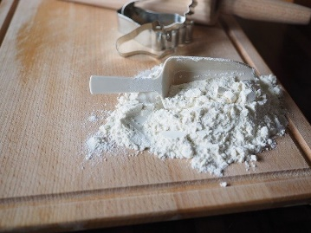
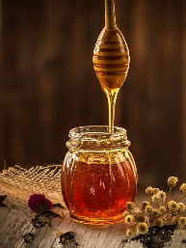
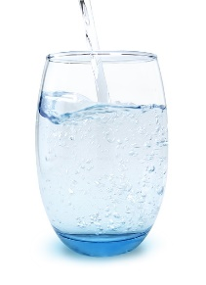
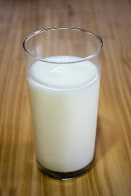
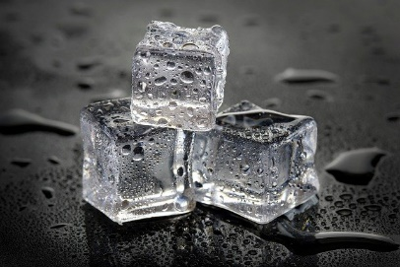
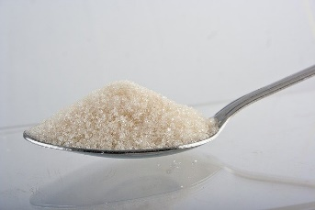
Word Search Puzzle
Find ten food words shown in the pictures. They are hidden left to right and up to down
J | A | M | B | C | D | E | F | B | G
H | I | I | C | E | J | K | L | U | M
N | O | L | P | Q | R | B | S | T | T
U | V | K | W | X | T | R | Y | T | Z
A | B | C | C | H | E | E | S | E | D
E | F | H | G | H | I | A | J | R | S
F | L | O | U | R | K | D | L | M | U
N | O | N | P | Q | R | S | T | U | G
V | W | E | X | Y | Z | A | B | C | A
D | E | Y | F | G | W | A | T | E | R
Notes:
Notes for Teacher - < Information for further reference or explanation >
Suggestions: <Ideas/ Images/ Animations / Others – To make better representation of the content >
Source of Multimedia used in this slide - <Please provide source URL where we find the image and the license agreement>
Bread: https://pixabay.com/illustrations/bread-a-slice-of-bread-bakery-baked-3182199/
Butter: https://pixabay.com/photos/food-butter-table-milk-3179853/
Jam: https://pixabay.com/vectors/strawberry-jar-jam-jelly-preserves-304544/
Cheese: https://pixabay.com/vectors/cheese-dairy-food-swiss-cheese-575540/
Flour: https://pixabay.com/photos/flour-flour-scoop-to-bake-2713990/
Honey: https://pixabay.com/photos/honey-yellow-beekeeper-nature-1958464/
Milk: https://pixabay.com/photos/milk-glass-of-milk-calcium-266997/
Sugar: https://pixabay.com/photos/sugar-calories-sweet-food-1068288/
Water: https://pixabay.com/photos/glass-of-water-water-glass-thirst-4087606/
Ice: https://pixabay.com/photos/ice-artificial-ice-studio-ice-macro-6215207/

Slide 3
MM INDEX
Slide # | Thumbnail | Source link and Attribution
1 |  | https://pixabay.com/photos/explore-word-letters-boggle-game-1945678/
2 |  | Bread: https://pixabay.com/illustrations/bread-a-slice-of-bread-bakery-baked-3182199/ Butter: https://pixabay.com/photos/food-butter-table-milk-3179853/
2 |  | Jam: https://pixabay.com/vectors/strawberry-jar-jam-jelly-preserves-304544/ Cheese: https://pixabay.com/vectors/cheese-dairy-food-swiss-cheese-575540/
2 |  | Flour: https://pixabay.com/photos/flour-flour-scoop-to-bake-2713990/ Honey: https://pixabay.com/photos/honey-yellow-beekeeper-nature-1958464/
2 |  | Milk: https://pixabay.com/photos/milk-glass-of-milk-calcium-266997/ Sugar: https://pixabay.com/photos/sugar-calories-sweet-food-1068288/
2 |  | Water: https://pixabay.com/photos/glass-of-water-water-glass-thirst-4087606/ Ice: https://pixabay.com/photos/ice-artificial-ice-studio-ice-macro-6215207/
Notes:
Notes for Teacher - < Information for further reference or explanation >
Suggestions: <Ideas/ Images/ Animations / Others – To make better representation of the content >
Source of Multimedia used in this slide - <Please provide source URL where we find the image and the license agreement>

